Slide 1
TAILORING THE APPROACH TO THE STORM

Slide 2
10 DAY
5 DAY
3 DAY
2 DAY
1 DAY
LIGHT
Operations
Supplies
Communications
FROST
Staffing
Pre-treatments
Response
MED
LT SNOW
Operations
Supplies
Communications
Staffing
Pre-treatments
Response
STORM
MOD
MODERATE
Operations
Supplies
Communications
Staffing
Pre-treatments
Response
HEAVY SNOW OR ICE
Operations
Supplies
Communications
Staffing
Pre-treatments
Response
STRONG
BLIZZARD
BLIZZARD HIGH WINDS
Operations
Supplies
Communications
Staffing
Pre-treatments
Response

Slide 3
TEN DAY
A STORM IS COMING ?

Slide 4
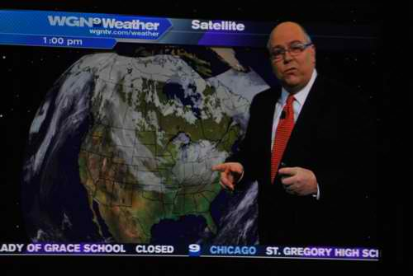
Tom Skilling - looking days ahead
Where do you get your weather?

Slide 5
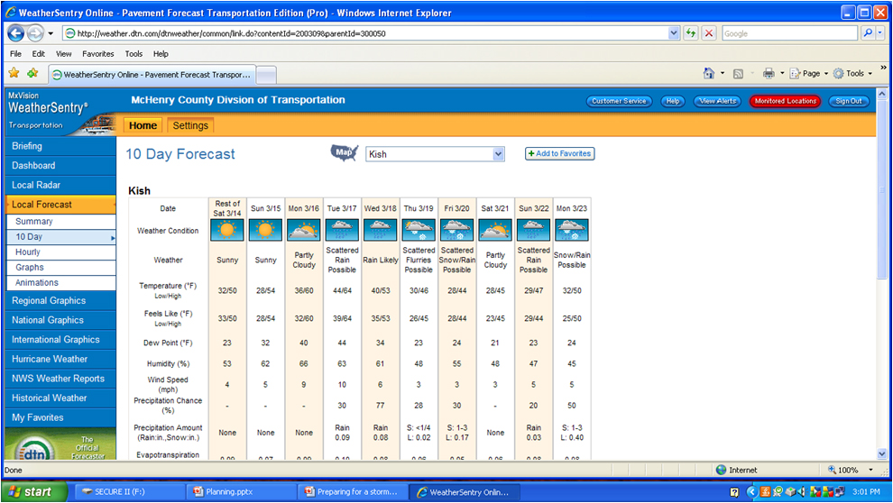

Slide 6
What is that forecast really telling you?
Watching how a forecast trends is probably one of best ways to determine where the real outcome likely will be.
For example a forecast for Friday:
  On Tuesday - Snow: 1-3” Start: Noon-2pm
  On Wednesday – Snow: 1-3” Start: 1-3pm
  On Thursday – Snow: 2-4” Start: 2-4pm
  On Friday Morning – Snow: 3-6” Start 5-7pm
  Actual: 5” of snow Start: 8pm

Slide 7
Between the 10 day and 5 day
Monitor the forecast
Determine what area of response is most likely
Keep staff informed

Slide 8
5 day

Slide 9
Still Way out…
At this point the storm is still fairly far out.
You should be monitoring trends:
  Has the forecast changed much in the past few days?
Listening to a TV broadcast or a private meteorologist should begin to give you clues to the scale of this storm
If you can ask questions:
  Is this a fast or slow moving system?
  How are the weather models handling the storm?
  What sort of impact can I expect?

Slide 10
Light snow
light snow – dusting to 3 inches
Get liquid equipment ready
Check basic supplies

Slide 11
moderate
3 Inches to 7 inches
Wet snow warm pavement temperatures
Dry snow, cold pavement temperatures, blowing likely
7 inches and higher
Wet snow warm pavement temperatures (could be followed by extreme cold)
Ice storm, cold and blowing, almost a blizzard
High amounts, 10 to 20 inches
Rain followed by snow and winds that exceed 50 mph
Snow, high winds blowing snow and drifting low visibility
heavy
blizzard

Slide 12
moderate
heavy
blizzard
Stock parts
Top off fuel
Inform staff
Plan response ready equipment
Stock chemicals
Five days are critical for some parts

Slide 13
Parts, Chemicals and Equipment
Salt, chloride & organics
fuel
Washer fluid and oils
Auger motors, wire harness
Air filters for blowing snow
Wiper motors, blades and mailbox supplies
Mount anti-icing equipment
Ready additional equipment
Make brine and blend

Slide 14
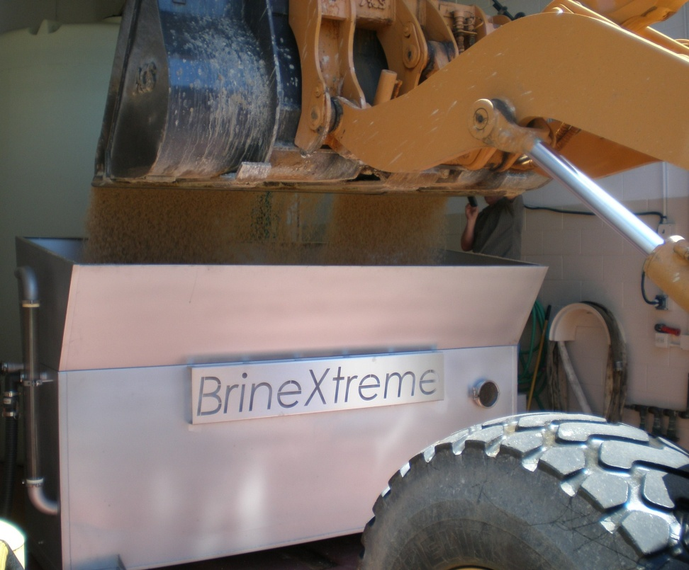
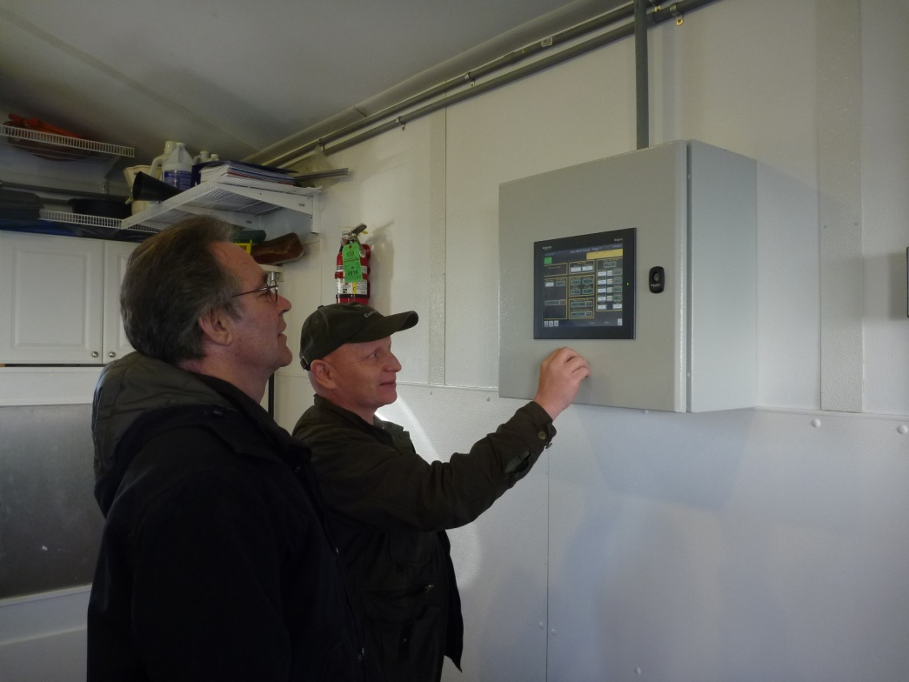
Making brine and blending

Slide 15
3 days
THIS IS WHEN MANY CHANGES OCCUR

Slide 16
Typically at Day 3, the forecasts begin to include such things as:
  Probabilities of Precipitation
  Air Temperature
  Precipitation Type
  Accumulations
At Day 3, meteorologist begin to get a pretty good idea, about much of the above. The closer the center of the low pressure is to you, the more these are still “up in the air.”
The main uncertainty at this point is exact timing. Right now the best they can typically do is give you the correct 24 hr window.

Slide 17
PRO-ACTIVE MEASURES
Light snow
Frost
Contact Weather
Make brine and blend
Anti-ice if conditions are correct
24 hour notice

Slide 19
SHOULD WE ANTI-ICE?
Review/monitor weather forecast.
Is snow or frost predicted within the next three days?
 |  |  |  | No
 |  | Yes
Is rain predicted before the snow? |  |  |  |  |  | Do not apply anti-icing materials.
 |  |  |  | Yes
 |  | No
Is the pavement temperature 15 degress or greater? |  |  |  |  |  | Do not apply anti-icing materials.
 |  |  |  | No

Slide 20
 |  | Yes
Is the dewpoint at least 3 degrees below the air temperature? |  |  |  |  |  | Do not apply anti-icing materials.
 |  |  |  | No
 |  | Yes
Is the relative humidity level 70% or less? |  |  |  |  |  | Do not apply anti-icing materials.
 |  |  |  | No
 |  | Yes
Is the pavement dry? |  |  |  |  |  | Do not apply anti-icing materials.
 |  |  |  | No

Slide 21
 |  | Yes
Are winds less than 15 miles per hour if loose snow is present? |  |  |  |  |  | Do not apply anti-icing materials.
 |  |  |  | No
 |  | Yes
Does suffcient time exist for pavement to dry before the pavement temperature falls below 20 degrees? |  |  |  |  |  | Do not apply anti-icing materials.
 |  |  |  | No
 |  | Yes
Has a visual inspection or RWIS confirmed sufficient anti-icing material residue does not exist on the pavement? |  |  |  |  |  | Do not apply anti-icing materials.
 |  |  |  | No
 |  | Yes
Apply anti-icing material (brine or brine blend) at 40 gallons per lane mile.

Slide 22
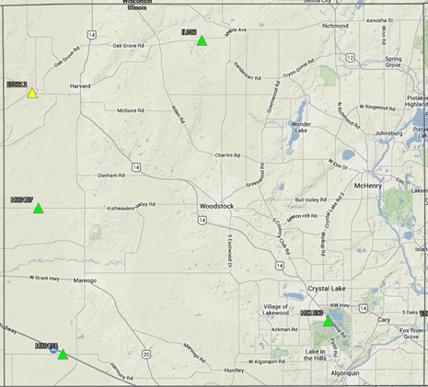
WE GET OUR INFORMATION FROM OUR RWIS SITES AND WEATHER SERVICE

Slide 23
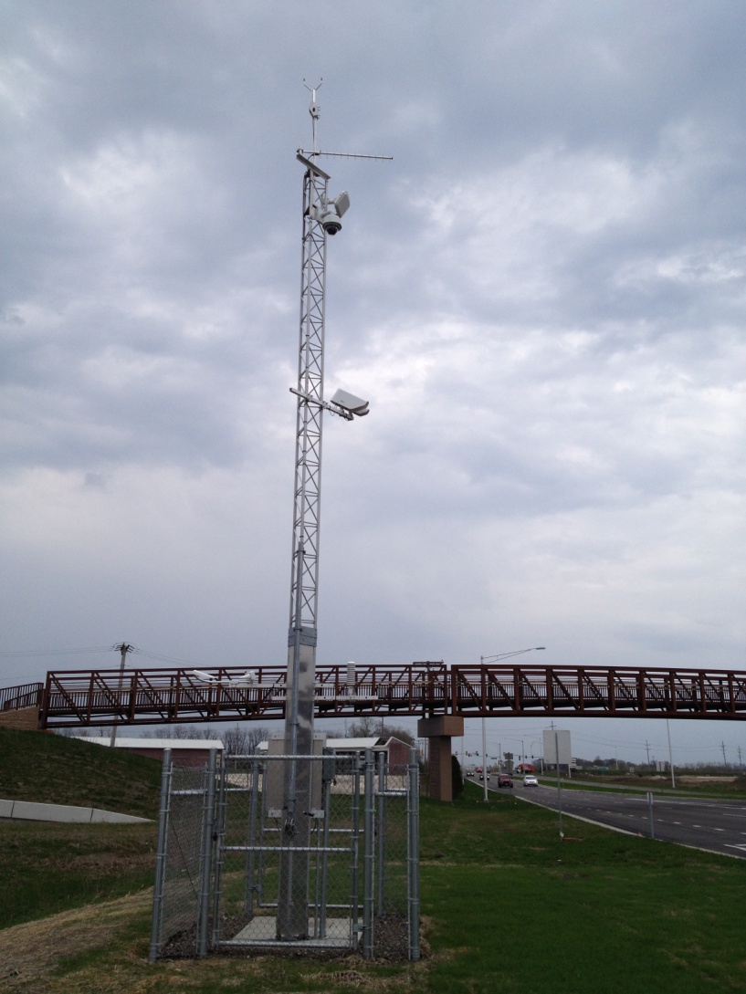
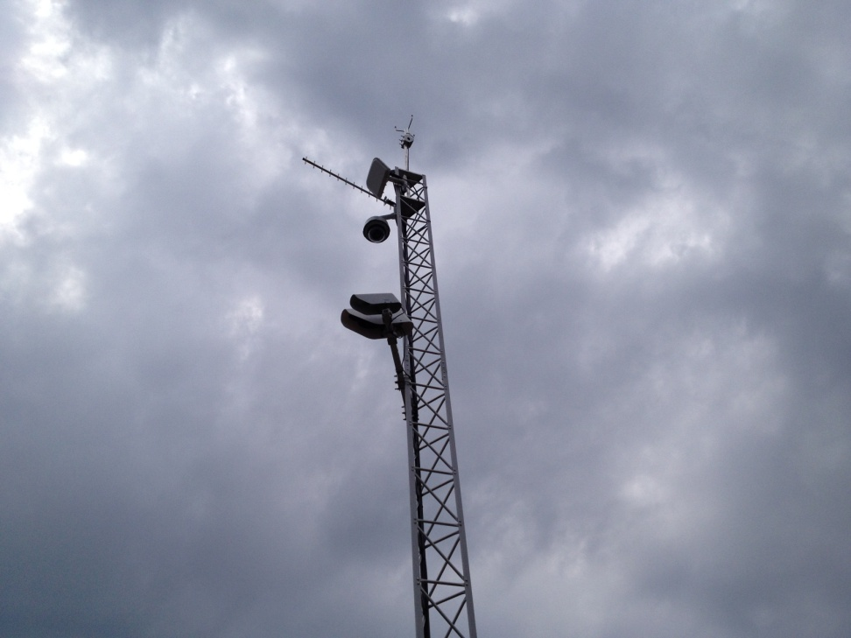
Getting real time information

Slide 24
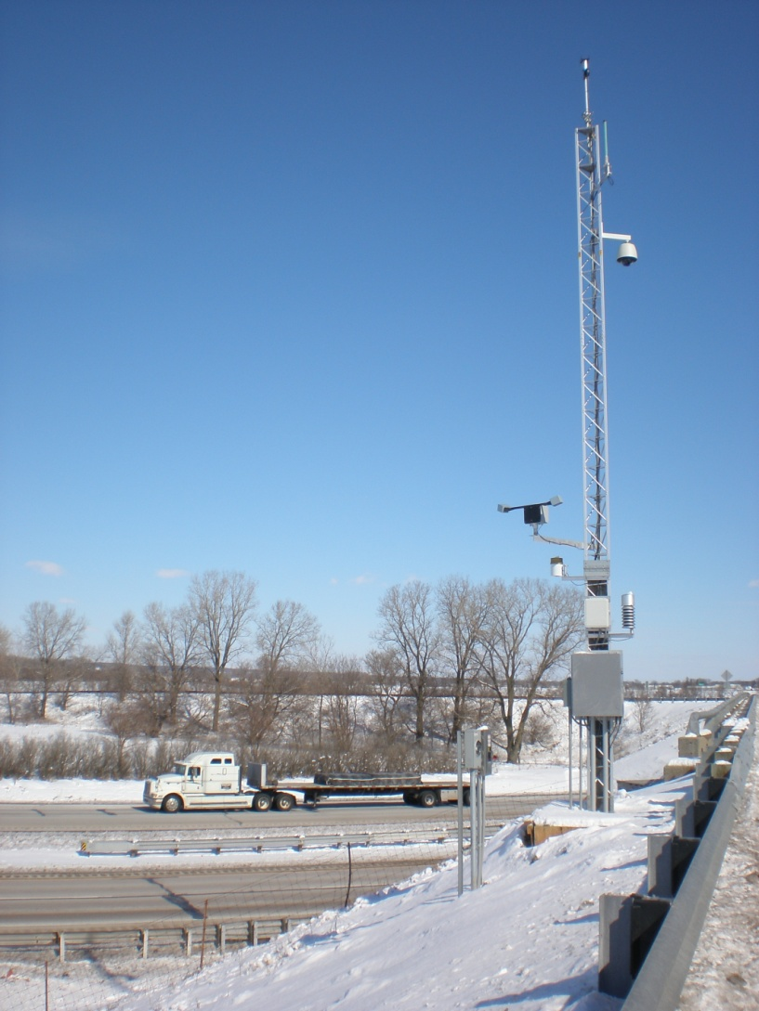
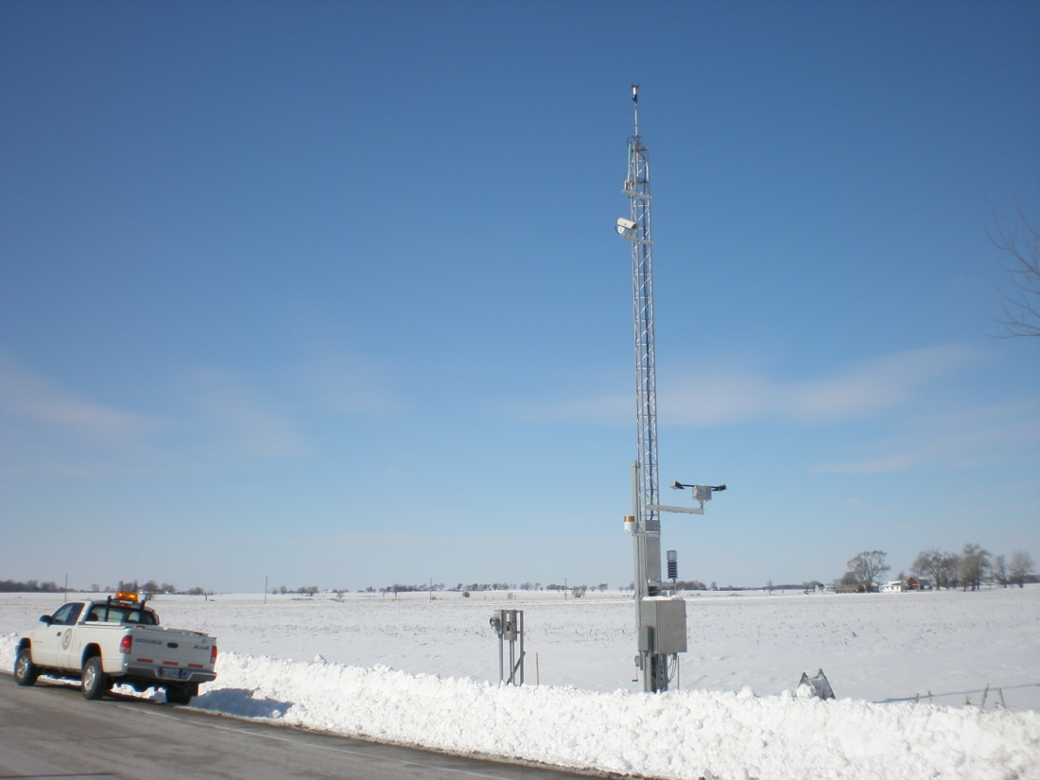
MCDOT currently has 3 RWIS sites

Slide 25
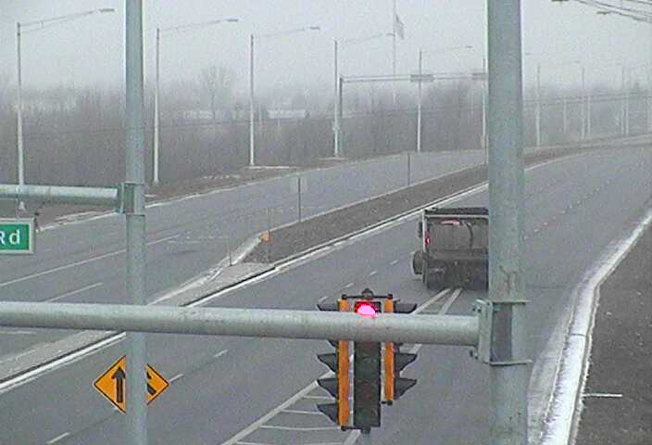
Real time visual images as well

Slide 26
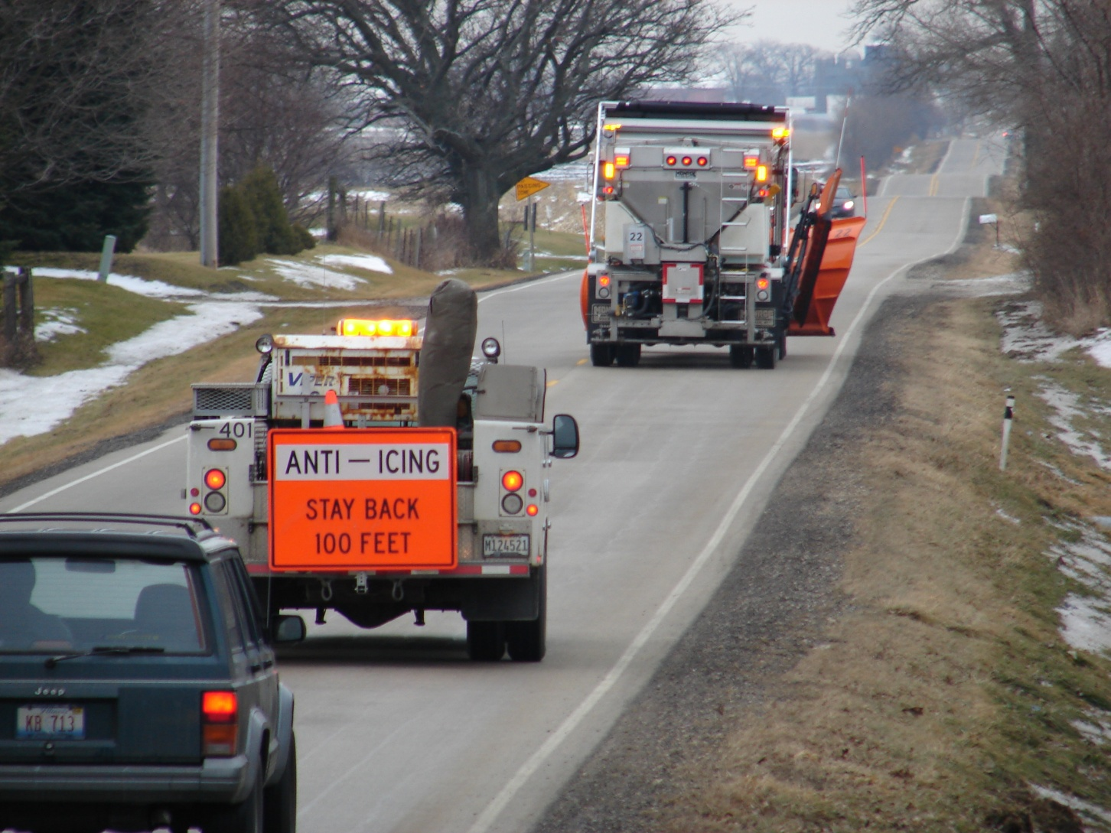
Anti-icing prior to an event

Slide 27
moderate
heavy
blizzard
Anti-ice if conditions are correct
Pre-storm meeting with supervisors
Develop a response
Notify contractors, local vendors and all personnel
Verify all equipment and additional resources are ready

Slide 28
Gearing up for the bigger events
Contact weather and meet with supervisors
First notification to staff and management of our response
Intense events – contact contactors (snow removal and trees) and hotels
Rain and ice events, plan to clear drains, ready vegetation equipment
Confirm fleet is ready, begin changer over on smaller or additional equipment
Develop a response based on the length and intensity of the event
Anti-ice if conditions are correct

Slide 29
2 days

Slide 30
As the storm approaches…
There are a lot of pieces of weather information to look at and analysis before a storm, however there are some simple key pieces.
  Air Temperature
  Dew Point
  Wind Direction
  Radar – Precipitation location
  Pavement Temperature

Slide 31
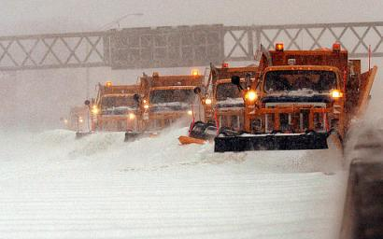
Air temperature at your location is crucial
especially during the winter months. Knowing
how temperature could change over the
next few hours could greatly affect how you
deal with a winter storm.

Slide 32
Air Temperature
Temperature at your location can be affected by
the movement of air.
Temperature Advection: The changing of
temperature caused by the wind.
Warm Advection: The warming of air produced by wind. Wind
blows from regions of warm air to regions of colder air, thus
cold air is replaced by warm air.
Cold Advection: The cooling of air produced by wind. Wind blows
from regions of cold air to regions of warmer air, thus warm
air is replaced by cold air.

Slide 33
DEW POINT – WHEN WILL IT SNOW?
Dew point is one of the most important variables
to monitor before and during a winter storm.
However, dew point is probably one of the least
understood concepts in weather, so we will start with
a little “Dew point 101”.

Slide 34
Dew point: The temperature to which air must be
cooled for saturation to occur.
An Example
If you cooled the air
40
Temperature 40
Dew point 30
to the dew point
35
Condensation
Occurs!!!
30
When the temperature reaches the dew point, it causes
water molecules in the air to form into water droplets
on a surface.

Slide 35
The Soda Can Effect
On a hot day when you take a soda can outside
the soda can sweats. Why?
Air Temperature 88°
Dewpoint 60°
Because the soda can
is colder than
the dew point outside.
Can temperature
35°
Air around the can is cooled causing water vapor in
the air to condense on the can’s surface, just like
water vapor condensing on dust particles in the
air to form clouds.

Slide 36
Why is Dew point important?
Dew point gives you a measure of how moist
or dry an airmass is.
This is a dry airmass
This is a moist airmass
Temp. 30
Dew point 15
Temp. 30
Dew point 27
So, the larger the spread between the temperature
and the dew point, the drier the air.
When temperature and dew point are the same,
relative humidity= 100%, but this does not mean
we have precipitation.

Slide 37

Wind Direction
The direction of the wind is very important when it comes to following the weather.
  Wind moves weather – At the surface the wind brings in air of a different temperature or air of a different level of moisture.
  Location of storm systems – The wind direction where you are can tell you where low pressure systems and fronts are located.

Slide 38

Pavement Weather
No matter where in the United States you are responsible for, temperatures are almost always at or near freezing during a winter event.
Even if they are not, the temperature of the pavement not the air temperature, determine how effective chemicals will be on the road.
First thing you must have is a way to monitor it:
  Mobile temperature sensor
  RWIS
Next you have got to use it!

Slide 39
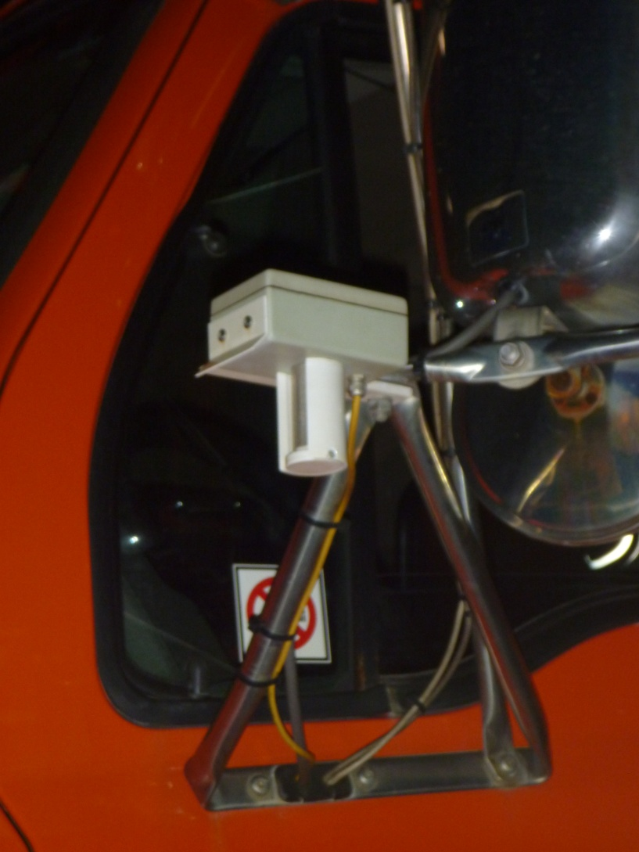
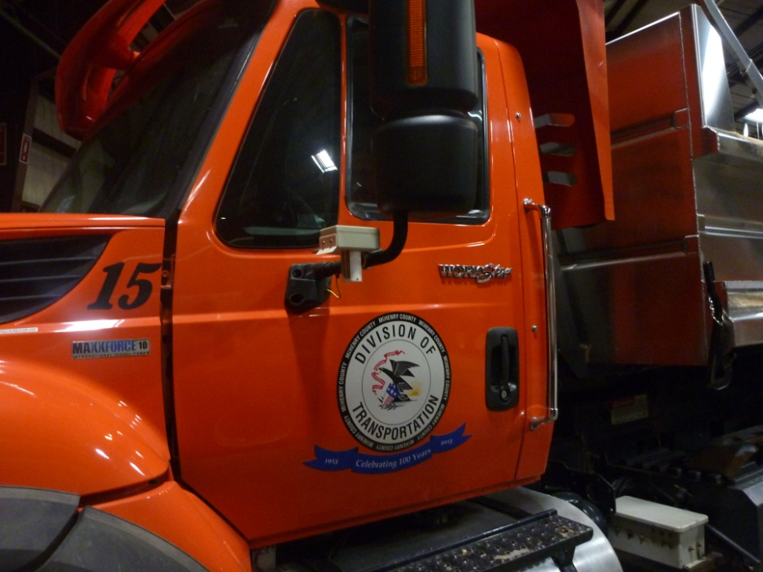
  Mobile temperature sensor

Slide 40
No Real changes
Light snow
Frost
Contact Weather
Make brine and blend
Continue anti-icing if conditions are correct
24 hour notice
No action taken yet

Slide 41
moderate
heavy
blizzard
Continue Anti-icing if conditions are correct
Pre-storm meeting with supervisors
Revise the response if needed
Staff checks the system for hazards and checks snow fence
Media and internal communication begins

Slide 42
1 day
This is when it all comes together
Any time within 24 hours of the event

Slide 43
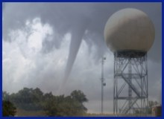

Things to watch with Radar
Can Radar Lie?
You Bet!!

Slide 44

Locating “real” precipitation
Why does radar sometimes not show all the
precipitation?
Because of the curvature of the Earth, radar can not see
lower snow clouds very far from the radar site.
However, it can see the mid and high level clouds of an
approaching storm, and since these clouds do reflect
well, it appears that precipitation is closer than it really is.

Slide 45

Why does radar sometimes show snow everywhere but it is not snowing out the window?
One common weather feature that can be misleading to view on Radar is Virga.
What is Virga?
As the snow falls from the clouds it falls into the drier air near the surface which causes the snowflakes to evaporate before they reach the ground.
Dry Air

Slide 46
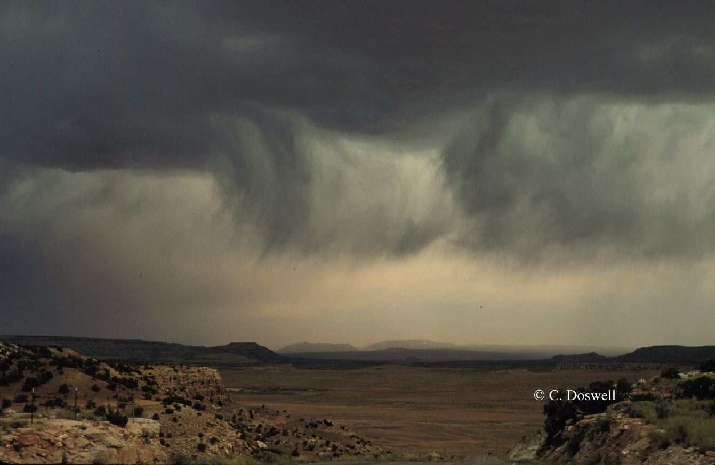
Virga

Slide 47
How does this look on radar?
On Radar, it will appear there is snow nearby, and sometimes it will even look like snow is all around the radar but not at the radar site.
Remember that radar sees moisture. It can not tell whether it is reaching the ground.

Slide 48
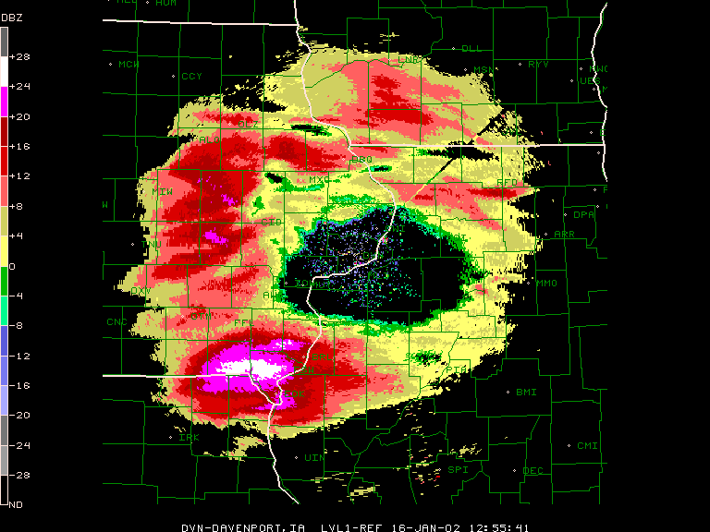

Slide 49
Frost
24 hour notice
If 50% chance or higher anti-ice Conditions must be correct
Forecast may be for Bridges or entire system, plan appropriate equipment
If conditions are not correct
Consider slurry
Pre-load trucks for a possible response, post the information for staff

Slide 50
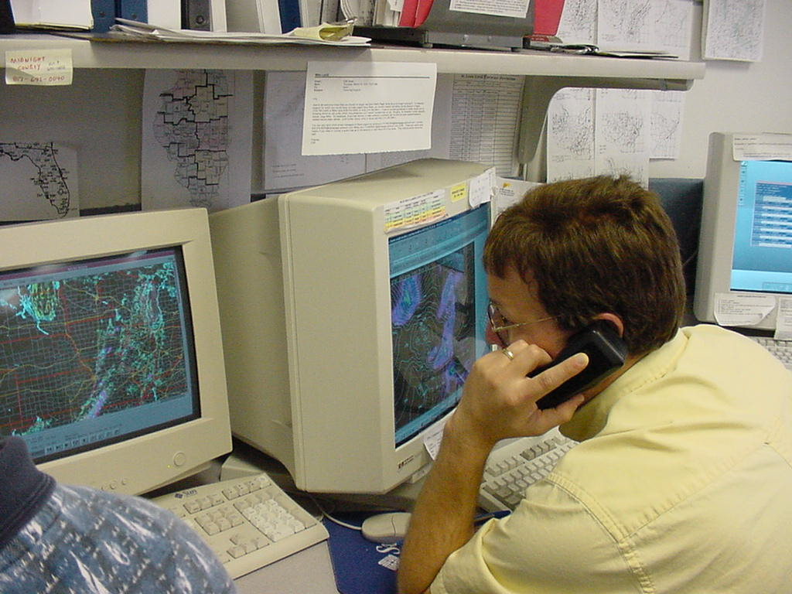
Forecast Consultation is the Key!
They have one job – watch the weather

Slide 51
Light snow
Contact weather, secure start and end time along with estimated storm totals and pavement temperatures
Post the forecast and inform staff
Any event greater that 16 hours shifts are split
Pre-load equipment
Trucks are filled based on the response, liquids are topped off
Internal e-mail is sent along with the forecast
No pre-storm meeting – post the forecast and inform the staff
Depending on the start time determine pre-determined start or “we will call you”
Notify Sheriff and management of our plan. Pre-determine supervisor response

Slide 52
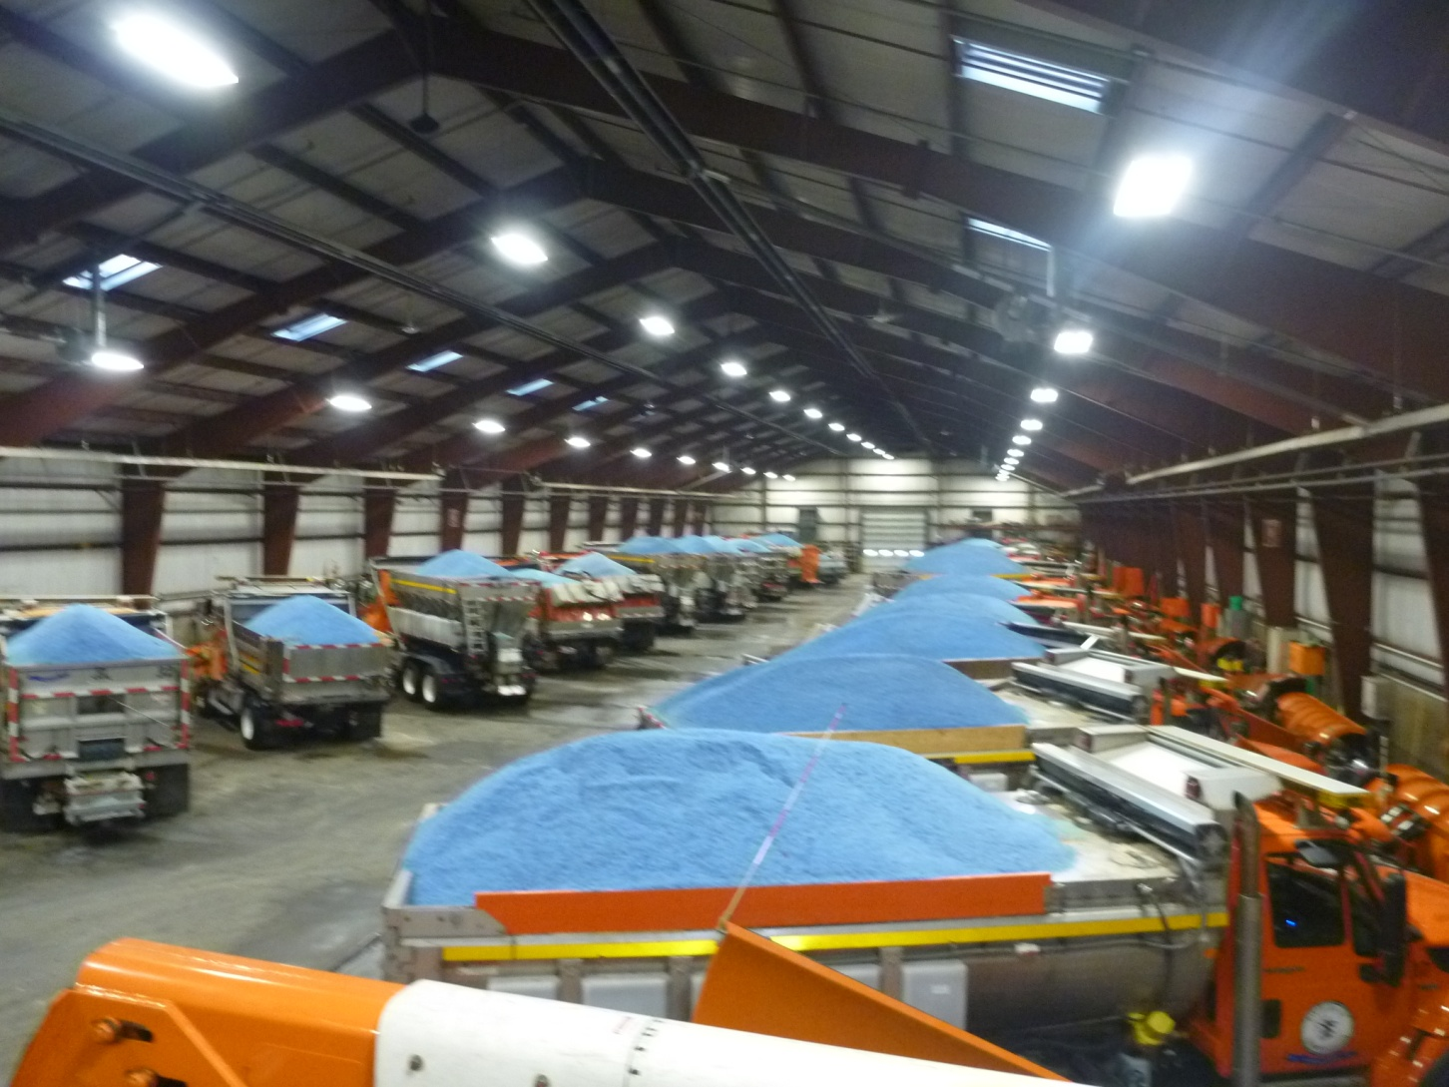
Pre-load Trucks

Slide 53
moderate
Contact weather, secure start and end time along with estimated storm totals and pavement temperatures
Post the forecast and inform staff
Any event greater that 16 hours shifts are split
Pre-load equipment
Trucks are filled based on the response, liquids are topped off
Internal e-mail is sent to all DOT staff along with the forecast
Pre-storm meeting with staff – post the forecast and anticipated response
Depending on the start time determine pre-determined start or “we will call you”
Notify Sheriff and management of our plan. Pre-determine supervisor response
In moderate events extra staff and additional equipment is utilized
Engineering staff may be used for fuel, mailboxes and parts runs. Equipment is ready and vehicles assigned

Slide 54
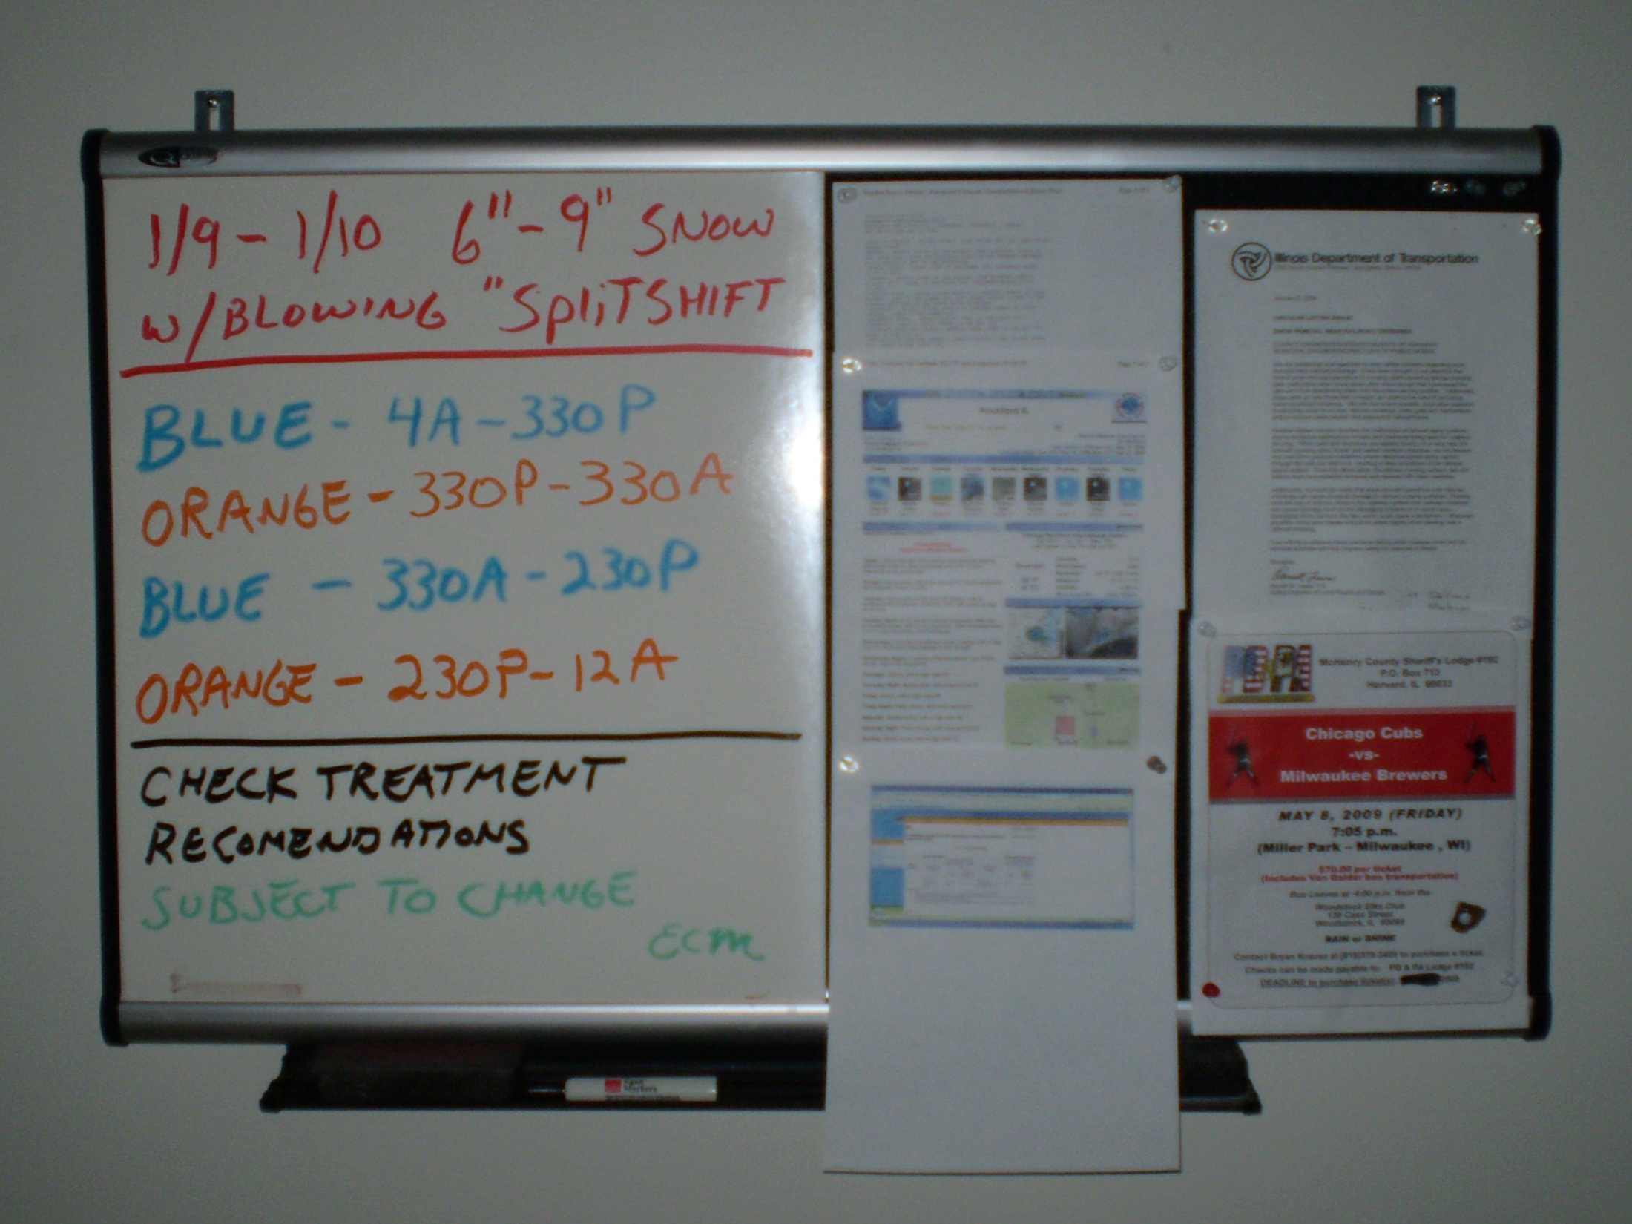
INFORMATION FOR STAFF

Slide 55
heavy
Contact weather, secure start and end time along with estimated storm totals and pavement temperatures
Post the forecast and inform staff
Shifts are split
Pre-load equipment
Trucks are filled based on the response, liquids are topped off
Internal e-mail is sent to all DOT staff , administration , elected officials, Sheriff and EMA
Pre-storm meeting with staff – post the forecast and anticipated response
Start time determine pre-determined ”
Notify Sheriff and management of our plan. Pre-determine supervisor s shifts
In heavy events extra staff and additional equipment is utilized
Engineering staff may be used for fuel, mailboxes and parts runs. Equipment is ready and vehicles assigned
Communication with the public and media
Meetings with administration , schools and courts

Slide 56
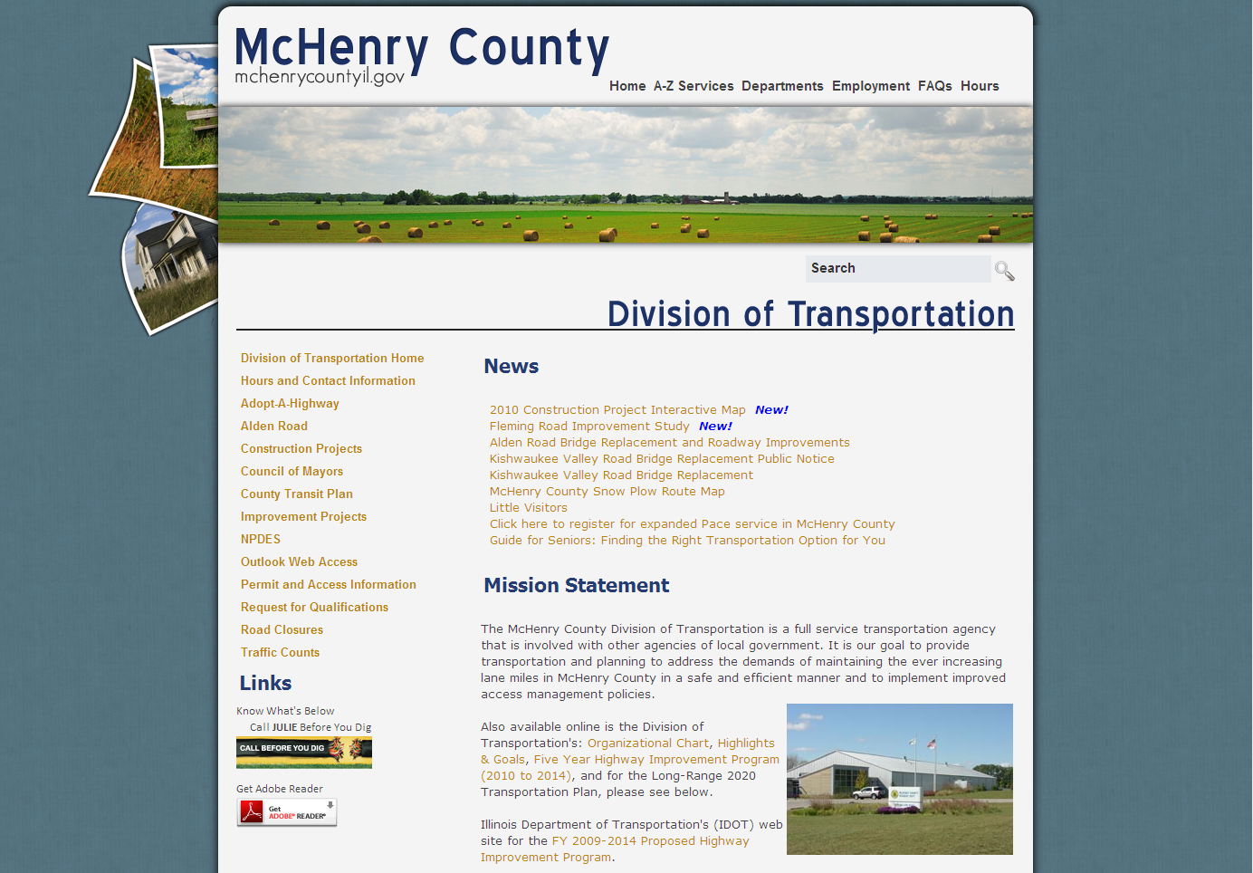

Slide 58
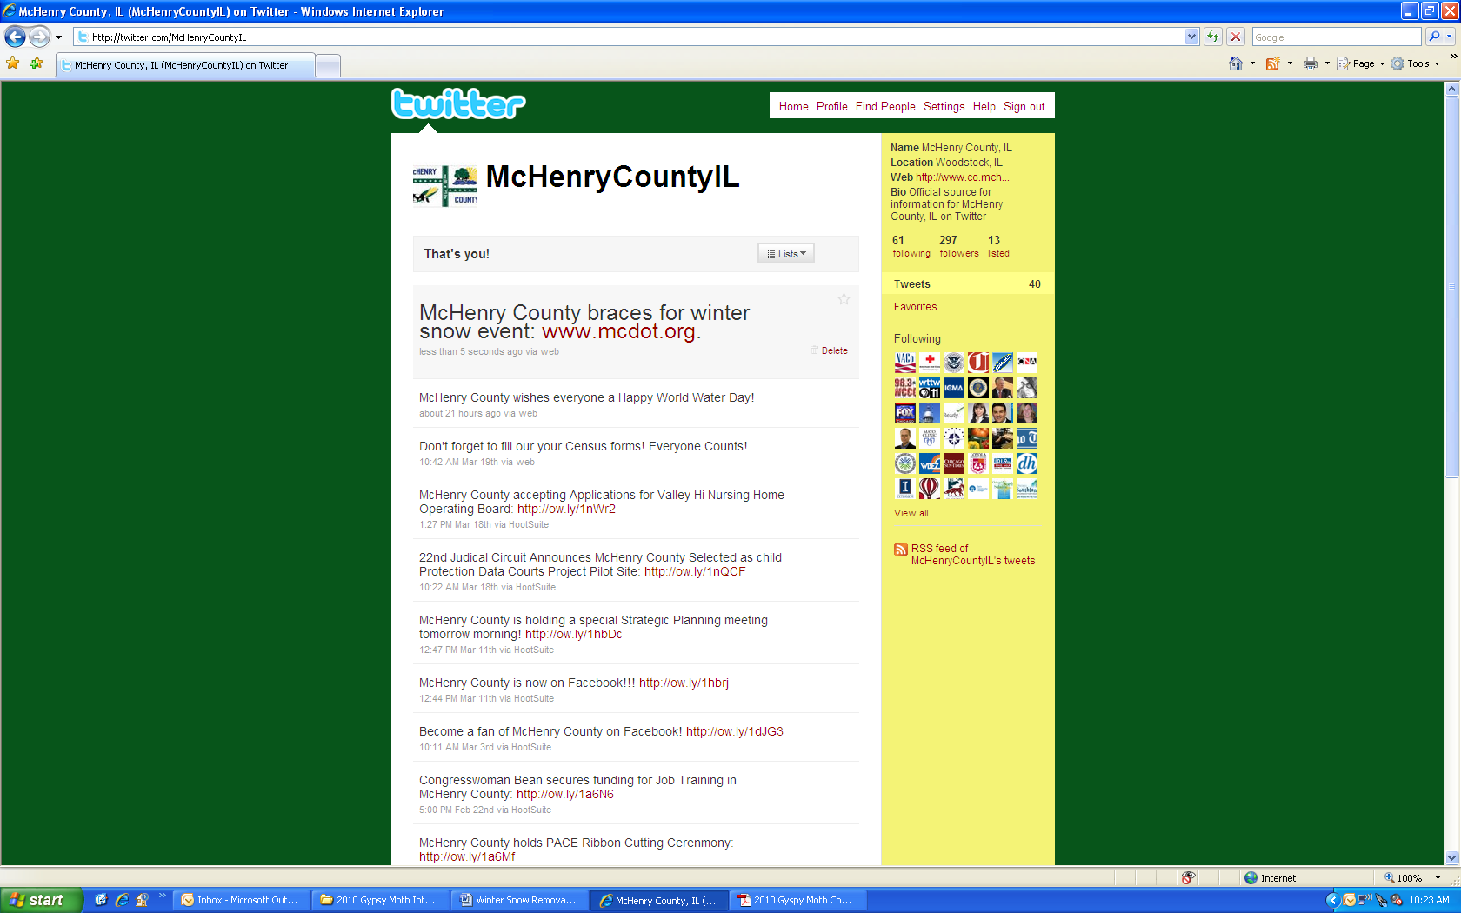

Slide 59
blizzard
Contact weather, secure start and end time along with estimated storm totals and pavement temperatures
Post the forecast and inform staff
Shifts are split
Pre-load equipment
Trucks are filled based on the response, liquids are topped off
Internal e-mail is sent to all DOT staff , administration , elected officials, Sheriff and EMA
Pre-storm meeting with staff – post the forecast and anticipated response
Start time determine pre-determined ”
Notify Sheriff and management of our plan. Pre-determine supervisor s shifts
In heavy events extra staff and additional equipment is utilized
Engineering staff may be used for fuel, mailboxes and parts runs. Equipment is ready and vehicles assigned. Heavy equipment is in place
Communication with the public and media
Meetings with administration , schools , courts and area municipalities
Notices sent out of building closures, press release, facbook tweeter and website
EOC may be opened, conference calls set up media is notified
Staff will be asked to stay
Hotel rooms are secured and keys picked up
Food, cots and supplies for extended stay

Slide 60
So what does it look like?

Slide 61
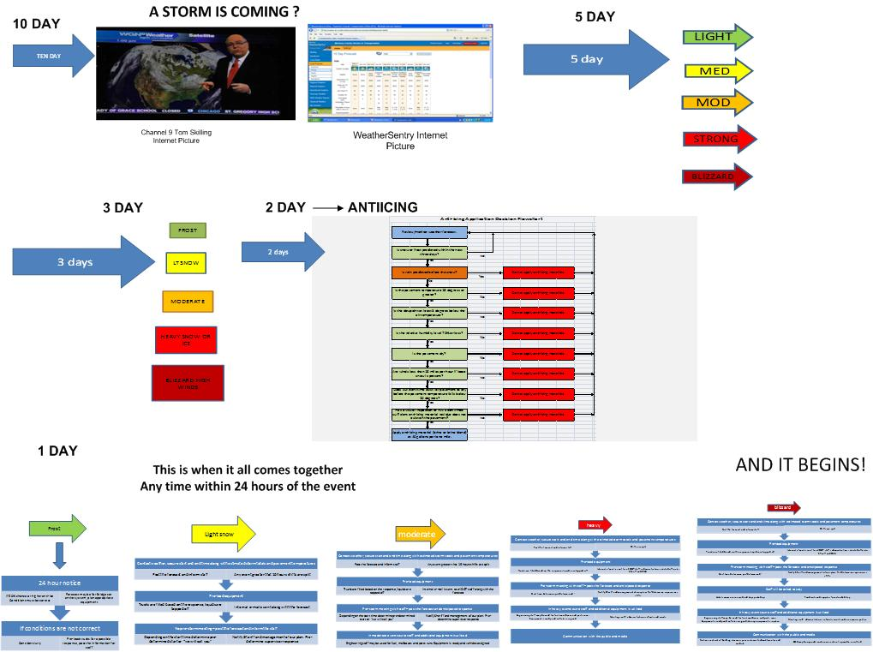

Slide 62
AND IT BEGINS!

Slide 63
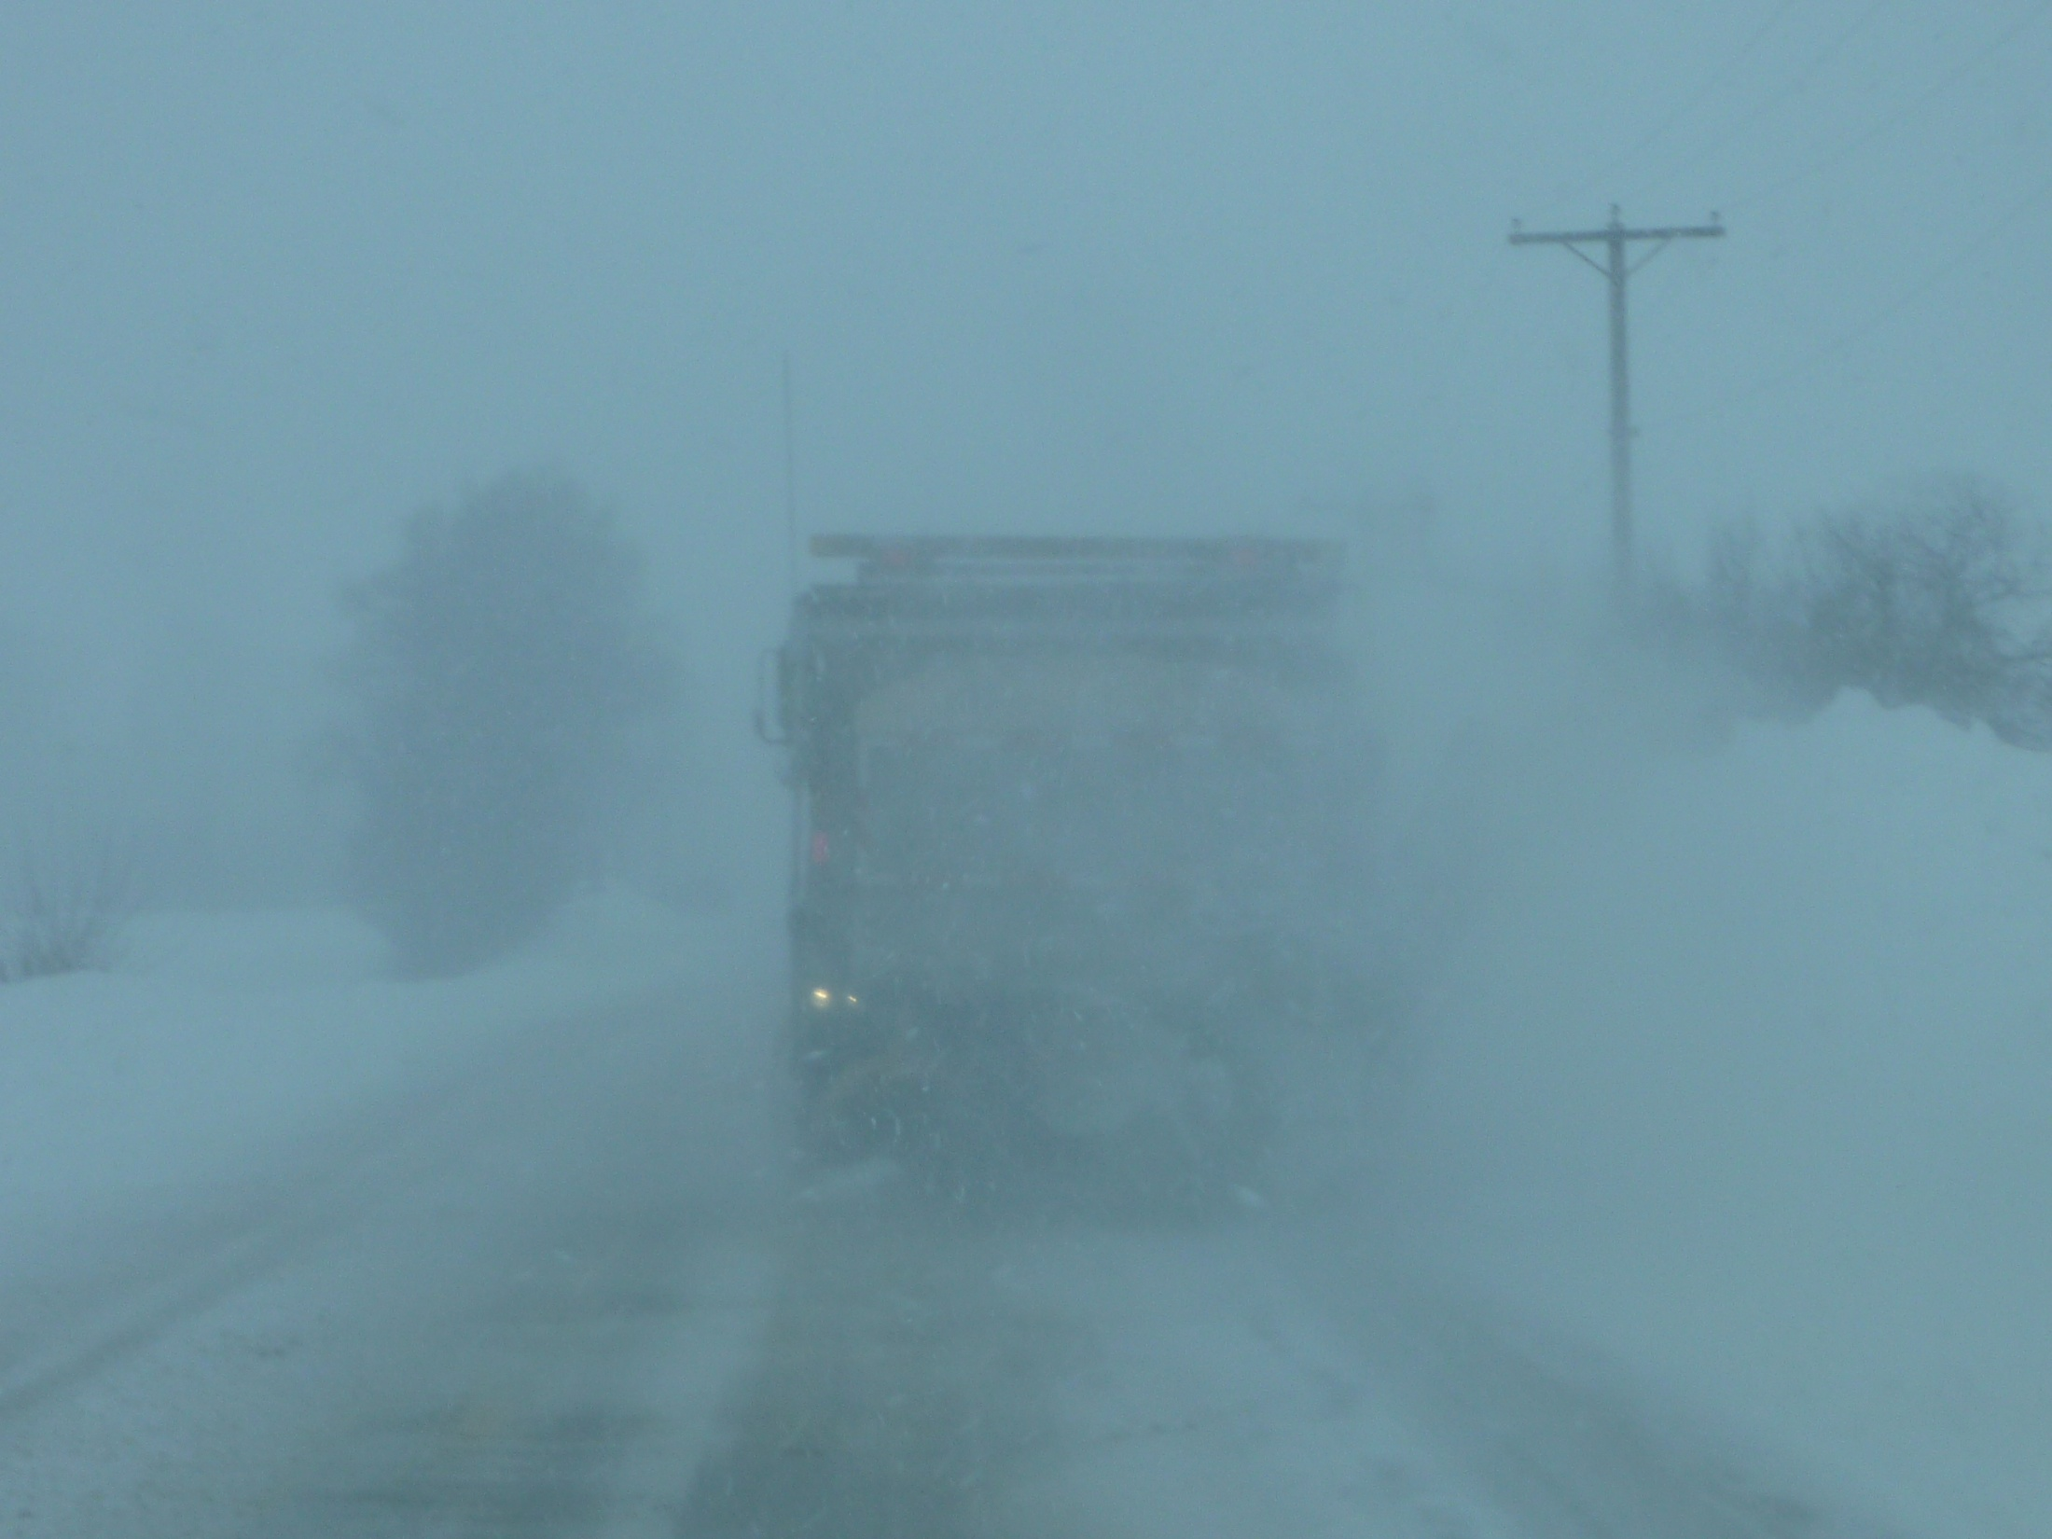
BLIZZARD 2011

Slide 64
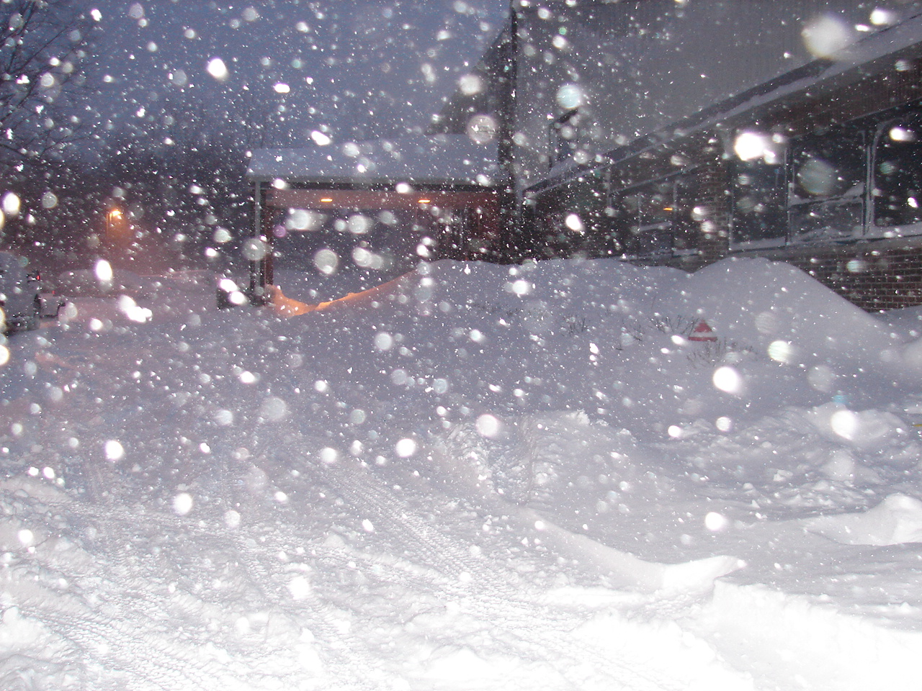

Slide 65
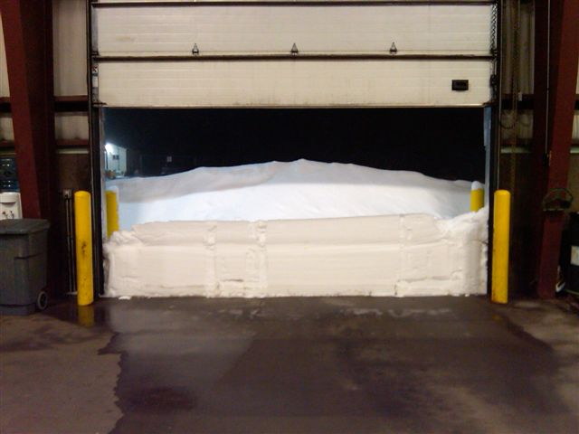

Slide 66
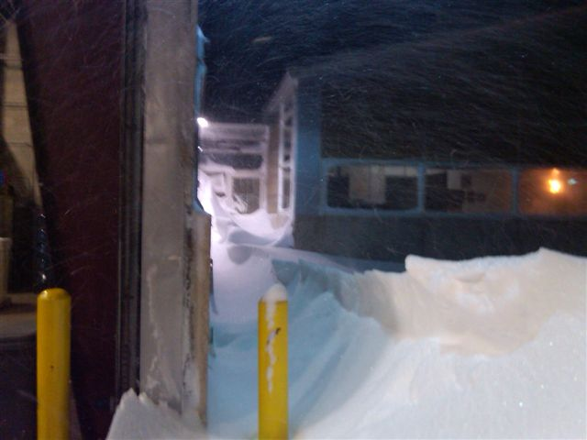

Slide 67
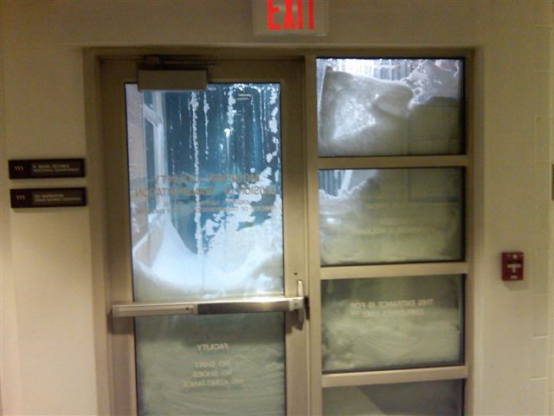

Slide 68
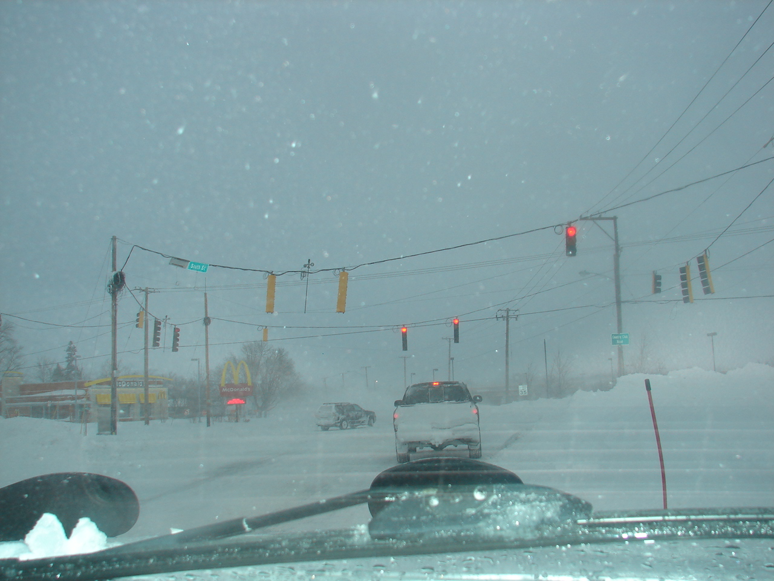

Slide 69
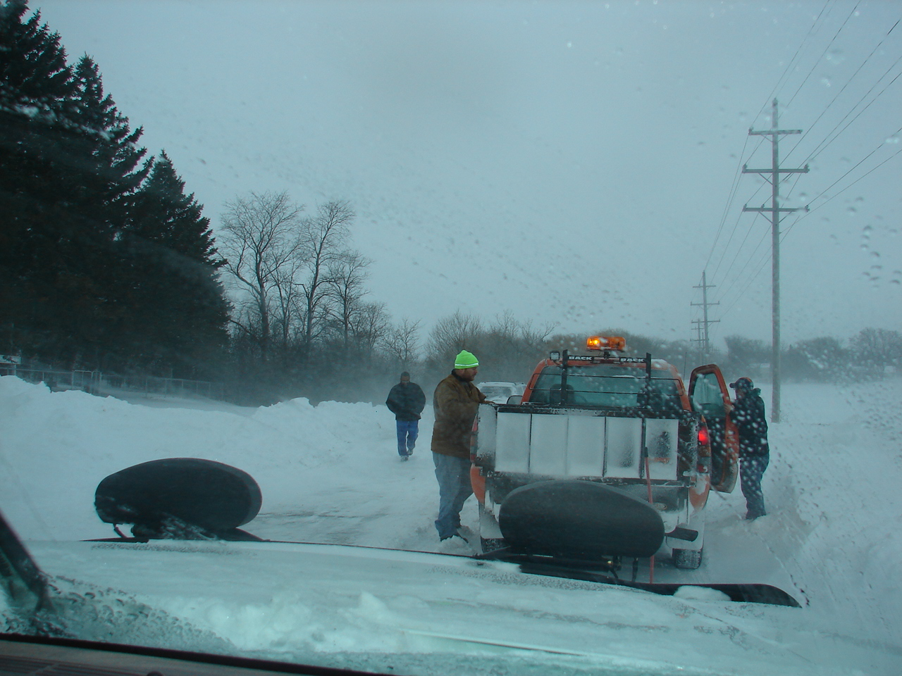

Slide 70
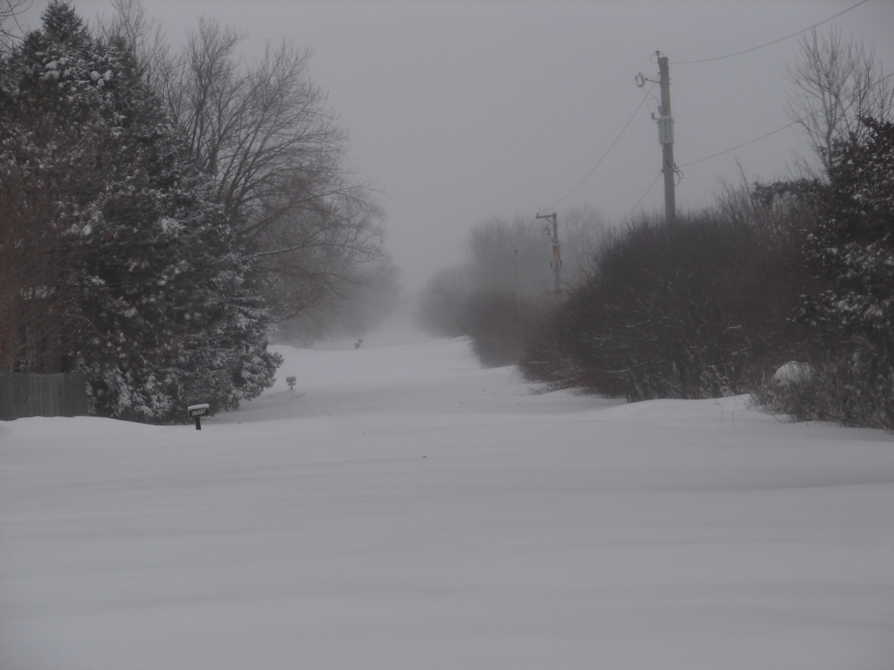

Slide 71
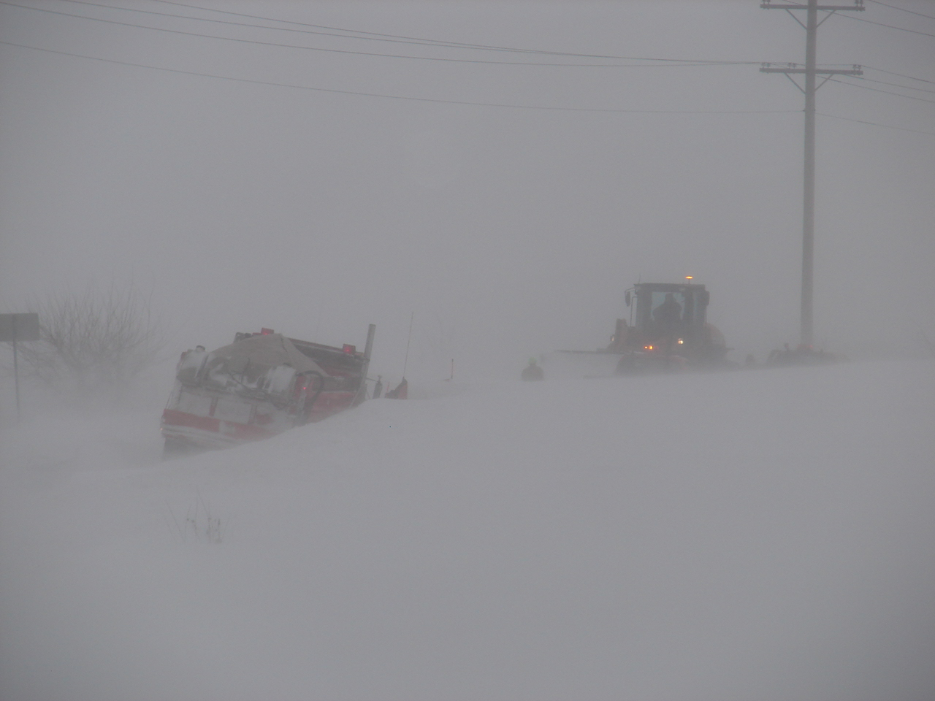

Slide 72
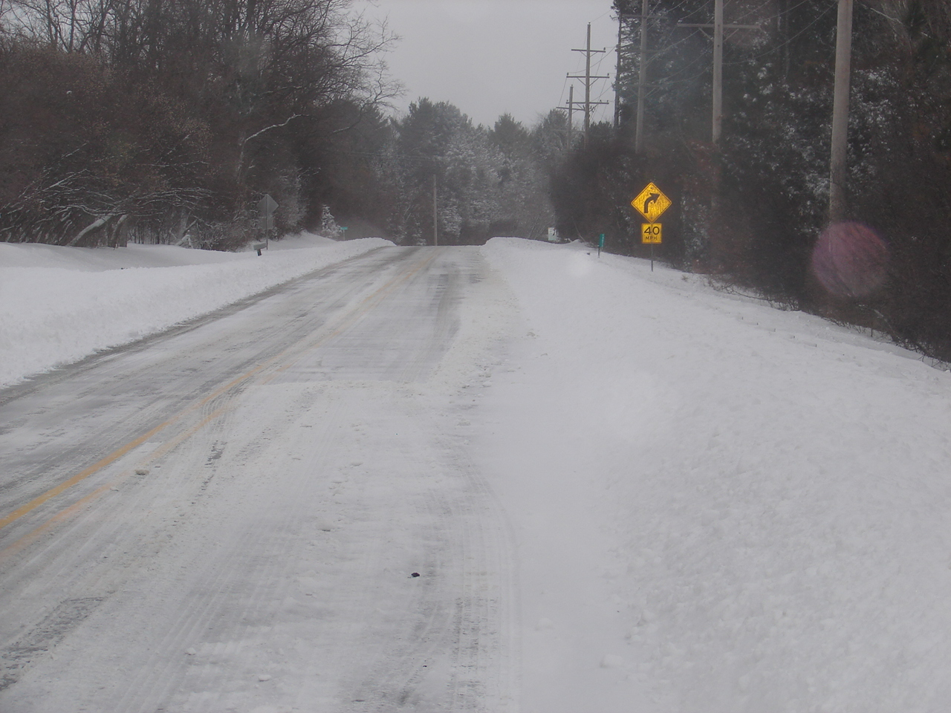

Slide 73
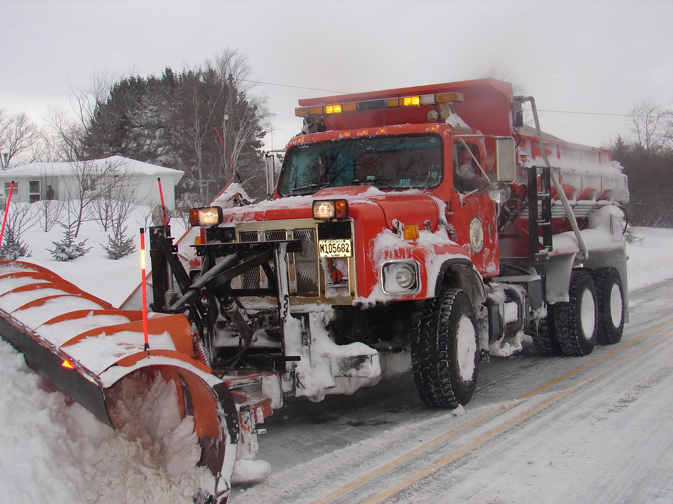

Slide 74
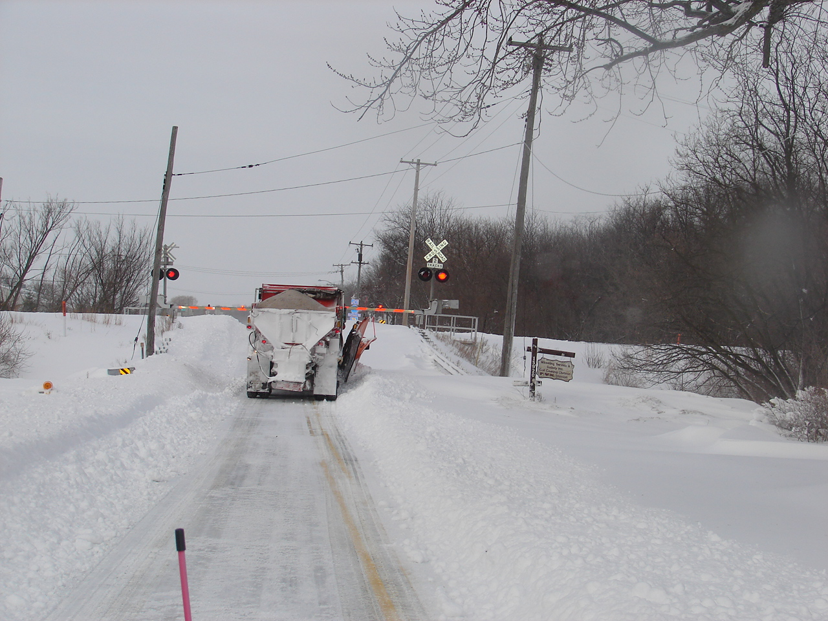

Slide 75
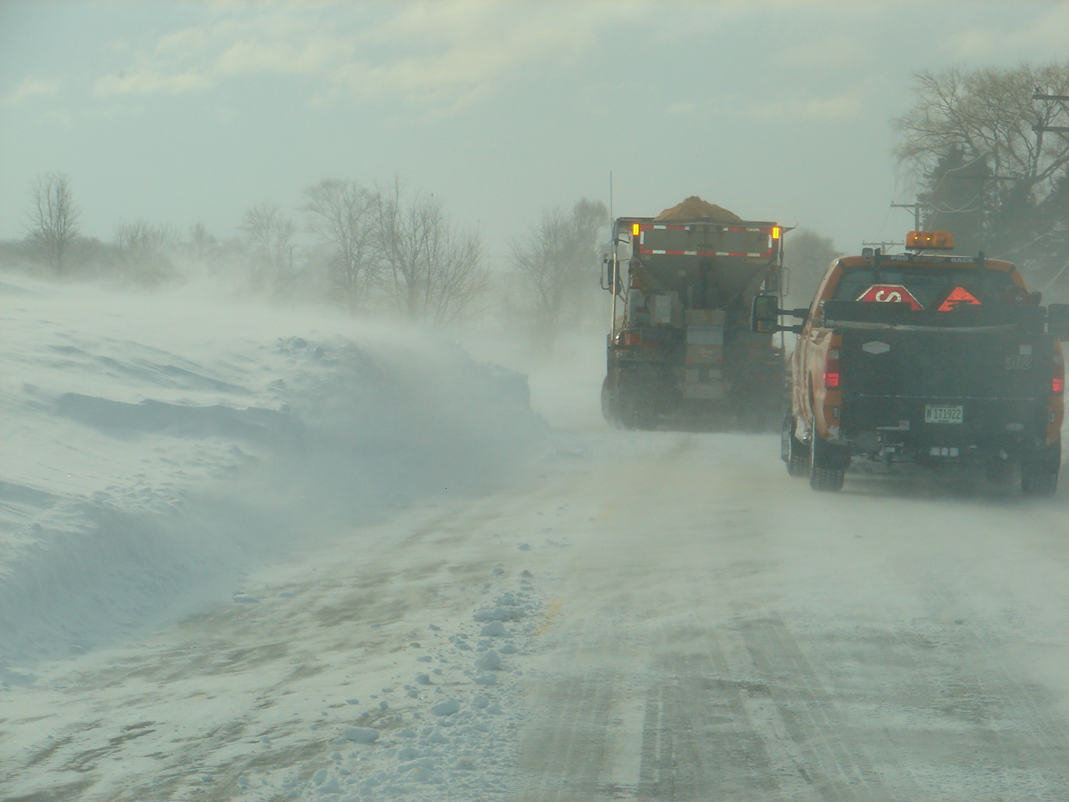

Slide 76
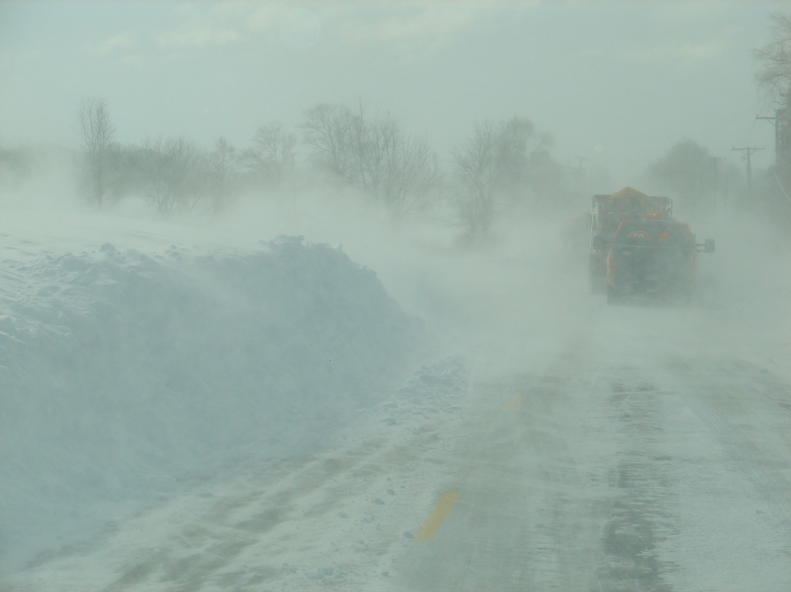

Slide 77
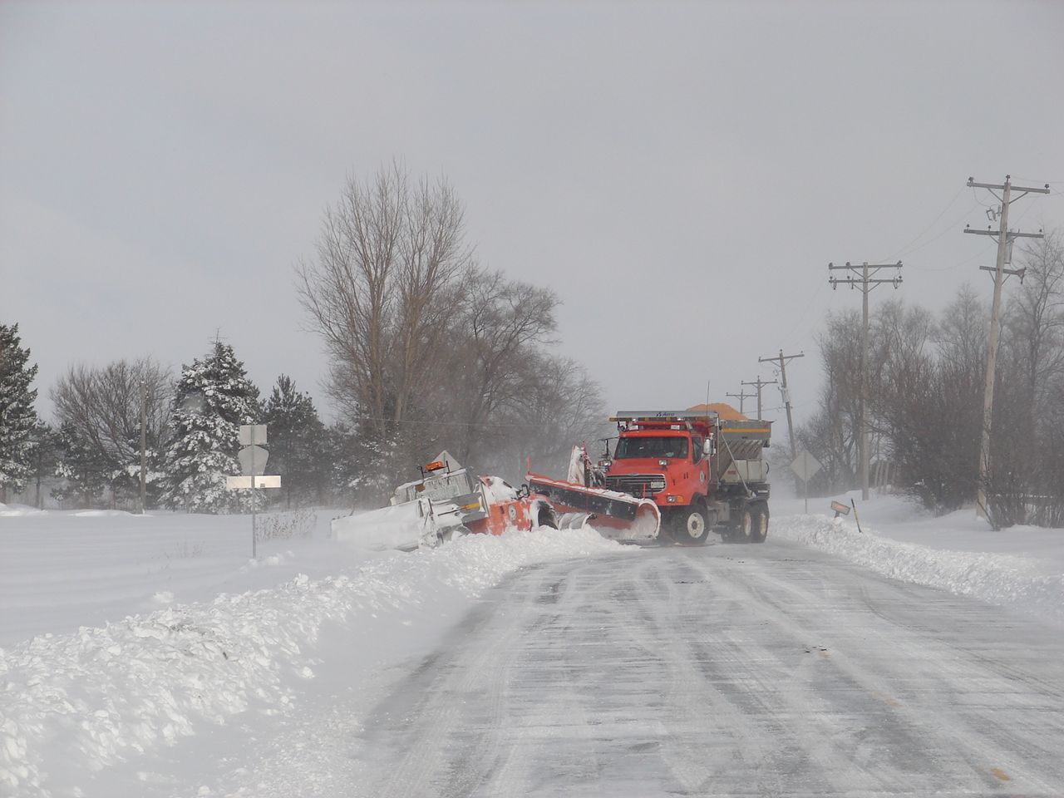

Slide 78
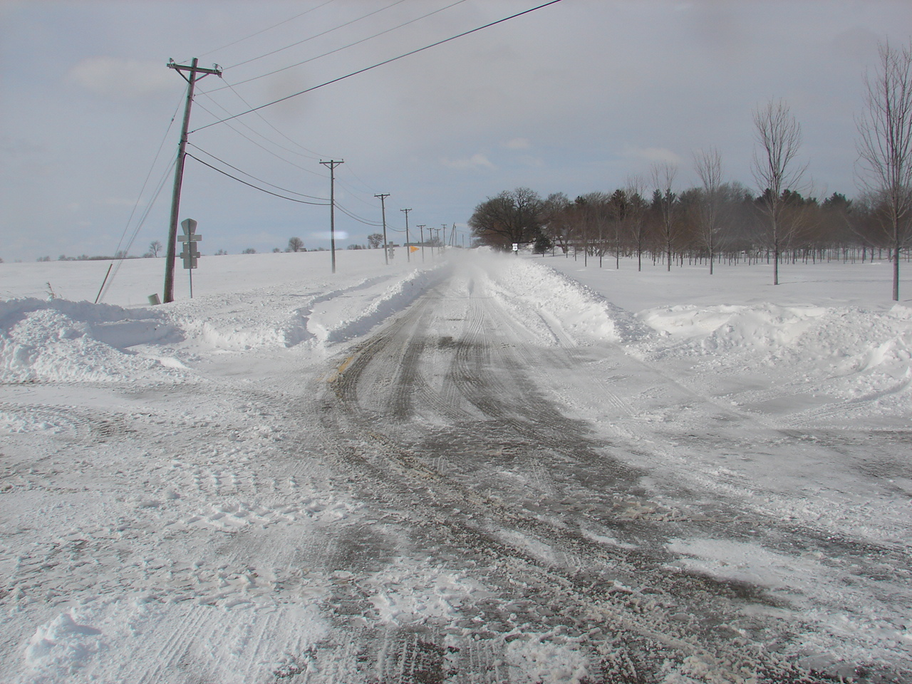

Slide 79
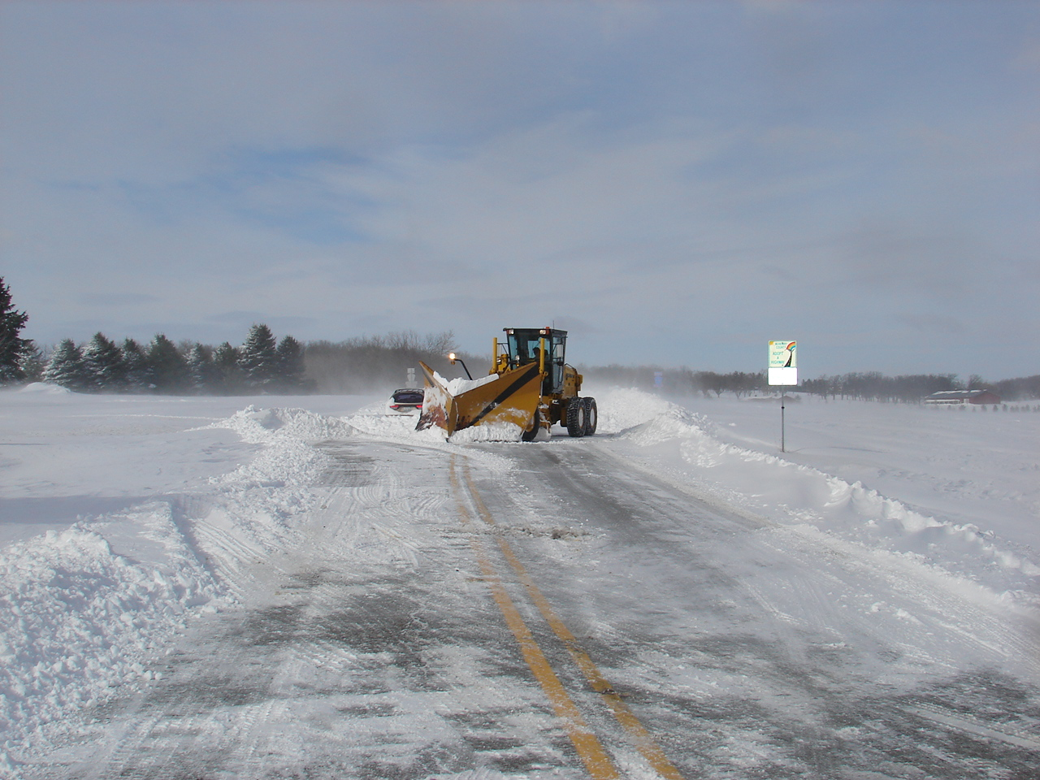

Slide 80
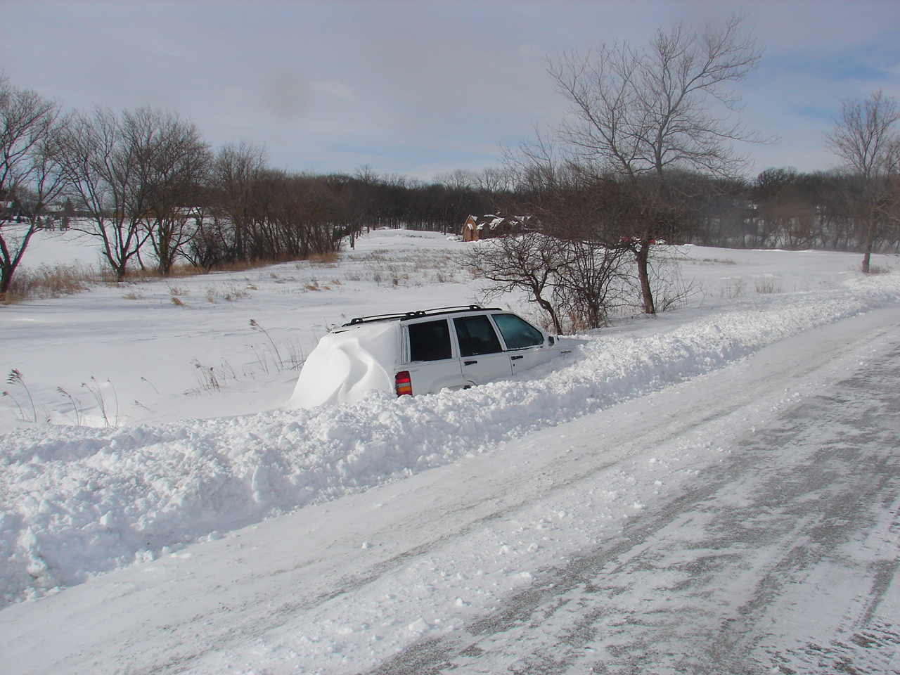

Slide 81
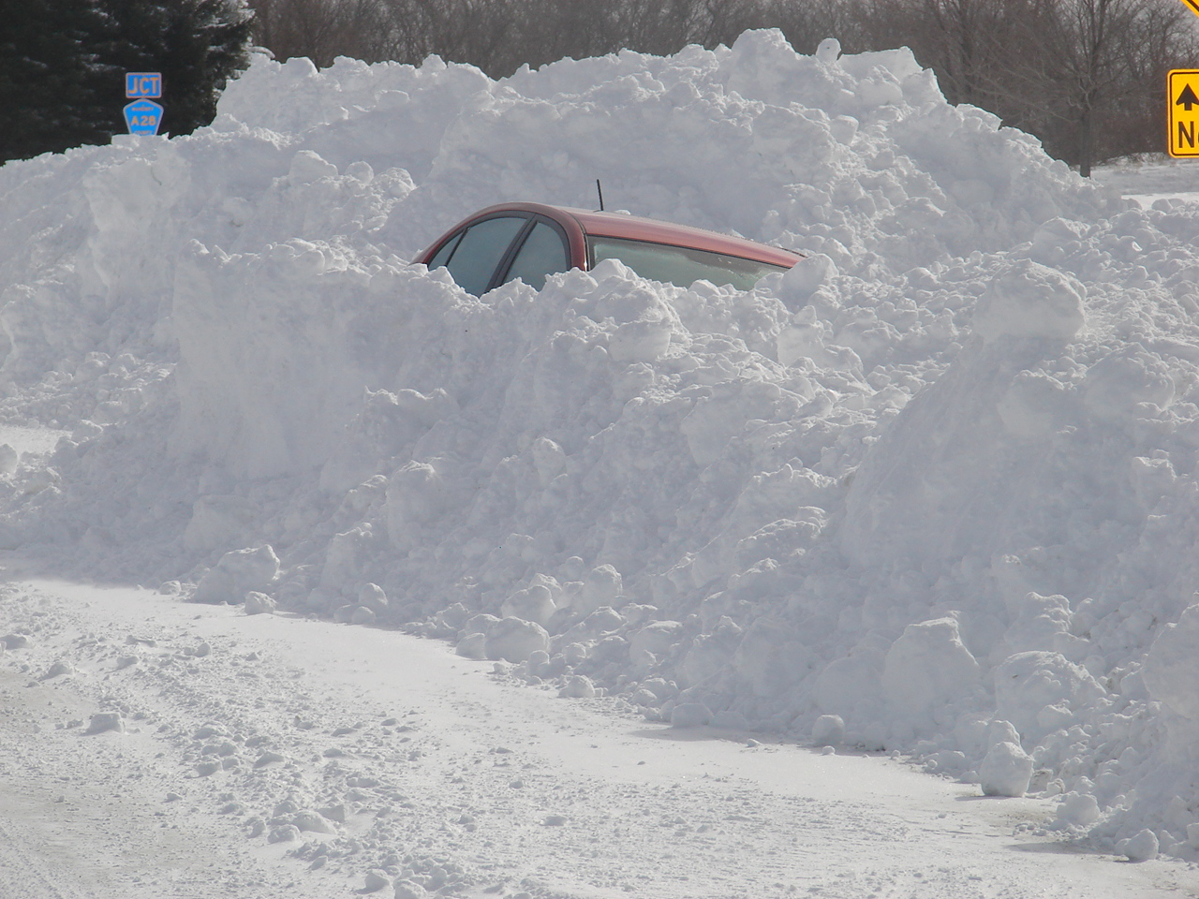

Slide 82
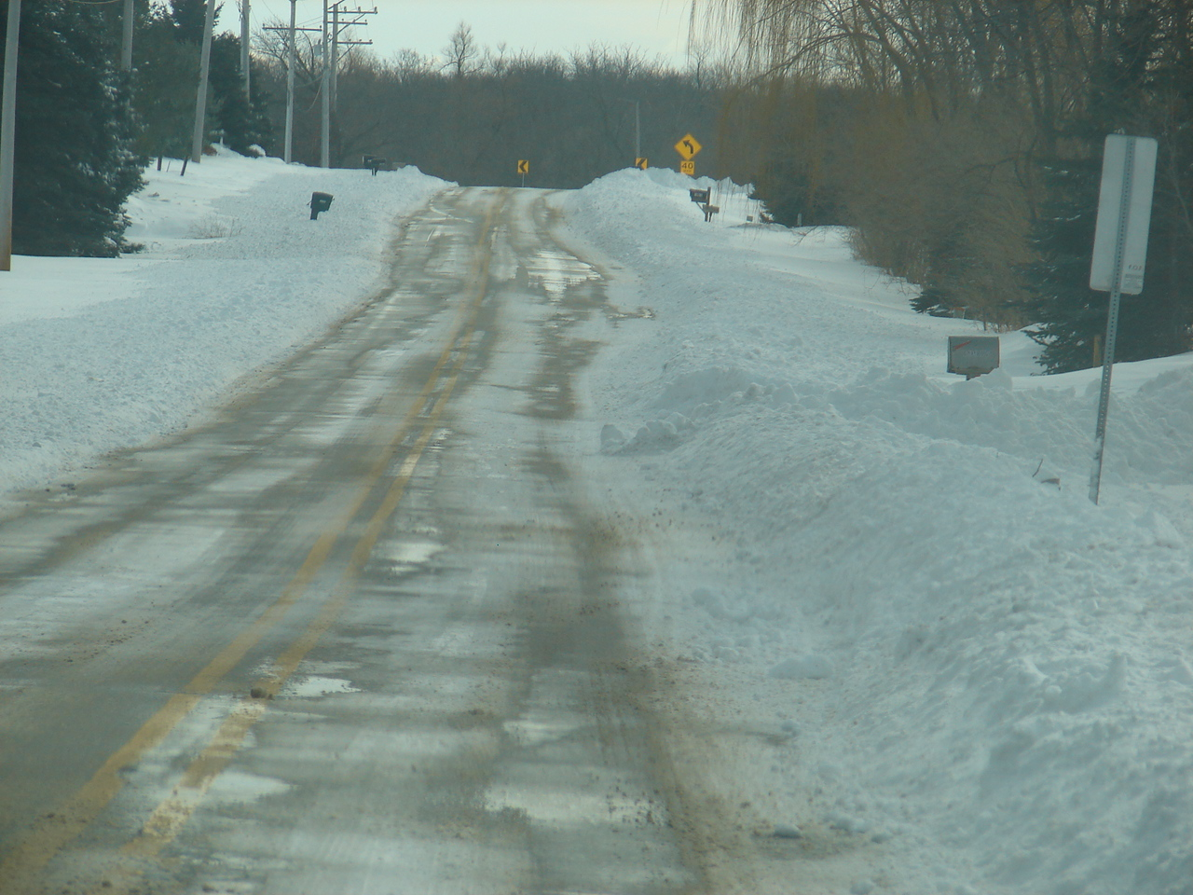

Slide 83
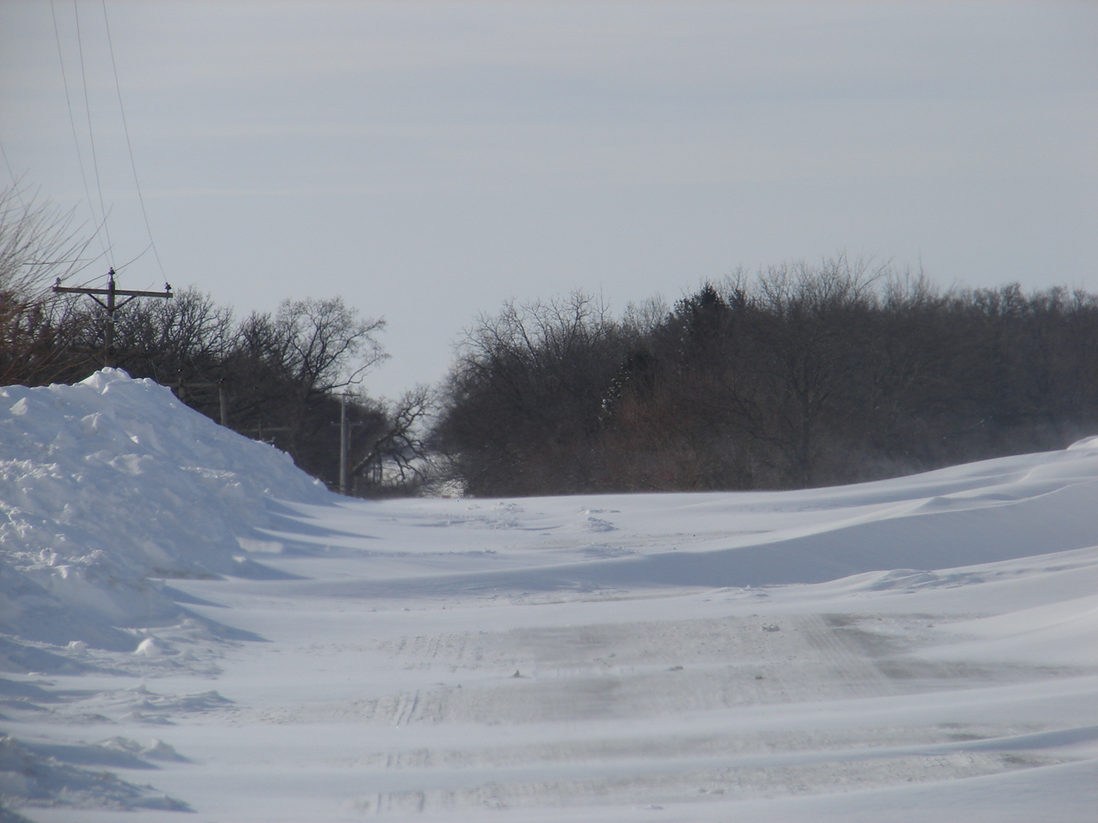

Slide 84
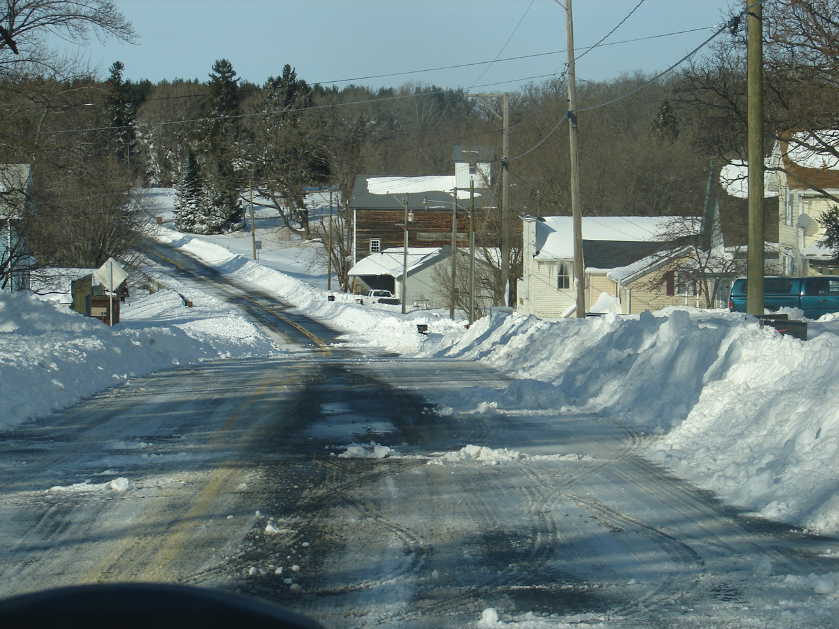

Slide 85
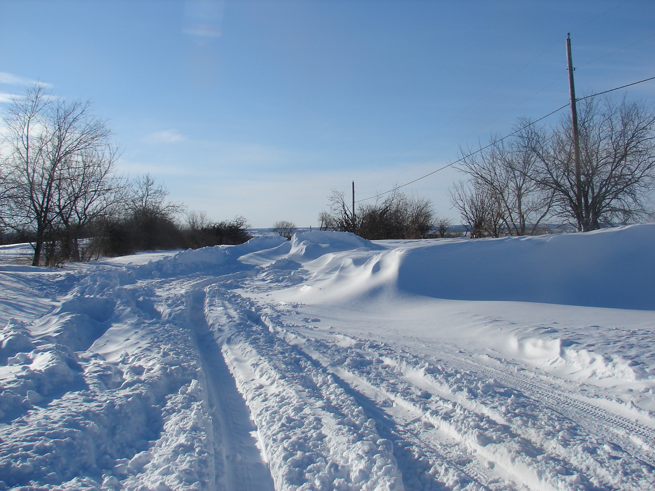

Slide 86
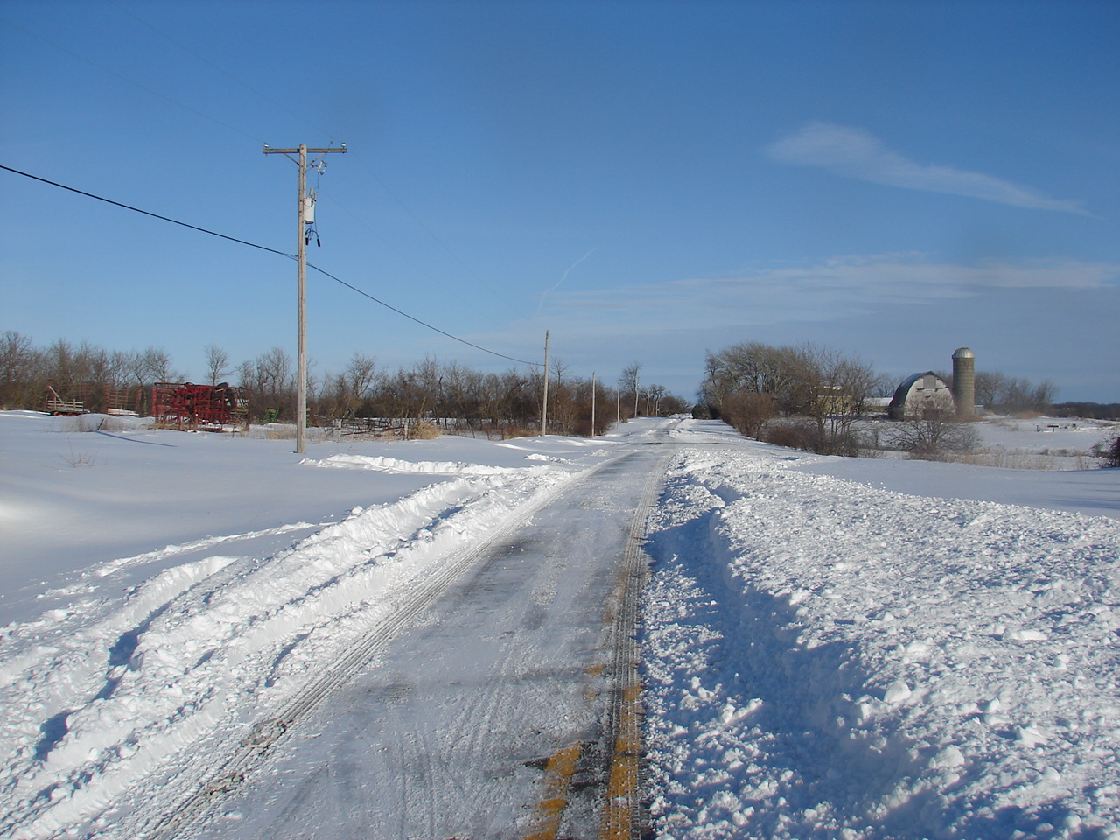

Slide 87
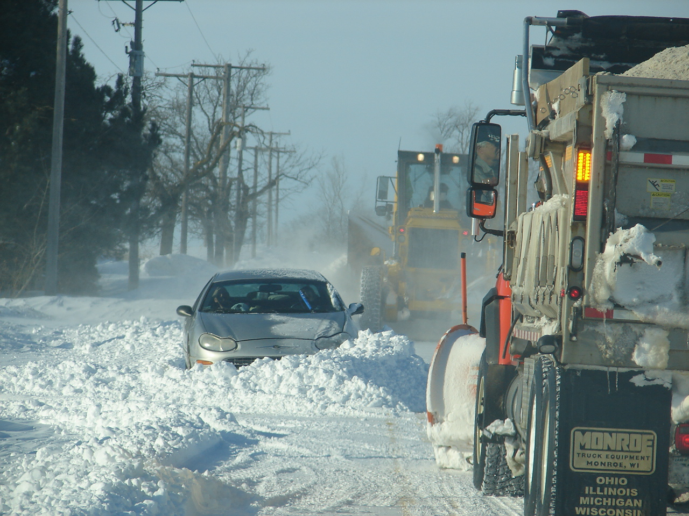

Slide 88
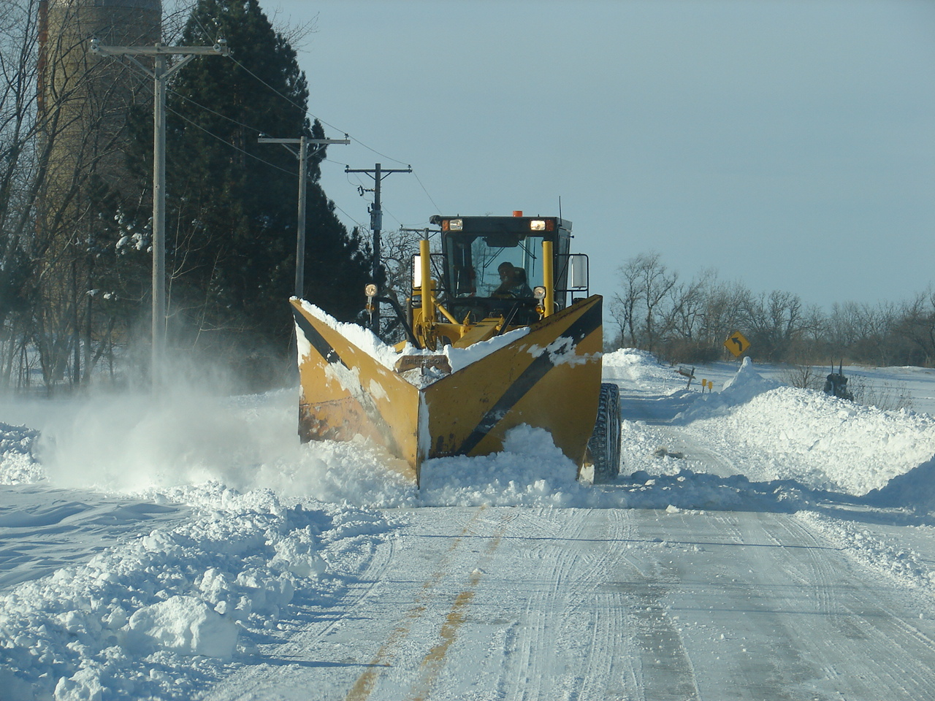

Slide 89
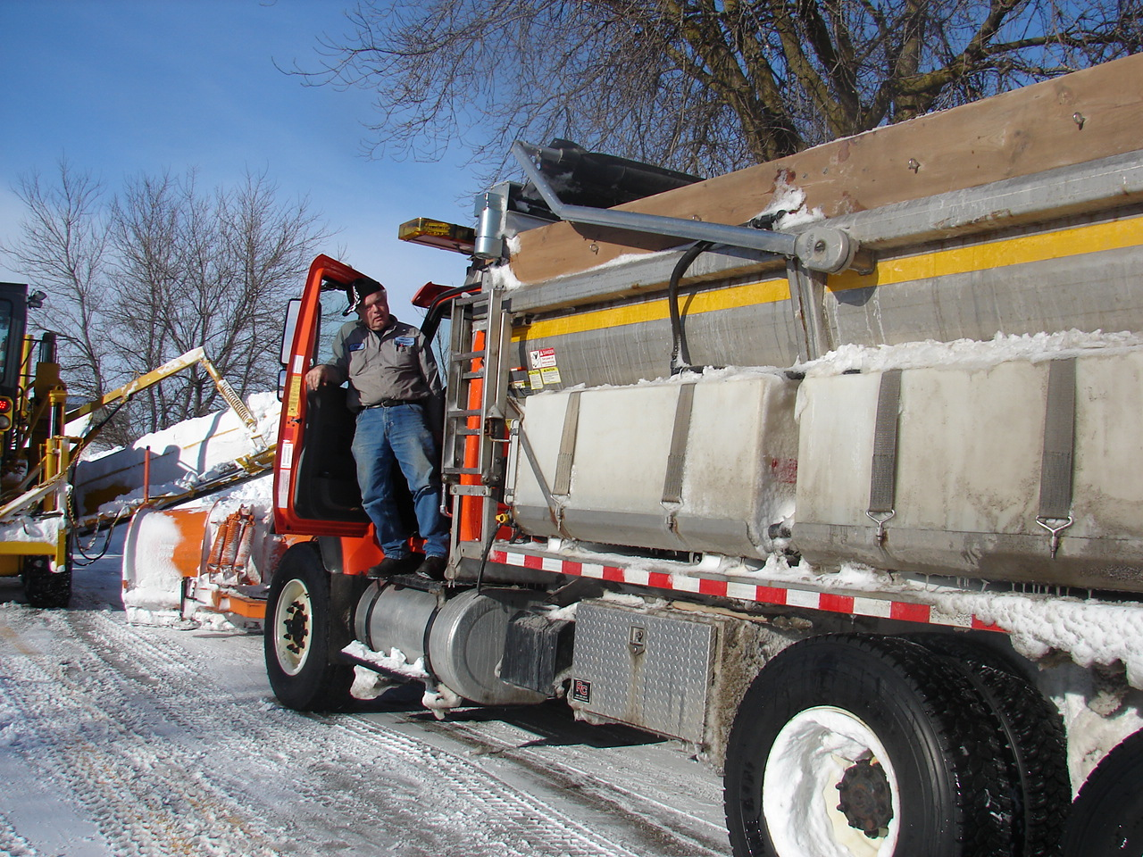

Slide 90


Slide 91


Slide 92


Slide 93


Slide 94


Slide 95


Slide 96


Slide 97


Slide 98


Slide 99
THANK YOU!
Mark DeVries
McHenry County DOT
(815) 334-4975
rmdevries@co.mchenry.il.us
Jon Tarleton
Roads and Rail Marketing Manager
Vaisala Inc.
Phone 314 872 0509
Mobile 314 704 0052
jon.tarleton@vaisala.com
http://www.vaisala.com/

