Slide 1
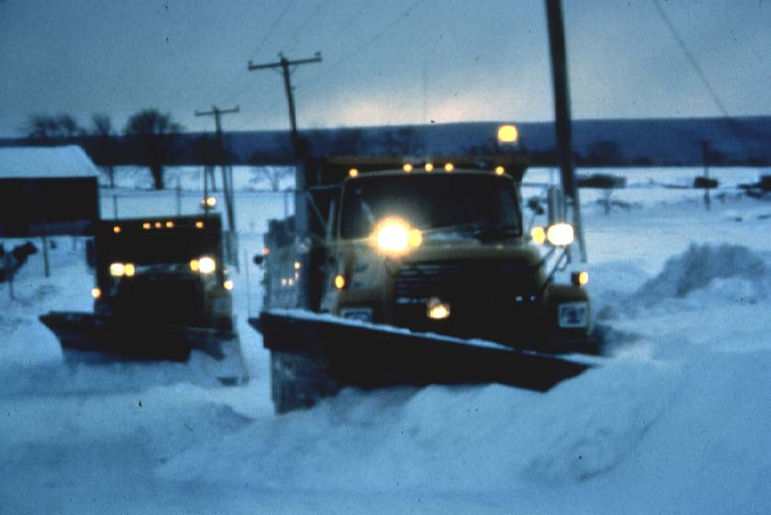
Plowing Operations
Policies and Procedures
Plowing Techniques
Special Concerns
Notes:
In this section we need to discuss:
Policies and procedures regarding plow operation
Actual plowing techniques for different types of roads and for different situations. We’ll also look at the use of different types of plows.
And we’ll consider those special problems that may be encountered while plowing.

Slide 2
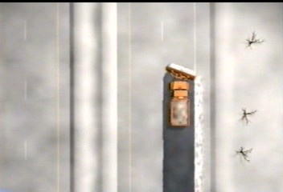
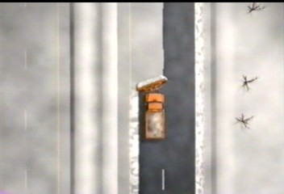
Plowing: Multiple lane highways
Priority
Open travel lane
With median
Plow right lane to right
Plow snow in left lane to left into median
Pick up all snow left from prior pass
Notes:
As you heard, the priority is to open the road.
The difference here is in which lane of a multi-lane road do you do first and in which direction you push the snow.
As seen, it really depends on whether or not there is a median into which the snow can be plowed.
With a median, you can plow the right lane first pushing snow to the right.
You then plow the left lane, pushing snow to the left and into the median, and picking up all snow left from the prior pass.

Slide 3
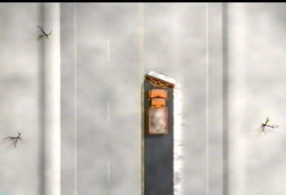
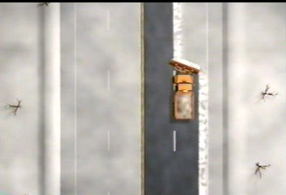
Plowing: Multiple lane highways
Without median
Plow snow in left lane to right
Continue to plow right lane to right, picking up snow from left lane
Pick up all snow from prior pass
Notes:
If there is no median into which you can push the snow, then you need to altar your technique.
You will need to plow the left lane first pushing snow to the right.
You will then plow the right lane, picking up the snow plowed from the left lane and continue to move it to the right.

Slide 4
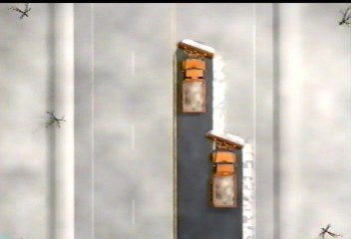
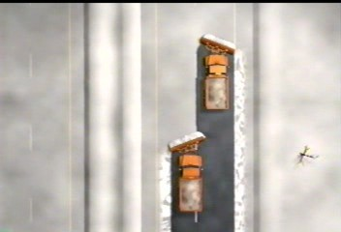
Tandem Plowing
Efficient & effective
without median
with median
Notes:
If you have the truck and operator resources to do tandem plowing, clearing multiple-lane roads is much more efficient and effective, clearing the road and making it safer in less time.
With a median area for pushing the snow, the lead truck can plow the left lane pushing the snow to the left into the median.
The second truck follows plowing the right lane, pushing snow to the right.
Without the median, the lead truck plows the left lane pushing snow to right.
The second truck plows the right lane, picking up the snow plowed by the lead truck and continues to push the snow to the right.

Slide 5
Plowing:
Policies & Procedures
Know the Policy:
Accidents involving your plow trucks
Operator to report immediately
Follow CDL regulations
Call for police to investigate on site
Other Accidents
Render assistance as needed (call for help – police, emergency medical)
Use universal safety precautions in treating injured persons
Notify supervisor
Notes:
Recommendations for accident policy
For accidents involving your plow trucks: operator should report any accident immediately and call for medical assistance as needed and for police to investigate
For other accidents, call for police and emergency medical assistance as required. Render site assistance as to traffic control until police arrive, work with police afterward if needed.
If you assist the injured, you should be trained and know what you are doing, using universal precautions in order not to endanger your own health.
Notify your supervisor of any roadway accidents.
You may want to document road conditions for potential liability claims. A disposable camera in each plow truck has proven valuable in defending future claims.

Slide 6
Plowing: Wing Plows
Avoid ‘down winging’ – may damage equipment
Could also cause damage to roadside
Push arms level with moldboard
Notes:
You should avoid down winging. The push arms should always be level with the wing moldboard. As you saw in the video, not only can downwinging cause undue stress on the equipment, but can cause damage to the roadside and create higher drifting in windy conditions.

Slide 7
Plowing: Wing Plows
Good for benching
Better sight distance
More room for next snow storm
Notes:
When the roadside snow piles become extremely high, the wing plow can be used for benching, cutting off the top of these large piles.
This serves to provide better sight distance for the motorist and will give more room if another storm hits in the near future.

Slide 8
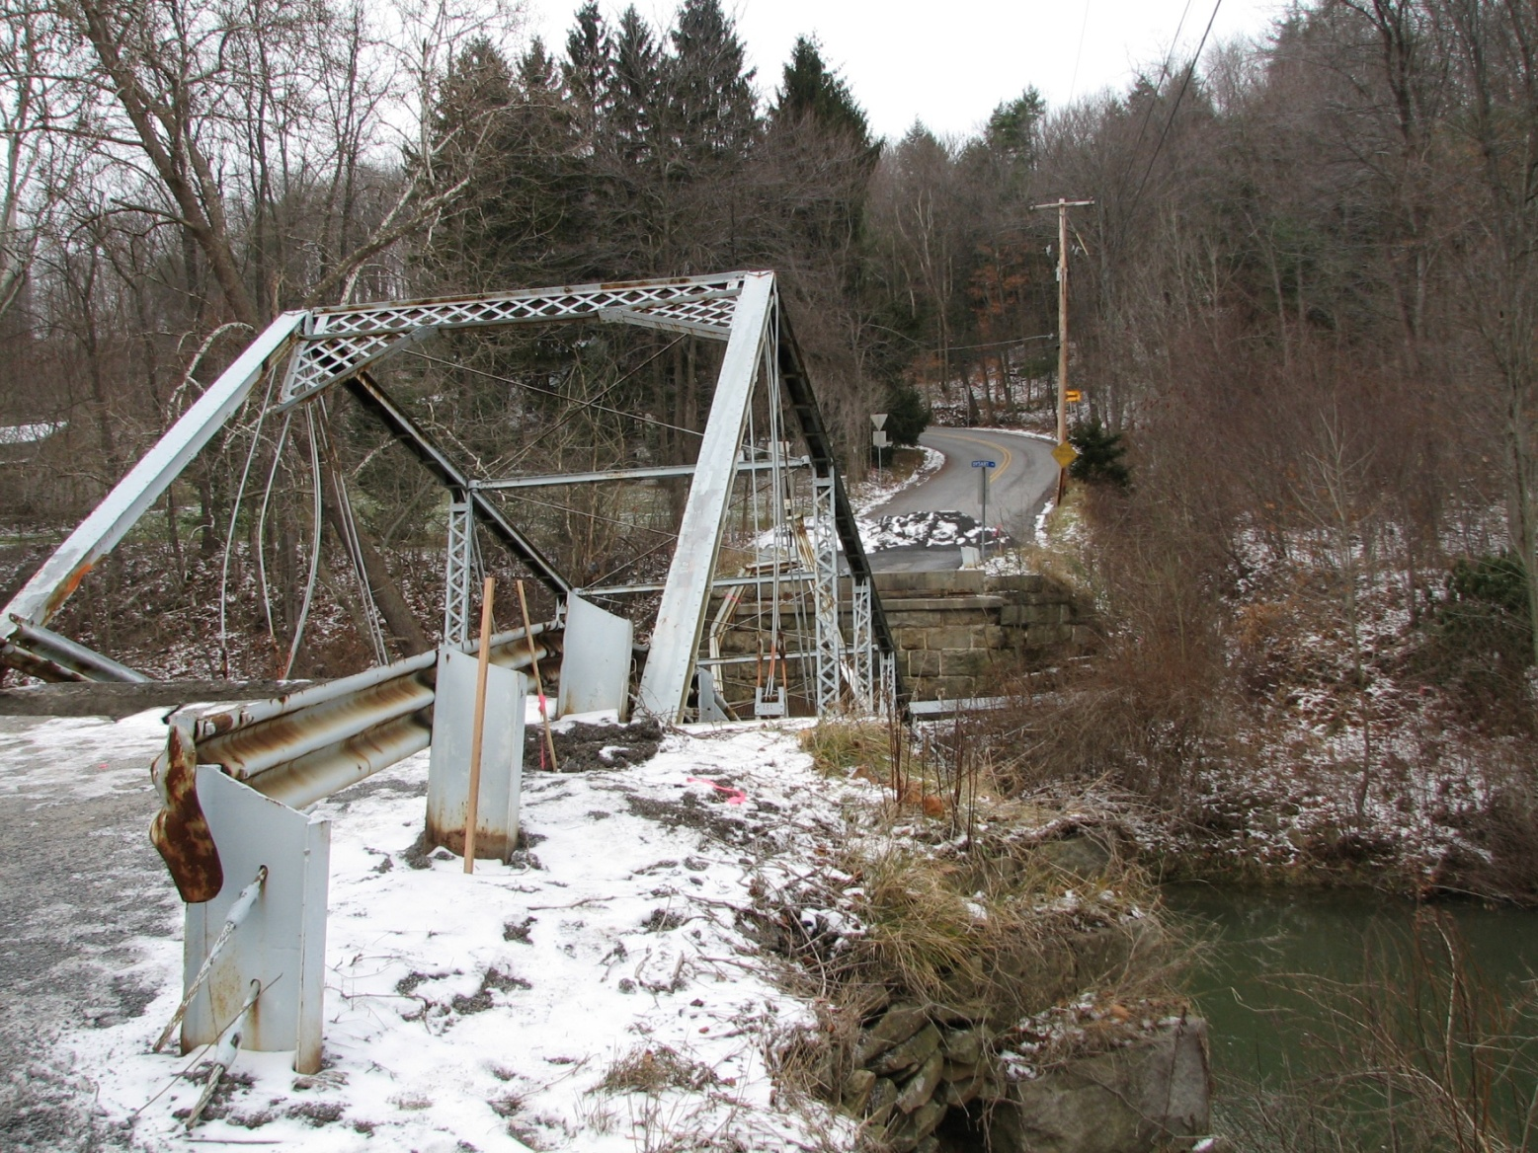
Plowing: Bridges
Notes:
Remember, bridge surfaces freeze faster than normal roadway surfaces.
So be aware of potential icy conditions, particularly in the fall and early winter.
You also need to watch for expansion joints keeping the plow angled so as not to fall into the joint, causing a potentially serious accident.

