Slide 1
Fundamentals: Materials
Materials Policies:
Anti Skid
Salt & Other Chemicals
Deicing, Prewetting, Anti-icing
Storage Facilities
Notes:
To sum up:
Good storage can be summed up in a few major points.
Good storage means sufficient capacity, inside a building, if possible.
If the salt is stored outside, it needs to be properly shaped in a windrow and covered to protect it from the elements.
Salt should be stored on an impermeable pad with proper drainage away from the storage area.
We already mentioned containment facilities to catch any storm runoff or other possible leaching from the salt storage area.
And good housekeeping practices cannot be over-emphasized. A well kept facility is an efficient and safe facility.

Slide 2
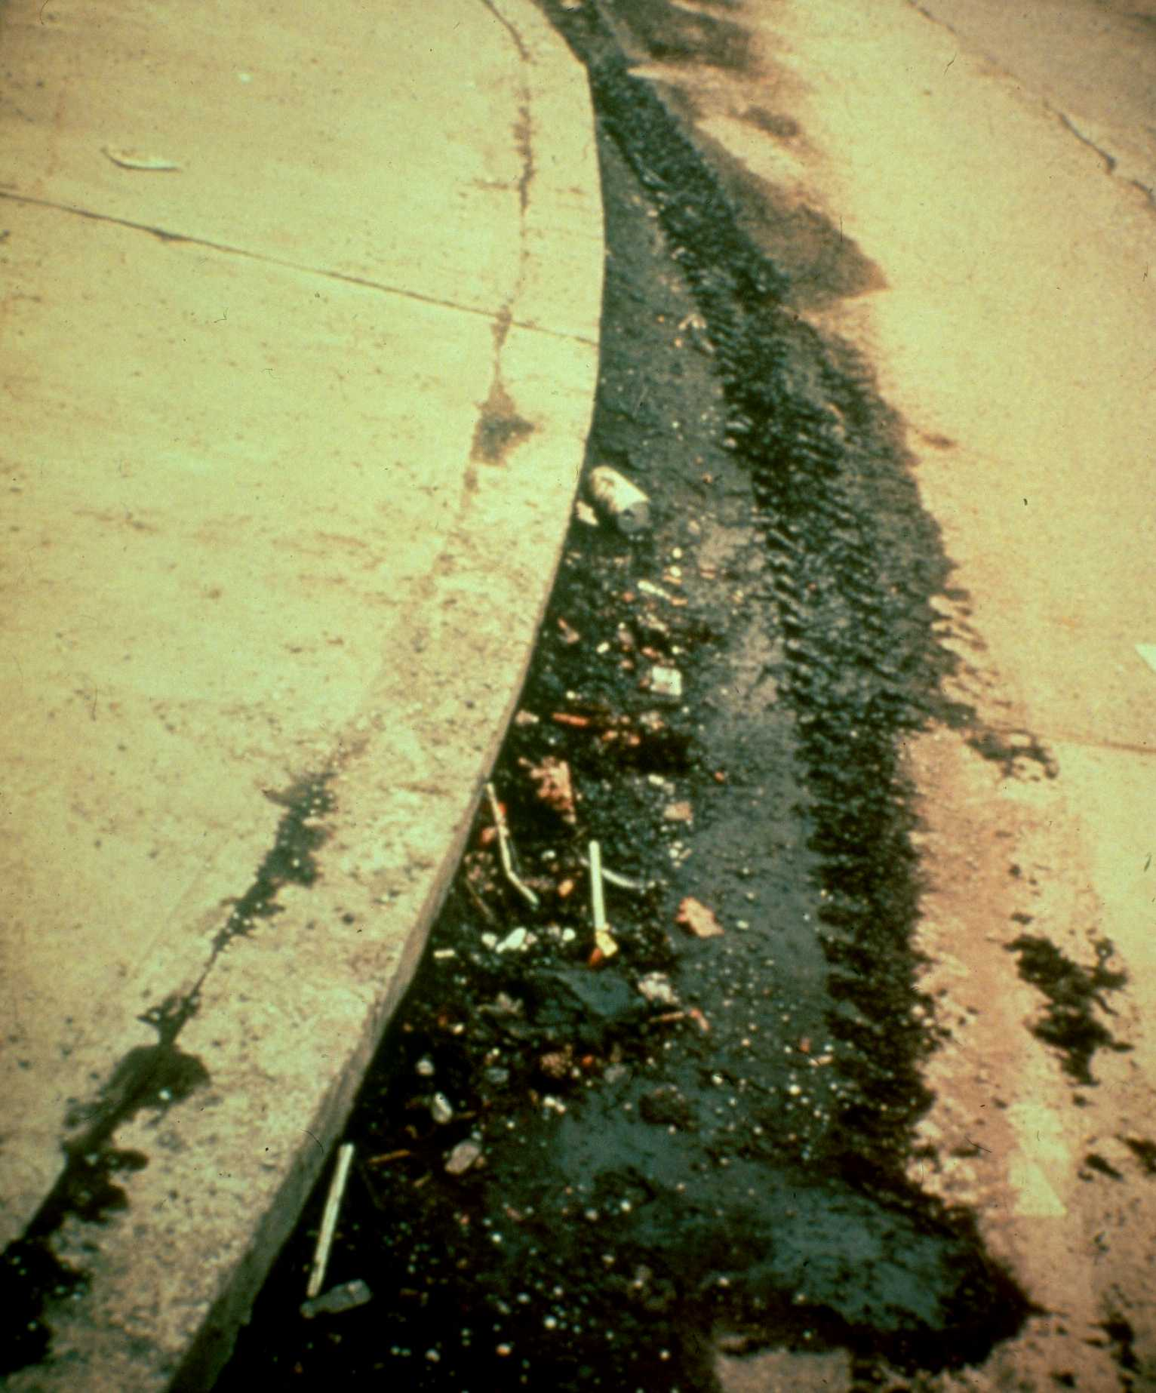
Anti-skid
AS-1 and AS-2.
Stockpile early to avoid freezing
Control spreader width to avoid excess whip off
Mix ratios affect melting/skid resistance effect
Consider spring clean up potential
Notes:
What are the advantages?
As we stated, abrasives are readily available and relatively inexpensive. The inexpensive factor applies to the initial material costs. There are other costs you need to consider, such as cleanup, which is associated with the disadvantages of abrasives.
They are also relatively easy to apply.
A major advantage is the nearly instant skid resistance provided by abrasives.
Abrasives mixed with salt provides not only the immediate skid resistance but also the melting of the ice and snow.
Abrasives can be prewetted with salt or other chemicals which adds melting action to the material and helps hold the abrasives in place.
However, that brings to attention a major disadvantage of using just abrasives…..

Slide 3
Anti-skid
Chemicals applied to:
prevent bonding of ice and snow to road surface
prevent ice or frost from forming
prevent buildup of snowpack
melt ice that has formed
Notes:
Now let’s turn our attention to chemicals.
Chemicals are used on the roads for various reasons, all related to safer roads
We need to prevent bonding of ice and snow to the road. If we can do this effectively, less chemical will be used and more timely melting action will take place.
We use chemicals to prevent ice from forming or to melt ice that has already formed and to prevent buildup of snowpack.
We also use chemicals to reach bare surface conditions after plowing and to treat spot areas of refreezing

Slide 4
Chemicals: How do they work?
Depress the freezing point of water, turning ice or snow into liquid or slush
Solid salts dissolve to form brine solution
Notes:
Generally, all deicers work in the same way. They depress the freezing point of water and turn snow and ice into a liquid or a semi-liquid slush. Solid chemical salts bore through ice and snow, dissolving to form a strong brine solution which spreads under the ice or hard-packed snow, undercutting and breaking the bond to the road surface. Once the bond is broken, the ice and snow can be plowed off or removed by other means. By applying material prior to the storm, we can prevent the bond to the road surface and melt the snow and ice as it comes in contact with the brine.
Agricultural byproducts work much the same way but do not form a brine. They are soluble in water and the resulting solution acts by depressing the freezing point of snow and ice. As stated before, these products are usually used in combination with other materials.
Although all these materials work in the same way, they vary widely in performance. By performance, we have to consider several factors – effective temperature range, speed, amount of material required, and duration of melting action.

Slide 5
Chemical Terms
Concentration
% by weight of chemical in solution
Eutectic Temperature
Lowest Temp solution will melt ice
Endothermic
Requires heat when going into solution
Exothermic
Gives off heat when going into solution
Hygroscopic
Draws water from the air
Notes:
To talk about performance, we should first discuss some chemical terminology.
Concentration
Eutectic Temperature
Endothermic
Exothermic
Hygroscopic

Slide 6
Dilution of Solution
Explains why one application rate will not fit all winter events
Application effectiveness will depend on:
Road surface temperature
Application rate
Concentration
Moisture
Notes:
As you can see, we really need to understand this ‘dilution of solution’.
Dilution of solution explains why one application rate will not fit all winter events.
Temperature, moisture, intensity of each event (amount of snow, duration, rate of snowfall) can vary considerably and therefore vary the effectiveness of your chemical application.

Slide 7
Materials: Salt 101
Salt in it’s solid form need’s to turn into a solution/brine before the melting process can occur
When you apply a deicer and before it can begin the process of melting, it must absorb heat from it’s surroundings, air or pavement this process is called endothermic
So how does that relate to rock salt on the
road?
Notes:
7

Slide 8
Salt/Sodium Chloride
When you apply rock salt the heat required for the melting action must come from somewhere, the air, brine solution (pre-wetting) , the roadway or the subsurface
In October of 2007, a strike-off letter was sent out to the Districts is to make all Department trucks pre-wet capable by November 2010. Counties are also to establish pre-wet storage tanks at all stockpiles (tank farms) before 2010

Slide 9
Sodium Chloride
Specifications
Eutectic Temperature (freeze point of a chemical): -6 Degrees
Effective Temperature: 15 Degrees
Hygroscopic: A chemical is said to be hygroscopic when it has a tendency to attract moisture; however, with rock salt, the humidity has to be much higher before it can begin absorbing moisture from the air. The relative humidity has to exceed 75% before salt will begin to attract moisture.

Slide 10
Salt
Effectiveness drops with temperature
Notes:
Salt also has some disadvantages:
One of the disadvantages is that salt starts to lose its effectiveness when temperatures drop below 20 degrees F.
The lower the temperature, the more salt is needed and a longer time for it to take effect.
Salt is also corrosive as are all the chlorides. Proper vehicle washing is essential when using salt to minimize this corrosiveness.
And then there are the environmental concerns, impacts on water quality, soil fertility and plants. Most all the environmental problems can be contributed to two causes - excessive use of salt on the roadway and improper storage.
If salt is used effectively and stored properly, you should not have environmental problems.
We’ll talk about salt storage and containment facilities later.

Slide 11
Other Natural Salts
Calcium Chloride
Exothermic: gives off heat
Hygroscopic: attracts moisture
Eutectic Temp: -60ºF
30-33% concentration in solution
Magnesium Chloride
Exothermic: gives off heat
Hygroscopic: attracts moisture
Eutectic Temp: -28ºF
22-26% concentration in solution
Notes:
Both of these materials are exothermic, giving off heat when they go from solid into solution. Both are hygroscopic, attracting moisture from the air or the surroundings, improving their effectiveness in dry cold conditions.
Both have low eutectic temperatures meaning we get more melting action at lower temperatures. This factor makes them advantageous as prewetting materials for salt, particularly when the temperatures drop below 20ºF
Calcium chloride is usually sold in a 30-33% solution and magnesium chloride at a 23-26% solution. These concentrations relate back to the respective eutectic temperatures of these materials.

Slide 12
Product Evaluation
ICE BITE 55
All natural, agricultural product
Anti-icing @ 20 gallons/lane mile
Mixed with salt brine lowers freezing point to -15F
Prewetting agent
Treat mix piles
Less corrosive than salt brine
Notes:
Both of these materials are exothermic, giving off heat when they go from solid into solution. Both are hygroscopic, attracting moisture from the air or the surroundings, improving their effectiveness in dry cold conditions.
Both have low eutectic temperatures meaning we get more melting action at lower temperatures. This factor makes them advantageous as prewetting materials for salt, particularly when the temperatures drop below 20ºF
Calcium chloride is usually sold in a 30-33% solution and magnesium chloride at a 23-26% solution. These concentrations relate back to the respective eutectic temperatures of these materials.

Slide 13
Product Evaluation
CHEMSHIELD
Pilot this winter
Natural sticking agent for anti-icing
with salt brine
Notes:
13
Chemshield - The data and analysis given in in this report is the outcome of the research performed by Professor Zoltan Rado at
the Thomas D. Larson Pennsylvania Transportation Institute at the PennState to test and
evaluate the CHEMSHIELD additive developed by Miller Chemical and Fertilizer Corp. The
objective of the testing performed was to deliver a comprehensive performance analysis of the
CHEMSHIELD additive’s capability to improve anti-icing chemicals’ ability to bond to road
pavement surfaces and resist wear by traffic and weather conditions. The testing was
performed with a single anti-icing agent, magnesium chloride at 25-26 percent solution provided
by Miller Chemical and Fertilizer Corp.
The testing compared the performance of the CHEMSHIELD additive to improve bonding to
pavement surface of the anti-icing material without the additive by evaluating the surface
coverage of the applied materials as a function of time, traffic and weather conditions. The
following combinations of conditions were tested: application of materials on dry and damp
surfaces; application of materials on surfaces with and without traffic; evaluation of coverage
under dry conditions with traffic, simulated and natural rain with traffic, heavy and light winter
precipitation with traffic.
The results of the research show that in all conditions tested, the additive delivered
significant improvements over the untreated chemical in terms of resistance to wear on the
pavement surface. It also was observed that the performance improvement increased with
weather ad precipitation severity. Thus, the performance improvement was magnified by
precipitation rate and type. While the performance increase measured close to 500 percent
under light rain and dry conditions, the performance increase measured close to 1,000 percent
in terms of surface area coverage and resistance to wear under heavy rain, snow, and heavy
snow conditions.
2011 Dump Truck – Got input from our customers – equipment operators and diesel mechanics and made a number of design changes. Built two prototypes – Western Star with J & J Bodies - which incorporated updates plus some additional items we want to test over the next three years. Ordered 54 (have 752) Single axle, 115 (have 1544) Tandem axle and 2 (have 55) Tri-axle dump trucks.
Go though PowerPoint.
Plows – Tow plow – piloted one last winter –purchasing at least three more for this winter.
Purchased 3 triple blade plows to test this winter. Hoping that triple blade plow will reduce material costs and overtime.
Developed Innovation Bulletins to transfer technology information to the field.

Slide 14
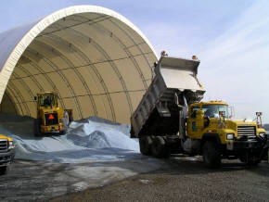
Stocking Areas and Facilities
Major points of salt storage
Sufficient capacity to hold on hand goals
Impermeable pads
Proper drainage with containment as required
Good housekeeping
Notes:
To sum up:
Good storage can be summed up in a few major points.
Good storage means sufficient capacity, inside a building, if possible.
If the salt is stored outside, it needs to be properly shaped in a windrow and covered to protect it from the elements.
Salt should be stored on an impermeable pad with proper drainage away from the storage area.
We already mentioned containment facilities to catch any storm runoff or other possible leaching from the salt storage area.
And good housekeeping practices cannot be over-emphasized. A well kept facility is an efficient and safe facility.

Slide 15
Stocking Areas and Facilities
2010 -2011 Storage Requirements
Initial fills by November 1
75% of working capacity or 5 year average, which ever is lower from November 1 to January 15
60% on hand February 1
30% on hand March 1
10% on hand April 1
Notes:
To sum up:
Good storage can be summed up in a few major points.
Good storage means sufficient capacity, inside a building, if possible.
If the salt is stored outside, it needs to be properly shaped in a windrow and covered to protect it from the elements.
Salt should be stored on an impermeable pad with proper drainage away from the storage area.
We already mentioned containment facilities to catch any storm runoff or other possible leaching from the salt storage area.
And good housekeeping practices cannot be over-emphasized. A well kept facility is an efficient and safe facility.

Slide 16
Stocking Areas and Facilities
SEMP ISO 14001
Salt or treated winter materials should be stored out of the weather under roof to minimize environmental impacts
Inspect, Repair, and Maintain storage facilities year round

Slide 17
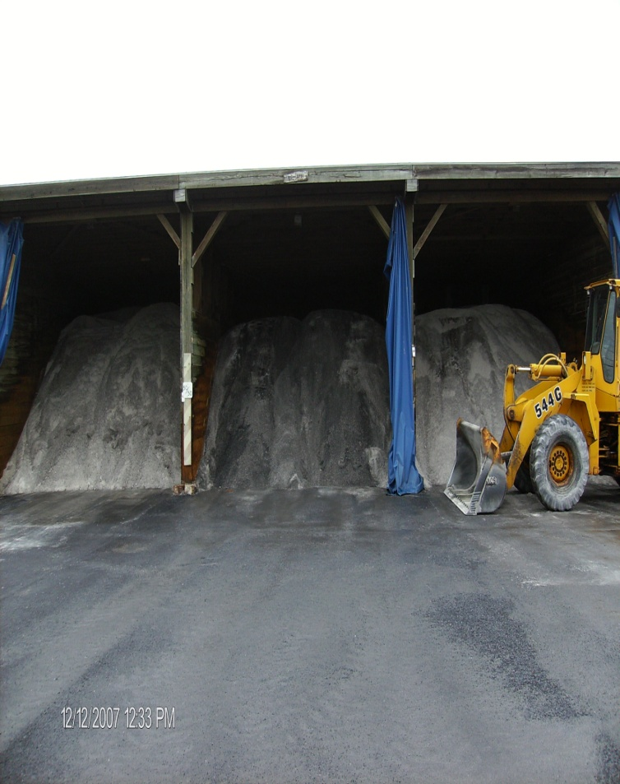
Material Storage
Anti-Skid piles should be well formed at all times with no overhangs or irregular shapes
The decision to treat anti-skid material must be made by the County Maintenance Manager
Treated anti-skid must be protected to control run-off and leaching
All mixed material shall be treated similar to salt

Slide 18
Material Storage
Salt Deliveries
Start initial fill in the fall
Complete initial fill by November 1st
Care should be taken to reduce adverse environmental impact during deliveries
Material storage buildings should:
Keep salt dry and in a free flowing condition
Provide completely covered storage
Reduce environmental concerns

Slide 19
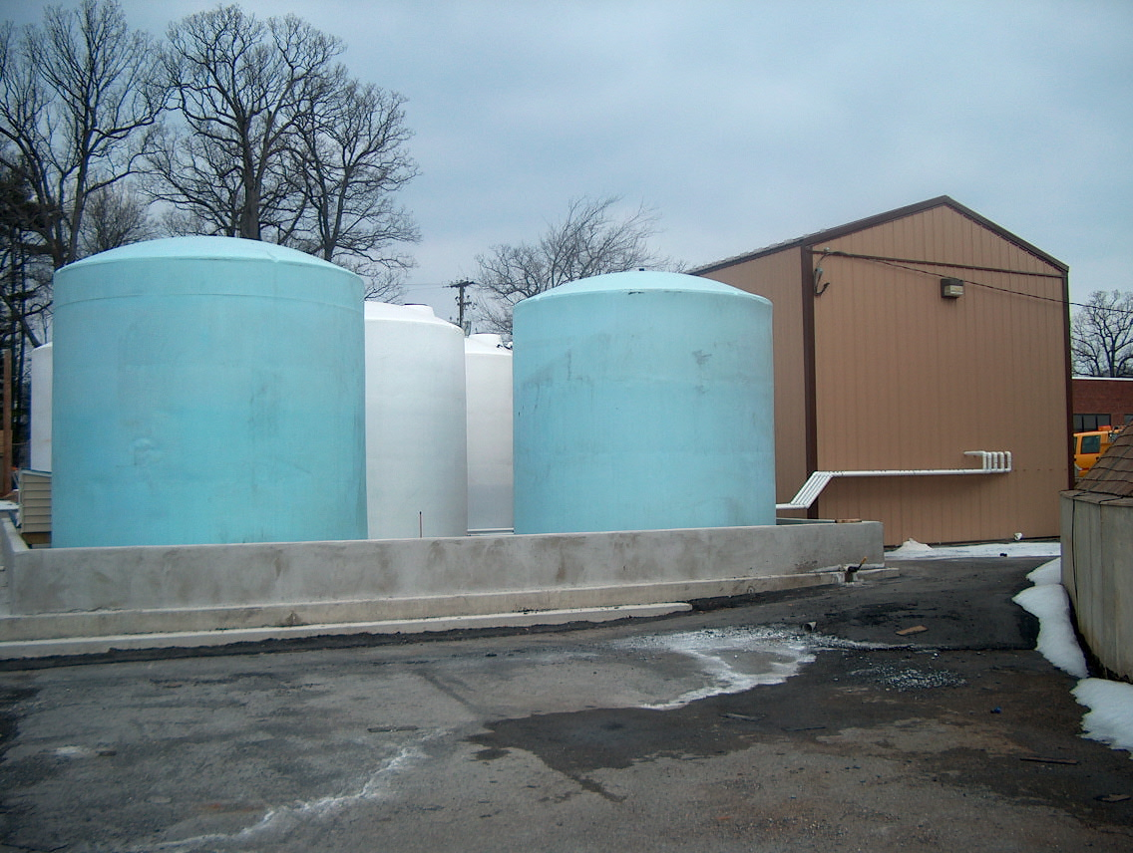
Material Storage
Storage of Bag Calcium Chloride
Stored on pallets
Stored in a dry well ventilated building
Used in the same order it is received –“First in, first out”
Liquid Deicing Materials
Corrosion resistant container
Periodic agitation may be required
Storage vessel should be thoroughly flushed prior to changing type of material being stored

Slide 20
Sampling of Material
Anti-Skid or Salt that does not appear to meet the contract specifications at the time of delivery should be visually inspected for contamination, moisture, and gradation
All winter materials shall be sampled and tested in accordance with the contract specifications
A representative sample of material that appears to not meet specifications should be forwarded to the BOCM Laboratory for testing

