Slide 1
Henderson Spinner/
Zero Velocity

Slide 2
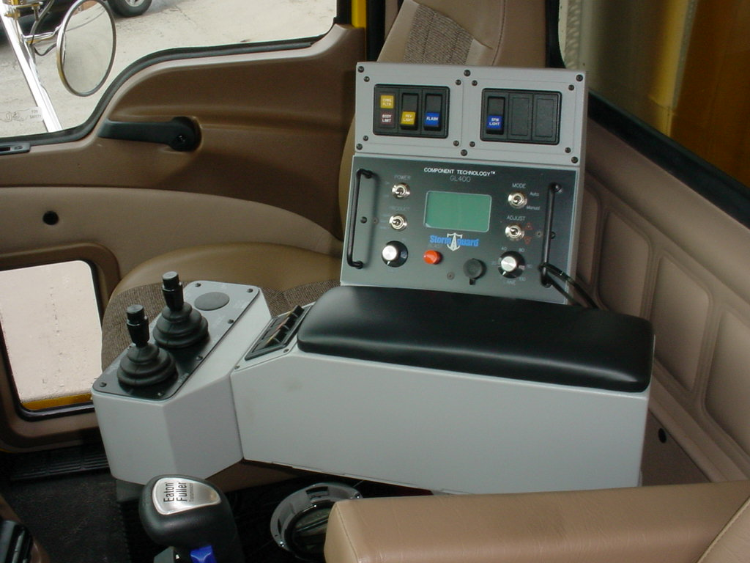
GL – 400 Control Unit

Slide 3
GL – 400 Control Unit
GL-400 & Freedom Controller
Electronic spreader controller installed in Department dump trucks since 1996
Ground speed oriented system are designed to automatically monitor and control the application rate of materials based on the ground speed of the truck
Beginning in 2008, all new trucks are equipped with Freedom controller’s that replaced the earlier version GL-400

Slide 4
Control Unit: Freedom

Slide 5
Freedom Controller Display

