Slide 1
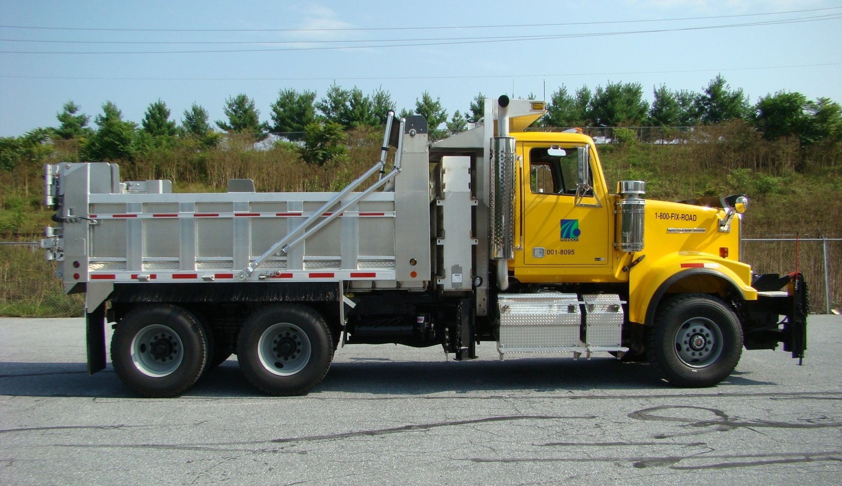
2011 Experimental
Tandem Axle Dump Trucks

Slide 2
2011 Experimental
Tandem Axle Dump Trucks
Bid by the Department of General Services using PennDOT detailed specifications
4 bids received, Western Star second lowest bid
Initial low bid was International, but bid was rejected due to failure to meet the specification. Truck was not equipped with proper engine brake. Engine brake would not be in production until July, 2010.
2 units purchased on 09/10 Capital Equipment Budget
Purchased by the Equipment Division - $153,990.00 each
Purchased prior to dump truck order to test new technologies and build practices

Slide 3
2011 Experimental
Tandem Axle Dump Trucks
Being tracked by PennDOT’s Experimental Projects
Project will be tracked during the 10/11 winter season
Required field generated reports to provide feedback of equipment updates/changes
As part of the process, numerous components have been donated by vendors for approval
Donated components – GVM 240 gallon pre-wet tank, Gledhill wing plow and hitch, Rollrite tarp, Cirrus spreader control system, Whelen lighting and Fabick bed liners

Slide 4
Build Info
Distribution – Erie and Cambria Counties
Chassis Manufacturer – Western Star
Body Manufacturer – J&J Body
Engine Manufacturer – Detroit Diesel
DD13, 13 liter engine, 435hp, 1550 ft. lb. torque, SCR technology (DEF-diesel exhaust fluid)
Transmission Manufacturer
Allison Automatic 4500 RDS
Complete Build Timeframe – 200 days
742 SA Dump Trucks – Purchasing 54
1544 TA Dump Trucks – Purchasing 115
55 Tri-Axle Dump Trucks – Purchasing 2

Slide 5
New Technology/ Equipment Updates (DESIGN IMPLEMENTED ON STANDARD BUILD)
Fixed Cab Shield
Complete ½ cab coverage
Provides protection for the pre-wet tank
Improved warning light location, lights incorporated into front and side face
Improved mounting location of AVL antenna
Includes tank shield and bed seal to protect against material spillage

Slide 6
New Technology/ Equipment Updates (DESIGN IMPLEMENTED ON STANDARD BUILD)
Pre-wet Tank
Mounted below the fixed cab shield
Increased from 120 to 240 gallons
Pump, flow meter and control box mounted to tank enclosure
Ground fill system
Can use different material in each tank
Discharge line routed to rear module for easy field integration
Single axle will remain 120 gallons, tri & tandem – 240 gallons

Slide 7
New Technology/ Equipment Updates (DESIGN IMPLEMENTED ON STANDARD BUILD)
Combo Tank
Due to limited frame rail space and emission/exhaust components being mounted under right-hand step, a combo tank was developed
Unit incorporates tank and valve into one package
Hydraulic and electrical components remain the same
Stainless steel for added strength and durability

Slide 8
New Technology/ Equipment Updates (DESIGN IMPLEMENTED ON STANDARD BUILD)
Whelen Light Package
LED design
Improved 360 degree visibility
Flush mount
Total of 8 warning lights
Completely sealed harness system, from cab to light source, but available at truck and trailer retailers
Sealed weather tight connections at light source
5 year warranty

Slide 9
New Technology/ Equipment Updates (DESIGN IMPLEMENTED ON STANDARD BUILD)
Lights in Side Pocket
Front Face of Cab Shield

Slide 10
New Technology/ Equipment Updates (DESIGN IMPLEMENTED ON STANDARD BUILD)
New Inverted “V” Pattern
Red/Yellow
Improved visibility
Complete illumination
Complete tailgate coverage
Light bar and 3 way “barn door” tailgate not part of standard build. Lights in mud flap housing were relocated there to allow for the mounting of the “barn door” hinges
Standard build will have all lights in the vertical corner member

Slide 11
New Technology/ Equipment Updates (DESIGN IMPLEMENTED ON STANDARD BUILD)
Barn Door Tailgate

Slide 12
New Technology/ Equipment Updates (DESIGN IMPLEMENTED ON STANDARD BUILD)
AVL/800HHz Provisions
Combo antenna mounted to left-hand side of fixed cab shield
Antenna cable routed to control system base
Radio mounting bracket included with each unit
A power/ground supply station has been added to the base of the control system to allow for easy radio installation for all future built units

Slide 13
New Technology/ Equipment Updates (DESIGN IMPLEMENTED ON STANDARD BUILD)
25-Ton Pintle
Upgraded rear module and pintle assembly
25-ton capability
Anti-rollover
Recessed and raised for paver, chipper, spreader, etc. operation
Pintle assembly can be removed either by bolts or cotter pin/nut to allow for greater flexibility
Weld-on D-rings

Slide 14
New Technology/ Equipment Updates (DESIGN IMPLEMENTED ON STANDARD BUILD)
Pre-wet Distribution Line
Uniformed across all units
Completely plumbed to rear of truck
Requires less up-fit time for field implementation

Slide 15
New Technology/ Equipment Updates (DESIGN IMPLEMENTED ON STANDARD BUILD)
Cirrus Control System
PennDOT is evaluating their product line
1-joystick for all hydraulic functions
Same functions and controls as Departments standard control system
Road and air temperature incorporated into display

Slide 16
New Technology/ Equipment Updates (DESIGN IMPLEMENTED ON STANDARD BUILD)
Rear Light Module
Completely sealed/enclosed aluminum light module
Module now incorporates trailer 7-way trailer plug and license plate lamp
Powered by factory chassis electrical harness This allows for easy diagnostics and schematic reference

Slide 17
New Technology/ Equipment Updates (DESIGN IMPLEMENTED ON STANDARD BUILD)
Additional Components Testes
On Experimental Units
Components and practices
Added to Standard Dump Trucks
Fabick Bed Liners
Wing laser lights
Flink dual flight spreader
Multi-blade plow
Body uniformity across all types in regards to add-on components and structure
Tailgate latches and cylinder
Tailgate hinges
Grease system

Slide 18
2011 Experimental Tandem Axle Dump Trucks

Slide 19
2011 Experimental Tandem Axle Dump Trucks

Slide 20
2011 Experimental Tandem Axle Dump Trucks

Slide 21
2011 Experimental Tandem Axle Dump Trucks
$153,990.00

Slide 22
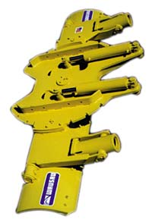
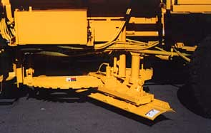
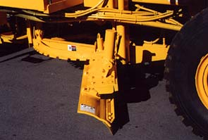
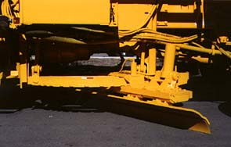
Underbody Plows
Notes:
NEW TECHNOLOGY?
Underbody plows are being use by many local governments.
They are used for plowing crowded urban streets where parked cars are a problem.
They are also use on highways for high speed plowing.
However, they are limited by the height of the snow accumulation that has to pass under the front of the truck.
They can be used effectively in clearing compacted snow and ice. For this type of operation, a variable down pressure is required to maximize effectiveness.
They are also used in summer in grading gravel roads and shoulders.

