Slide 1
Dry Run
Prepare Equipment
Familiarize Operators
Identify Hazards
Review Techniques
Contingency Plans and Maps should be discussed
Temporary Operators should be included in the process
All posted bridges on the route should be identified and permitted

Slide 2
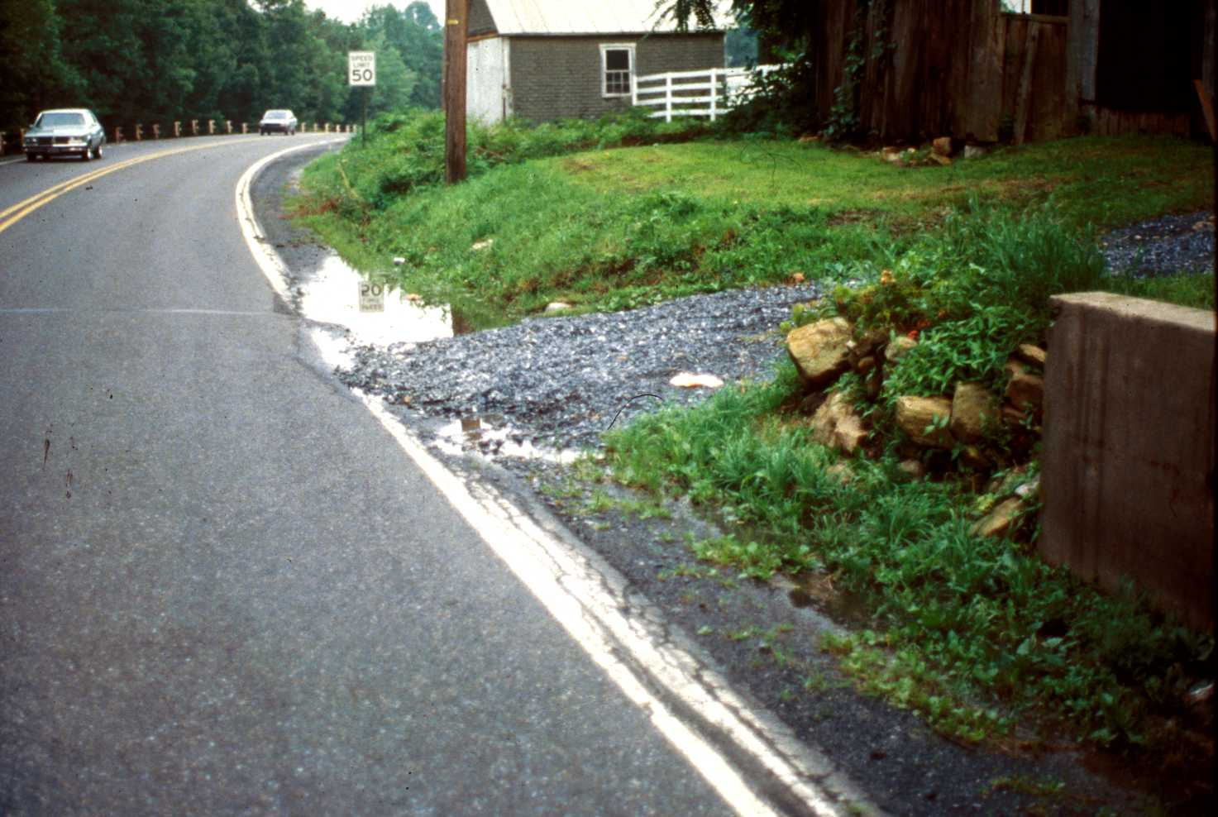
Conducting Dry Runs
Mark obstacles or make a note of them
Manholes
Bridges
Utility Plates
Mailboxes
Railroad Xings
Poles
Fire Hydrants
Guiderail
Overhead Wires / Guy Wires
Drainage Facilities
Notes:
Late Fall is the time to mark everything that can be marked that may be obliterated by snow.
Any obstacle that can be a safety hazard or can damage a plow should either be marked by delineator or mentally noted.
A list, with a map, can be developed for all obstacles on each specific route for the operator. This can be particularly important for stand-in operators new to the route.
Ask for past experiences involving obstacles and possible solutions to enhancing operator safety.

Slide 3
Safety
Employee Safety Program:
Crews
Personal protective equipment
Materials handling
Vehicles & Equipment
Operations
Policies
Training
Tail-gate Safety Talks
Safety Committee
Notes:
Key Element: Employee Safety Program
Remember, the crews are out there because the roads are unsafe for the traveling public. Thereby, if there was ever a need for a formal employee safety program, it is for winter operations.
A formal safety program means polices and procedures and their enforcement. If enforcement is lacking, safety will suffer which means everyone will suffer.
A designated safety committee or a designated safety person can be a real asset in keeping safety alive. Training is an essential safety item in all aspects of crew safety with personal protective equipment, materials handling, vehicles and equipment and total operations.
Tail-gate safety talks, whether daily or weekly, are always a good follow up to training and a way to keep safety in the minds of the crew.
You can use your Workman’s Compensation Insurance Carrier as a resource for safety training and safety program development.
Employee Safety Training is important for Risk Management!

Slide 4
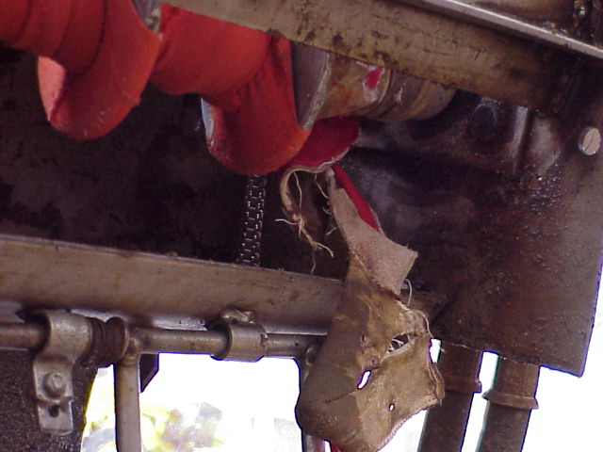
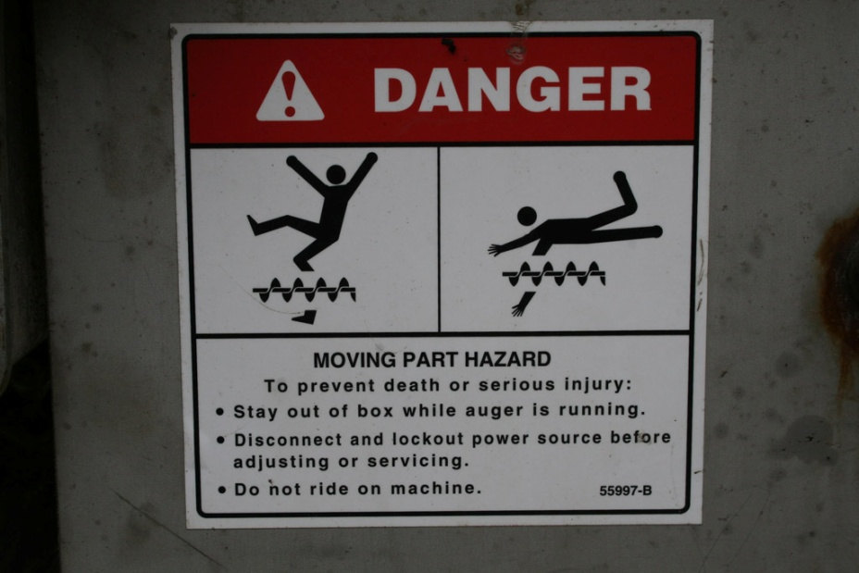
Safety
Safety - Personal
Keep steps clean
3 point contact when climbing
Block plow before changing blades
Disconnect spreader before unclogging
Notes:
Dump bed no higher than top of cab when driving.
Raise plow at railroad crossings (Correct procedure is to raise plow and turn off spreader as you cross the tracks).
Adequately block plow before changing blades. Recommended substantial wood blocking.
Turn off truck motor, release hydraulic pressure, and then still use a tool carefully to unclog the spreader. Don’t get into the habit of sticking your hand into the auger area.

Slide 5
Safety
Safety - Operations
Minimize backing and use circle of safety
Be aware of overhead obstructions
Dump bed no higher than cab top when moving
Allow sufficient stopping distance
Notes:
Dump bed no higher than top of cab when driving.
Raise plow at railroad crossings (Correct procedure is to raise plow and turn off spreader as you cross the tracks).
Adequately block plow before changing blades. Recommended substantial wood blocking.
Turn off truck motor, release hydraulic pressure, and then still use a tool carefully to unclog the spreader. Don’t get into the habit of sticking your hand into the auger area.

