Slide 1
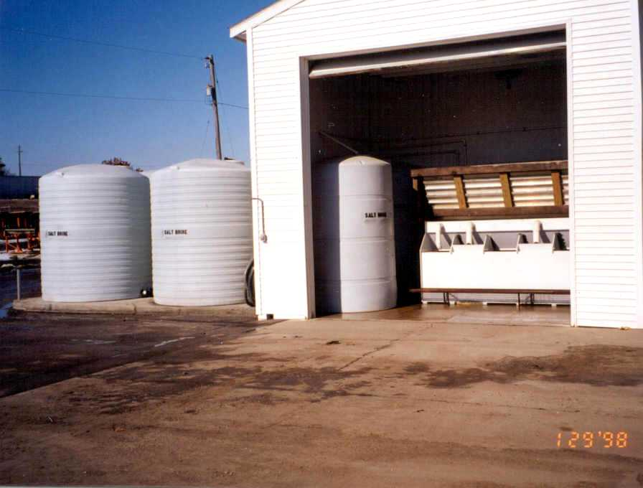
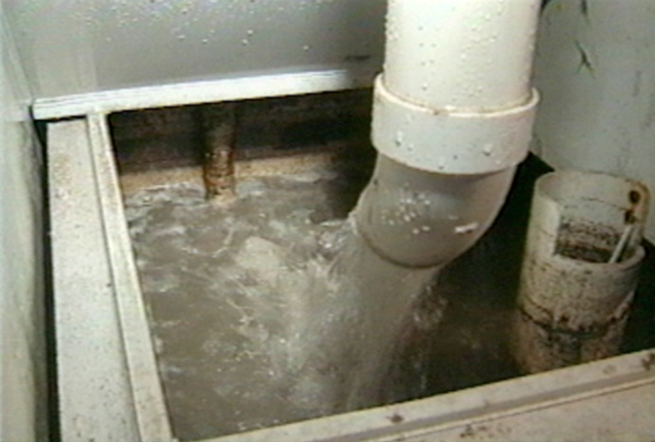
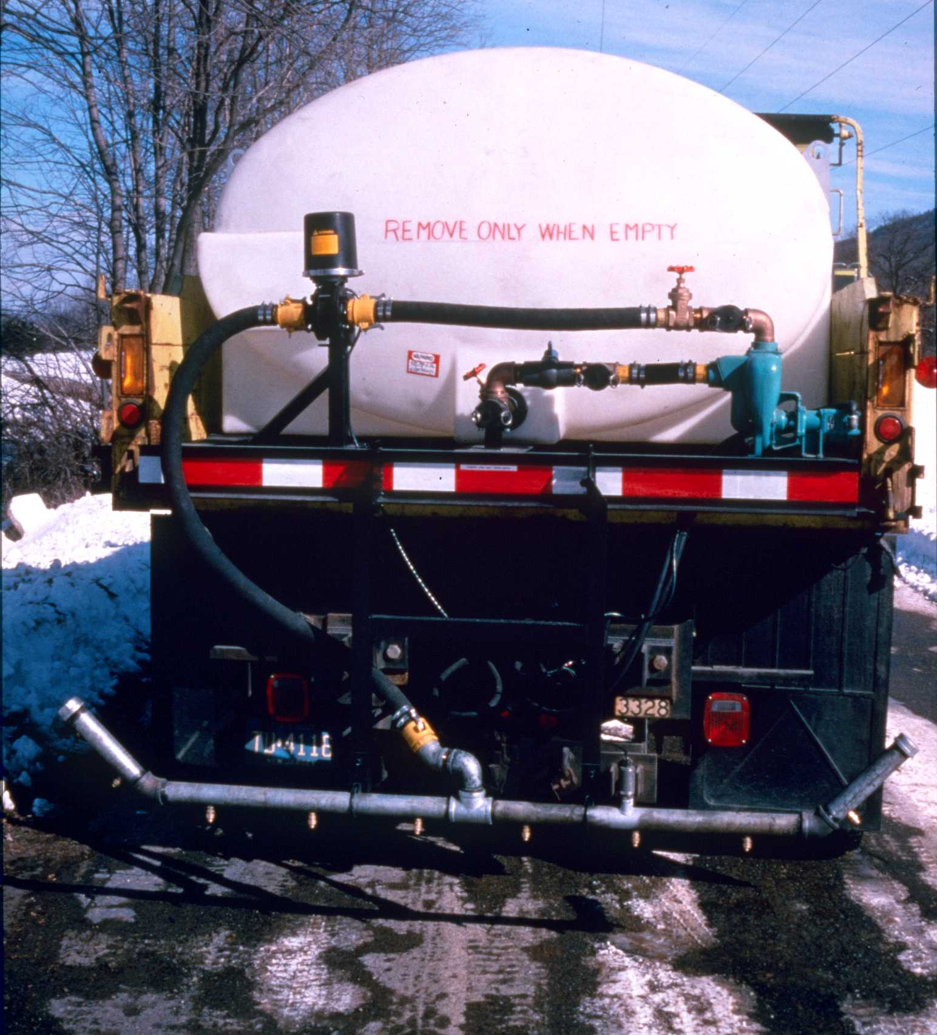
Anti-icing Equipment
Brine production
Liquid Storage
Truck mounted application equipment
Notes:
Anti-icing equipment could again include salt brine production units as shown before for prewetting operations along with storage tanks, or just storage tanks for other anti-icing products such as calcium or magnesium chlorides to be delivered to the site in bulk.
All types of tank trucks or trucks with portable tanks plus spray pumps and bars are the most common equipment being used for anti-icing operations.
Application rates are controlled with accurate ground speed control systems.
Anti-icing operations require a thorough understanding of pavement conditions and the chemicals being used along with accurate weather information.
The Manual of Practice for a n Effective Anti-icing Program, Publication No. FHWA-RD-95-202 describes anti-icing in detail and is available from the Federal Highway Administration.

