Slide 1
Pub 23 Levels of Service
Levels of Service By Priority
1st Priority, Limited access Highways, MFC A&B
2nd Priority, Secondary System, MFC C
3rd Priority, Local Roads, MFC D & E

Slide 2
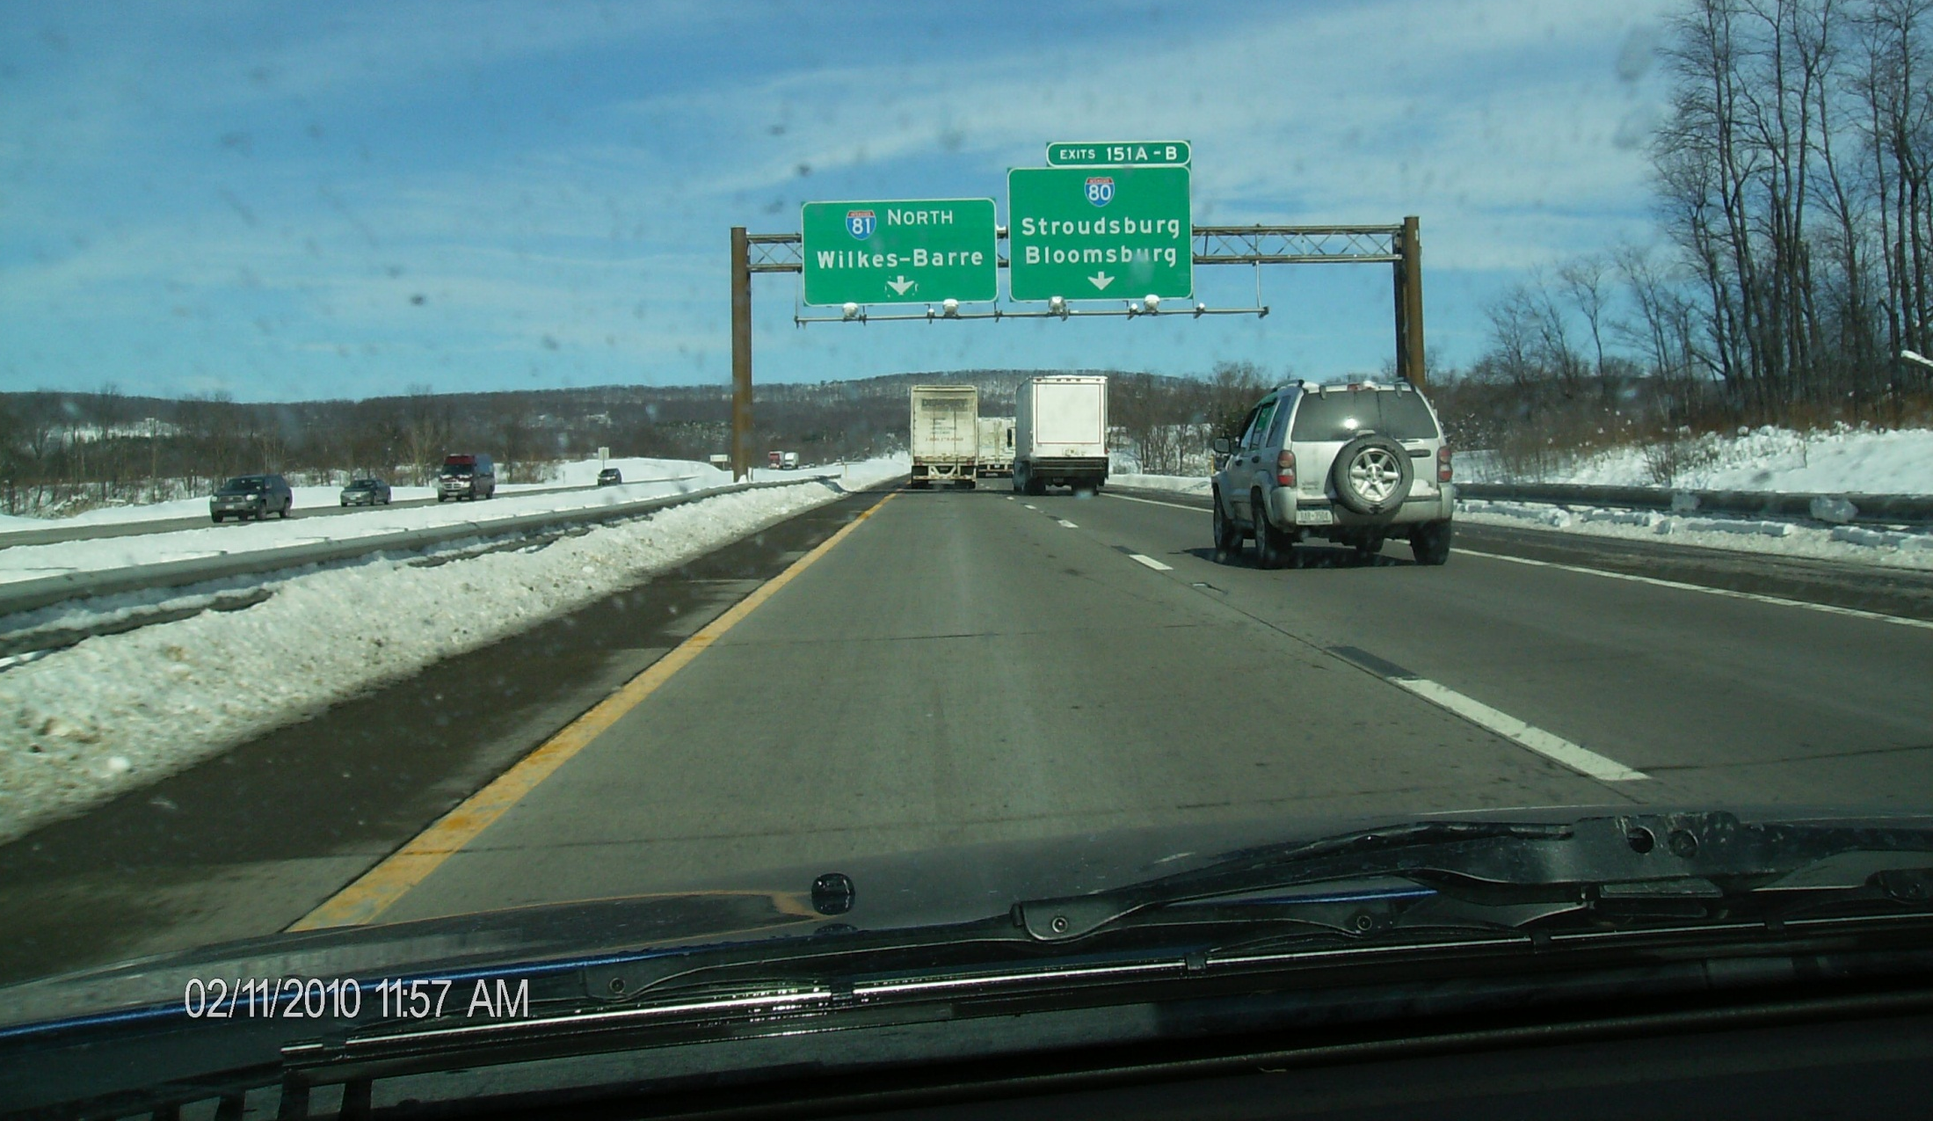
Pub 23 Levels of Service
1st Priority, Limited access Highways, MFC A&B
Maintain two operable lanes in each direction
Planned interval for treatment two hours during a moderate storm
All traffic lanes and shoulders to be cleared as soon as possible after the storm has ended

Slide 3
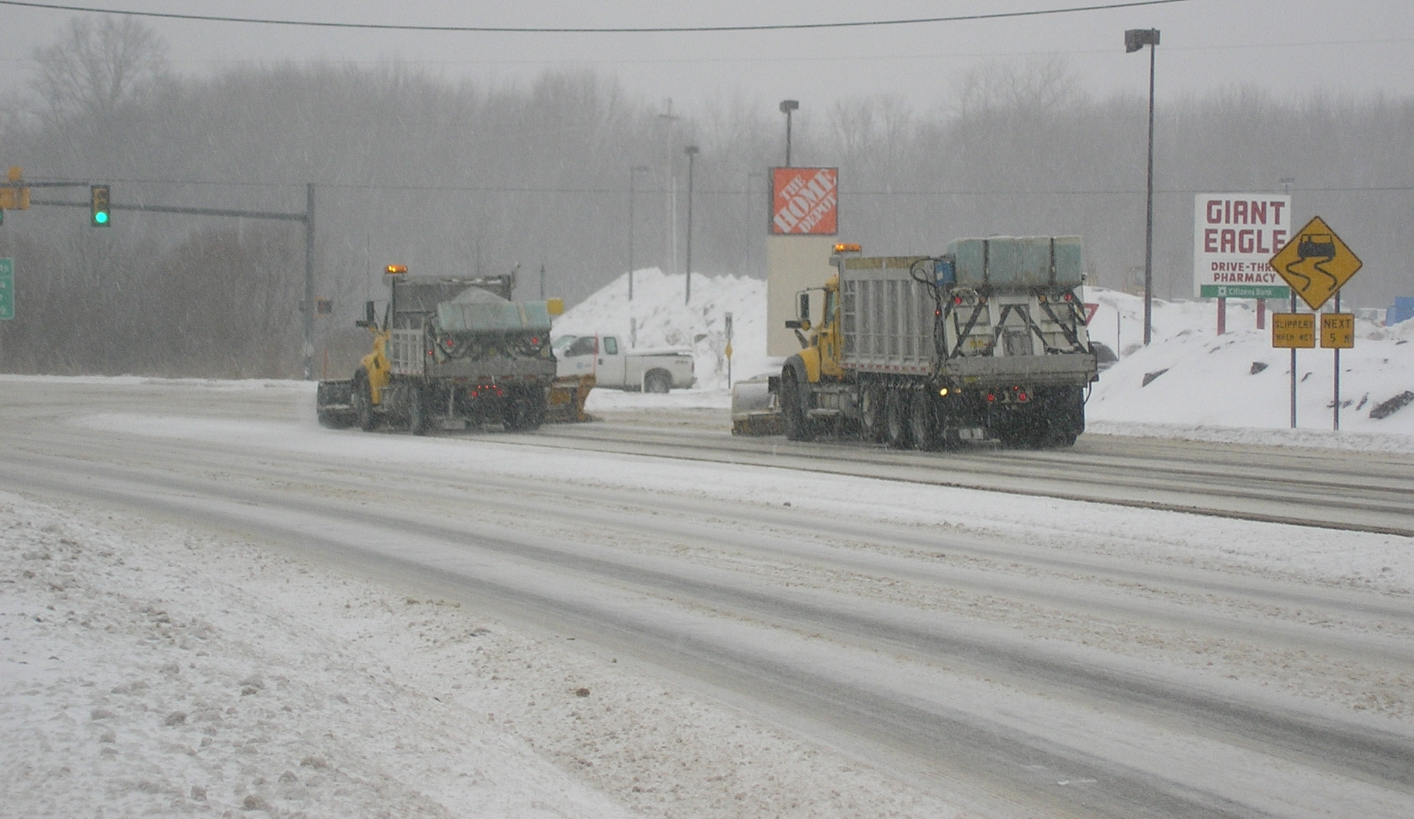
Pub 23 Levels of Service
2nd Priority, Secondary System, MFC C
Maintain driving lanes reasonably clear of ice and snow. During the off peak periods snow accumulation up to 4" may be acceptable.
When conditions warrant, resources may be temporarily diverted to second priority routes from other routes to achieve these goals.

Slide 4
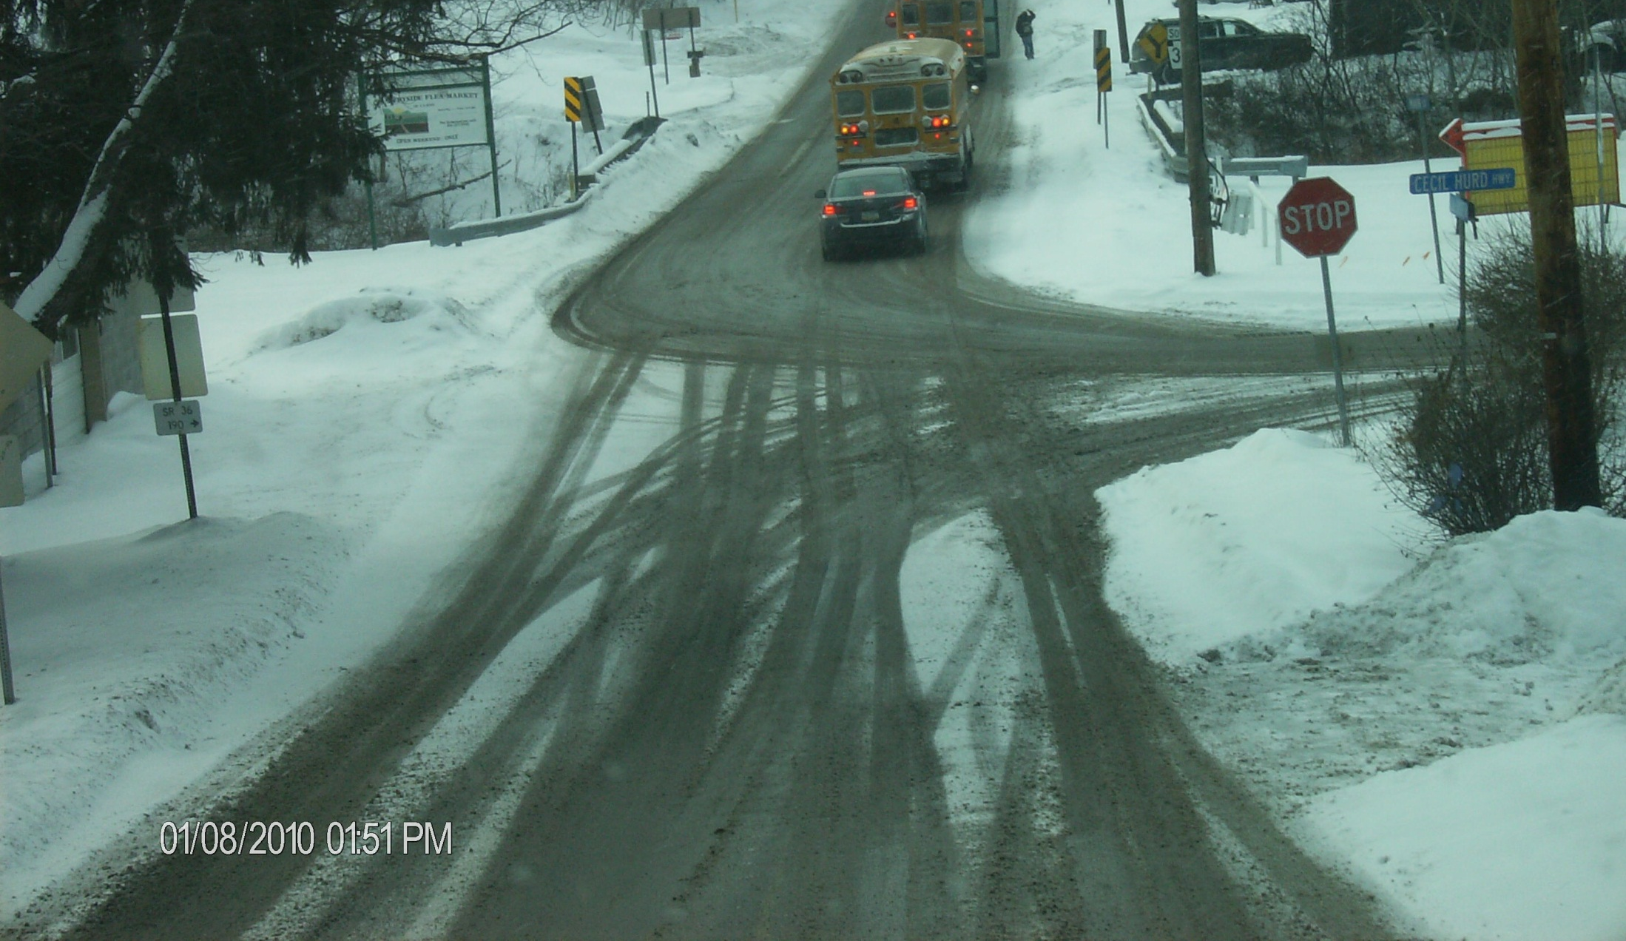
Pub 23 Levels of Service
3rd Priority, Local Roads, MFC D & E
Up to 5" of snow accumulation may be acceptable on third priority routes which may occasionally result in some closures during severe snowstorms and high wind conditions.
Service consists primarily of plowing with material applications normally limited to bridge decks, hills, curves, and intersections as required.
Third priority routes accommodating school buses should be scheduled for additional servicing as required.

