Slide 1
LESSON FOUR
Pre-Trip Inspection
Truck

Slide 2
Overview
Inspections are to be done daily or per shift as required by C.D.L. law
Inspections are performed by the operator
Inspections save money

Slide 3
Operator Selection
Good eyesight
Mobility
Hearing
Overall physical condition

Slide 4
Operator Selection
Mental Alertness
Experience
Awareness

Slide 5
Operator PPE – Proper Safety Apparel
Clothing
Footwear
Head protection
Eye protection
Gloves
Hearing protection
Safety vests

Slide 6
EM – 78 Truck Vehicle Inspection Form

Slide 7
EM-78 Form Truck Vehicle Inspection Form
Created by the Office of Equipment Management as a tool to be used prior to operating any piece of power equipment at ODOT

Slide 8
EM-78 Form Truck Vehicle Inspection Form
Designed to be a checklist for many types of equipment; therefore, only sections that apply to your particular situation need to be completed

Slide 9
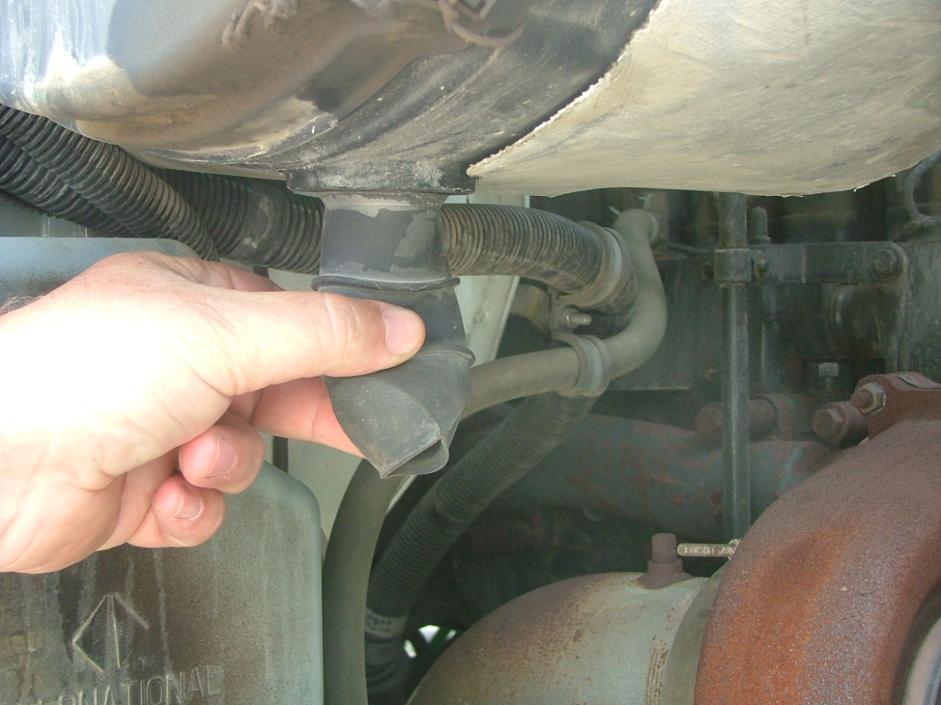
Engine Compartment
Dump truck engine compartment, dirt evacuator

Slide 10
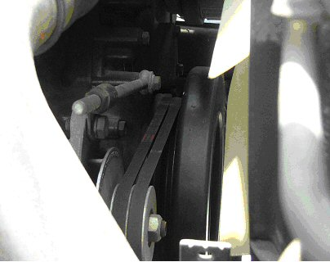
Engine Compartment
Dump truck engine belts

Slide 11
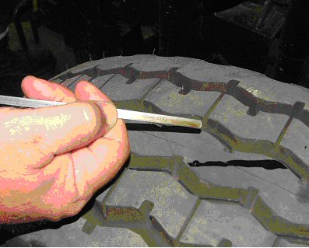
Engine Compartment
Engine oil dip stick

Slide 12
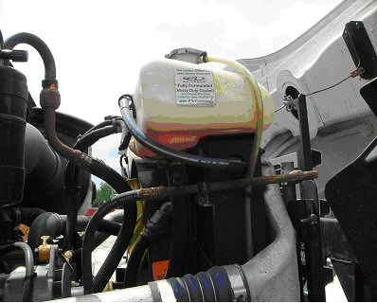
Engine Compartment
Dump truck coolant level fill bottle

Slide 13
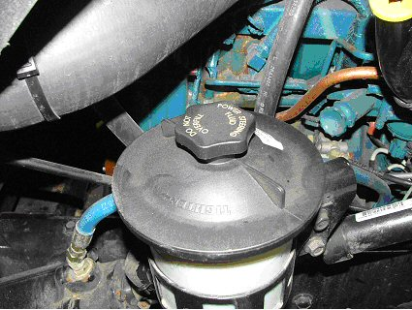
Engine Compartment
Dump truck power steering fluid reservoir

Slide 14
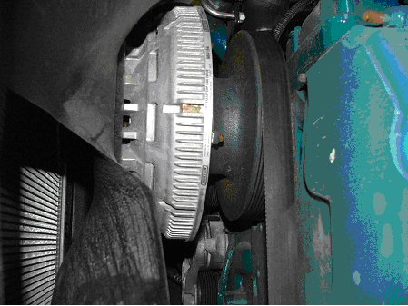
Engine Compartment
Dump truck water pump

Slide 15
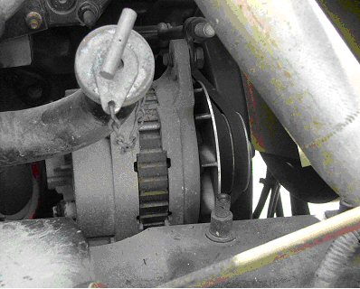
Engine Compartment
Dump truck alternator

Slide 16
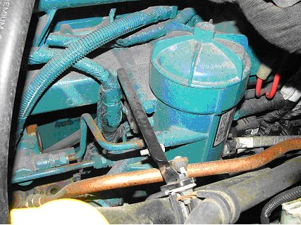
Engine Compartment
Dump truck air compressor

Slide 17
Engine Compartment
Check for leaks
Fluid
Air
Exhaust

Slide 18
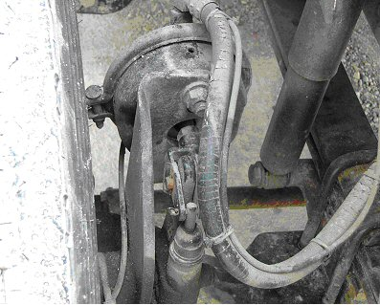
Engine Compartment
Dump truck front slack adjustor
Chambers
Hoses

Slide 19
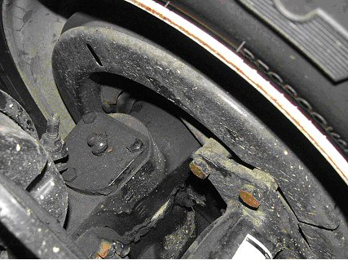
Engine Compartment
Dump truck front brake drum

Slide 20
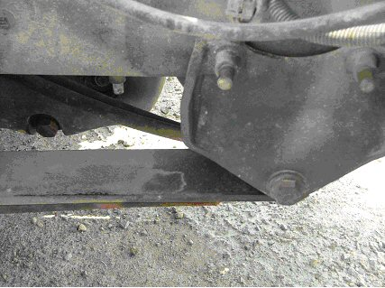
Engine Compartment
Spring mount at truck frame

Slide 21
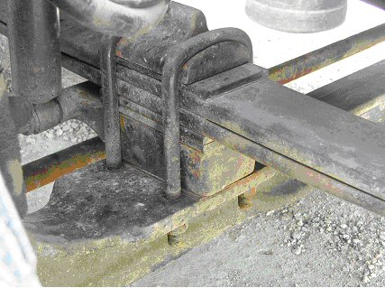
Engine Compartment
Truck spring shackle

Slide 22
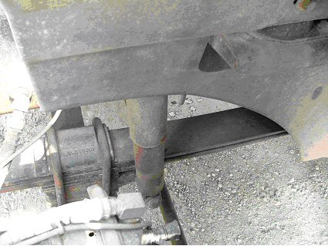
Engine Compartment
Truck shock absorber

Slide 23
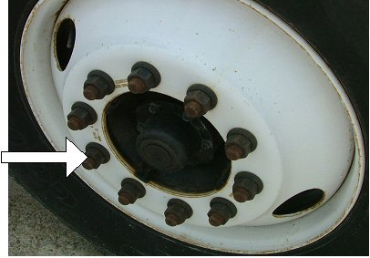
Engine Compartment
Truck front rim

Slide 24
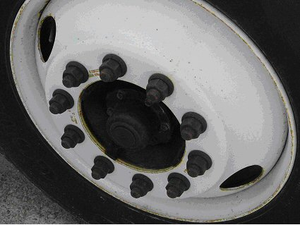
Engine Compartment
Truck front hub oil seal

Slide 25
Engine Compartment
Tires
Valve stem and cap
Wheel fasteners (lug nuts)

Slide 26
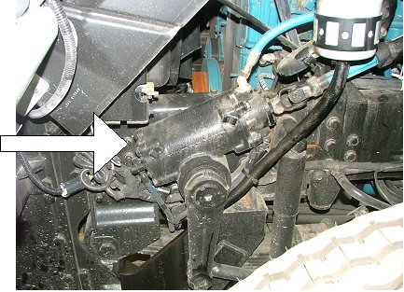
Engine Compartment
Truck power steering box

Slide 27
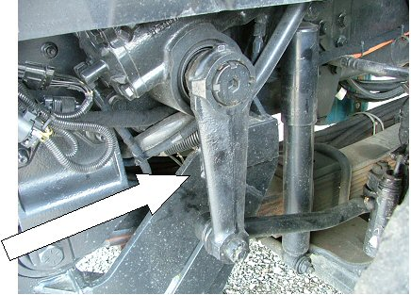
Engine Compartment
Pitman arm

Slide 28
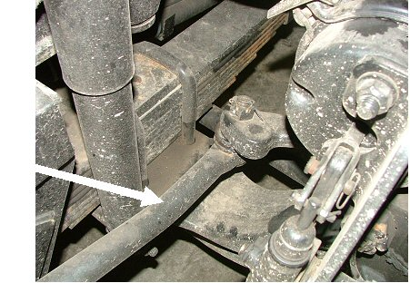
Engine Compartment
Drag link

Slide 29
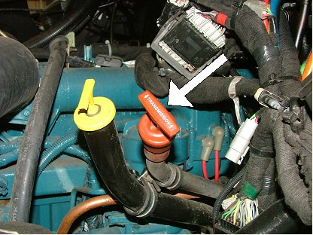
Engine Compartment
Transmission fluid dip stick location

Slide 30
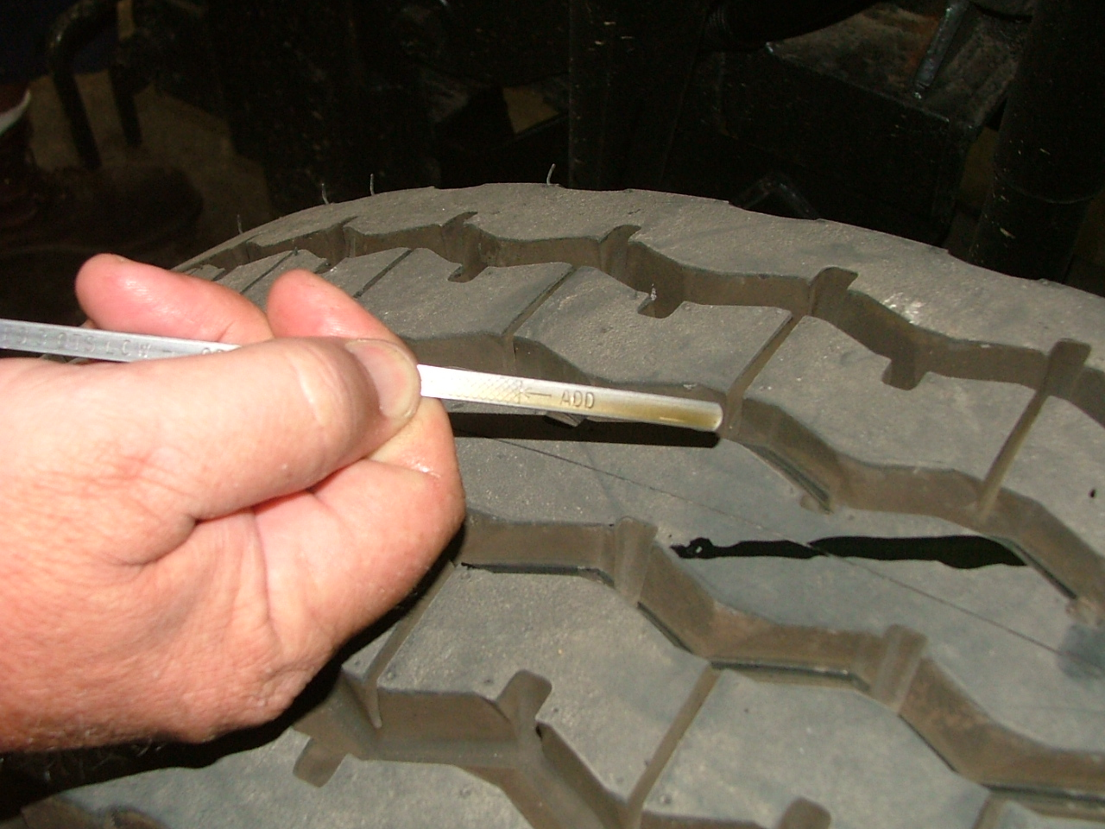
Engine Compartment
Transmission dip stick with fluid shown

Slide 31
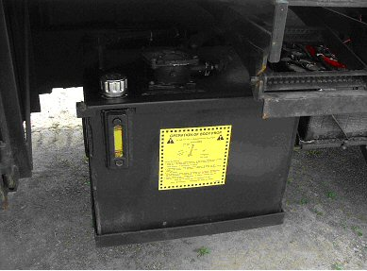
Engine Compartment
Hydraulic fluid tank with site glass

Slide 32
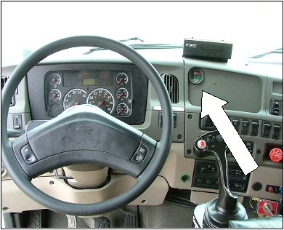
Engine Start Up
Listen for unusual noises
Air filter indicator

Slide 33
Engine Start Up
Lighting indicators
Clutch/gearshift
Oil pressure builds
Air pressure gauges

Slide 34
Engine Start Up
Ampmeter/voltmeter
Brake check (air/hydraulic)
Steering play
Parking brake

Slide 35
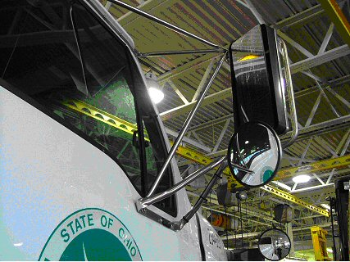
Engine Start Up
Truck mirrors and brackets

Slide 36
Engine Start Up
Wipers/washer fluid
Horns
Heater/defroster
Safety/emergency equipment
Doors/mirror brackets
State radio

Slide 37
Walk Around
Lights/high and low beams
Taillights
Strobe lights and brackets
Marker lights/reflectors

Slide 38
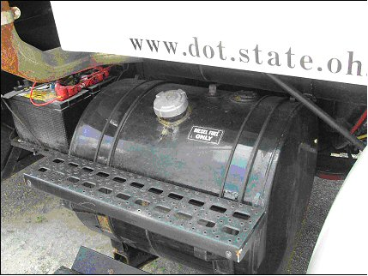
Drivers/Fuel Area
Truck fuel tank and steps

Slide 39
Drivers/Fuel Area
Exhaust system
Body
Mirrors
Handrails

Slide 40
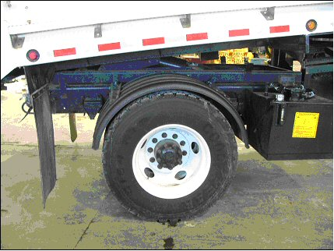
Rear Wheels
Truck rear wheels and rims
Check valve cap and stem

Slide 41
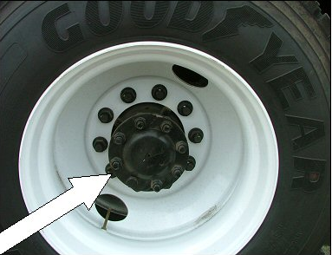
Rear Wheels
Truck rear wheel axle seal

Slide 42
Rear Wheels
Wheel fasteners (lug nuts)
Spacers

Slide 43
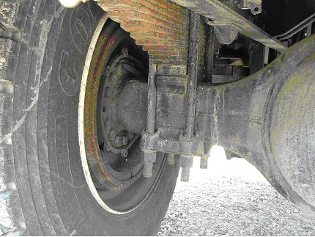
Rear Suspension
Truck rear axle spring leaves

Slide 44
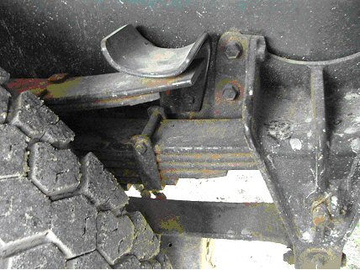
Truck Walk Around
Truck rear spring mounts

Slide 45
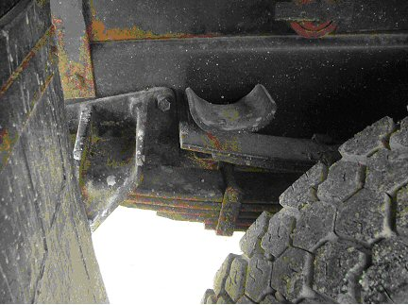
Truck Walk Around
Truck rear spring mounts
Also check torsion bars and airbags

Slide 46
Rear Brakes
Rear slack adjustors
Rear brake chambers
Rear brake hoses

Slide 47
Rear Brakes
Truck rear brake drum

Slide 48
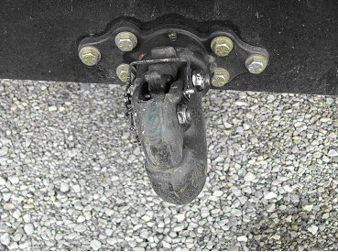
Under Vehicle – Rear of Truck
Truck mounted pintle hitch

Slide 49
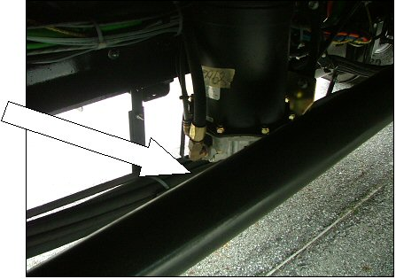
Under Vehicle – Rear of Truck
Truck mid frame drive shaft

Slide 50
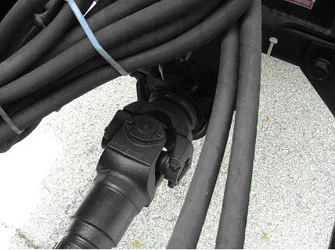
Under Vehicle – Rear of Truck
Drive shaft universal joints

Slide 51
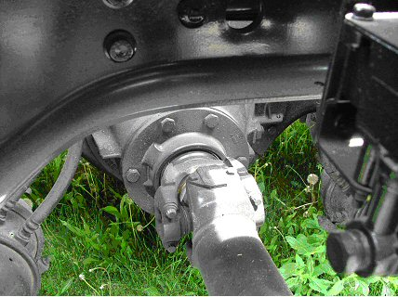
Under Vehicle – Rear of Truck
Drive shaft attaches to rear end

Slide 52
Under Vehicle – Rear of Truck
Frame
Check for dents, twists, rust, and other deformities
Inspect inside and outside of both sides

Slide 53
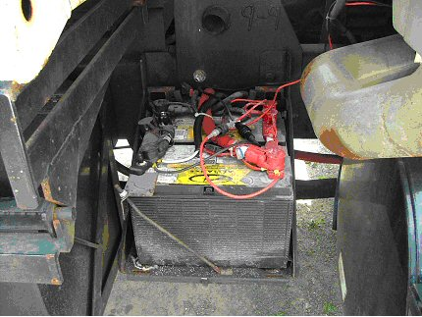
Under Vehicle – Rear of Truck
Truck battery box and batteries

Slide 54
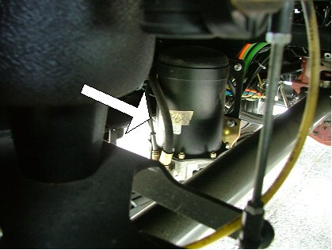
Under Vehicle – Rear of Truck
Air system automatic dryer

Slide 55
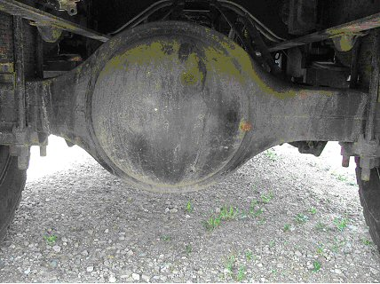
Under Vehicle – Rear of Truck
Rear axle

Slide 56
Under Vehicle – Rear of Truck
Bed and sub frame
Lights/reflectors
Hydraulic oil
Mud flaps

Slide 57
Plow
Hydraulic lines
Frame
Blade
Shoes
Plow lights
Snow deflector

Slide 58
On the Move
Seat belts
Steering
Parking brake
Service brake
Clutch/transmission
Backup alarm

