Slide 1
Plowing and Removal
Intent of plowing
Plow types

Slide 2
Plowing and Removal
Front Mounted Plow
Dump truck with front plow

Slide 3
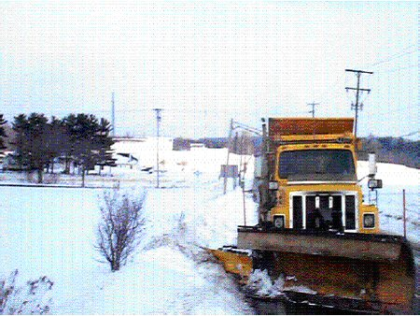
Plowing and Removal
Dump truck with front plow and wing plow

Slide 4
Plowing and Removal
Other removal equipment
Consideration must be given to loading and removal of snow when storage is a problem

