Slide 1
Solid Material Application
Advances
For decades, salt was spread onto roadways by shoveling it onto the road from the bed of a slow-moving truck
Today, we have much more efficient and easier application techniques for solid materials

Slide 2
Solid Material Application
Spreader types - dry chemicals are generally applied with:
Hopper spreaders
Tailgate-type dry material spreader

Slide 3
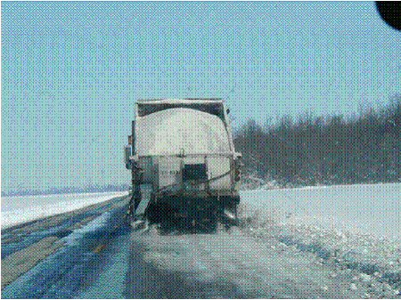
Solid Material Application
Dump truck plowing and applying material (tailgate style)

Slide 4
Solid Material Application
Two basic types of under tailgate spreaders that can be used with standard tailgates
Conveyor style dump bodies

Slide 5
Solid Material Application
Application rate
Depends on a number of factors
Controls
Types

Slide 6
Solid Material Application
Zero velocity spreaders
Solids tend to bounce off roadway
Zero velocity spreaders counteract certain effects

Slide 7
Plowing and Removal
Intent of plowing
Plow types

