Slide 1
Pre-wetting Solids
The effectiveness and efficiency of solid chemicals can increase when the material is pre-wetted
  Chemical then sticks to the road more effectively and becomes activated by the moisture

Slide 2
Pre-wetting Solids
Solid chemicals can be pre-wet in three ways:
  Pre-wetting the stock pile
  Pre-wetting single load
  Pre-wetting by on-board spreader systems

Slide 3
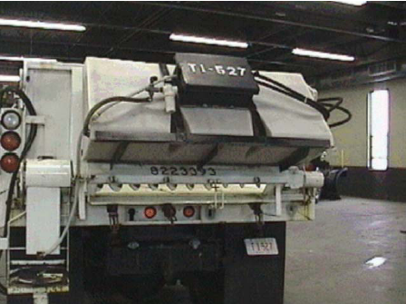
Pre-wetting Solids
Tailgate mounted brine tank
Tailgate mounted brine tank

Slide 4
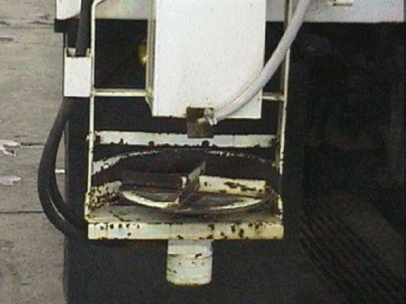
Pre-wetting Solids
Tailgate spinner showing pre-wetting material with brine

Slide 5
Pre-wetting Solids
Spreading pre-wetted material
  Use ground speed controls to adjust the material flow rate in relation to vehicle speed
  Combination systems

