Slide 1
Winter Maintenance Materials
Salt brine
Salt brine mixing hopper

Slide 2
Winter Maintenance Materials

Slide 3
Winter Maintenance Materials
Brine applicator, applying pre-treat

Slide 4
Winter Maintenance Materials
Brine being applied

Slide 5
Winter Maintenance Materials
Brine after drying

Slide 6
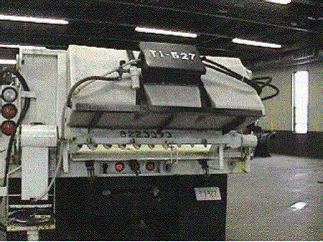
Winter Maintenance Materials
Tailgate mounted brine tank

Slide 7
Winter Maintenance Materials
Tailgate mounted material spinner

Slide 8
Liquid Chemical Application Equipment
Liquid chemicals are applied using a spray bar system
Applicator types
Permanently mounted on vehicle
Placed in truck bed or temporarily attached
Towed behind the truck

Slide 9
Liquid Chemical Application Equipment
Truck Mounted Applicator

Slide 10
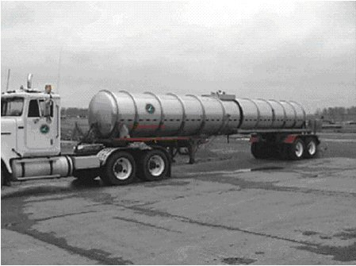
Liquid Chemical Application Equipment
Side view of brine semi tank

Slide 11
Liquid Chemical Application Equipment
Large Tankers
Rear view of brine semi tank

Slide 12
Liquid Chemical Application Equipment
Application methods – spray bar
Spray bar doesn’t actually “spray” liquid chemicals
Installation of rubber flaps or inexpensive rubber tubing directs liquid close to pavement
With typical spray bar, pumps push liquid through nozzles in the spray bar

Slide 13
Liquid Chemical Application Equipment
Brine insert tank with bottom spray bar

