Slide 1
Winter Maintenance Materials
Salt (sodium chloride)
What is salt?
Why is salt used?
How does salt work?

Slide 2
Winter Maintenance Materials
Salt brine
Salt brine mixing hopper

Slide 3
Winter Maintenance Materials

Slide 4
Winter Maintenance Materials
Brine applicator, applying pre-treat

Slide 5
Winter Maintenance Materials
Brine being applied

Slide 6
Winter Maintenance Materials
Brine after drying

Slide 7
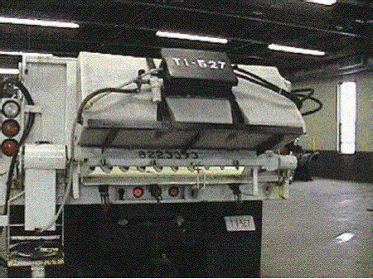
Winter Maintenance Materials
Tailgate mounted brine tank

Slide 8
Winter Maintenance Materials
Tailgate mounted material spinner

Slide 9
Winter Maintenance Materials
Other chlorides (calcium or magnesium)
What are chlorides?
How do calcium and magnesium chlorides work?
How is calcium chloride used?

Slide 10
Winter Maintenance Materials
Agricultural by-products
Work in the same way as other chemicals, but do not form a brine
Environmentally friendly and less corrosive than many conventional materials
Concentrated liquid residues from the processing of grains and other agricultural products

Slide 11
Liquid Chemical Application Equipment
Liquid chemicals are applied using a spray bar system
Applicator types
Permanently mounted on vehicle
Placed in truck bed or temporarily attached
Towed behind the truck

Slide 12
Liquid Chemical Application Equipment
Truck Mounted Applicator

Slide 13
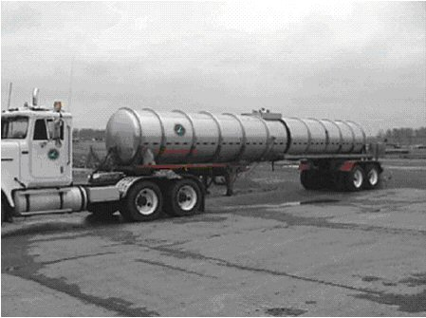
Liquid Chemical Application Equipment
Side view of brine semi tank

Slide 14
Liquid Chemical Application Equipment
Large Tankers
Rear view of brine semi tank

Slide 15
Liquid Chemical Application Equipment
Application methods – spray bar
Spray bar doesn’t actually “spray” liquid chemicals
Installation of rubber flaps or inexpensive rubber tubing directs liquid close to pavement
With typical spray bar, pumps push liquid through nozzles in the spray bar

Slide 16
Liquid Chemical Application Equipment
Brine insert tank with bottom spray bar

