Slide 1
LESSON NINE
Defensive Driving

Slide 2
Defensive Driving
Exercise: Your Driving Risks

Slide 3
What is Defensive Driving?
Driving to save lives, time, and money in spite of conditions and the actions of others
Road hazards and poor weather conditions are two of the worst possible conditions a driver can face

Slide 4
Conditions, Dangers And Defenses
Fog

Slide 5
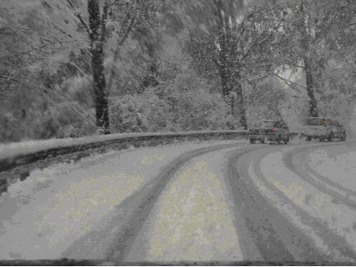
Conditions, Dangers And Defenses
Snow and ice

Slide 6
Conditions, Dangers And Defenses
Rain

Slide 7
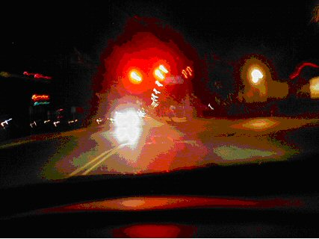
Conditions, Dangers And Defenses
Night driving

Slide 8
Conditions, Dangers And Defenses
Daytime driving

Slide 9
Conditions, Dangers And Defenses
Trucks/tractor trailers

Slide 10
Conditions, Dangers And Defenses
Accidents

Slide 11
Conditions, Dangers And Defenses
Emergency vehicles

Slide 12
Conditions, Dangers And Defenses
School buses

Slide 13
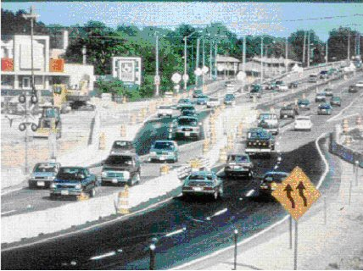
Conditions, Dangers And Defenses
Road construction

Slide 14
Conditions, Dangers And Defenses
Animals

Slide 15
Conditions, Dangers And Defenses
Personal security issues

Slide 16
Why Drive Defensively?
In the past 30 years
The number of licensed drivers has doubled
The number of registered vehicles has tripled

Slide 17
Why Drive Defensively?
National Survey of Driving Behaviors
Drivers reported committing these unsafe acts during the week prior to taking the survey
Ran red light
Rolled stop sign
Drove over speed limit
Drove while intoxicated

Slide 18
Why Drive Defensively?
Alcohol
48% of all motor vehicle fatalities are alcohol related
What is one drink?
Annual fatalities
Average about 43,000 per year in the U.S.

Slide 19
Defensive Driving
Seat belts
Why are they necessary?
Use of seat belts

Slide 20
Air Bags
Driver recommendations
If possible, the driver should be at least 11 inches away from the steering wheel
Hand position should be at eight o’clock and four o’clock on the steering wheel

Slide 21
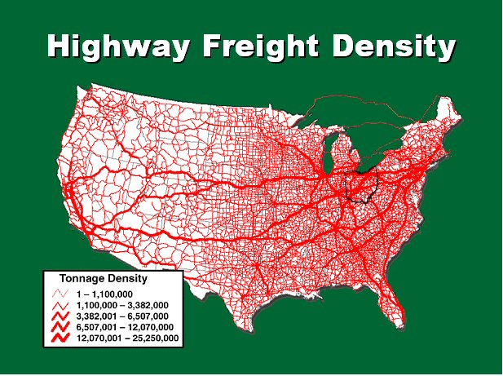
Highway System
Truck traffic in Ohio

Slide 22
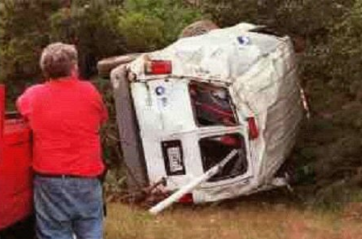
Driver Behavior
Road rage

Slide 23
Driver Behavior
Aggressive driving
Driving in a selfish, bold, or pushy manner without regard for the rights or safety of other road users
Aggressive driving behaviors
Many drivers believe that traffic laws are guidelines

Slide 24
Defensive Driving
Exercise: Rules, Regulations, and Responsible Driving

Slide 25
Defensive Driving Review
True or False: – Ohio is known as a “Secondary Seat Belt Law” state

Slide 26
Defensive Driving Review
True

Slide 27
Defensive Driving Review
The illegal blood/breath alcohol concentration for drivers over 21 years of age in Ohio is ______.

Slide 28
Defensive Driving Review
.08 for non CDL drivers
.04 for CDL drivers

