Slide 1
LESSON EIGHT
Emergency Equipment and Set-Up

Slide 2
Standard Equipment
Fire Extinguisher
First aid kit
Reflective triangles
flares

Slide 3
Emergency Warning Device Placement and Distance
The type of road you are on dictates where you place flares or triangles. You may use either device, depending on availability and conditions as described earlier in this section.

Slide 4
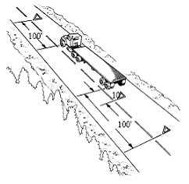
Emergency Equipment Set Up
Two lane highway (one lane each direction)

Slide 5
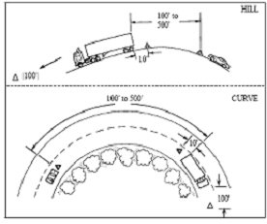
Emergency Equipment Set Up
Two lane highway with hill or curve

Slide 6
Emergency Equipment Set Up
Four lane highway

Slide 7
Measuring Distance
The easiest way to measure distance for the placement of emergency warning devices is to use the lane dividing lines (the dashed yellow lines)
Each line is 10 feet long
The distance between the lines is 30 feet
From the start of one line to the end of the next line is 50 feet

