Slide 1
LESSON SIX
Brake Systems

Slide 2
Brake Types
Hydraulic
Air

Slide 3
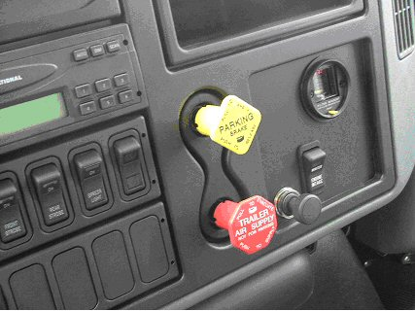
Brake Types
Truck and trailer parking and emergency brake controls

Slide 4
Inspection
Critical to daily operation
  Determine whether your brake system is air or hydraulic
  Review inspection procedure outlined in pre-trip lesson

Slide 5
Chambers
Sections
Pancakes
Springs

Slide 6
Damage
Avoid brake system damage
  Never set parking brake while vehicle is still rolling
  Never apply parking brake while brakes are hot
  Never apply service brakes while the parking brakes are set
  Never disassemble brake chamber

Slide 7
Heat
A brake system’s worst enemy
  Caused by friction
  Heat increases due to a number of factors

Slide 8
Heat
  400 degrees
  750 degrees
  800 degrees
  960 degrees
  1350 degrees
  Remittent brake application is not the answer

Slide 9
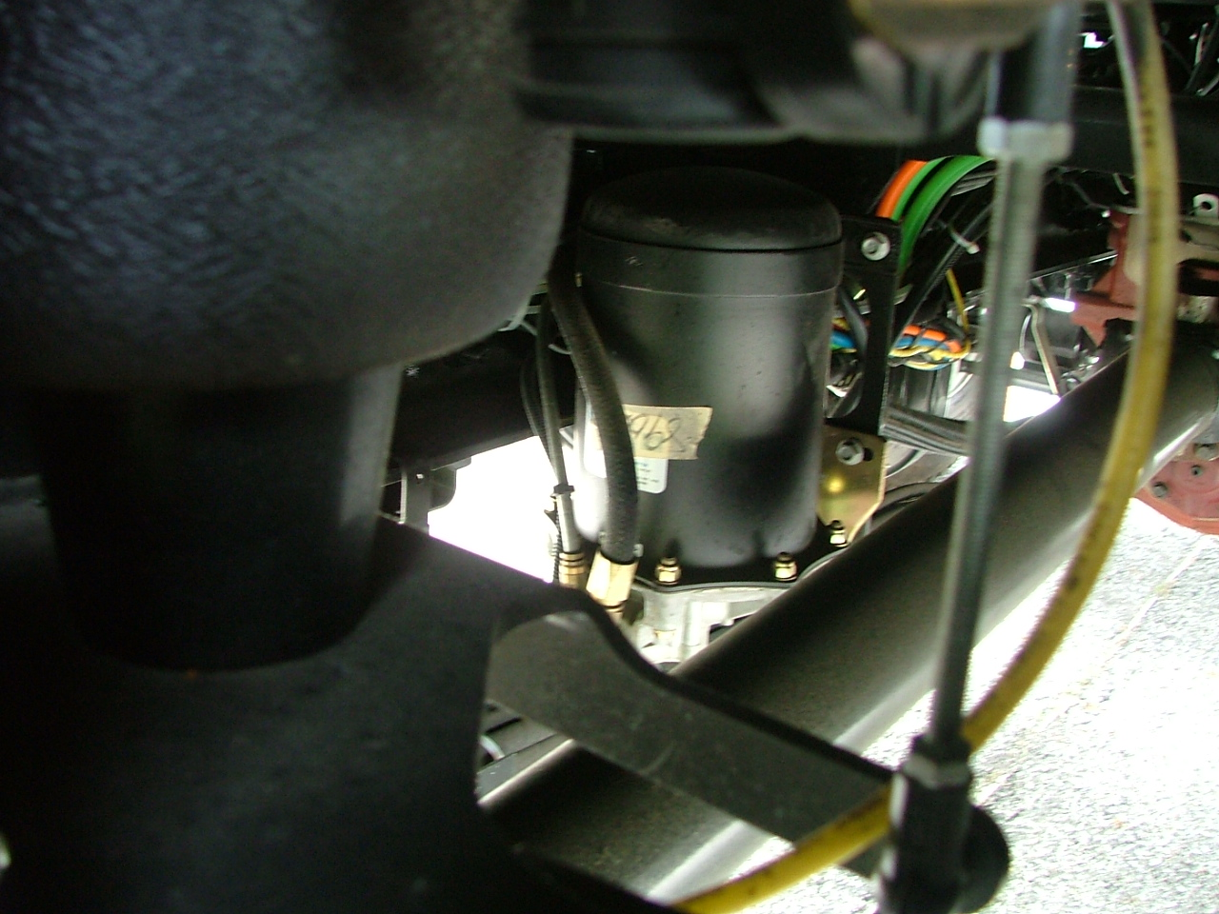
Air Dryer
Brake system automatic air dryer

Slide 10
Gauges
Air supply pressure gauge
  Located on dashboard of truck
  You may have more than one
  Shows available pressure reading
  Shows pressure decrease when brake pedal is depressed
  Includes dashboard warning device for low psi

Slide 11
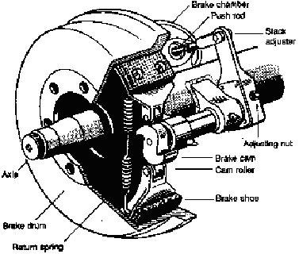
S Cam Brakes
S Cam brake system

Slide 12
Maintenance
Brake systems are generally easy to maintain
  Daily proper pre-trip inspections
  Lubrication
  Cleanliness

