Slide 1
LESSON FIVE
Convex Mirrors

Slide 2
Convex Mirrors
A convex mirror is a round or square mirror with a raised center.
Vision
Mirror use is essential to safety

Slide 3
Convex Mirrors
Requirements and Standards
Federal Law
ODOT Standards

Slide 4
Convex Mirrors
Quartering the Mirror
You can determine distance by
Size of image in mirror
Position of image in mirror
In class demonstration

Slide 5
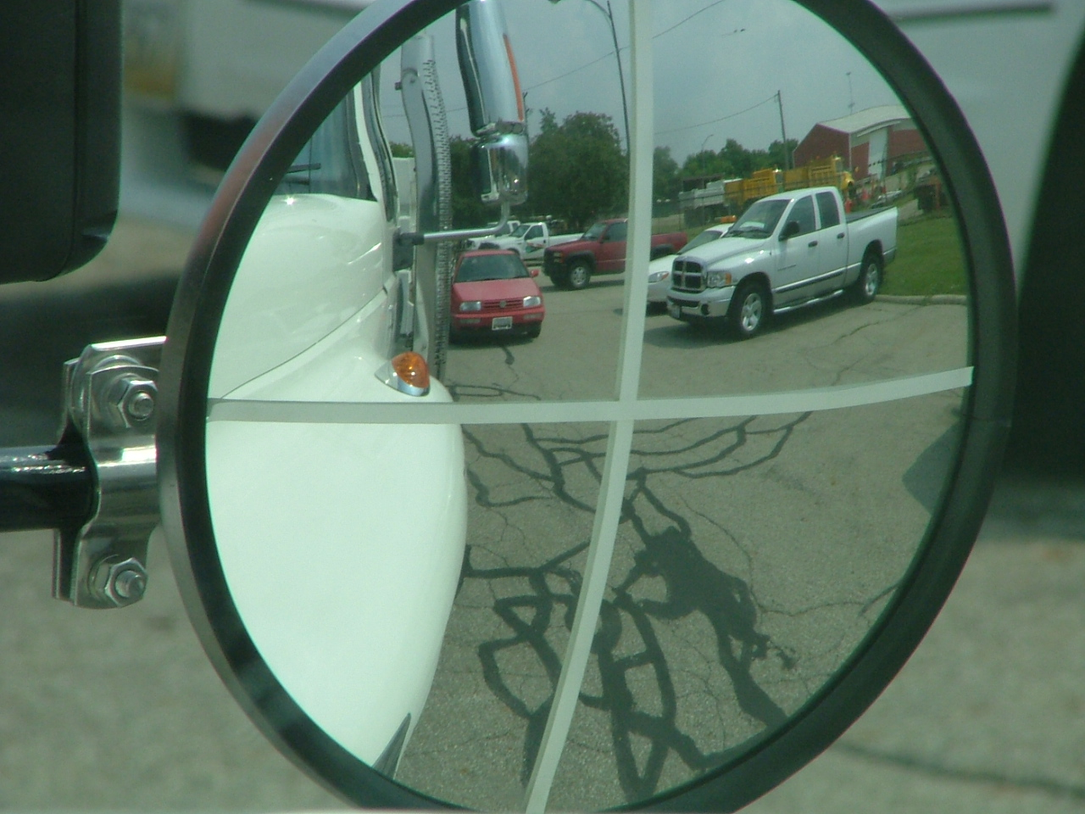
Quartering the Mirror
Convex mirror, quartered

Slide 6
Convex Mirrors
Maintenance
Proper maintenance includes
Cleaning mirrors and windows
Proper adjustment
Inspection of mirrors and mounting hardware

Slide 7
Convex Mirror Review
True or False: ODOT standards require that two convex mirrors be on all trucks where vision is cut off by a dump bed or other means

Slide 8
Convex Mirror Review
True

Slide 9
Convex Mirror Review
2. True or False: A convex mirror is a round or square mirror with a raised center.

Slide 10
Convex Mirror Review
2. True

Slide 11
Convex Mirror Review
3. True or False: The distance and position of other things or vehicles you see in the mirror can be determined by where they are in the mirror

Slide 12
Convex Mirror Review
3. True

Slide 13
Convex Mirror Review
4. How should you make a right turn with no reference point?

Slide 14
Convex Mirror Review
4. Determine a fixed point on the ground and begin to make your turn when it looks like it is at the five o’clock position in the convex mirror

Slide 15
Convex Mirror Review
5. True or False: If you are passing a vehicle, it is safe to return to your lane when the image in your right convex mirror is in the upper left portion of the mirror.

Slide 16
Convex Mirror Review
5. True

