Slide 1
LESSON THREE
Safe Truck Operation

Slide 2
Truck Safety
Overview
This portion of the course is designed to help produce a safe and competent dump truck operator

Slide 3
Truck Safety
General Safety
Every operator’s primary concern
Safety related factors
Operator responsibilities

Slide 4
Truck Safety
General safety
Know the capabilities of the truck, and understand the job at hand
Hurrying to complete a job could result in severe injury
Read the operator’s manual and safety manual

Slide 5
Safe Truck Operation
Circle of Safety Walk Around
Mandated by federal, state, and agency regulations as well as by manufacturer’s requirements

Slide 6
Truck Safety – Proper Entry and Exit
Face the machine at all times
Maintain three points of contact

Slide 7
Truck Safety – Proper Entry and Exit
Keep boots as clean as possible
Keep the steps clean
Never jump out of the truck

Slide 8
Safe Truck Operation
Seat belt
Proper use is mandated by state law and agency regulations
Even with air bags, crumple zones, and other safety improvements, seat belt MUST be worn

Slide 9
Safe Truck Operation
Seat belt use is mandatory
Seat belt should be properly adjusted and should fit snugly

Slide 10
Safe Truck Operation
Look before backing
When in a hurry, it’s easy for operators to forget to look before backing
Prior to placing the transmission in reverse, look over both shoulders and make sure the area is clear

Slide 11
Safe Truck Operation
Operating Speed
Operators are evaluated on cost efficiency and production
Excessive speed causes problems

Slide 12
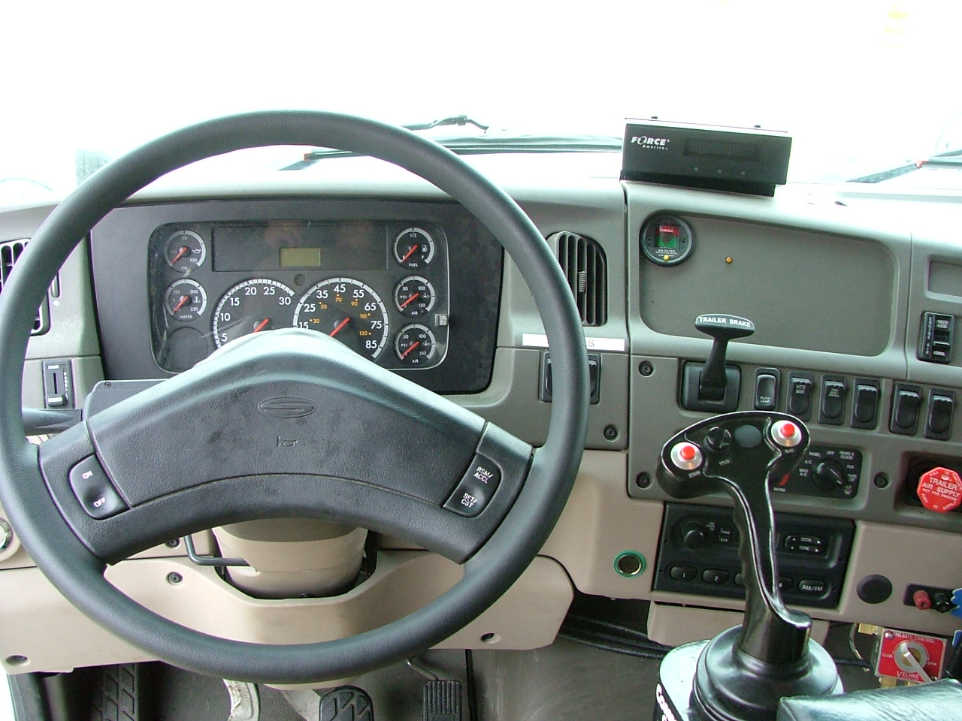
Safe Truck Operation
Operator platform -cab

Slide 13
Safe Truck Operation
Operator platform – cab
Cleanliness is important in the cab
Familiarization with all controls is a must

Slide 14
Safe Truck Operation
Center of gravity
Known as the balance point or tipping point
Center of gravity depends on many factors
Tipping point varies
Bed height and amount of weight affects tipping point

Slide 15
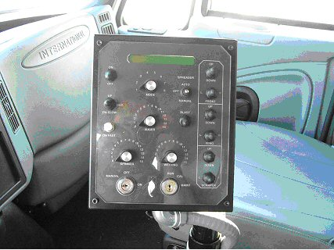
Safe Truck Operation Controls
Pengwyn Hydraulic Control

Slide 16
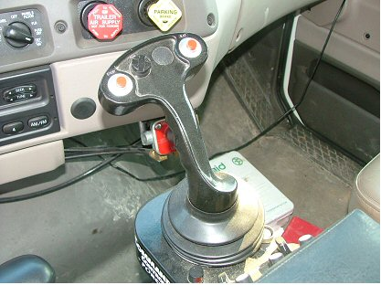
Safe Truck Operation Controls
Force America Hydraulic Control

Slide 17
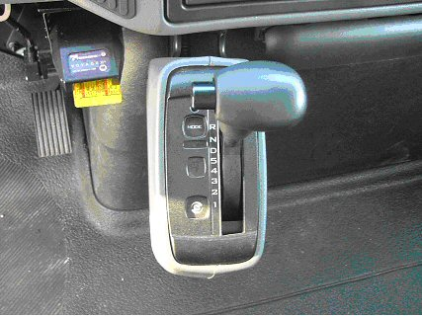
Safe Truck Operation Controls
T-handle automatic transmission selector

Slide 18
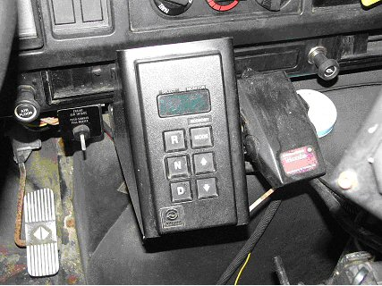
Safe Truck Operation Transmission
Push button automatic transmission selector

Slide 19
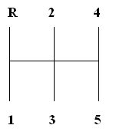
Safe Truck Operation Transmission
The five speed has a double H shift pattern

Slide 20
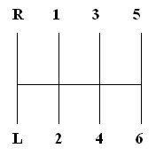
Safe Truck Operation Transmission
The six plus has a triple H shift pattern

Slide 21
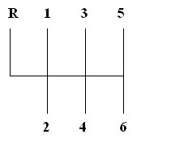
Safe Truck Operation Transmission
The six speed transmission is the same triple H pattern without low gear

