Slide 1
Winter Maintenance Materials
Material Characteristics
Salt Brine

Slide 2
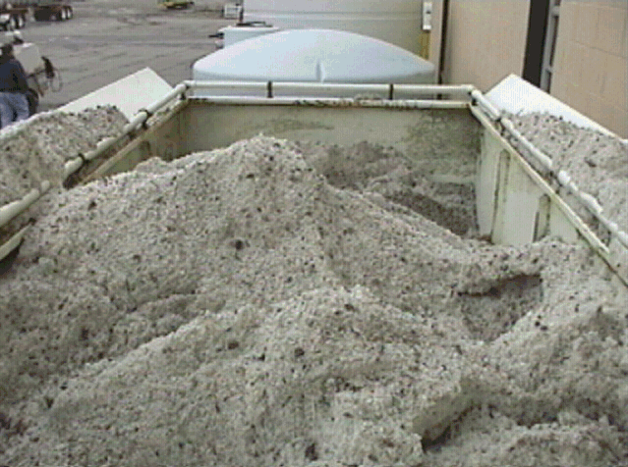

Slide 3
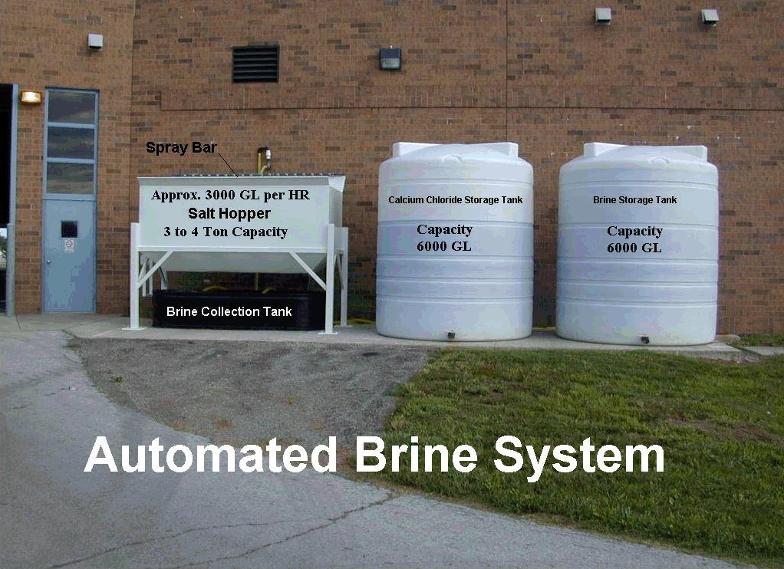

Slide 4
Exercise: Salt Brine
True or False? The proportion of salt to water is critical to brine effectiveness.

Slide 5
Exercise: Salt Brine
True or False? The proportion of salt to water is critical to brine effectiveness.
Too much or too little affects the freeze point depressing qualities.

Slide 6
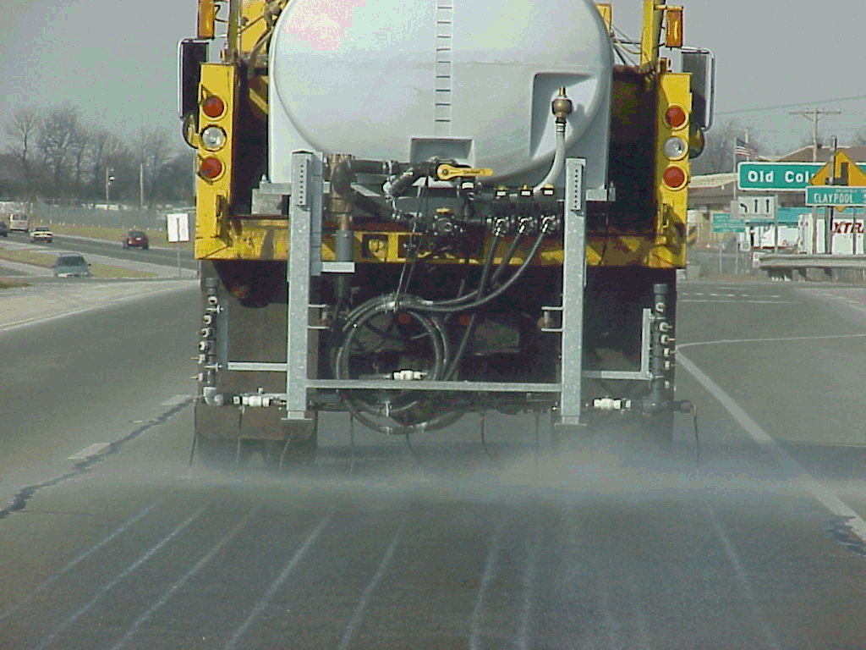

Slide 7
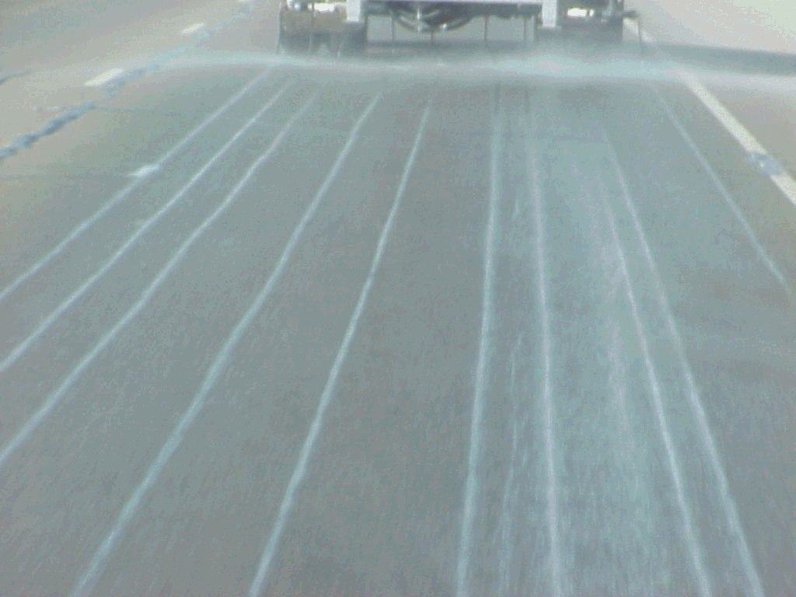

Slide 8
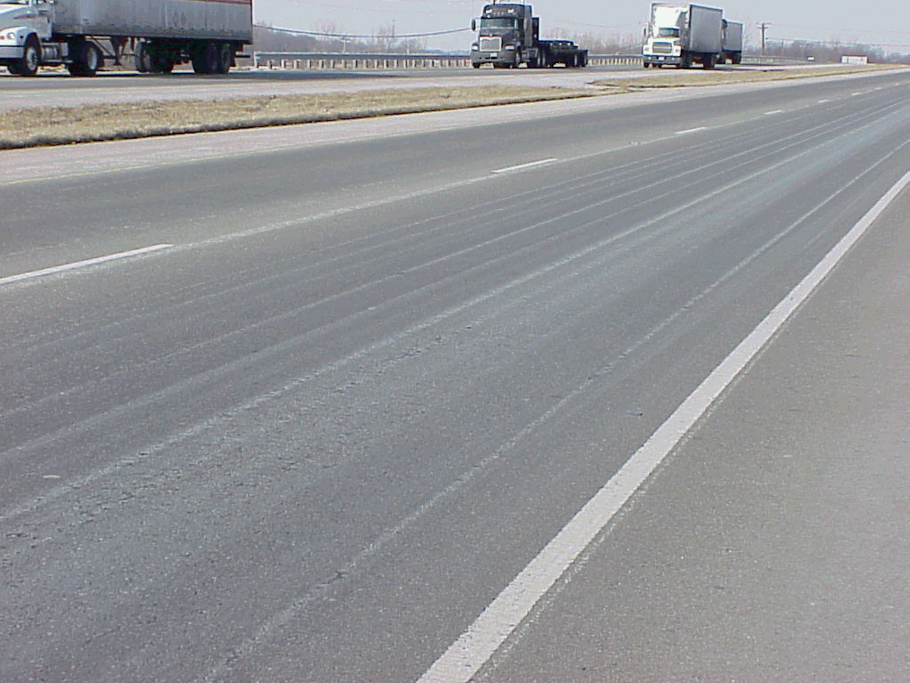

Slide 9
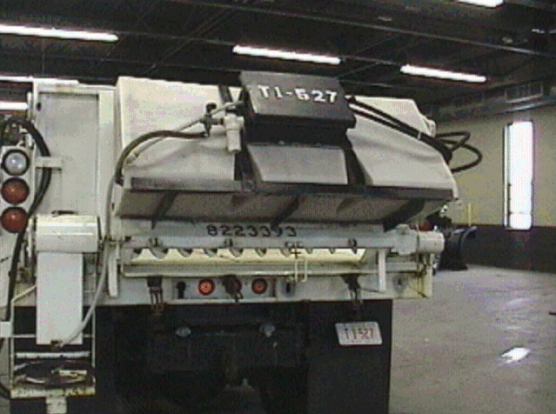

Slide 10
