Slide 1
LESSON FOUR: Materials

Slide 2
Lesson Four: Materials
Winter Maintenance Expenditures
Winter Maintenance Materials
Availability, Selection and Processes
Material Handling and Storage

Slide 3
Winter Maintenance Materials
Material Availability
Material Selection
How Chemicals Work
Depress the freezing point of water
Understanding Dilution of Solution
Solids must mix with moisture

Slide 4
Exercise: How Chemicals Work
True or False? Snow and ice removal chemicals depress the freezing point of water.

Slide 5
Exercise: How Chemicals Work
True or False? Snow and ice removal chemicals depress the freezing point of water.

Slide 6
Winter Maintenance Materials
Material Characteristics
Abrasives
Rock Salt

Slide 7
Exercise: How Does Salt Work?
True or False? Salt absorbs energy to dissolve.

Slide 8
Exercise: How Does Salt Work?
True or False? Salt absorbs energy to dissolve.
During lower temperatures more salt and a longer time period is required for melting to take place.

Slide 9
Exercise: How Does Salt Work?
True or False? To melt snow and ice, rock salt must mix with moisture and create brine.

Slide 10
Exercise: How Does Salt Work?
True or False? To melt snow and ice, rock salt must mix with moisture and create brine.
In order for salt to act as a freezing point depressant, it must go into solution.

Slide 11
Winter Maintenance Materials
Material Characteristics
Salt Brine

Slide 12
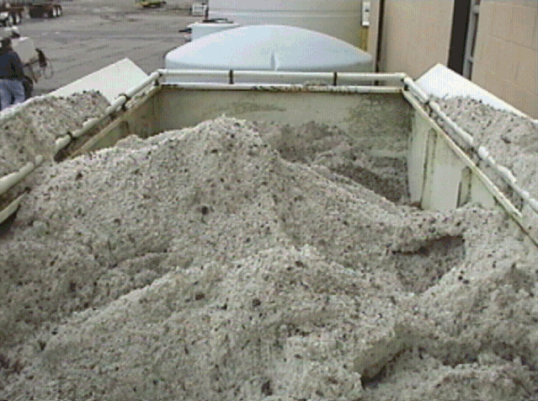

Slide 13
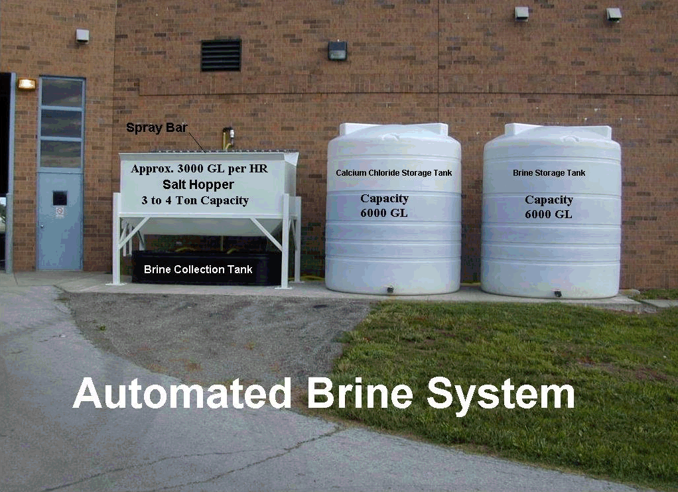

Slide 14
Exercise: Salt Brine
True or False? The proportion of salt to water is critical to brine effectiveness.

Slide 15
Exercise: Salt Brine
True or False? The proportion of salt to water is critical to brine effectiveness.
Too much or too little affects the freeze point depressing qualities.

Slide 16
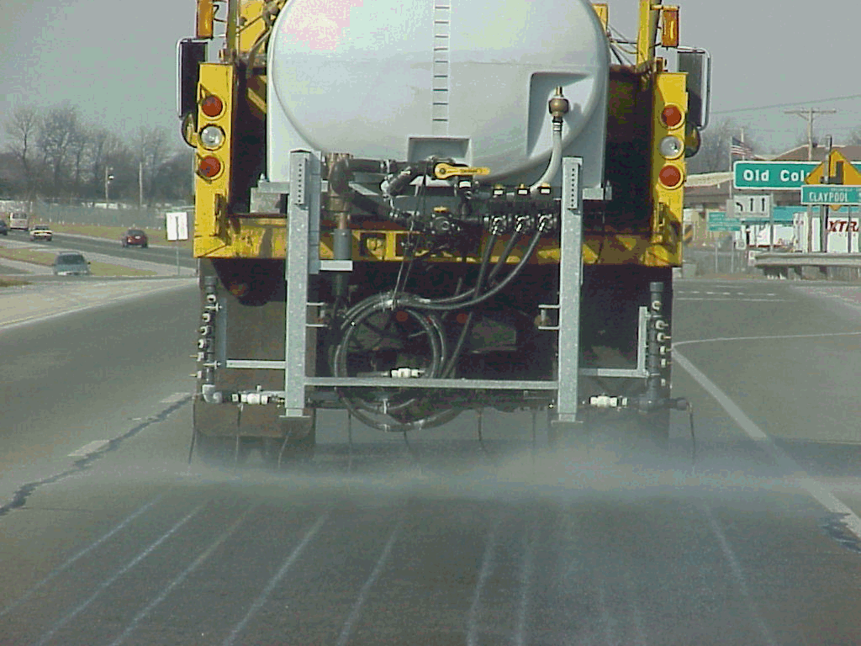

Slide 18
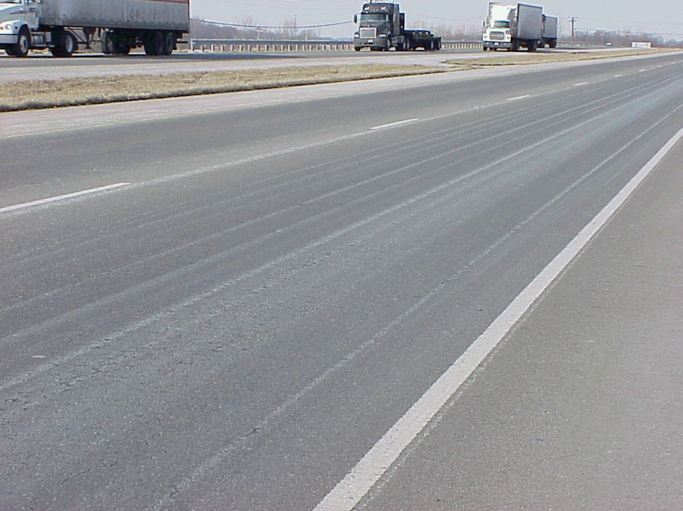

Slide 19
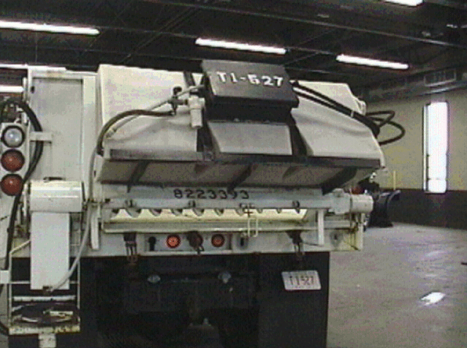

Slide 20
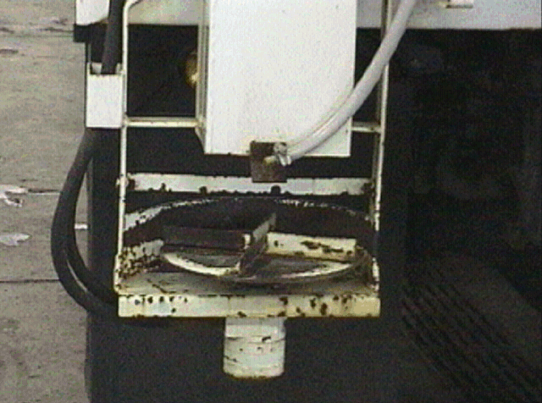

Slide 21
Winter Maintenance Materials
Material Characteristics
Other Chlorides

Slide 22
Exercise: Other Chlorides
True or False? Calcium chloride releases heat as it goes into solution which improves effectiveness in cold weather.

Slide 23
Exercise: Other Chlorides
True or False? Calcium chloride releases heat as it goes into solution which improves effectiveness in cold weather.
This is one of the reasons that calcium chloride is effective in cold temperatures.

Slide 24
Winter Maintenance Materials
How is Calcium Chloride used?
Agricultural By-products

Slide 25
Material Handling and Storage
Material Handling
MSDS Sheets
Material Storage

Slide 26
Exercise: Lesson Four Review
True or False? Generally, all snow and ice chemicals work the same by depressing the freezing point of water.

Slide 27
Exercise: Lesson Four Review
True or False? Generally, all snow and ice chemicals work the same by depressing the freezing point of water.

Slide 28
Exercise: Lesson Four Review
The effectiveness of a chemical to depress the freezing point of water depends upon the percent of chemical in ______.

Slide 29
Exercise: Lesson Four Review
The effectiveness of a chemical to depress the freezing point of water depends upon the percent of chemical in solution.

Slide 30
Exercise: Lesson Four Review
True or False? Solid chemicals, such as rock salt, must mix with moisture to create brine before it has any melting capabilities.

Slide 31
Exercise: Lesson Four Review
True or False? Solid chemicals, such as rock salt, must mix with moisture to create brine before it has any melting capabilities.

Slide 32
Exercise: Lesson Four Review
“Dilution of ______” means that as a liquid mixture dilutes that its melting temperature changes.

Slide 33
Exercise: Lesson Four Review
“Dilution of solution” means that as a liquid mixture dilutes that its melting temperature changes.

Slide 34
Exercise: Lesson Four Review
Information on safe material handling is found on the ____________________ for each chemical used in snow and ice control.

Slide 35
Exercise: Lesson Four Review
Information on safe material handling is found on the Material Safety Data Sheet for each chemical used in snow and ice control.
Each county garage has all MSDS sheets readily available - become familiar with where the MSDS are located in your garage facility

