Slide 1
LESSON SEVEN: Safety Practices

Slide 2
Safety Practices
Safety Preparations
Crew Safety
Material Safety
Vehicle Equipment Safety
Facilities
Operations

Slide 3
Safety Preparations
Training
Knowing Your Route

Slide 4
Exercise: Knowing Your Route
True or False? Being familiar with your route before snow and ice removal starts is not important.

Slide 5
Exercise: Knowing Your Route
True or False? Being familiar with your route before snow and ice removal starts is not important.
Knowing your route is essential.

Slide 6
Crew Safety
Adequate Sleep or Rest
Multi-Layers of Warm Clothing
Personal Protective Equipment
Emergency Survival Kit
Fire Extinguisher

Slide 7
Material Safety
Material Safety Data Sheet, MSDS

Slide 8
Vehicles and Equipment Safety
Preventive Maintenance
EM-78, pre-trip
Full Fuel Tanks
Check All Lights
Back-Up Alarm, Plow Flags
Radio Communications
Safety Belt

Slide 9
Operations Safety
Know Your Truck and Equipment
Truck Bed
Changing Plow Blades
Hydraulics
Protective Eye Ware
Defensive Driving
Fatigue
Exiting Vehicle
Keep Cool

Slide 10
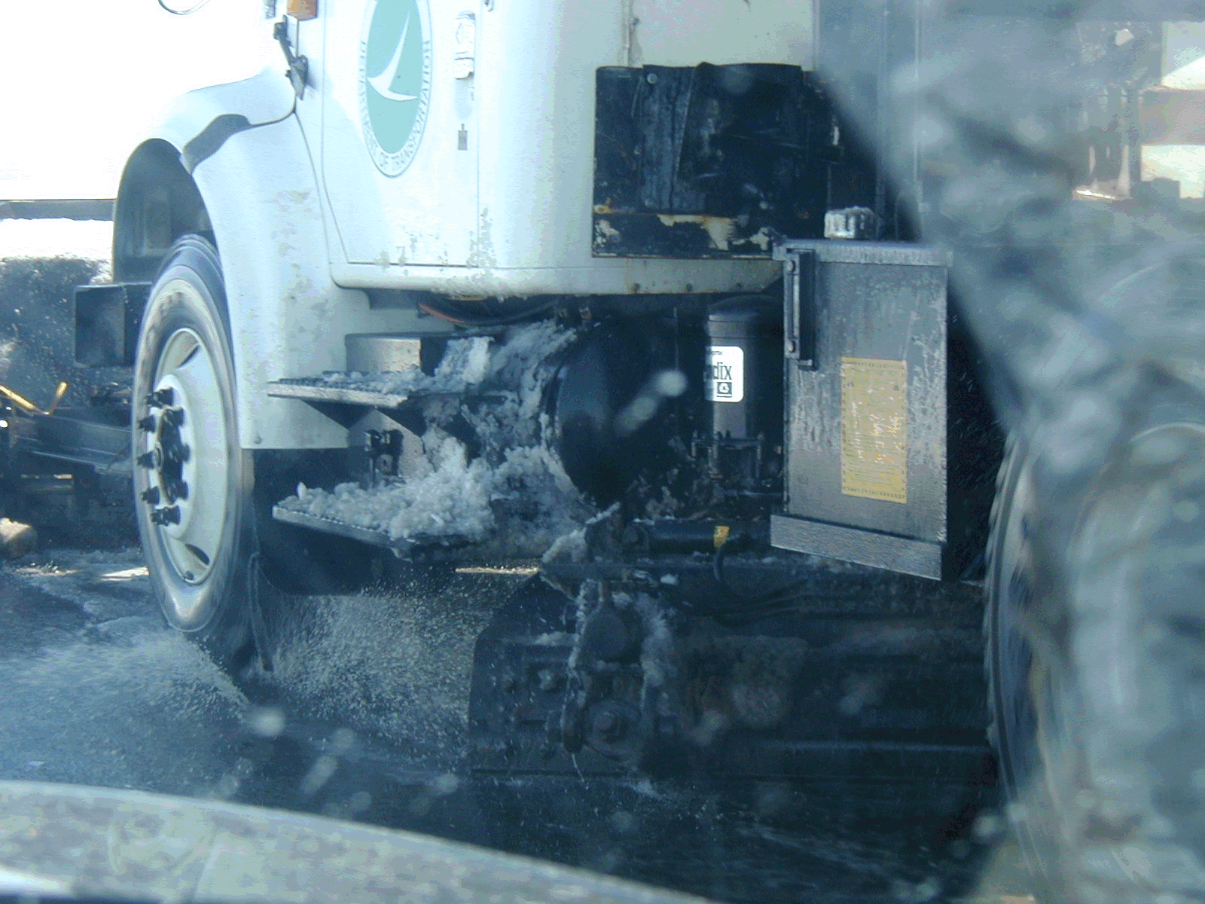

Slide 11
Exercise: Lesson Seven Review
True or False? Training is an important part of winter safety.

Slide 12
Exercise: Lesson Seven Review
True or False? Training is an important part of winter safety.
Knowing all areas of you job is essential – preparation, materials, equipment maintenance and operation.

Slide 13
Exercise: Lesson Seven Review
True or False? Lights are only important for the operator’s use to see.

Slide 14
Exercise: Lesson Seven Review
True or False? Lights are only important for the operator’s use to see.
Lights are not only used for the Operator to see but also to be seen by others.

Slide 15
Exercise: Lesson Seven Review
True or False? When using a single axle truck and running with the truck bed up, the bottom of the truck bed should not be higher than the top of the cab.

Slide 16
Exercise: Lesson Seven Review
True or False? When using a single axle and running with the truck bed up, the bottom of the truck bed should not be higher than the top of the cab.

Slide 17
Exercise: Lesson Seven Review
True or False? Once a spreader is turned off, the hydraulic pressure should be first relieved before working on a jam.

Slide 18
Exercise: Lesson Seven Review
True or False? Once a spreader is turned off, the hydraulic pressure should be first relieved before working on a jam.
Even when turned off, the reserve pressure can still turn the auger – relieve all pressure before working on the jam.

Slide 19
Exercise: Lesson Seven Review
True or False? Operators need to be aware of fatigue during long hours of operation.

Slide 20
Exercise: Lesson Seven Review
True or False? Operators need to be aware of fatigue during long hours of operation.
Know you own limitations and advise your supervisor if your fatigue level is too great.

