Slide 1
Applications, Operations And Policy
Material Applications
Application Rates
Plowing and Spreading
Treatment Guidelines
Preparation Check List
Operational Guidelines

Slide 2
Application
Timing
Material Applications

Slide 3
Exercise: Rock Salt
True or False? When properly spread, salt forms a brine that flows across the pavement surface.

Slide 4
Exercise: Rock Salt
True or False? When properly spread, salt forms a brine that flows across the pavement surface.
Salt is normally applied to the high side of curves and ramps and to the middle (crown) of the pavement.

Slide 5
Application Rates
Factors Determining Rate Selection
Recognizing Storm Elements
Special Areas – Berms, Shoulders and Ramps

Slide 6
Plowing and Spreading Tips
Salt bridges first
Salt the high side of elevated curves
Leave no gaps
Watch for drifting
Watch for slick spots
Get equipment on the road
Note trouble spots
Allow material enough time to work

Slide 7
Plowing Techniques
Two-lane roads
Multi-lanes
Bridges
Ramps and elevated curves
Gore areas
Railroad tracks

Slide 8
Treatment Guidelines
Material Application Guidelines – MAG
Pre-Treatment Plan

Slide 9
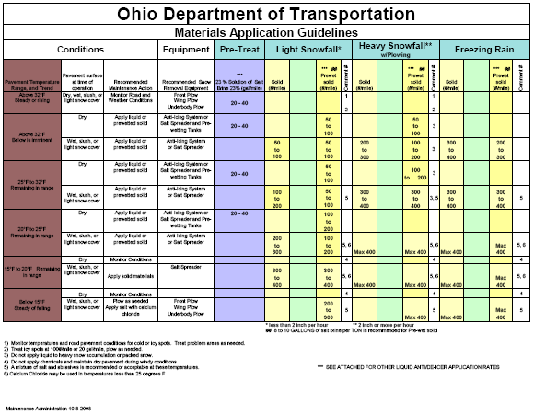

Slide 10
Exercise: Using the MAG
Given pavement temperatures that are in the range of 20°F to 25°F, with wet pavement surface and heavy snow fall. What is the recommended application rate if using pre-wetted solids?

Slide 11
Exercise: Using the MAG
Given pavement temperatures that are in the range of 20°F to 25°F, with wet pavement surface and heavy snow fall. What is the recommended application rate if using pre-wetted solids?
Max of 400 pounds per lane mile

Slide 12
Pre-Treatment Plan
Advantages
Pre-Treatment Plan Document

Slide 13
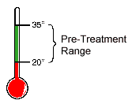
OHIO DEPARTMENT OF TRANSPORTATION SNOW & ICE PRE-TREATMENT GUIDELINES
I. | PURPOSE
 | Pre-treat Priority Routes and any identified trouble spots with liquid material for black ice, unexpected winter events, frost control, and forecasted winter events when conditions warrant.
II. | PRE-TREATMENT LIQUIDS
 | Salt Brine or equivalent
III. | APPLICATION
 | Pre-treat Priority Routes when conditions or forecast warrants. On higher volume roads where material may be tracked away by traffic, pre-treat as close to the onset of an event as possible.
IV. | WHEN CONDITIONS WARRANT
 | A. | Roadways are dry.
 | B. | Rain is not forecasted for the next 24 hours.
 | C. | Forecasted low temperature to fall within the range of 20 to 35 degrees Fahrenheit or within critical dew point range.
 | D. | Sufficient time exists for pavement to dry before pavement temperature falls below 20 degrees Fahrenheit.
 | E. | Blowing snow is not anticipated.
 | F. | Visual observation indicates sufficient material residue does not exist.
V. | IMPLEMENTATION
 | The Pre-Treatment Plan will begin immediately.
VI. | SPECIAL CONDITIONS
 | A. | Refer to the Material Application Guidelines.
 | B. | "Black Ice" - Pavement temperature is equal to or predicted to be less than the due point temperature and is equal to or below 32 degrees Fahrenheit. When available, utilize RWIS data for pavement temperature, dew point temperature, etc.
Maintenance Administration 10-8-2008

Slide 14
Exercise: Using the Pre-Treatment Plan
Is pre-treating recommended if the forecasted temperature is below 20°F?

Slide 15
Exercise: Using the Pre-Treatment Plan
Is pre-treating recommended if the forecasted temperature is below 20°F?
No, pre-treat between the temperature ranges of 20°F to 35°F.

