Slide 1
Plowing and Removal
Definition
Plow Types

Slide 2
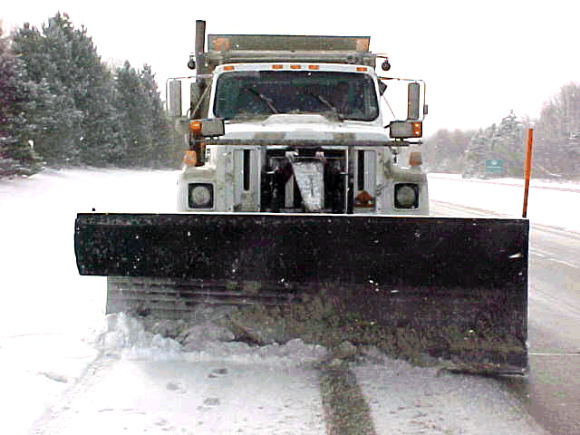

Slide 3
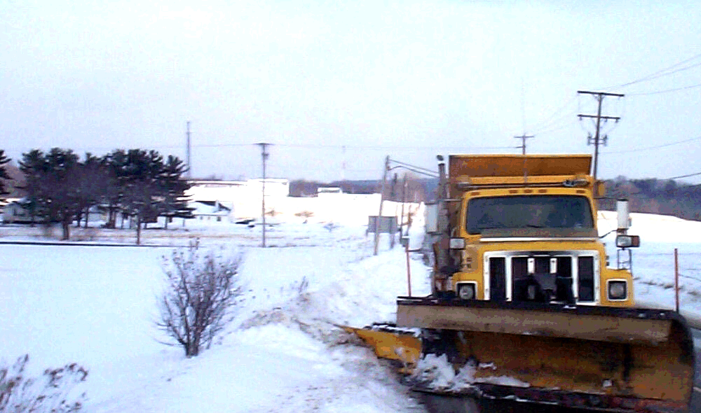

Slide 4
Plowing and Removal
Other Removal Equipment
Loading and Removal

Slide 5
Exercise: Lesson Five Review
True or False? The intent of plowing is to remove snow and ice from the pavement surface.

Slide 6
Exercise: Lesson Five Review
True or False? The intent of plowing is to remove snow and ice from the pavement surface.
Plowing takes place to remove as much snow and ice from the pavement as possible before applying chemicals and to keep the snow and ice from adhering to the pavement surface.

Slide 7
Exercise: Lesson Five Review
True or False? There are only two types of plows.

Slide 8
Exercise: Lesson Five Review
True or False? There are only two types of plows.
There are many types of plows available – the most common types used at ODOT are: front, underbody and wing (or a combination of these types).

