Slide 1
Solid Material Application
Spreader Types

Slide 2
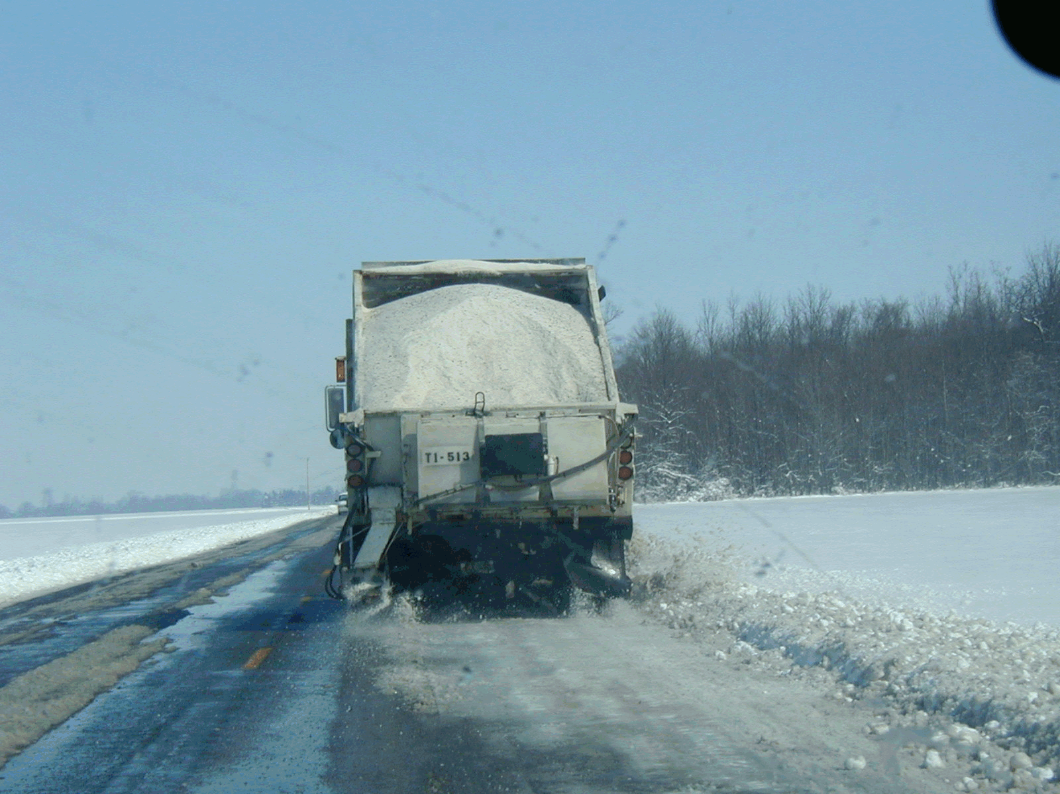

Slide 3
Solid Material Application
Application Rates
Controls
Zero Velocity Spreaders

Slide 4
Exercise: Equipment
What type of controls are used on the ODOT fleet?

Slide 5
Exercise: Equipment
What type of controls are used on the ODOT fleet? Automated
This device automatically adjust application rates to vehicle speed.

Slide 6
Exercise: Lesson Five Review
True or False? The application rate of a spreader never changes.

Slide 7
Exercise: Lesson Five Review
True or False? The application rate of a spreader never changes.
Spreader rate depends upon: size of gate opening, auger speed, truck speed, type of material, and calibration.

Slide 8
Exercise: Lesson Five Review
True or False? ODOT’s fleet is equipped with automated controls.

Slide 9
Exercise: Lesson Five Review
True or False? ODOT’s fleet is equipped with automated controls.
Automated controls are the most effective and efficient way of controlling application rates.

