Slide 1
Pre-wetting Solids
Pre-Wetting Methods
Spreading Pre-Wetted Material

Slide 2
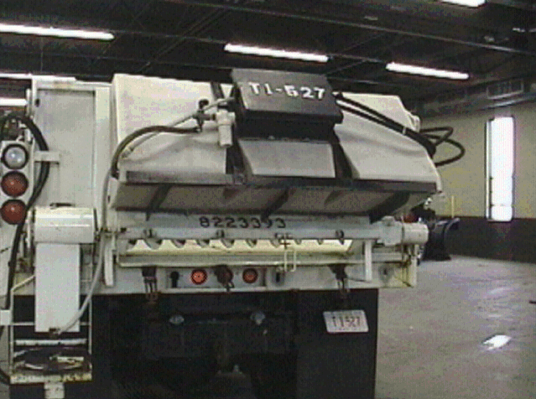

Slide 3
