Slide 1
Liquid Chemical Application Equipment
Applicator Types

Slide 2
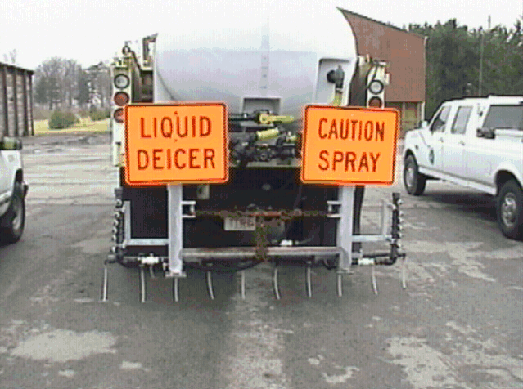

Slide 3
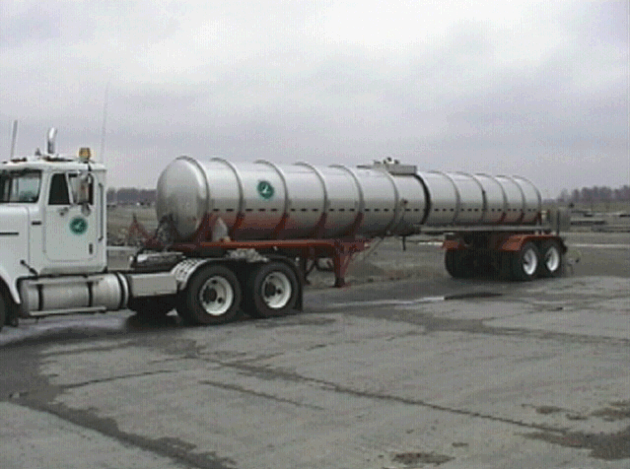

Slide 4
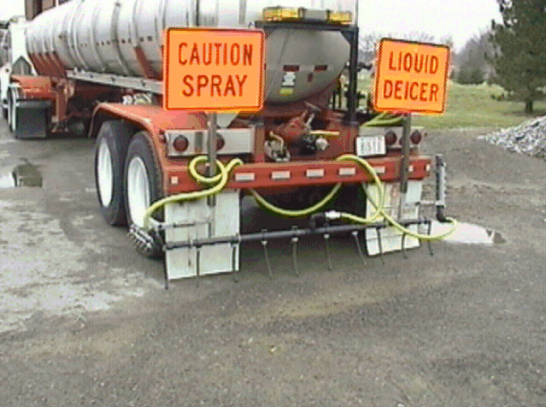

Slide 5
Liquid Chemical Application Equipment
Application Methods

Slide 6
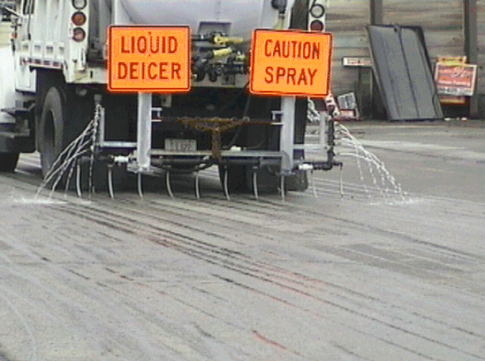

Slide 7
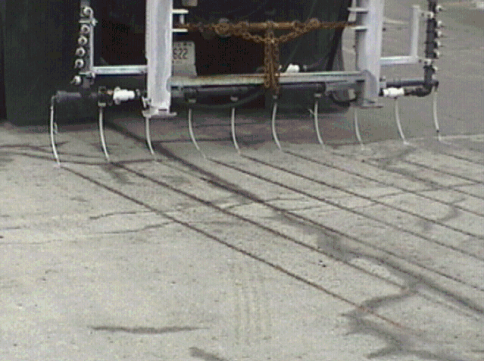

Slide 8
Exercise: Lesson Five Review
True or False? Liquid chemicals are applied using a spray bar system.

Slide 9
Exercise: Lesson Five Review
True or False? Liquid chemicals are applied using a spray bar system.
The system does not actually spray – instead a stream of liquid is applied through nozzles

