Slide 1
The National Weather Service and Winter Weather Safety
Presented By
Tim Duda - Meteorologist
NWS Caribou
WISE COLLEGE

Slide 2

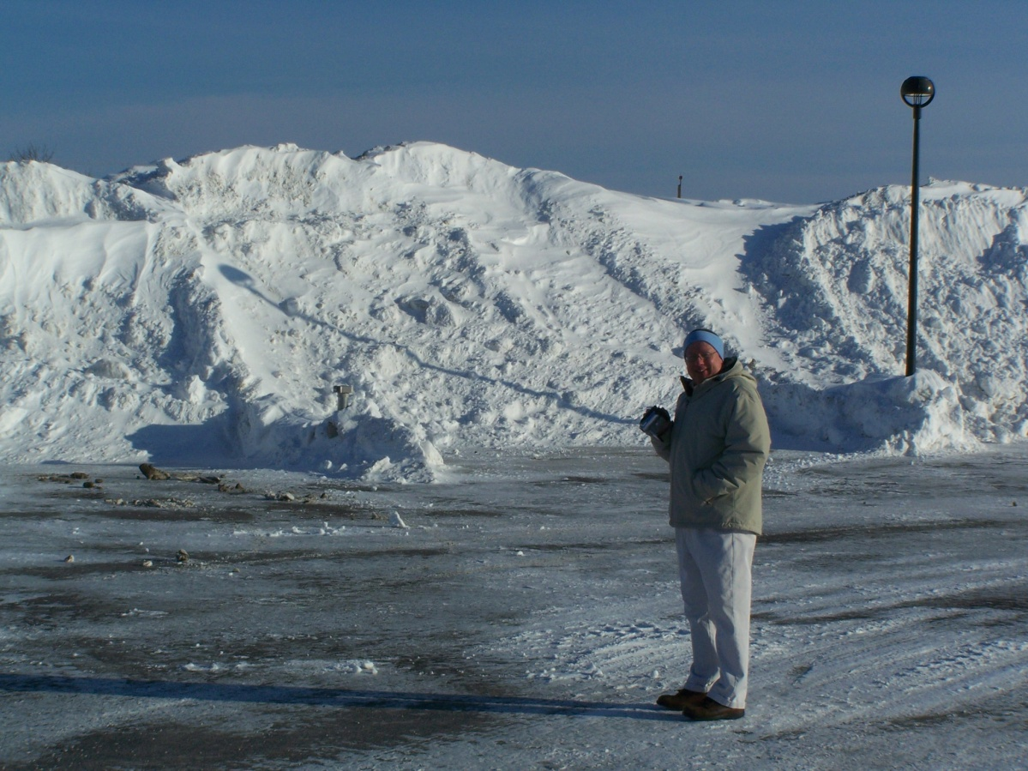
Presentation Outline
Our agency & mission
Our local office
weather.gov/car
Winter Weather Challenges
Weather Safety
Winter Wx. Criteria
You’re Role
Contact information

Slide 3


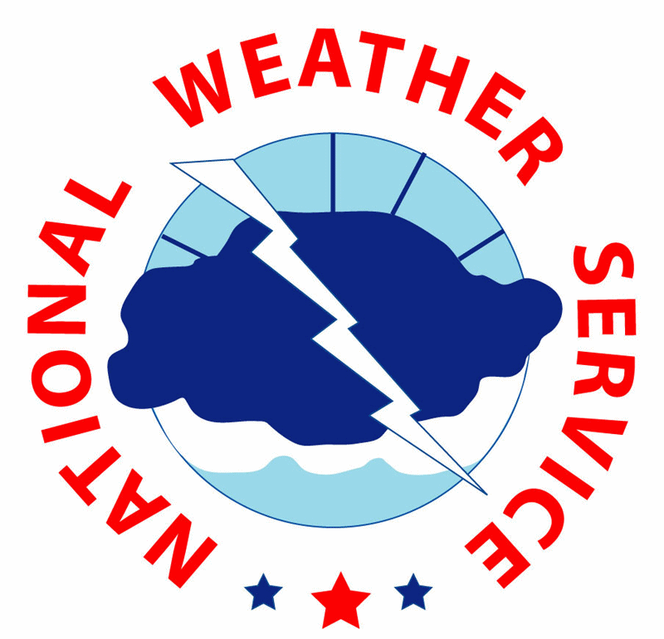
The National Weather Service
"The National Weather Service (NWS) provides weather, hydrologic, and climate forecasts and warnings for the United States, its territories, adjacent waters and ocean areas, for the protection of life and property and the enhancement of the national economy. NWS data and products form a national information database and infrastructure which can be used by other governmental agencies, the private sector, the public, and the global community."

Slide 4
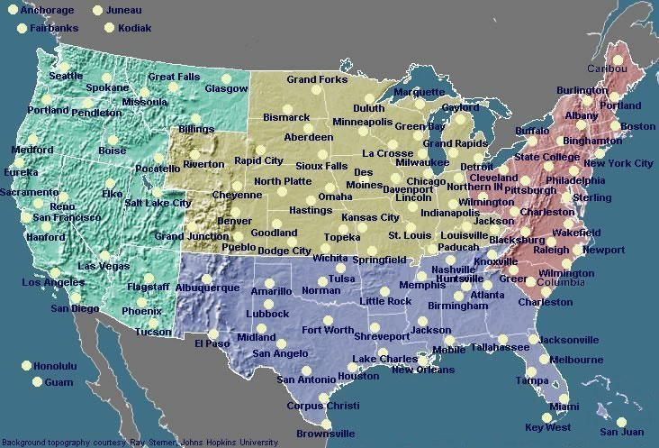
A National Perspective

Slide 5
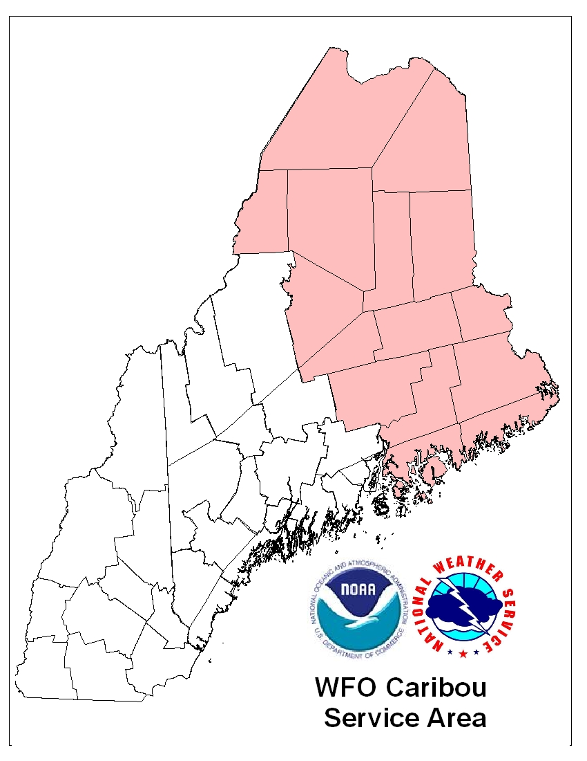
Serving Northern and Downeast Maine
Aroostook
Hancock
Piscataquis
Penobscot
Washington
Portions of Somerset
25nm Off-shore from Eastport to Stonington

Slide 6
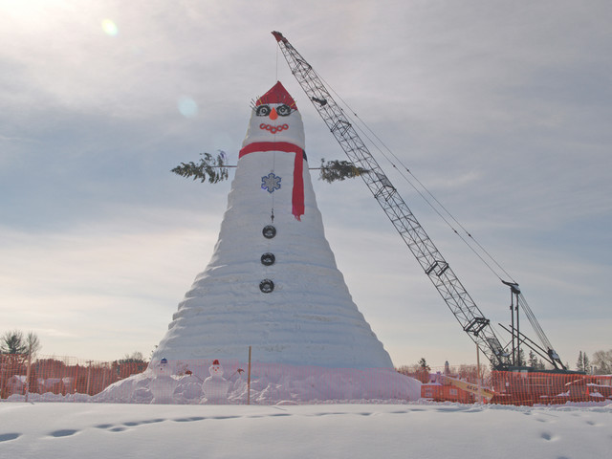
Routine Services
7 day forecasts
Severe Weather
Aviation
Fire Weather
Marine
Upper Air
Ozone testing
24 hour conferencing

Slide 7
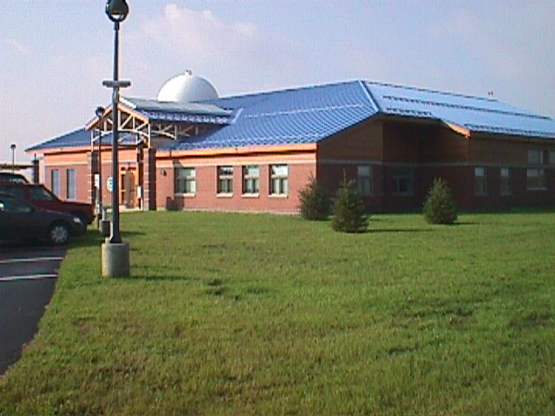
Our Office
23 Employees
9 Meteorologists
2 Hydromet Technicians
2 Engineering staff
4 Management staff
1 Observation Program Leader
1 Information Technology Officer
1 Service Hydrologist
1 Admin. Assistant
2 Meteorologist Intern

Slide 8
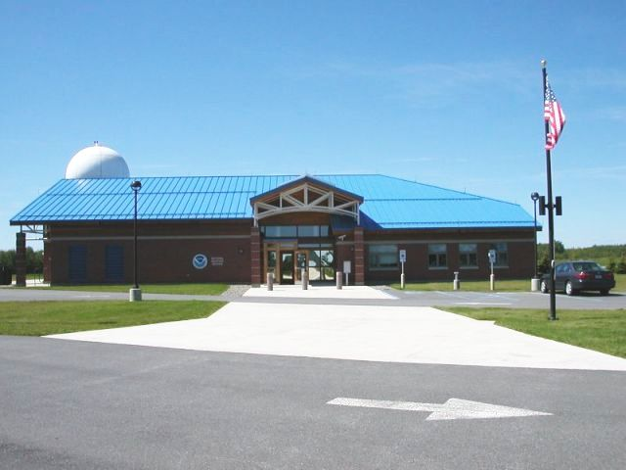

Slide 9
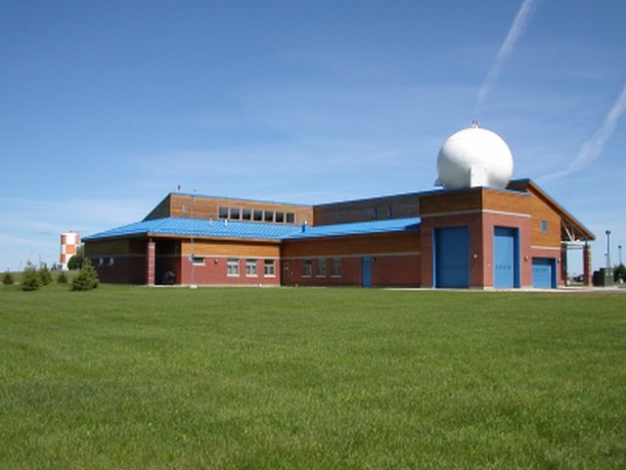

Slide 10
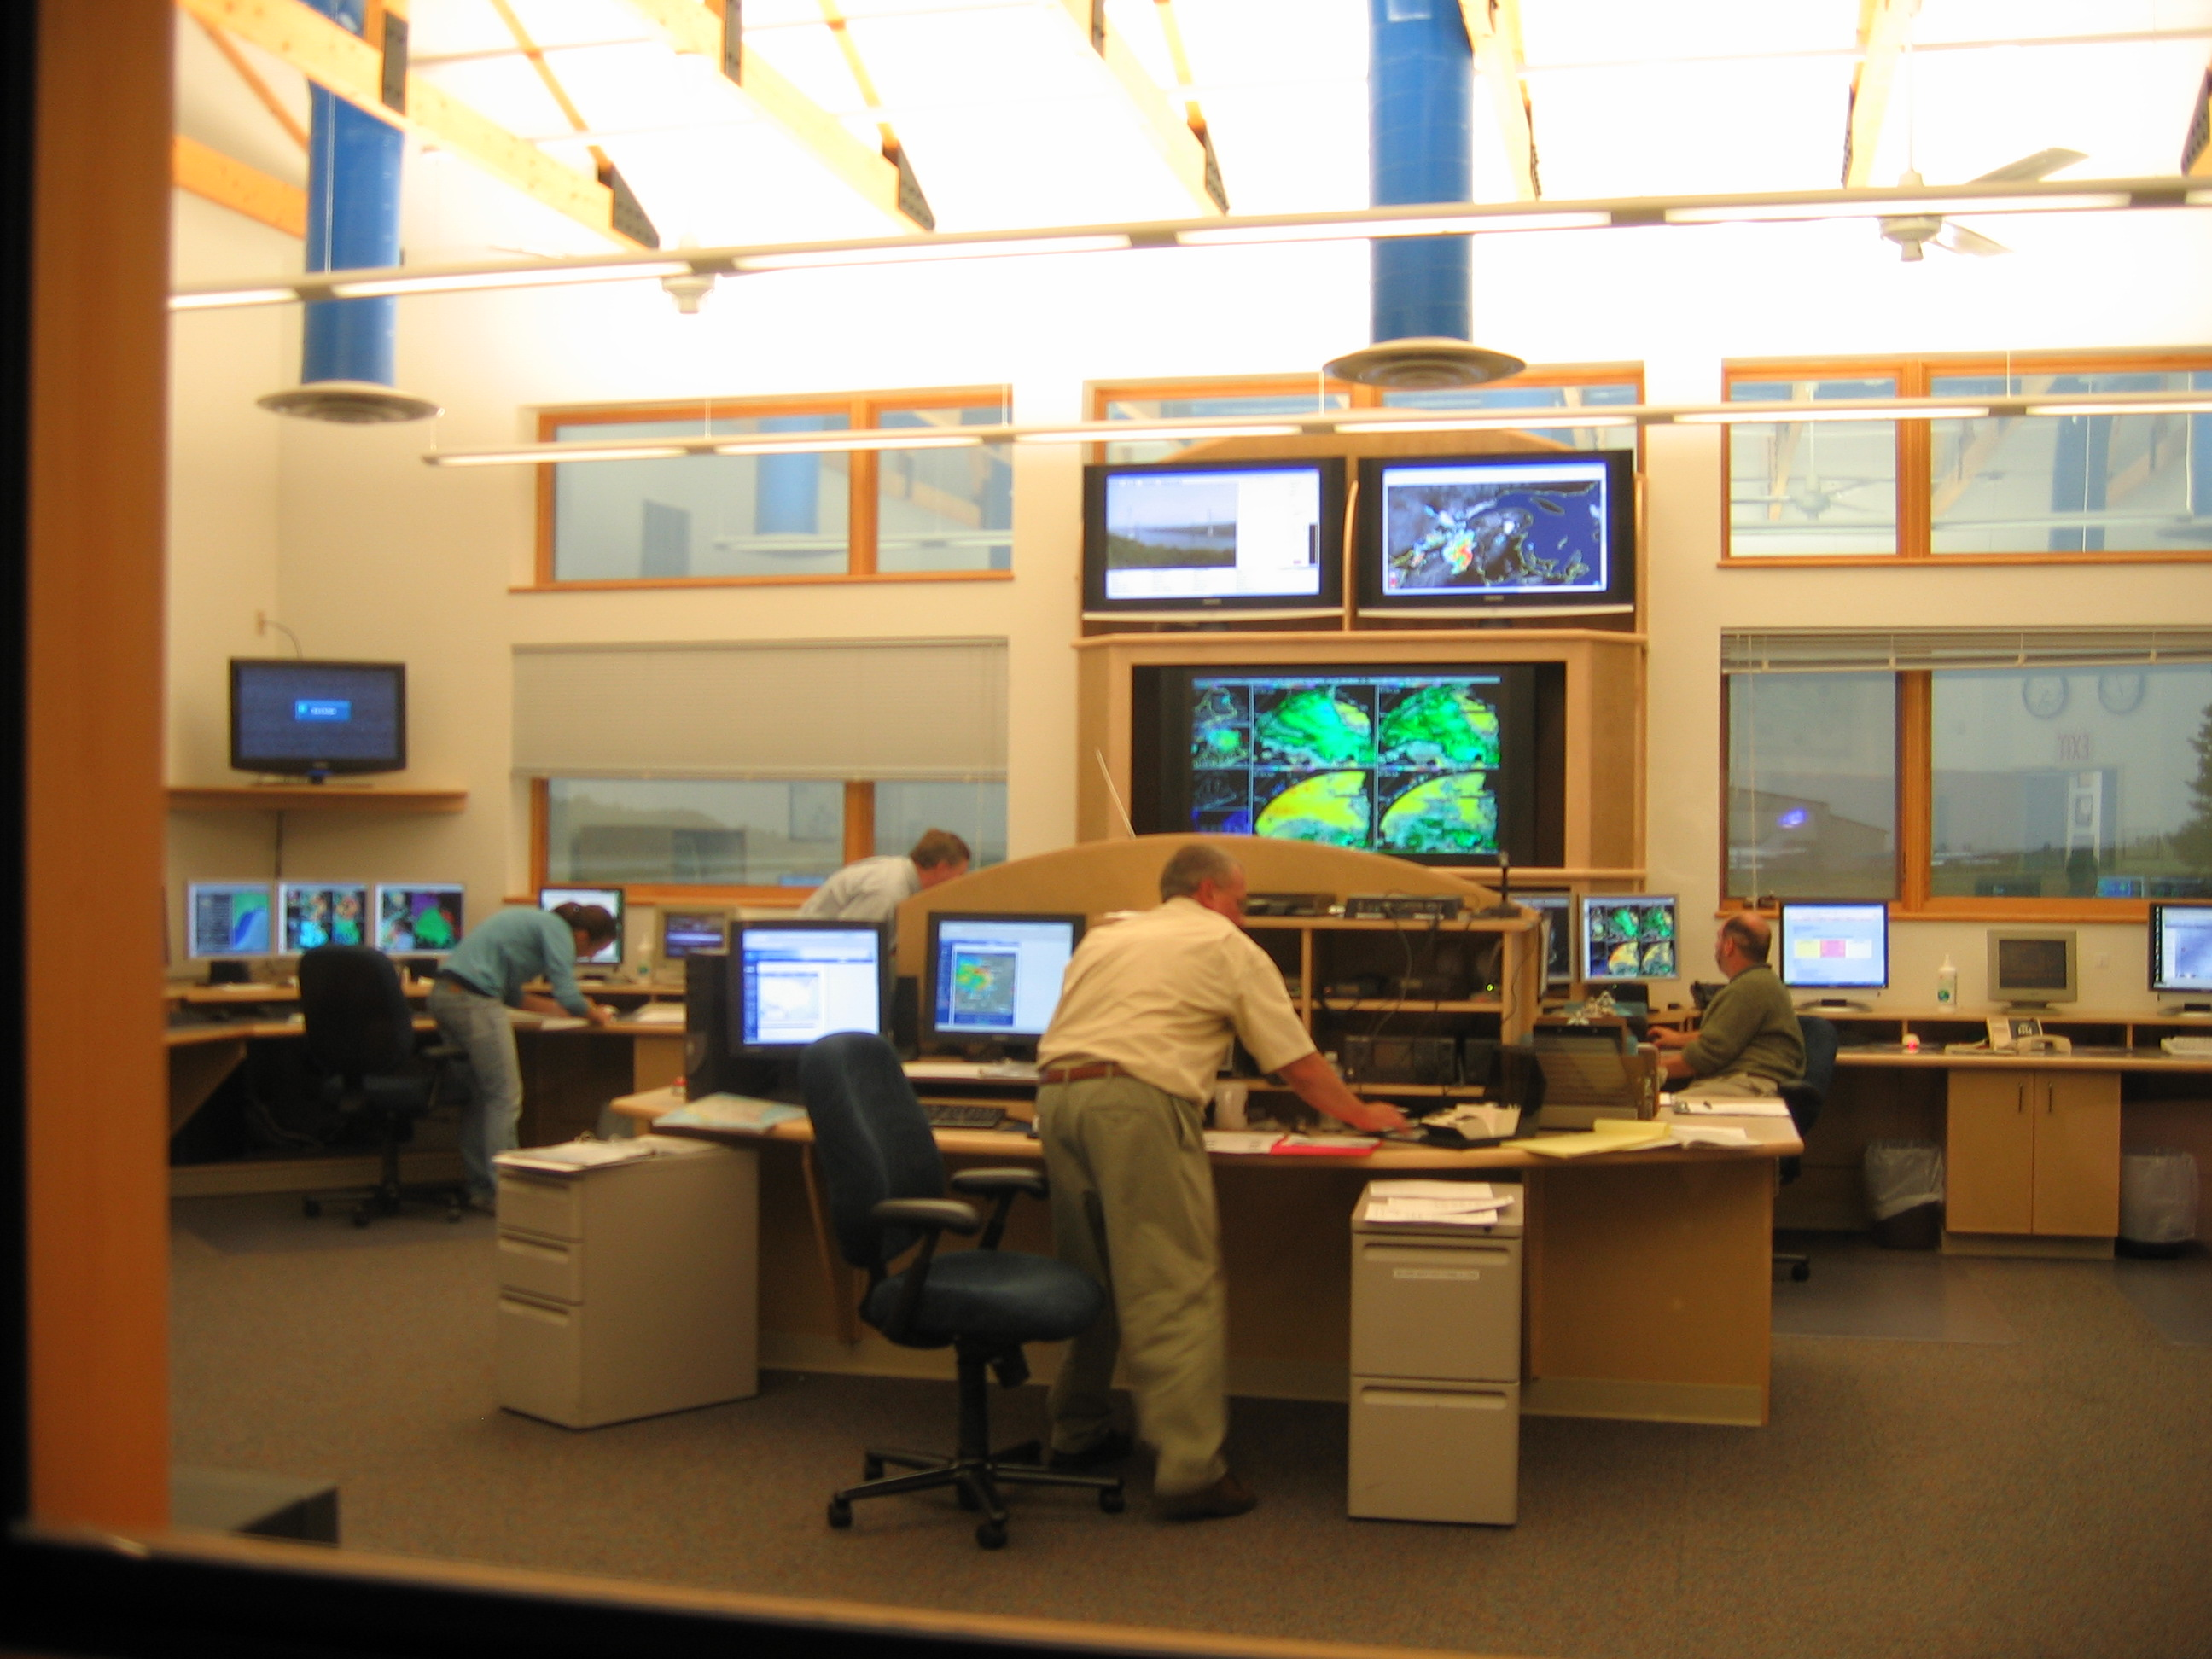

Slide 11
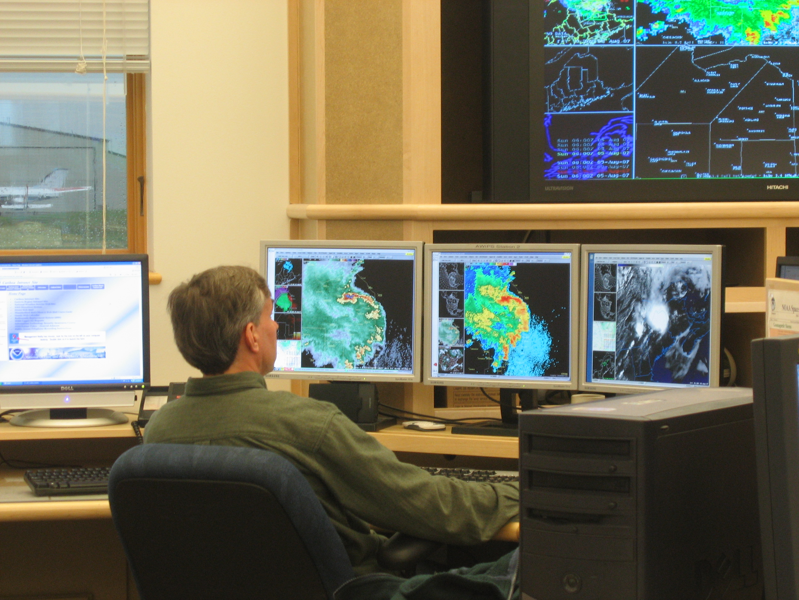
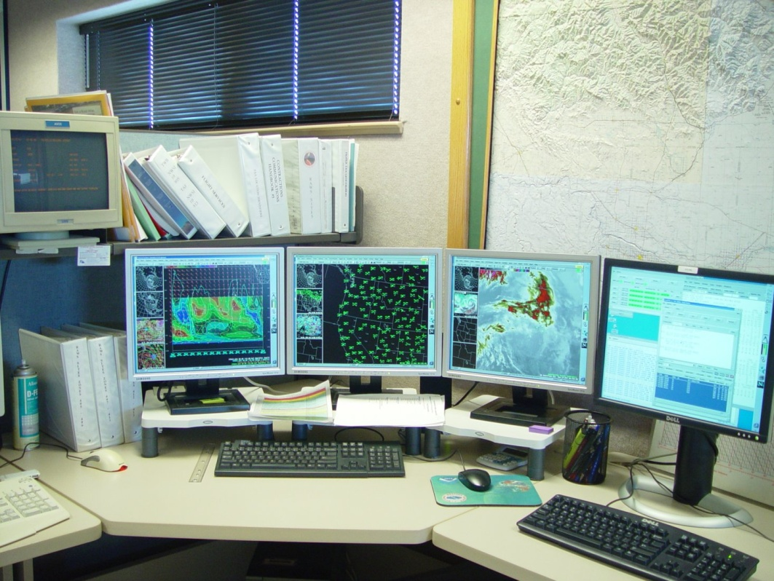
AWIPS
Advanced Weather Interactive Processing System
Real-time weather information
Forecast model output
Issuing severe weather products

Slide 12
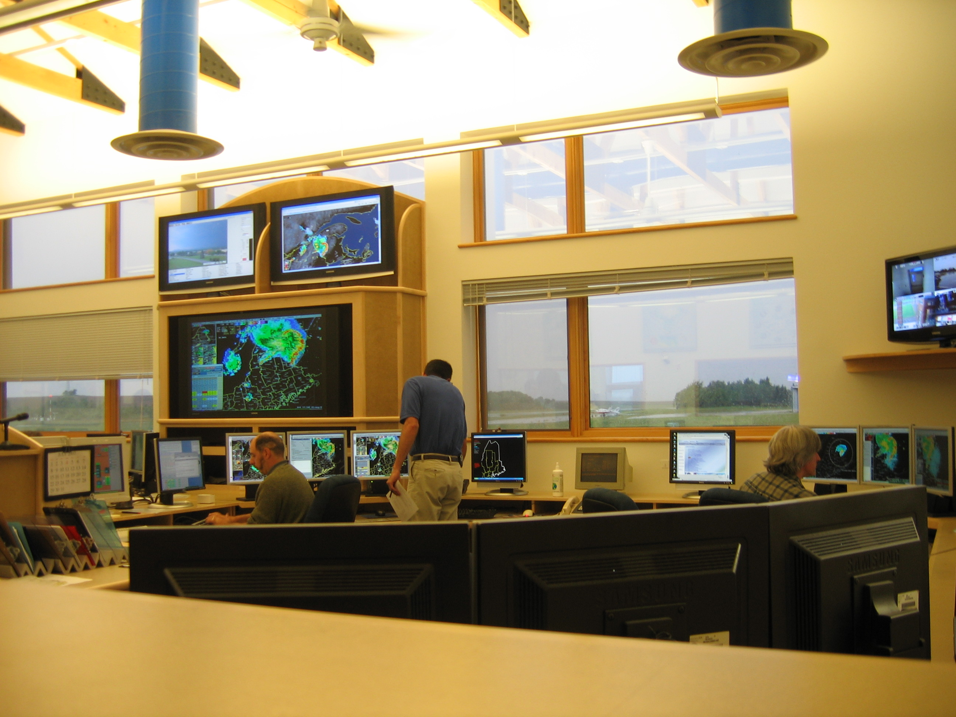

Slide 13
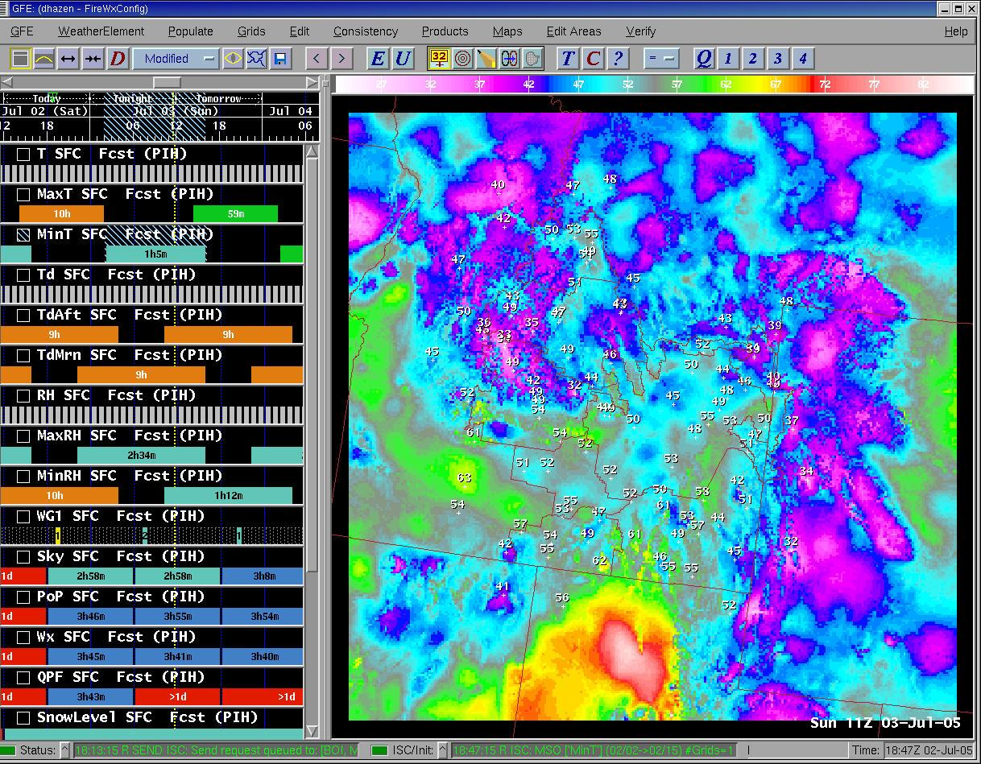
GFE
Graphical Forecast Editor
Temps, precipitation, winds, sky cover, hazards, relative humidity, etc…
Updated continuously

Slide 14
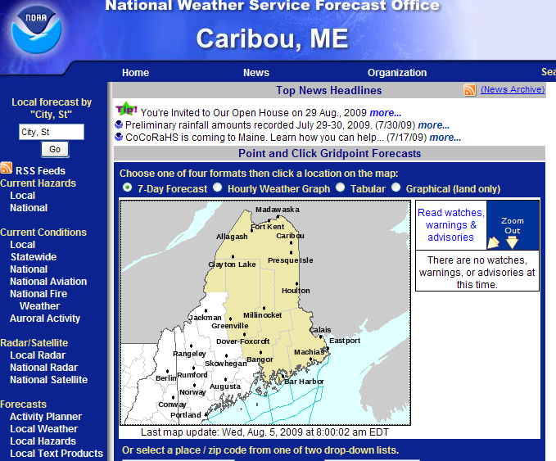
Our Website
www.weather.gov/caribou
Clickable forecast map
Links to observations, radar, satellite, climate, river, safety and forecast information

Slide 15
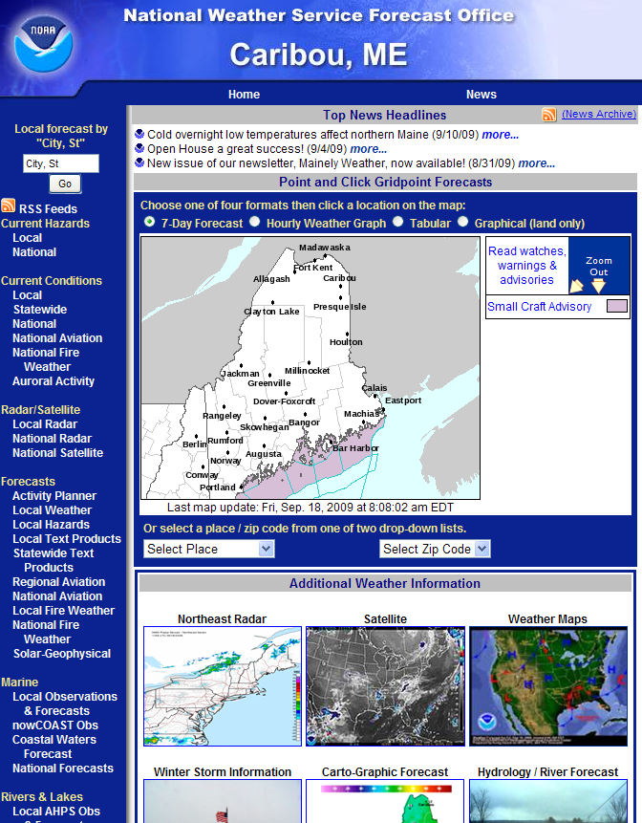
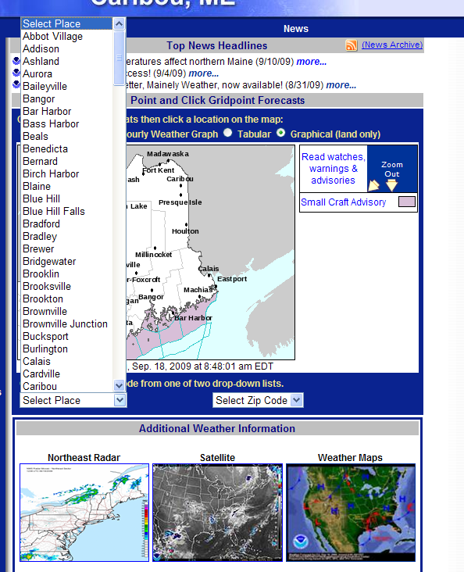
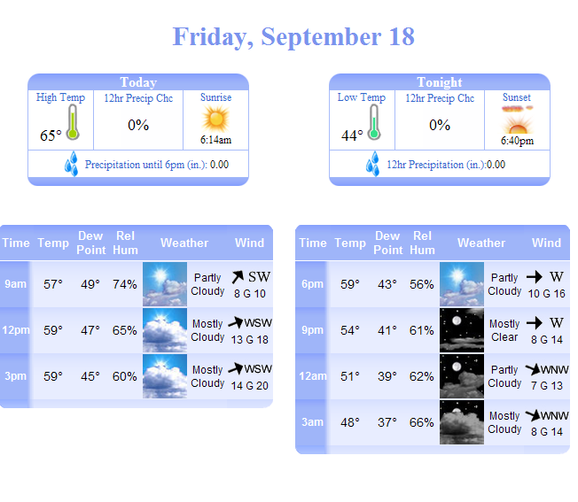
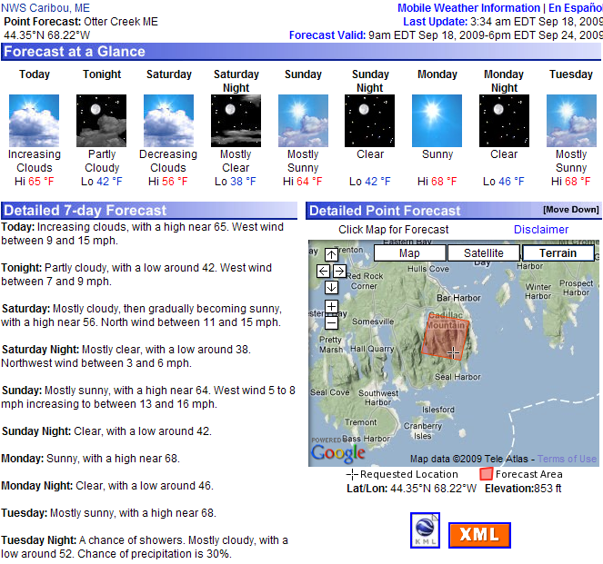
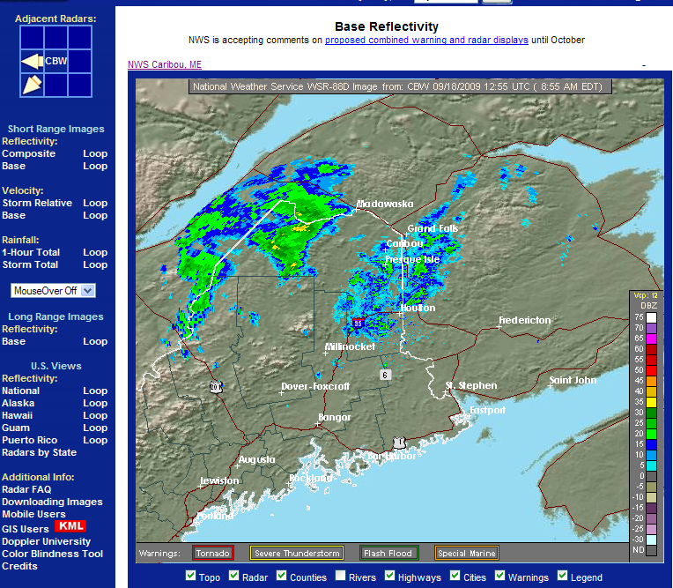
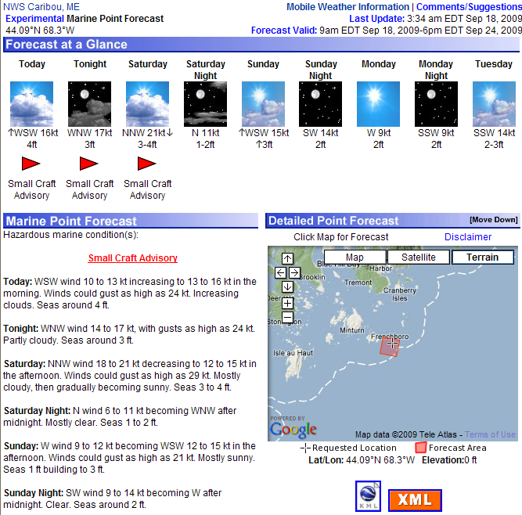
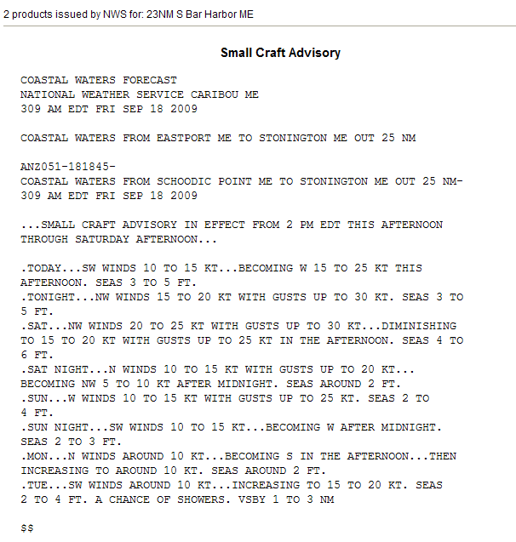
Our Website

Slide 16
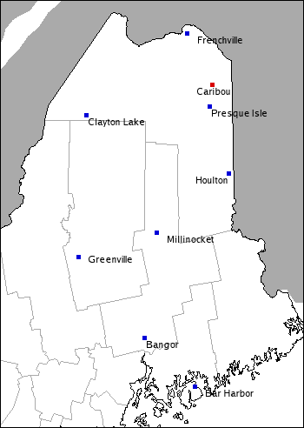
Summary of 2009-2010 Winter Season
Temps Above Average
70.3 inches
Below Average Snowfall
55.7 inches

Slide 17
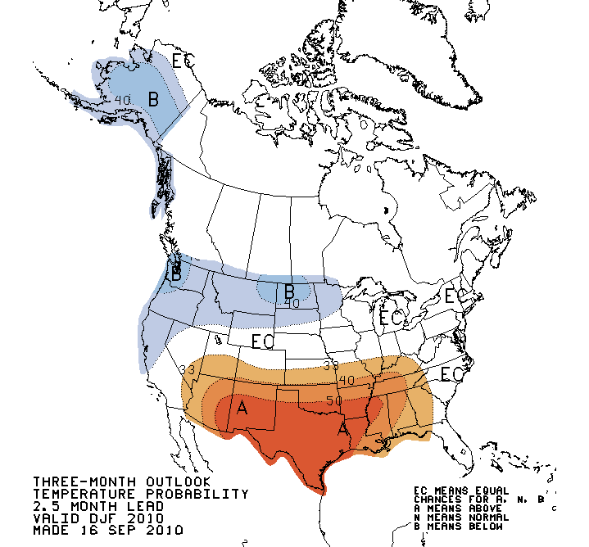
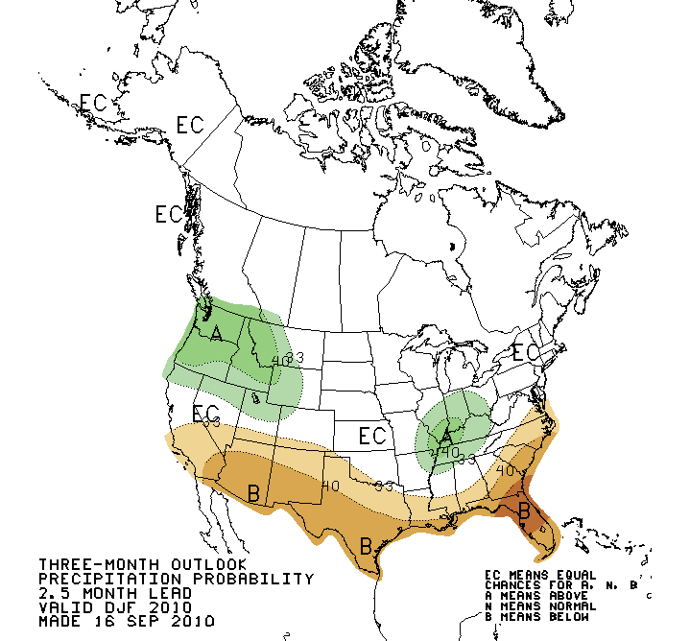
Climate Prediction Center
Winter Outlook 2010-2011

Slide 18
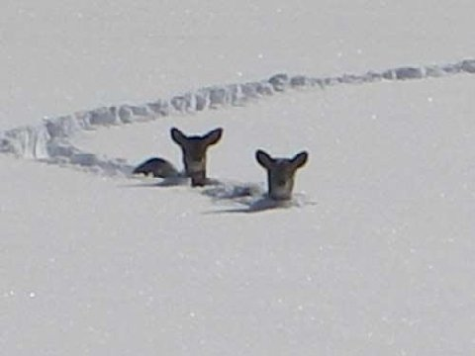
Maine Winter Wx. Hazards
Strong Winds
Heavy Snow
Freezing Rain
Extreme Cold
High Surf/Seas

Slide 19
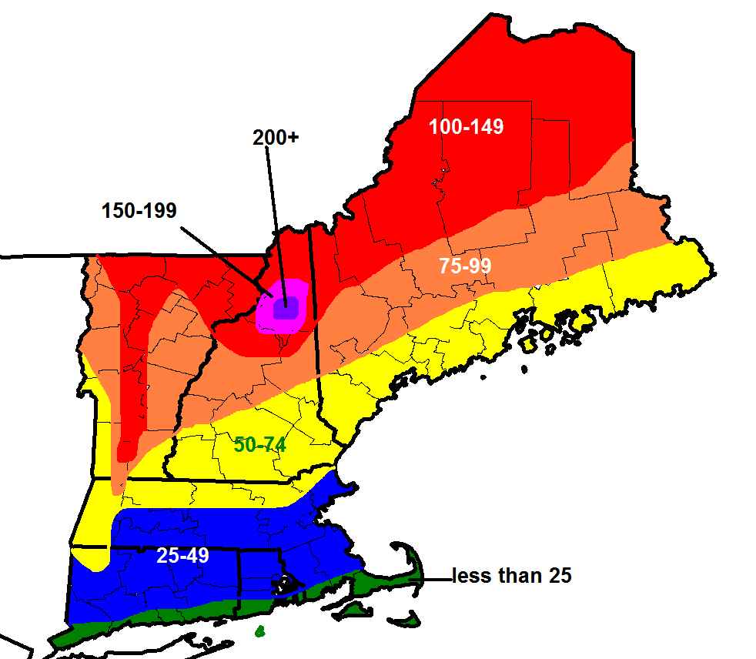
Annual Snowfall (inches)
10/11/2010
19

Slide 20
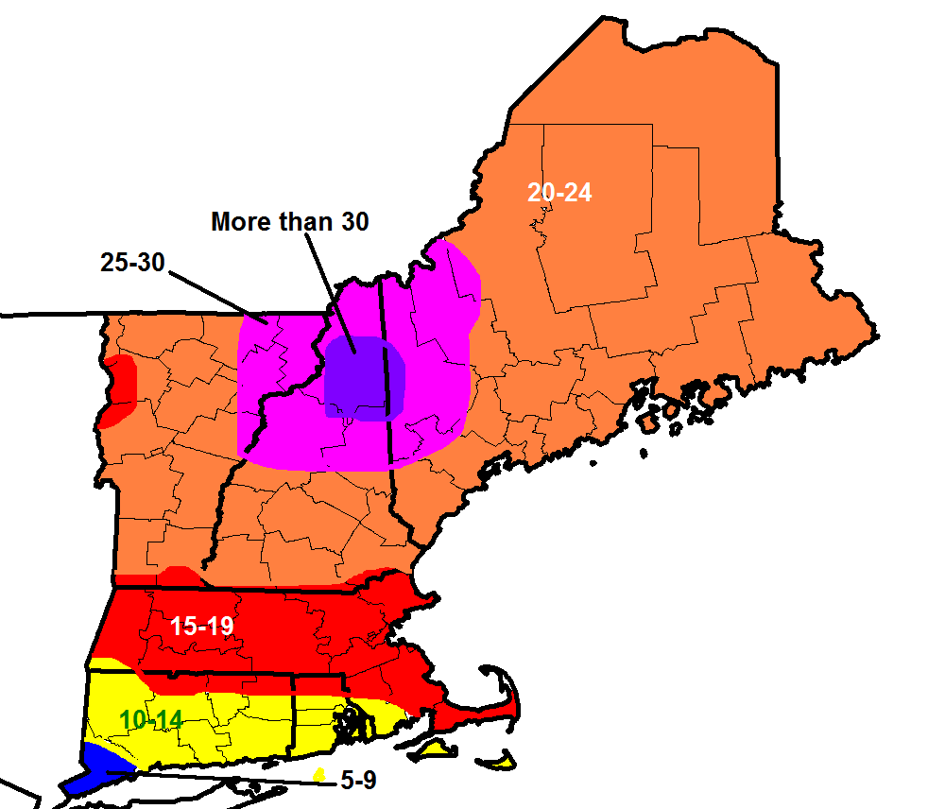
Days with Freezing Precipitation
20

Slide 21
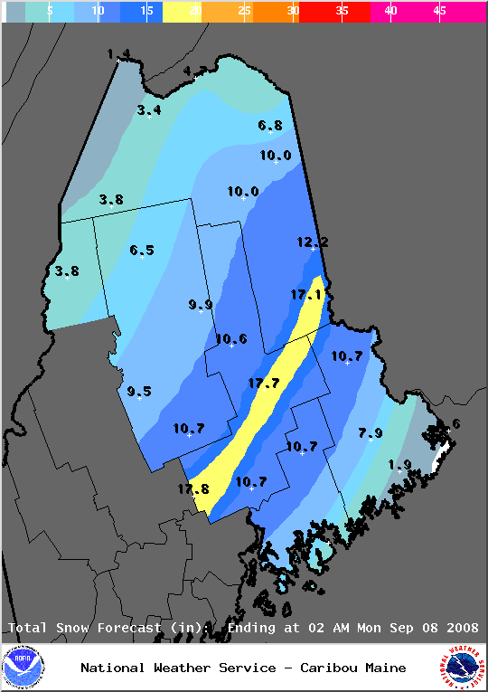
www.weather.gov/car
Example Storm Total Snowfall graphic

Slide 22
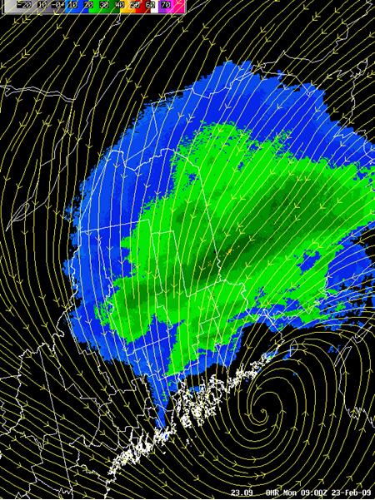
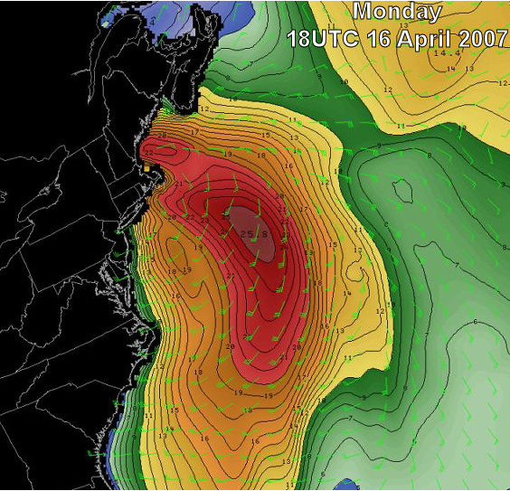
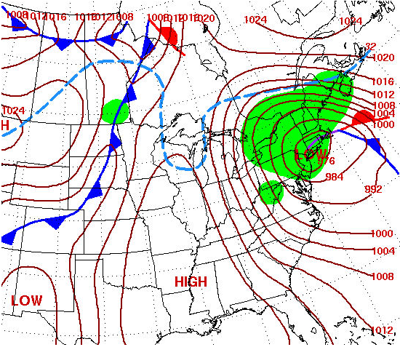
Coastal Storms
Low tracking up the coast
Deepening pressure
High winds, snow, ice, high seas, etc.

Slide 23
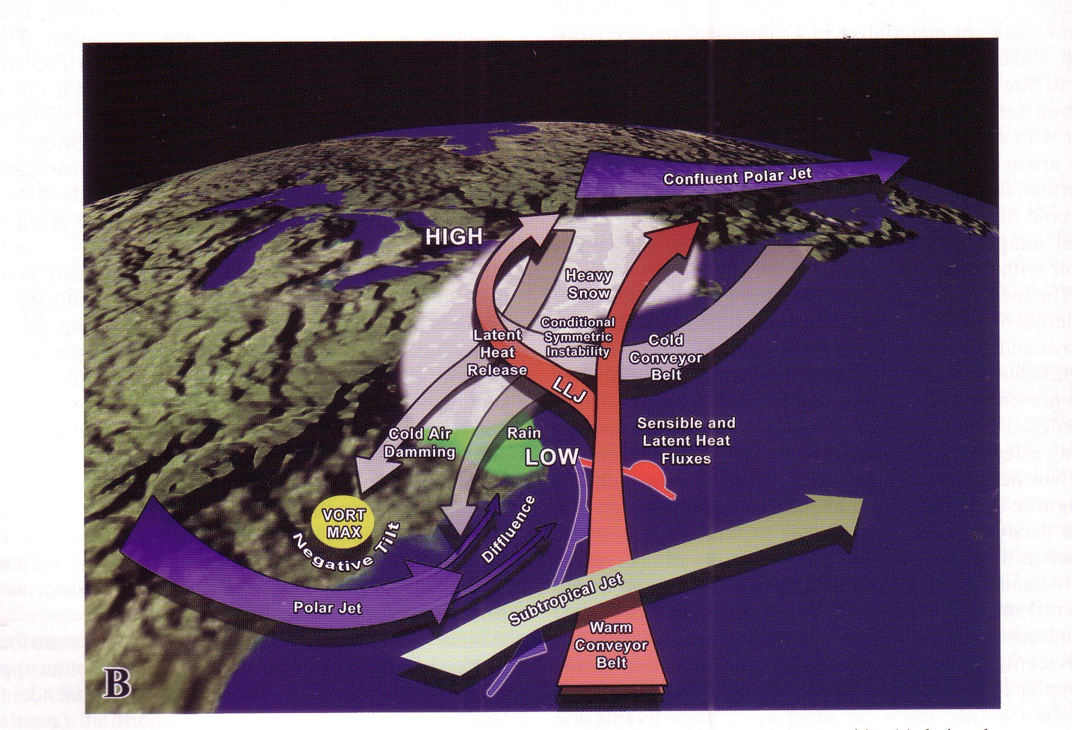
Nor Easter

Slide 24
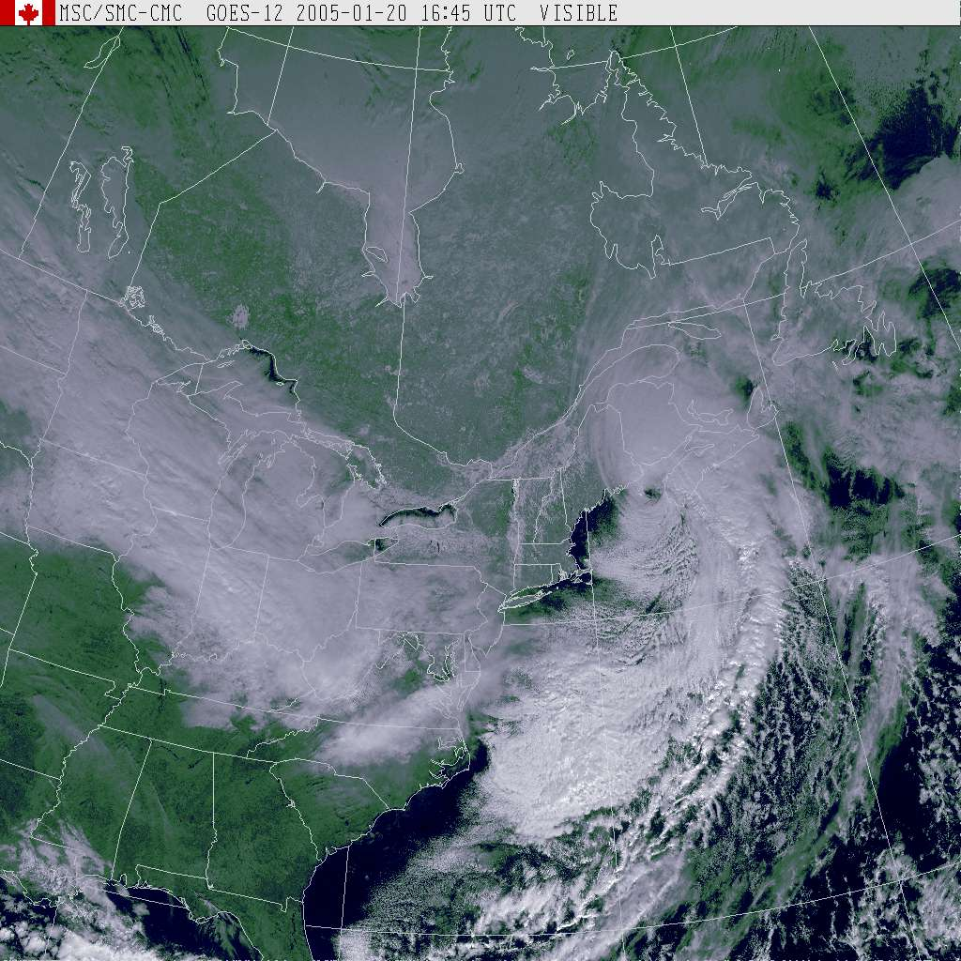

Slide 25
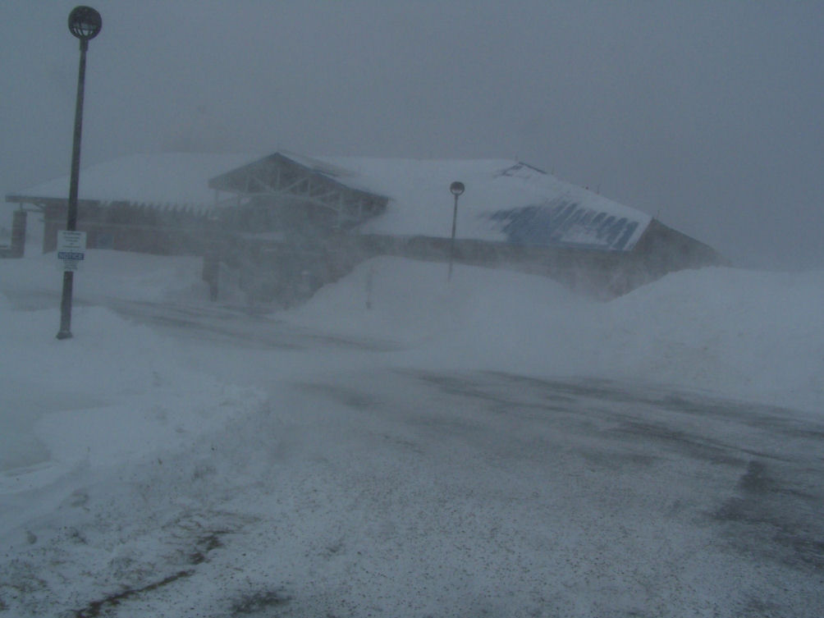
Blizzards
Sustained winds or gusts 35 mph or more
Accompanied by falling and/or blowing snow
Frequently reduces visibility to ¼ mile or less for 3 or more hours

Slide 26
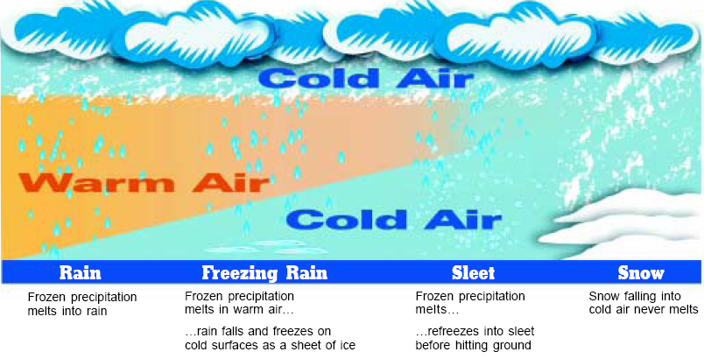
Precipitation Types

Slide 27
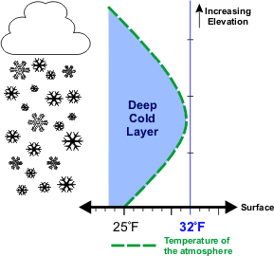
SNOW
Entire Column is Below
Freezing

Slide 28
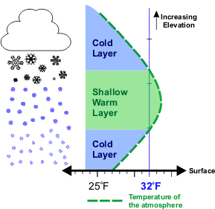
SLEET
Shallow Warm Layer Above
a Sub Freezing Layer

Slide 29
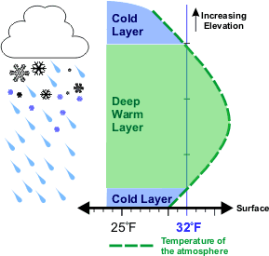
Freezing Rain
Deep Warm Layer Aloft

Slide 30
Multi-tiered Winter Weather Forecast Concept
READY Hazardous Weather Outlook
SET Watch
GO Warning or Advisory

Slide 31
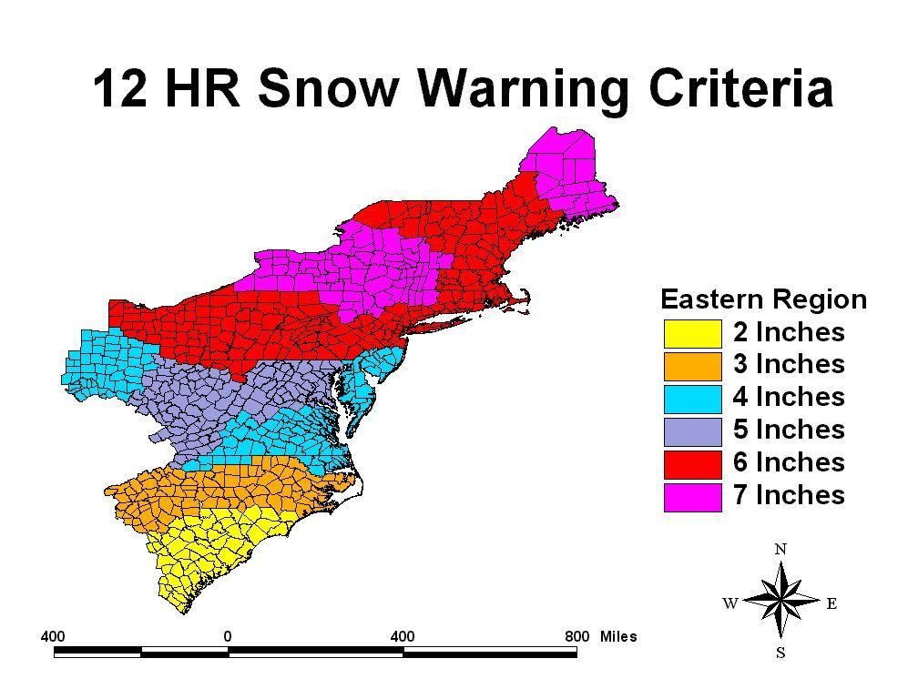

Slide 32
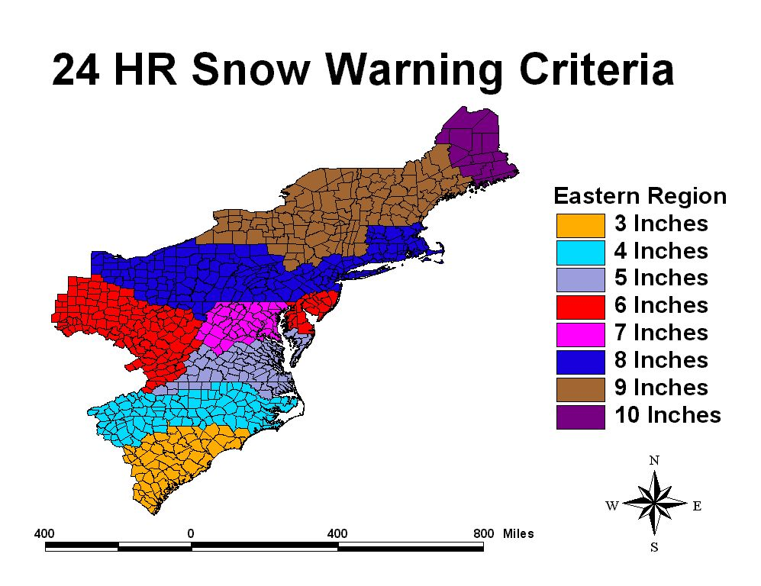

Slide 33
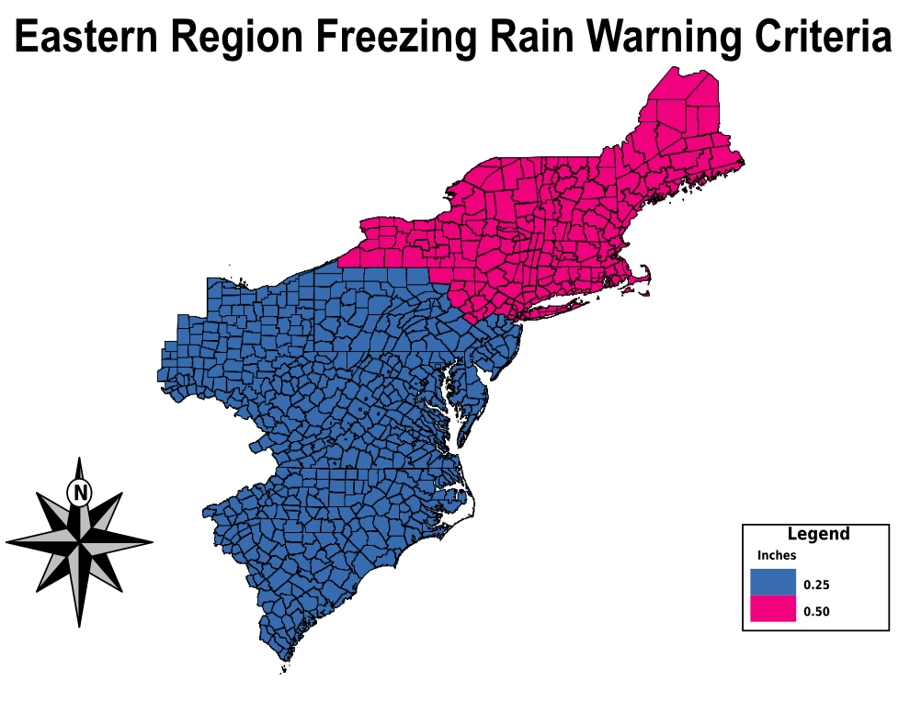

Slide 34
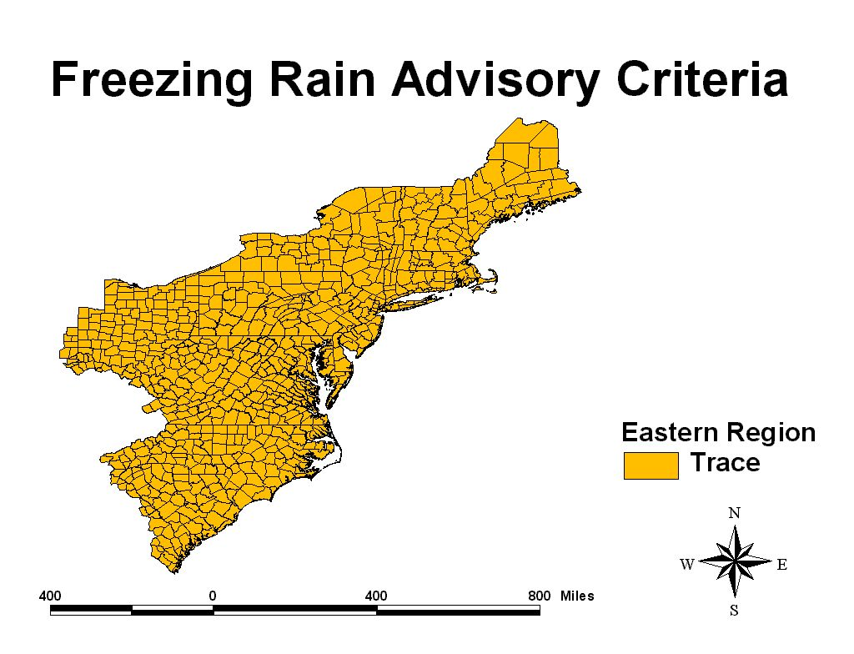

Slide 35
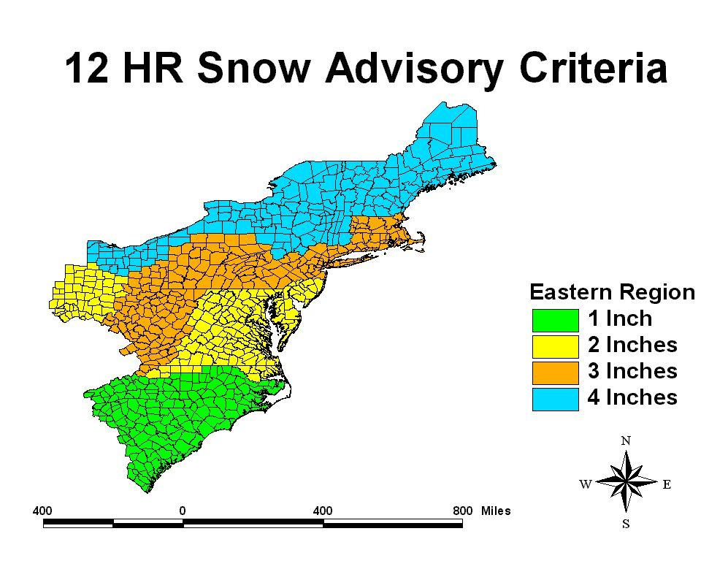

Slide 36
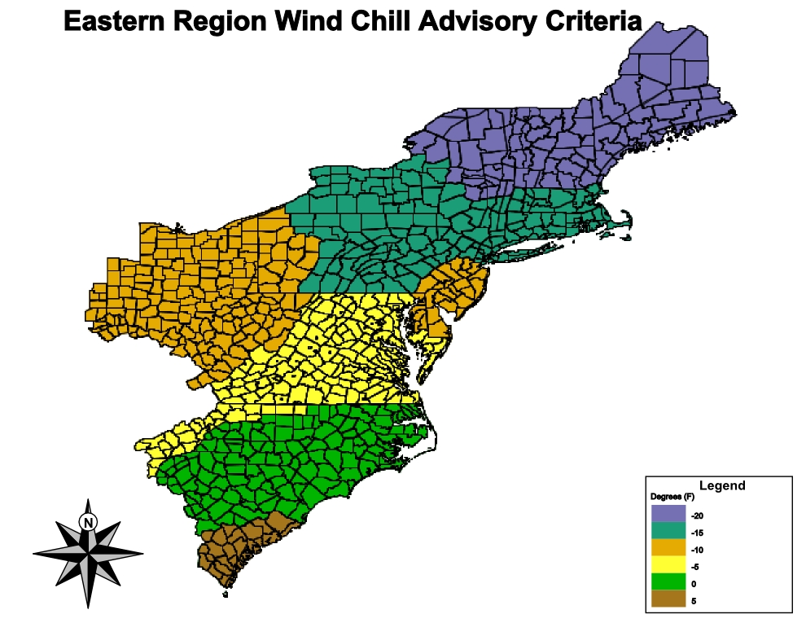

Slide 37
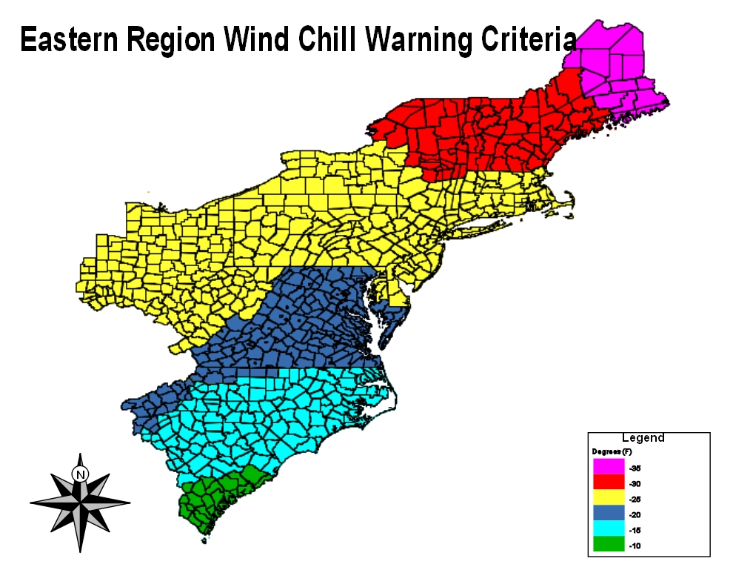

Slide 38
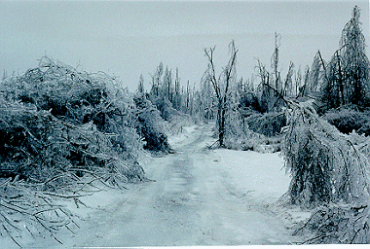
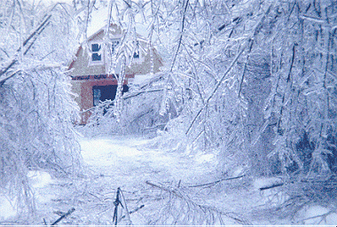
Ice Storms
Ice Storms
Widespread damage
Power outages
Dangerous travel

Slide 39
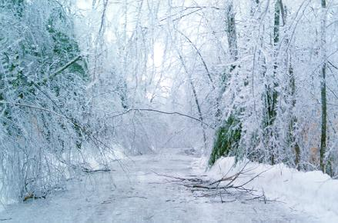
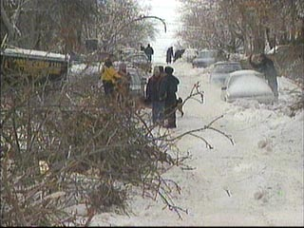
January 1998 Ice Storm
The January ice storm was the worst ever in the experience of many people in upstate New York and northern New England, both in the amount of ice that accreted on trees and structures, and the extent of the storm. USACE Report
Some locations received over 3 inches of rain (as freezing rain)
Northeast through New England reported over 500,000 customers without power (some up to three weeks).
80% of Maine's population lost electrical service.
Damages at least $1.4 billion for the U.S.

Slide 40
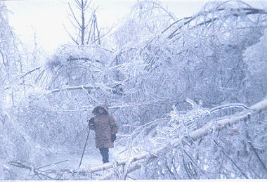
Mooers NY Jan 7-9 1998

Slide 41

Mooers NY Jan 7-9 1998

Slide 42

Black Ice Formation and Safety
-Watch for days when the pavement becomes cooler than the dew point.
-Pavement will cool the air above it, and cause ice to form.
-Most common in low spots, and bridges/overpasses when the structure is not insulated by ground.

Slide 43
Black Ice Considerations
Black ice can be VERY localized and will usually form in low-lying areas first.
Black ice situations are difficult to forecast. We will issue forecasts only if conditions are ripe for widespread black ice. These widespread situations are rare.
Prime time for black ice formation is LATE at night – but can occur as early as the evening.
Black ice usually comes when daytime highs have been near or above freezing.
The closer the dewpoint and temperature are together, the higher likelihood of black ice (ie – dewpoint of 29 and air or surface temps of 30 = good chance).
Black ice is most likely to form on nights when fog is widespread.
Black ice more likely with calm or very light winds. Direction of winds leading up to a black ice situation most likely southeast, south or southwest.
Black ice more likely when skies are in process of clearing – especially when any of the other conditions listed above occur.
Watch for rapidly dropping temps with relatively high dewpoints (dewpoints in the 20s to near 32).
Be wary of periods of thawy weather.
High humidity and fog are always key indicators of potential black ice situations.
When looking at RWIS or Weather Sentry graphs, Be wary of temperature and dewpoint traces that are getting closer together. This indicates rising humidity.

Slide 44

Moisture Source Nearby?

Slide 45



NOAA Weather Radio Transmitters
KHB55
KHB55 Frenchville
WXM77 Mars Hill
WXN28 Springfield
KHC47 Meddybemps
KEC93 Ellsworth
KHB54 Milo
WNG542 Greenville
Marine Only
WNG543 Jonesboro
WXM77
WNG542
WXN28
KHC47
KHB54
WNG543
KEC93
8 NWR Transmitters Maintained by Electronics Staff

Slide 46

NOAA Weather Radio
Forecast and warning information 24 hours a day
Audible alarms
Programmable for your area
Civil Emergency Messages
Presidential Declarations
Amber Alerts

Slide 47

iNWS
Text alerts
Email alerts

Slide 48

NWSChat
24 hour access to forecasters via chat system
Instant access to hazardous weather products

Slide 49

Flood Safety
Never drive across a flooded roadway!
Avoid low-lying areas
When flooding is expected avoid roadways along rivers/streams

Slide 50


Slide 51

Verification:
Sources of Snow/Ice Reports
NWS Office
Airport observers
NWS “COOP” Observers
Skywarn spotters
Public, Media
Highway Departments
51

Slide 52


Slide 53
Thank You!
Thanks for your reports, and for keeping our roads safer!

Slide 54
Contact Information
207-492-0180
timothy.duda@noaa.gov

