Slide 1
What’s the big deal – salt is a naturally occurring substance!
While salt is a naturally occurring substance, high concentrations of salt negatively affect or destroy land based and aquatic habitats and species.

Slide 2
Once salt goes into solution (melts into the water) it cannot be recovered. It is stored in soil or water and can reach levels that are considered contamination.
Salt can contaminate drinking water supplies in wells and in reservoirs, inhibit the establishment of vegetation or crops, and eliminate habitat for fish and other aquatic species.

Slide 3
By implementing a few Best Management Practices (BMP’s) in handling salt and other de-icing materials, water resources can be protected.
BMP’s are also requirements in SHA’s National Pollutant Discharge Elimination System (NPDES) Industrial and Municipal Permits. Failure to implement the BMP’s can result in fines and/or criminal charges.

Slide 4
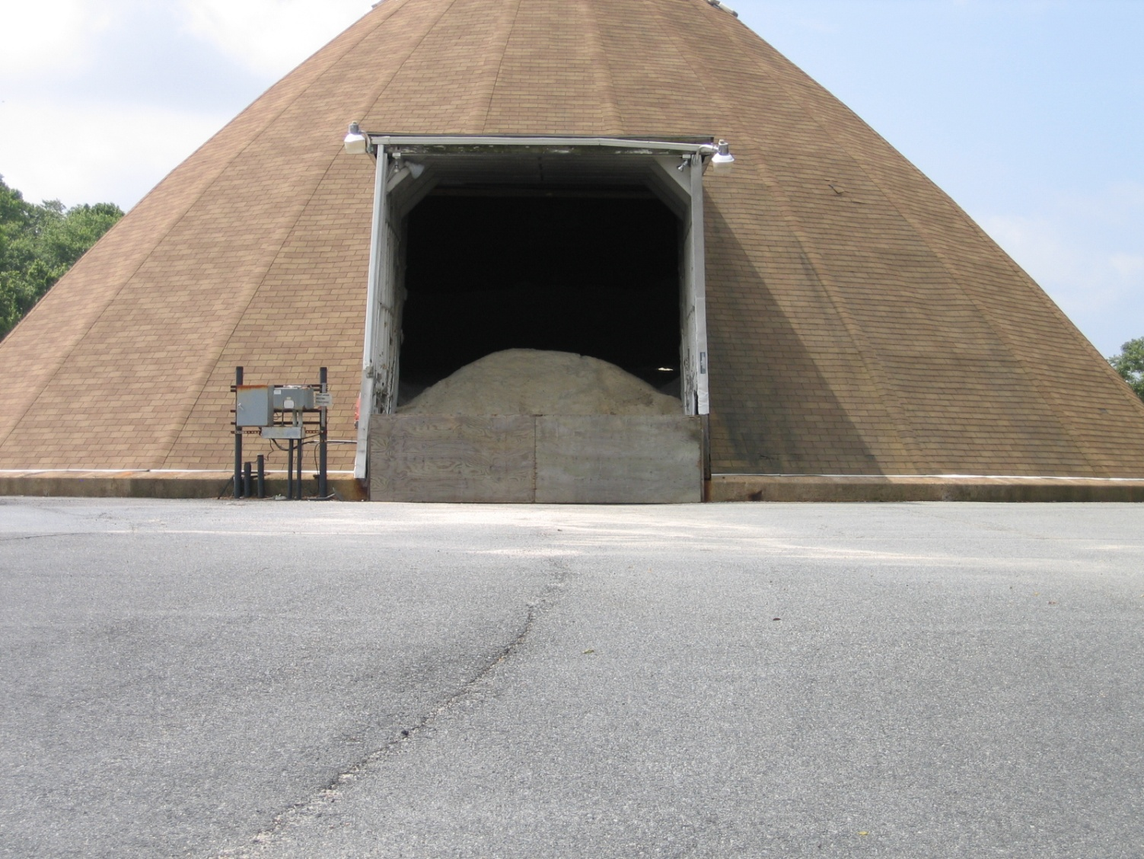
Salt Storage
During the off-season, a barrier should be placed across the structure’s opening to prevent salt from contaminating the environment.

Slide 5
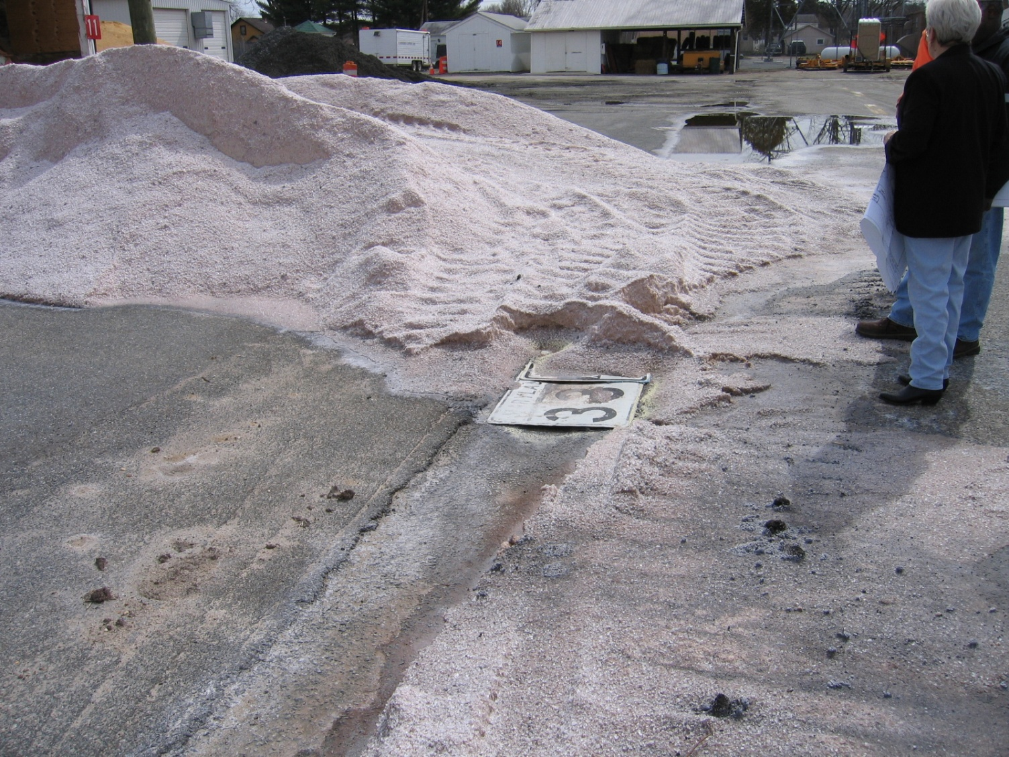
Salt Storage
Inlet
Make sure when salt is delivered, that all inlets and drainage structures are protected and all the salt is under covered storage by day’s end. Here, an inlet was protected by covering it with sheet signing, but overnight rain washed dissolved salt into the drainage system discharging it off site.

Slide 6
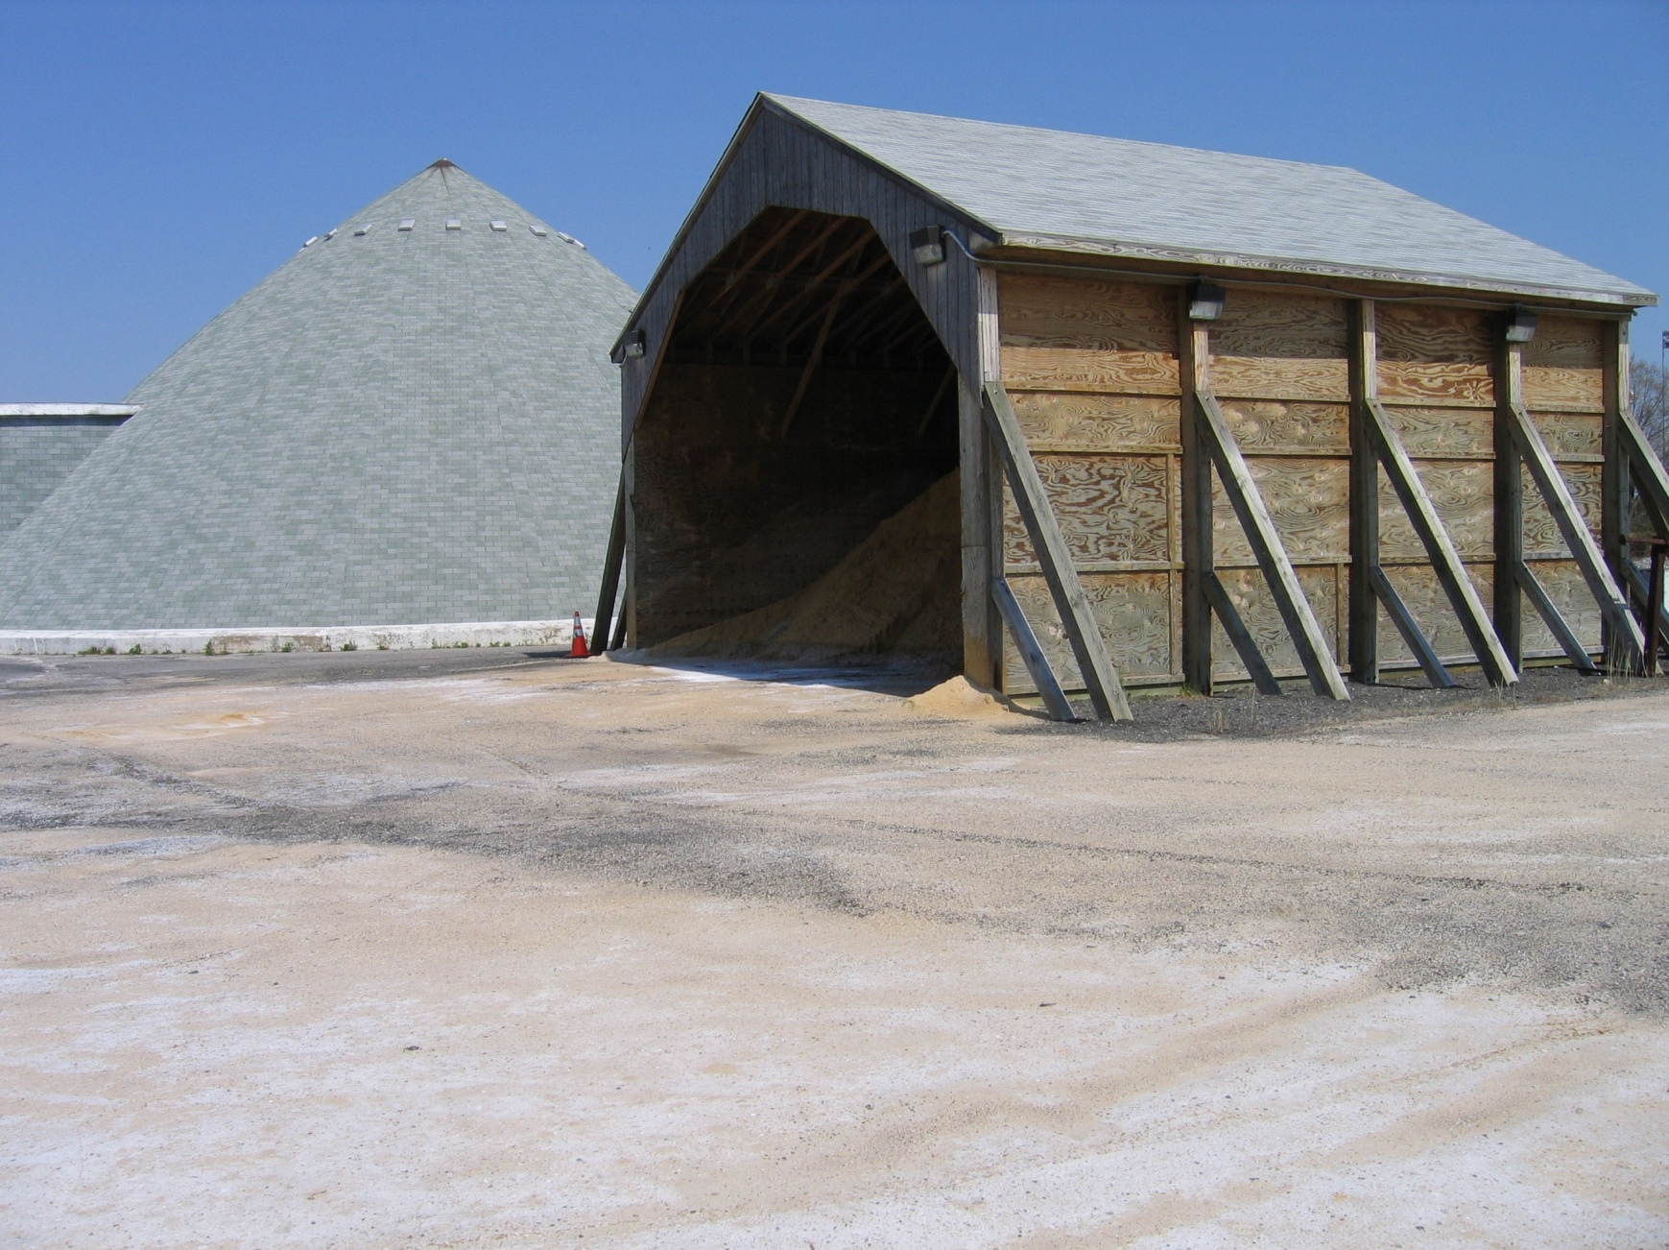
Abrasive Storage
Abrasives stored under cover. Here the material is far enough away from opening that it does not need a barrier across the opening.

Slide 7
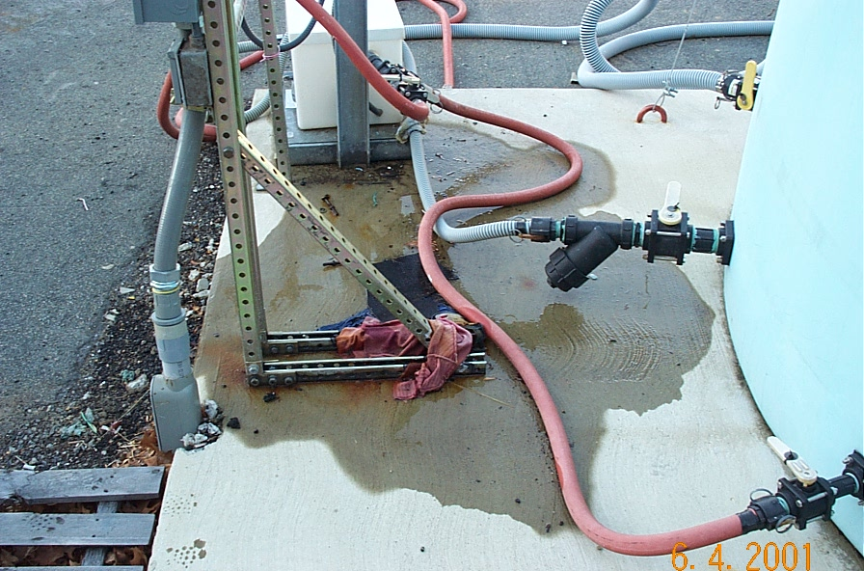
Brine and/or MgCl Storage
Inspect tanks monthly paying particular attention to valves and fittings. Place drip pan under leaks and repair immediately.

Slide 8
Salt Handling
During winter storm events, mixing salt and abrasives on impervious surfaces is allowable.
Uncovered salt/abrasive stockpiles are allowed during a storm event; however, they must be placed under cover immediately after plowing operations have stopped and the mixing area must then be free of any residual salt and/or abrasives.

Slide 9
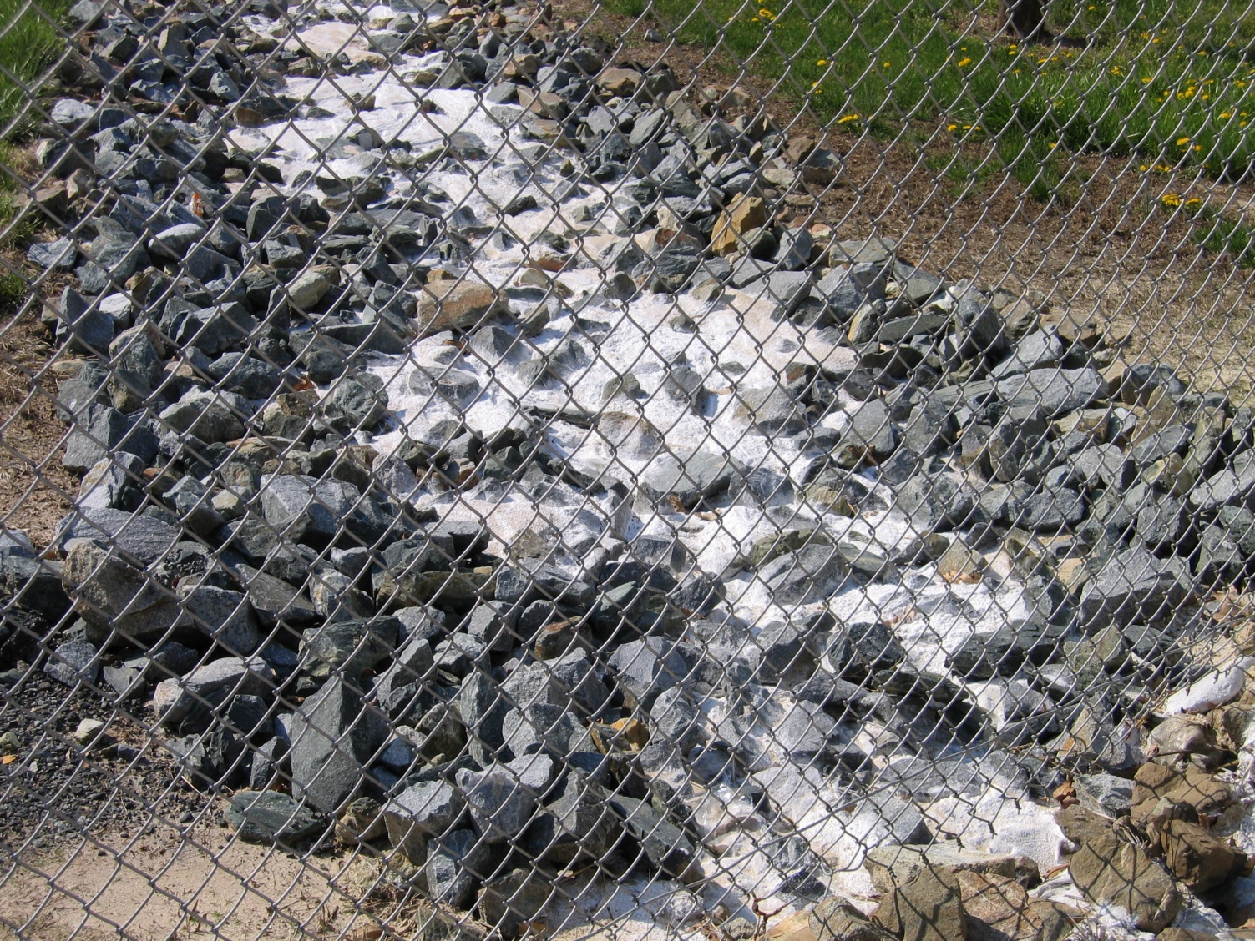
Salt Handling
Impact of a salt/abrasive mix not being placed under cover. Non-compliant with NPDES permit conditions.

Slide 10
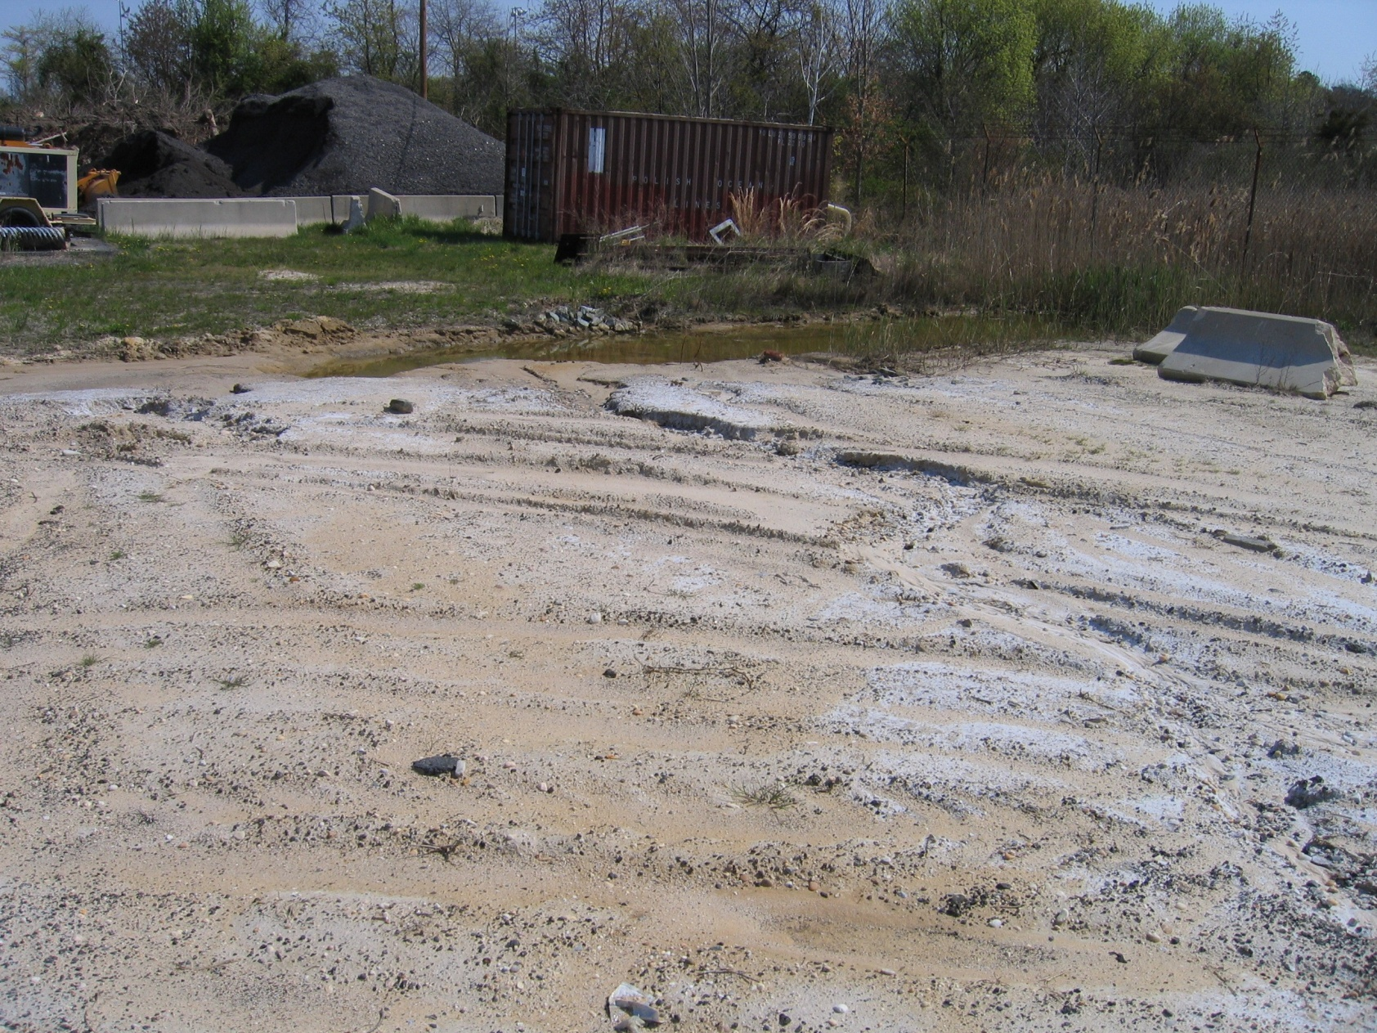
Salt Handling
Mixing salt/abrasives on unpaved areas can result in destroying vegetation and causing an erosion problem.

Slide 11
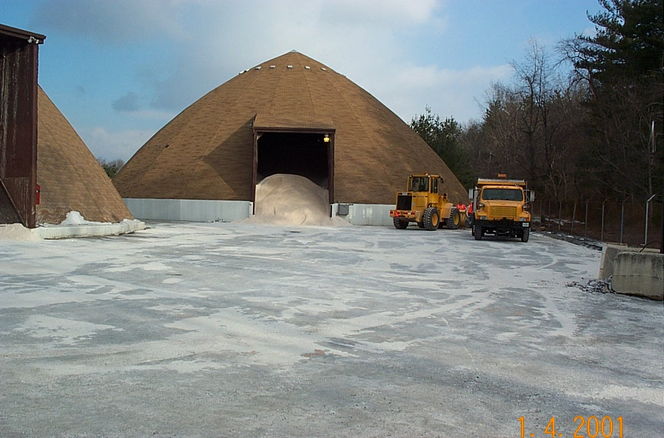
Salt Handling
To minimize spillage do not overfill trucks with salt or salt/abrasive mix. After a plowing event, all material on the lot must be swept and returned to covered storage.

Slide 12
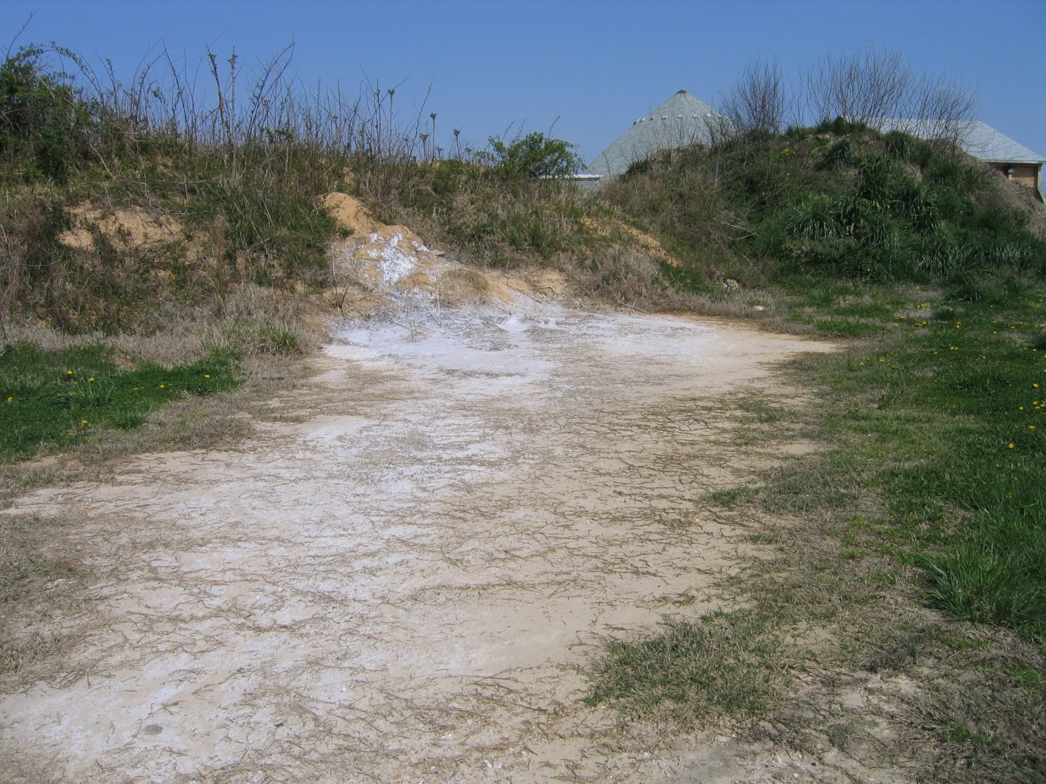
Salt Handling
All unused salt must be returned to covered salt storage area. Dumping salt in this area killed the vegetation and the area was at risk for erosion. This area had to be restored by removing contaminated soil, backfilling and seeding and mulching.

Slide 13
Materials Spreading
To provide bare pavement in a cost-effective and environmentally responsible manner:
Use appropriate shop application rates to match specific storm conditions
Unless otherwise directed, only apply salt to your designated route
Return unused salt to designated dome or barn. Never spread salt just to get rid of it.

Slide 14
Materials Spreading
By following appropriate Salt Spreading Guidelines you will be performing your job duties in an environmentally sensitive manner, reducing the amount of materials discharging from the roadway environment into the natural environment.
Remember - Excess salt run-off not only impacts aquatic habitat but also impacts drinking water in wells and reservoirs.

Slide 15
Materials Spreading
Keep your load covered - use the tarp to reduce wind erosion of material

Slide 16
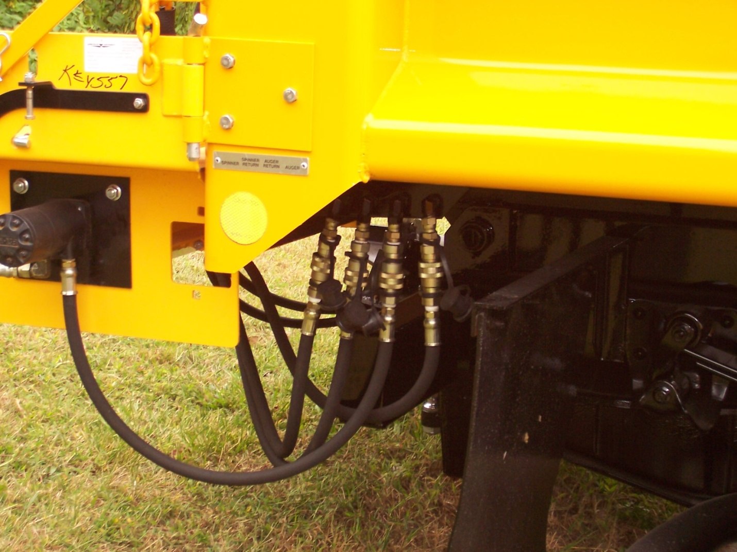
Equipment Preparation and Cleaning
Prior to winter maintenance season, calibrate equipment to ensure maximum efficiency and proper application rates.

Slide 17
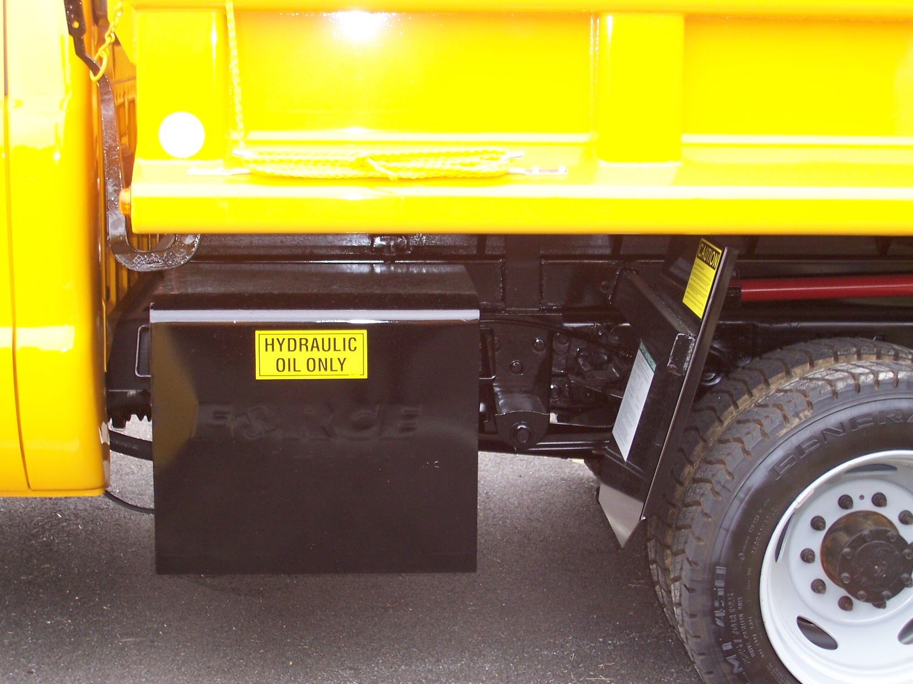
Equipment Preparation and Cleaning
Check all fluid systems for leaks to reduce the risk of leaking petroleum based products on roadways and lots.

Slide 18
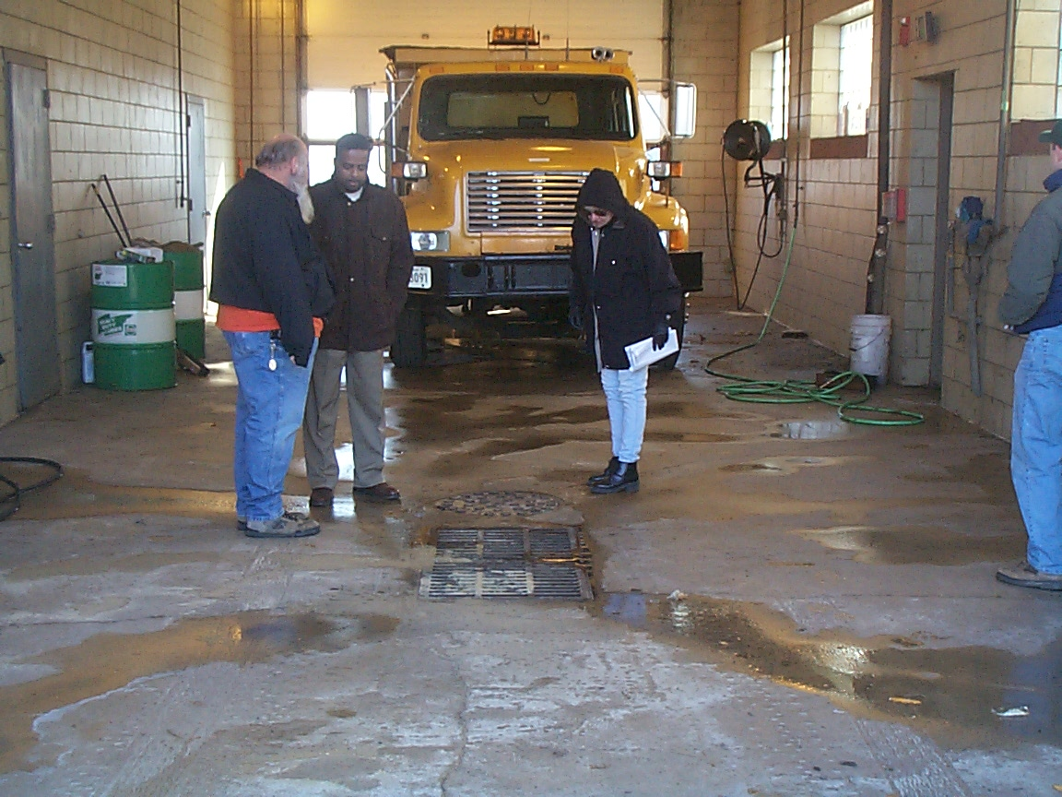
Equipment Preparation and Cleaning
Clean equipment in the wash bay so that wash water is treated by the grit separator and oil/water separator to minimize the discharge of sediment, salt and heavy metals into the environment.

Slide 19
Do your part in helping to protect the environment.
Be an Environmental Steward,
Salt Sensibly.

