Slide 1
SADDLE TANK OPERATIONS
Keep saddle tank filled with salt brine or during winter months.
Spray Mag or salt brine on your salt load at the rate of 10 gallons per ton of salt.
Use saddle tank when applying salt to dry snow.

Slide 2
SADDLE TANK OPERATIONS
Use saddle tank when pavement temperatures are 25°F or below.
Use saddle tank to combat freezing rain, sleet, or black ice.
Do not use saddle tank on slush or wet snow unless pavement temperatures are below 25°F.

Slide 3
LIQUID APPLICATOR TANK GUIDELINES
Apply salt brine 2 to 10 hours before storm.
Spray bridges and cold spots prior to cold weekends to prevent emergencies.

Slide 4
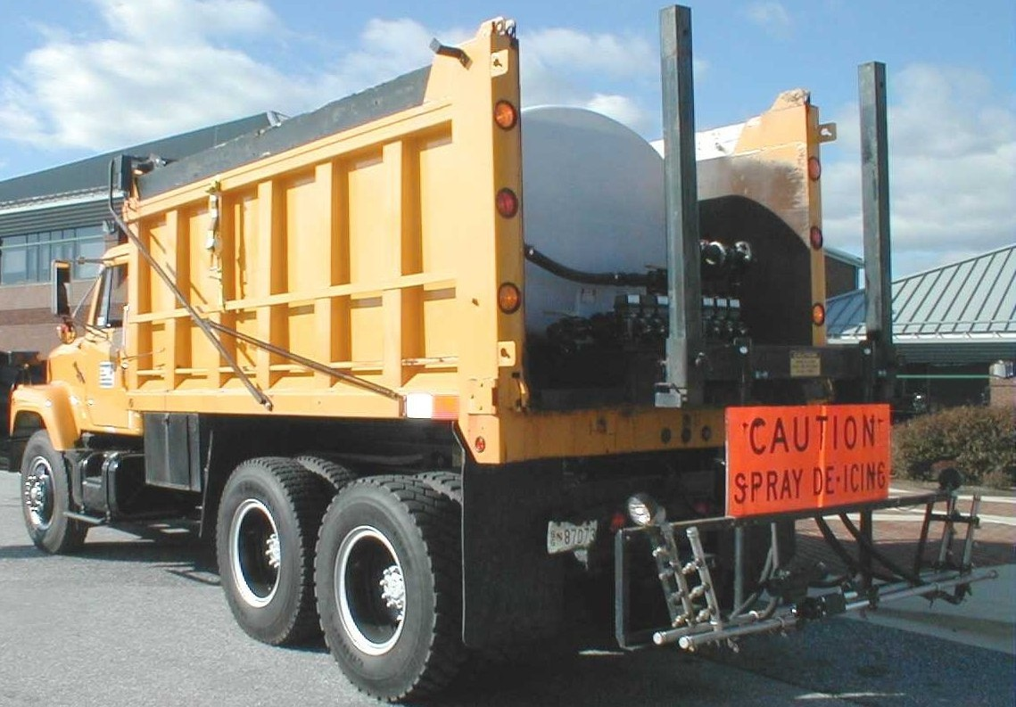
LIQUID APPLICATOR TANK GUIDELINES
Standard application rate of salt brine is 45 to 80 gallons per lane mile.
See section 15 charts for correct application.

