Slide 1
POINTS TO REMEMBER
Always give bridges and ramps special attention.
Salt the high sides of curves.
Do not over-use salt.
Use just enough to get the job done.

Slide 2
POINTS TO REMEMBER
Salt loses most of its effectiveness at temperatures below 20°F.
Salt stops working altogether at - 6°F.
Adding more salt to an already salted roadway can actually cause the brine solution to freeze.

Slide 3
POINTS TO REMEMBER
Salt mixed with calcium chloride melts snow and ice down to minus 67°F.
Maintain 300 to 500 pounds salt distribution per lane mile.
Do not use “Manual”, “Stationary Unload”, or “Blast” unless absolutely necessary.

Slide 4
POINTS TO REMEMBER
Use left spinner setting when spreading salt on two lane flat roadways.

Slide 5
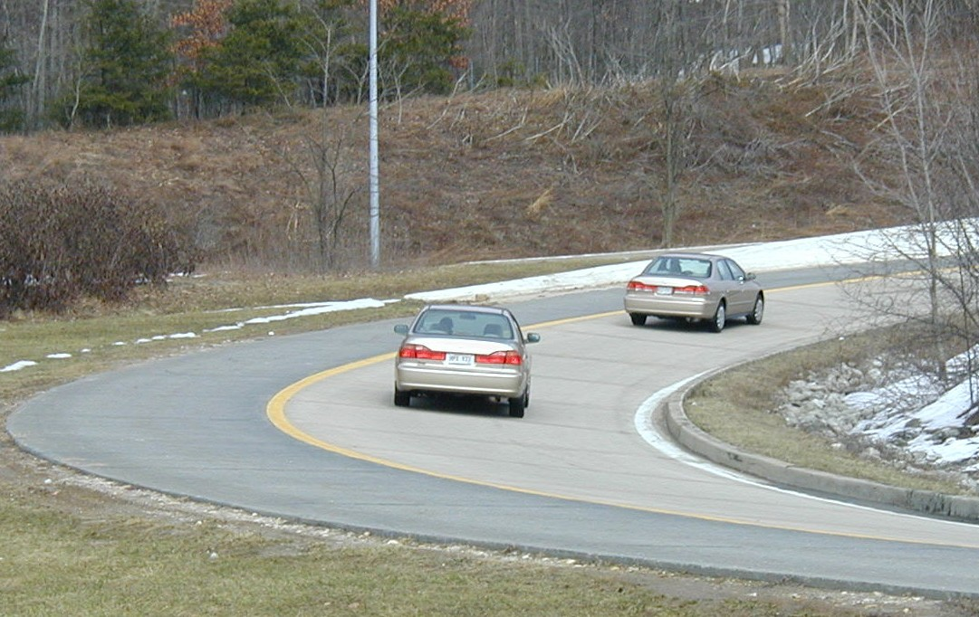
POINTS TO REMEMBER
Spread salt on high side of banked curves.
Adjust spinner setting to correct for wind velocity and direction.

