Slide 1
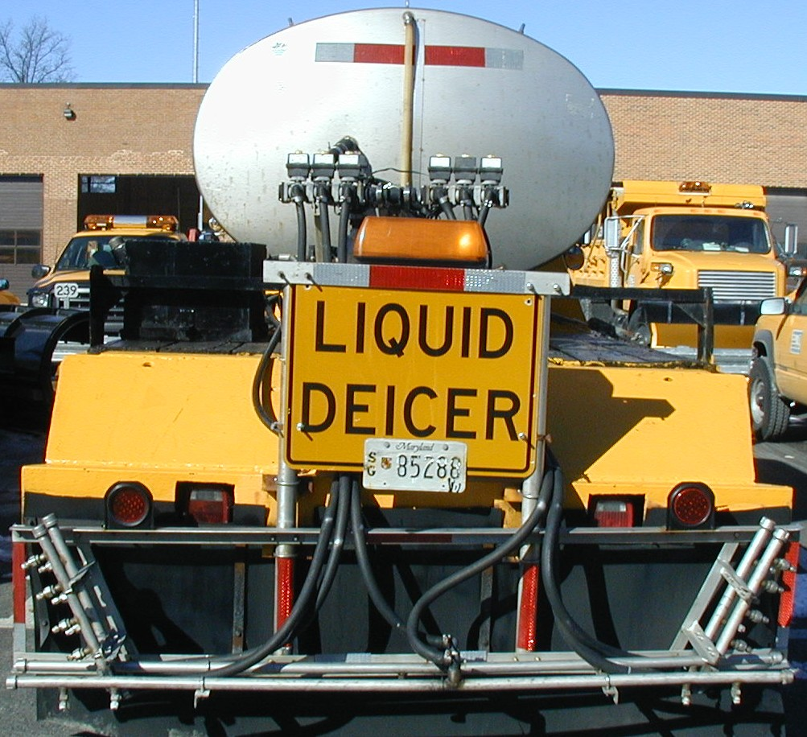
ANTI-ICING OPERATIONS
Anti-icing involves a timely application of pre-wetted salt or liquid chemicals on highways usually before start of a storm.

Slide 2
ANTI-ICING OPERATIONS
Anti-icing helps SHA maintain highways in the best condition possible throughout a storm.
Anti-icing lessens the occurrence of snow pack.
Anti-icing increases traffic safety at a lower cost.
Anti-icing limits damage to the environment.

Slide 3
DE-ICING OPERATIONS
Deicing operations require large amounts of salt to work its way through snow pack and break its bond to the pavement.
Deicing results in higher safety costs due to delays in achieving bare pavement.
Deicing leads to more damage to the environment and highway system.

