Slide 1
ROADWAYS AND SURFACES
TWO-LANE ROADWAYS
One 12 foot wide lane traveling in each direction.
The standard plow angled correctly will clear 8 to 9 feet per pass.

Slide 2
ROADWAYS AND SURFACES
TWO-LANE ROADWAYS
Four passes needed to clear the entire road.
Clear road shoulders.

Slide 3
MULTI-LANE HIGHWAYS
Multiple lanes traveling in both directions.
Road width determines the number of plow trucks needed.

Slide 4
MULTI-LANE HIGHWAYS
Factors considered are the median width, shoulders, and Jersey barriers.
When possible, begin plowing before rush hour traffic.

Slide 5
ASPHALT ROAD SURFACE
An asphalt road surface has a crown in the center to aid in run-off.
Super-elevated curves have a high side.
Always keep in mind how these roadway features respond to salting operations.

Slide 6
CONCRETE ROAD SURFACE
Reinforced concrete has a contraction joint every 40 feet.
Reinforced concrete has an expansion joint every 600 feet.
Bridges have expansion joints at both ends and may have an expansion dam near the middle of the bridge.

Slide 7
ROADWAY CONFIGURATIONS
INTERSECTIONS
Empty your plow before crossing intersections.
Reduce the size of the windrow.
Avoid building snow banks that interfere with sight distance.
Keep traffic signs unobstructed from view.

Slide 8
RAMPS AND CURVES
Plow ramps and curves from the high side to the low side.
Spread salt on the high side of ramps and curves.
Keep your speed down on all ramps and curves.

Slide 9
BRIDGES AND OVERPASSES
Bridge surface may be higher than the road surface due to the bridge freezing and expanding.
Care must be taken not to throw snow over the bridge to the road below.
Keep the sidewalks on bridges open for pedestrians.

Slide 10
SHOULDERS, MEDIANS & JERSEY BARRIERS
Plow away from medians with minimum width shoulder and barrier wall.
Avoid plowing snow against a Jersey barrier.
This creates a ramp for vehicles to launch to the other side.

Slide 11
MOUNTAINS AND HILLS
Traction is limited on hills.
Stopping can be difficult on hills.
Watch for melted snow refreezing in the road valley.

Slide 12
RAILROAD CROSSINGS
Avoid piling snow against signals, switch boxes, signs, etc.
Raise plows slightly when crossing railroad tracks.

Slide 13
TYPES OF PLOWS
- THE ONE WAY PLOW -
One way reversible plow (manual adjust).
One way reversible plow (hydraulic adjust).
One way non-reversible plow.
Wing plow.

Slide 14
V - PLOW
V-Plows are mounted to a Grader or Oshkosh.

Slide 15
V - PLOW
Plows in both directions at the same time.
Also known as the “Drift Buster”.

Slide 16
PLOWING TIPS AND TECHNIQUES
- PLOWING SPEED -
Keep your speed fast enough to move the snow away from the roadway…
…but slow enough so as not to damage whatever it hits.
The faster your speed the more unstable the truck.

Slide 17
PLOWING SPEED
Plowing too fast can create a blizzard-like condition that can obscure your vision.
Reduce plowing speed at bridges.
Reduce your left shoulder plowing speed when Jersey barriers located in the median.

Slide 18
PLOWING SPEED
When part of a plow train, continually adjust your speed to maintain a good, even spacing between trucks.

Slide 19
POINTS TO REMEMBER
Always give bridges and ramps special attention.
Salt the high sides of curves.
Do not over-use salt.
Use just enough to get the job done.

Slide 20
POINTS TO REMEMBER
Salt loses most of its effectiveness at temperatures below 20°F.
Salt stops working altogether at - 6°F.
Adding more salt to an already salted roadway can actually cause the brine solution to freeze.

Slide 21
POINTS TO REMEMBER
Salt mixed with calcium chloride melts snow and ice down to minus 67°F.
Maintain 300 to 500 pounds salt distribution per lane mile.
Do not use “Manual”, “Stationary Unload”, or “Blast” unless absolutely necessary.

Slide 22
POINTS TO REMEMBER
Use left spinner setting when spreading salt on two lane flat roadways.

Slide 23
POINTS TO REMEMBER
Spread salt on high side of banked curves.
Adjust spinner setting to correct for wind velocity and direction.

Slide 24
PLOWING TIPS
Never drive faster than speed limit.
Use a lower gear than normal driving.
Use extra care plowing curves.
Plow with direction of traffic.

Slide 25
PLOWING TIPS
Do not block radiator with plow when traveling.
Plow from centerline out to shoulder.
Plow towards low side of ramps or curves.
Plow away from wind when possible.

Slide 26
PLOWING TIPS
Raise blade before making sharp turns.
Don’t leave windrow across an intersection.
Know your turn around points.
Refuel with meal breaks or reloading.

Slide 27
SINGLE VEHICLE PLOWING
Plow lane in one direction and drop salt behind truck.

Slide 28
SINGLE VEHICLE PLOWING
Plow lane in one direction, turn at end of route, plow lane in opposite direction and salt both lanes.

Slide 29
MULTI-VEHICLE PLOWING
The width of the road determines how many plows are needed to clear the snow.
Minimum overlap of any “plow train” should be about 1 foot.
Distance between plow trucks should be around 150 feet.

Slide 30
MULTI-VEHICLE PLOWING
The deeper the snow, the more overlap needed to avoid leaving a windrow.
First truck clears 8 feet of the left traffic lane, leaving 4 feet for second truck.
Second truck overlaps 1 foot clearing 4 feet of first lane and 3 feet of second lane, leaving 9 feet for third truck.

Slide 31
MULTI-VEHICLE PLOWING
Third truck overlaps 1 foot clearing 7 feet of second lane, leaving 2 feet for fourth truck.
Fourth truck overlaps 1 foot clearing 2 feet of second lane and 5 feet of shoulder.
One more truck would be required if a third lane was present.

Slide 32
MULTI-VEHICLE PLOWING
Four or more lanes would require more plow trucks.
The larger trucks should be at the end of the train.
The last truck plows ramps.

Slide 33
TYPES OF SNOW AND PLOW ANGLE
Wet snow requires more plow angle to discharge snow from plow moldboard.
Plow must still clear a path for the truck tires.

Slide 34
SADDLE TANK OPERATIONS
Keep saddle tank filled with salt brine or during winter months.
Spray Mag or salt brine on your salt load at the rate of 10 gallons per ton of salt.
Use saddle tank when applying salt to dry snow.

Slide 35
SADDLE TANK OPERATIONS
Use saddle tank when pavement temperatures are 25°F or below.
Use saddle tank to combat freezing rain, sleet, or black ice.
Do not use saddle tank on slush or wet snow unless pavement temperatures are below 25°F.

Slide 36
LIQUID APPLICATOR TANK GUIDELINES
Apply salt brine 2 to 10 hours before storm.
Spray bridges and cold spots prior to cold weekends to prevent emergencies.

Slide 37
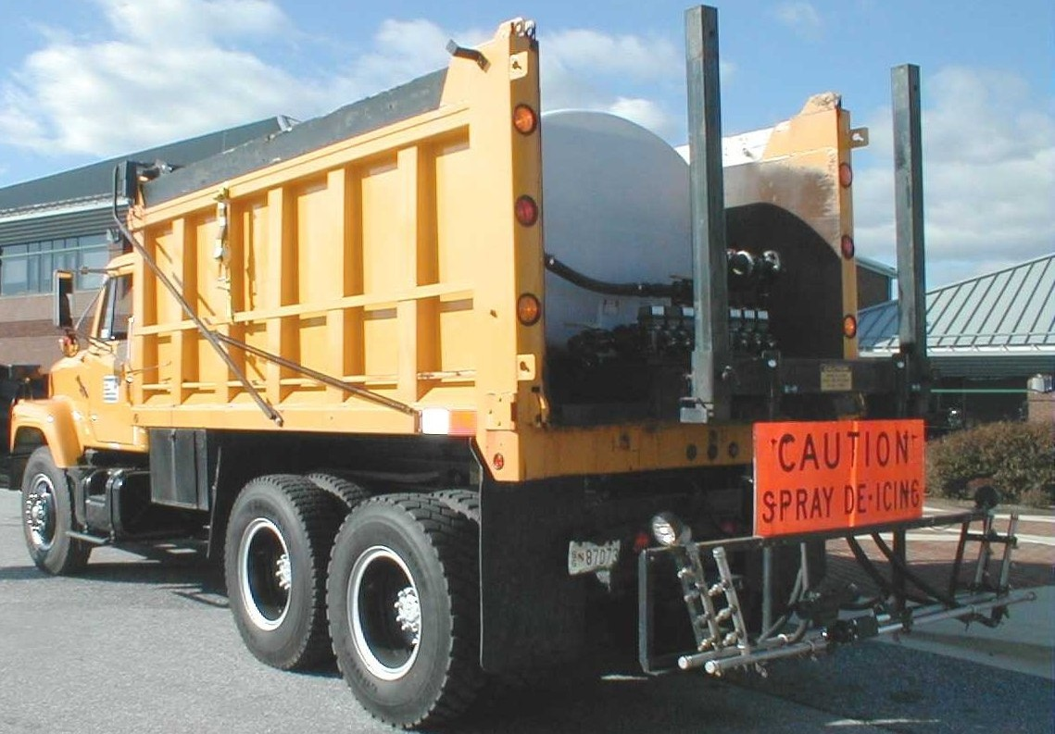
LIQUID APPLICATOR TANK GUIDELINES
Standard application rate of salt brine is 45 to 80 gallons per lane mile.
See section 15 charts for correct application.

