Slide 1
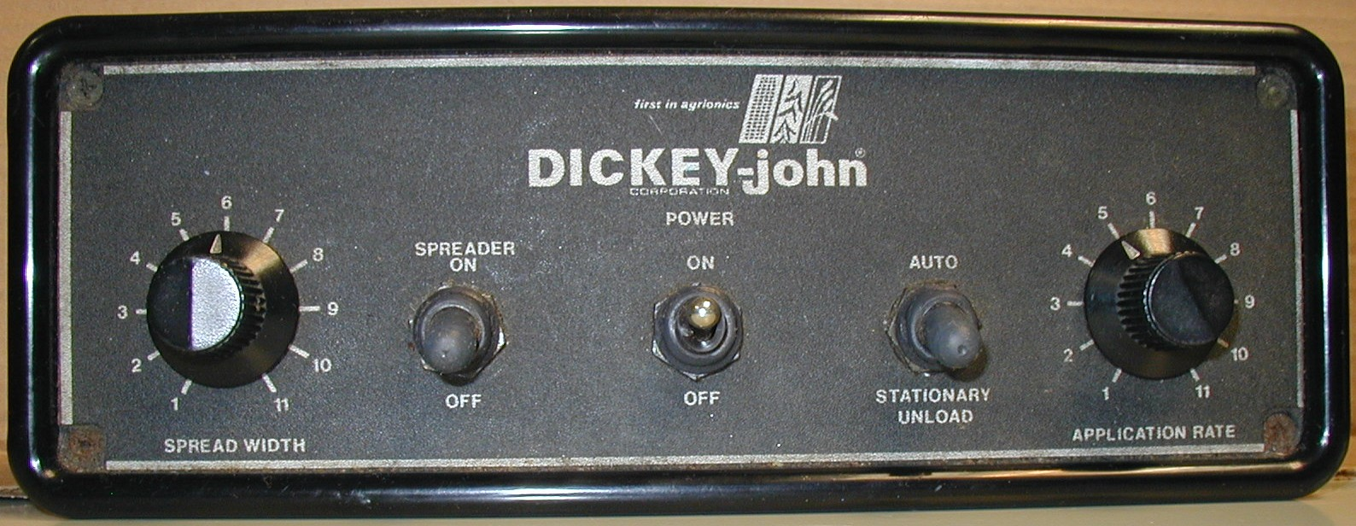
SALT SPREADER SYSTEMS
DICKEY - JOHN
DjGC15

Slide 2
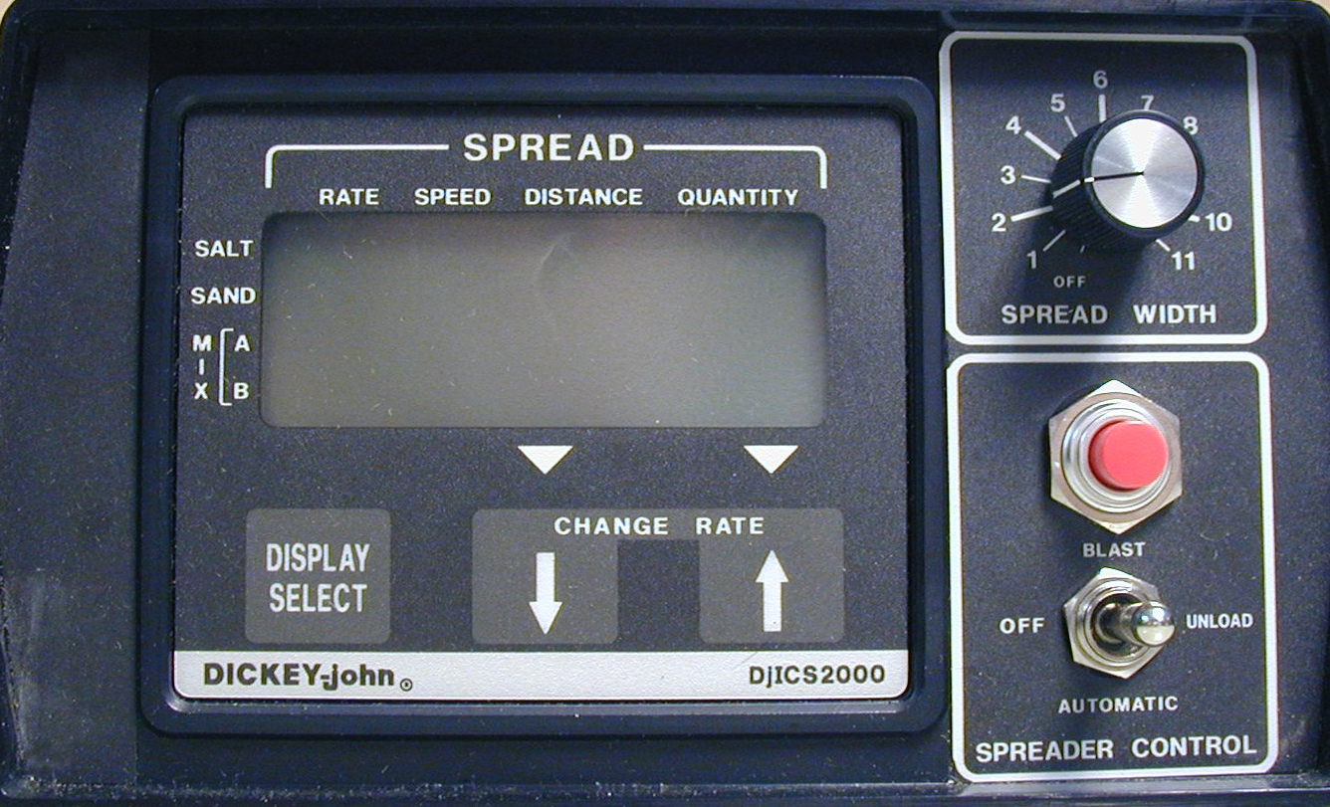
SALT SPREADER SYSTEMS
DICKEY - JOHN ICS2000

Slide 3
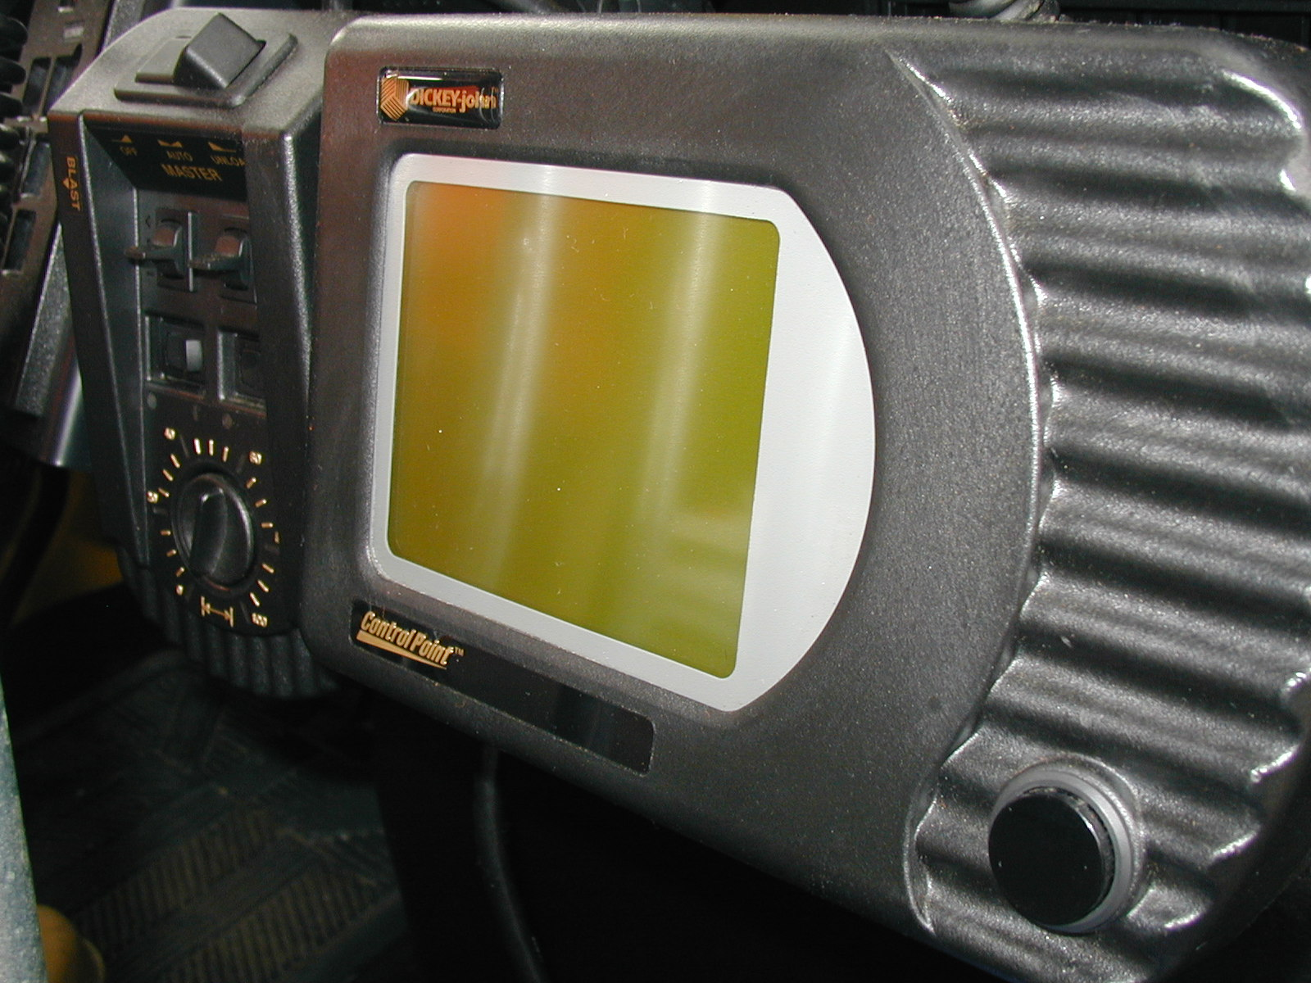
SALT SPREADER SYSTEMS
DICKEY - JOHN CONTROL POINT

