Slide 1
WINTER OPERATIONS STRATEGIES
Anti-icing is a proactive winter strategy of preventing snow or ice from bonding to the pavement.
Deicing is traditional reactive winter maintenance strategy of breaking the snow/ice and pavement bond once formed.
Both strategies are critical and play roles in SHA’s snow and ice control operations.

Slide 2
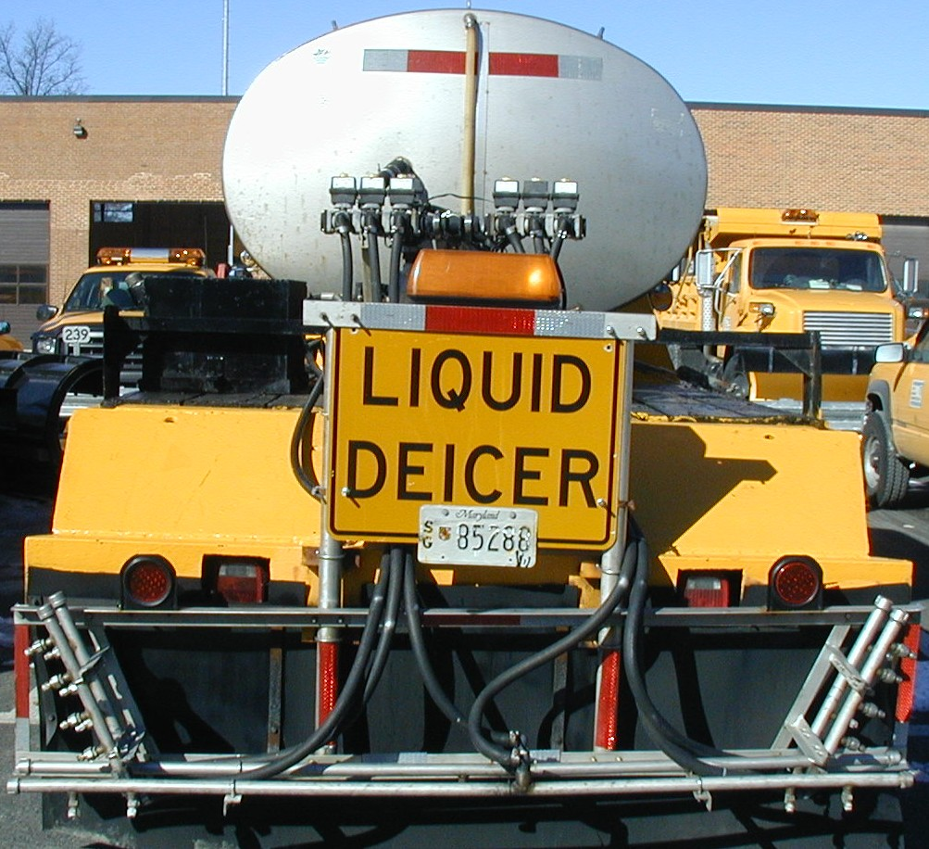
ANTI-ICING OPERATIONS
Anti-icing involves a timely application of pre-wetted salt or liquid chemicals on highways usually before start of a storm.

Slide 3
ANTI-ICING OPERATIONS
Anti-icing helps SHA maintain highways in the best condition possible throughout a storm.
Anti-icing lessens the occurrence of snow pack.
Anti-icing increases traffic safety at a lower cost.
Anti-icing limits damage to the environment.

