Slide 1
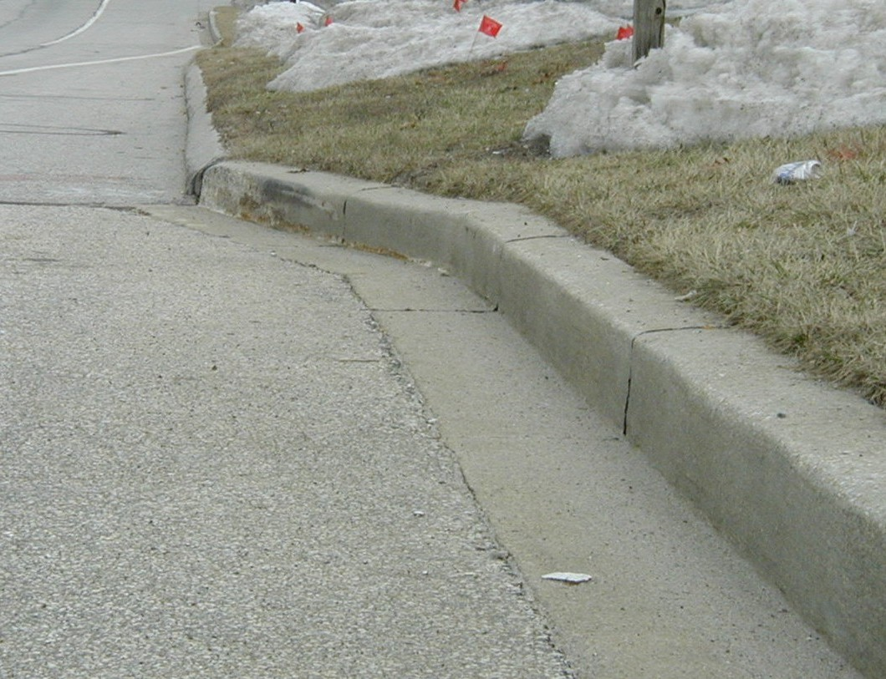
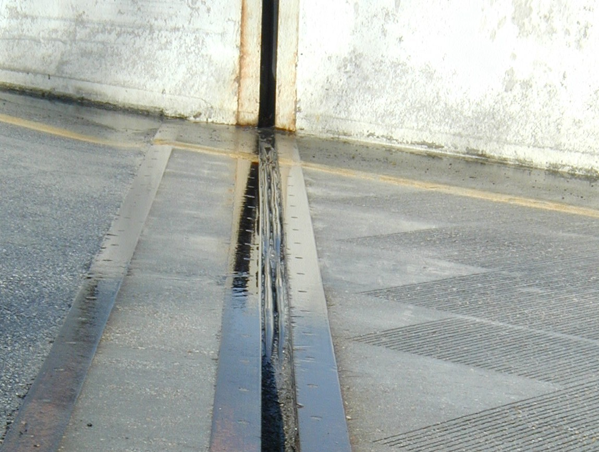
ROADWAY HAZARDS
Always be alert to obstructions to your plowing.
Offset Curbs
Expansion Joints

Slide 2
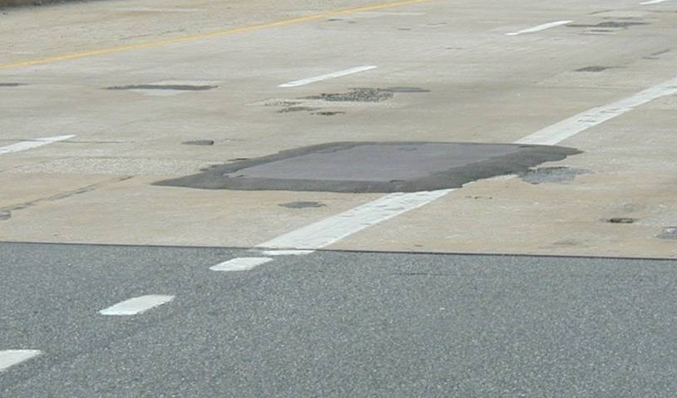
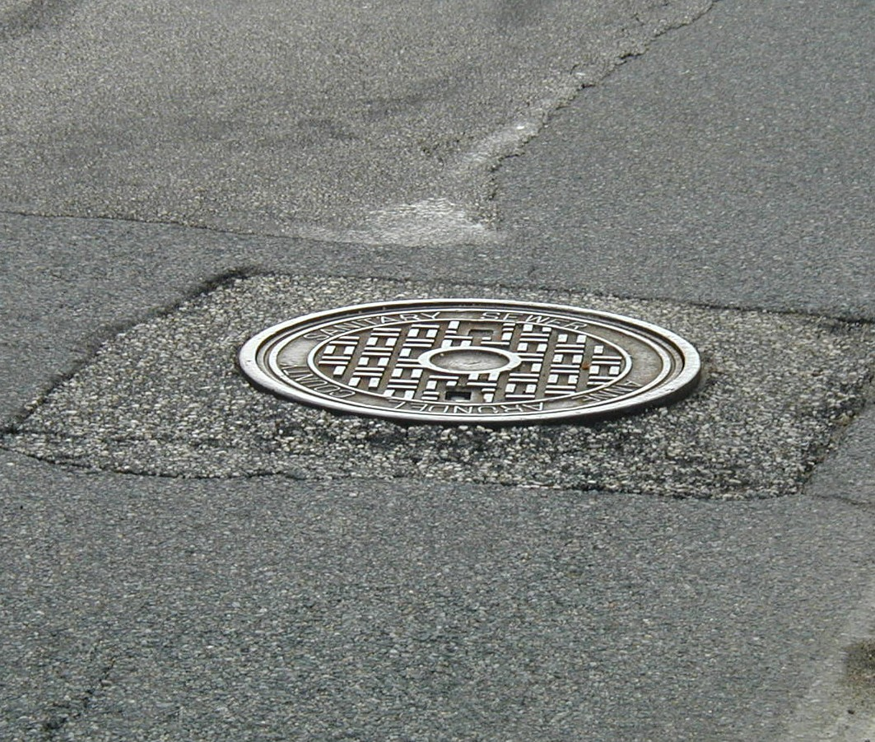
ROADWAY HAZARDS
Manhole Covers
Steel Plates

Slide 3
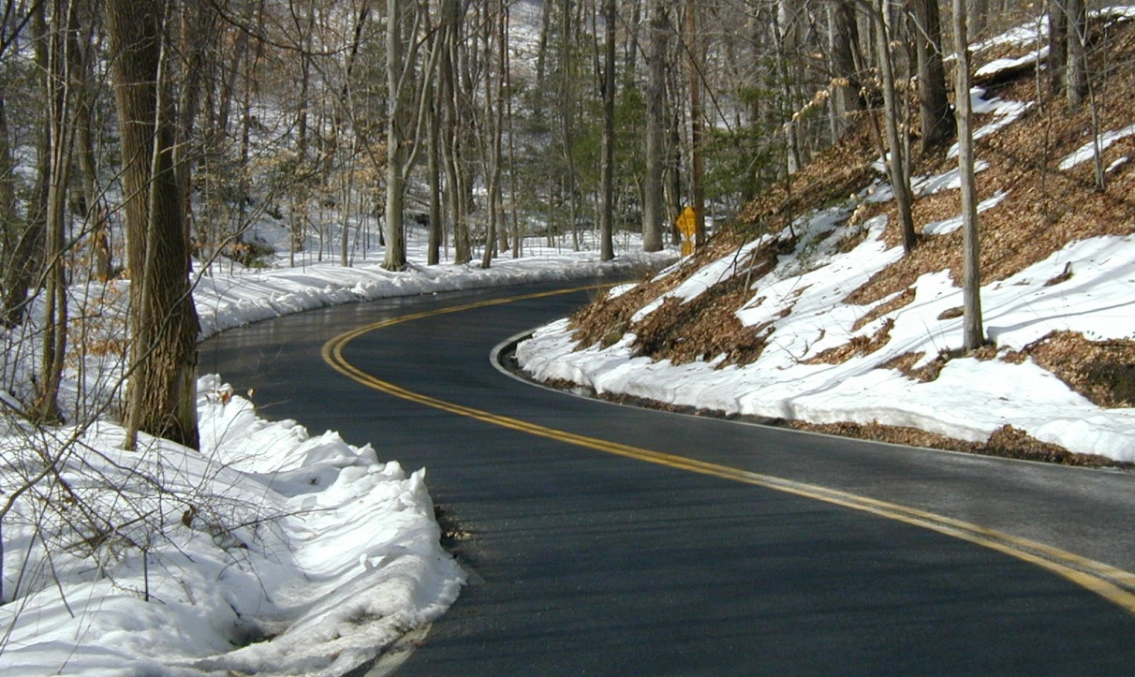
ROADWAY HAZARDS
Cold Spots and Black Ice
Low Shoulders / No shoulders
Overhead obstructions - bridges, trees, wires
And, of course, the traveling public

Slide 4
ROADWAY MARKING DEVICES
Delineating posts
Stop bars
Arrows
Raised pavement markers

