Slide 1
Weather information to support winter operations
Pavement temperature, frost and general weather forecasts (Oct. 15 to April 15)
DTN -- Radar, Satellite, forecasts
Roadway Weather Information System (RWIS) data
Infrared thermometers
Automated Weather Observation Station (AWOS) data

Slide 2
Weather Forecasts
Iowa DOT contracts with a forecast agency specializing in roadway weather forecasting
Pavement and bridge deck temperature forecasts are provided for 99 counties
Forecasts received at 6 AM, noon, 6 PM and Midnight
Forecast summaries are available via a toll free number
Available on DTN Weather Centers, and the Internet
Speak directly to a weather forecaster via a toll free number
Notes:
Toll free # on a later slide

Slide 3
Frost Forecasts
“Official” noon zone forecast for bridge frost
Available on DTN, and the Internet
Frost forecast information also available via toll-free number
“Yes” means the weather forecaster expects frost to occur
Road frost probabilities
Notes:
Toll free number on a later slide

Slide 4
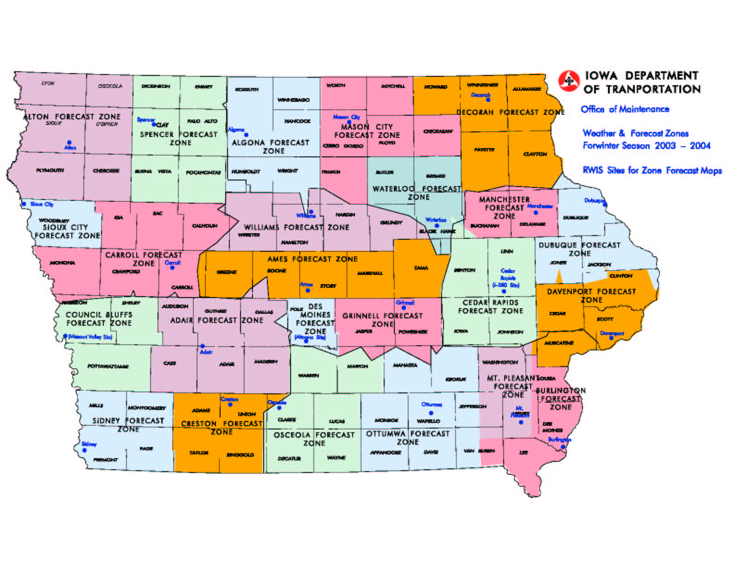
Frost Forecast Zones

Slide 5
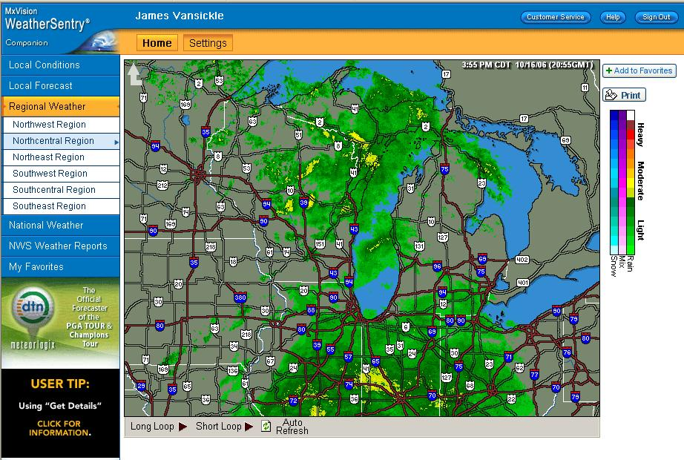
DTN/Meteorlogix
Available at 110 garages
Available on line for home use
Provides radar, current conditions and forecasts

Slide 6
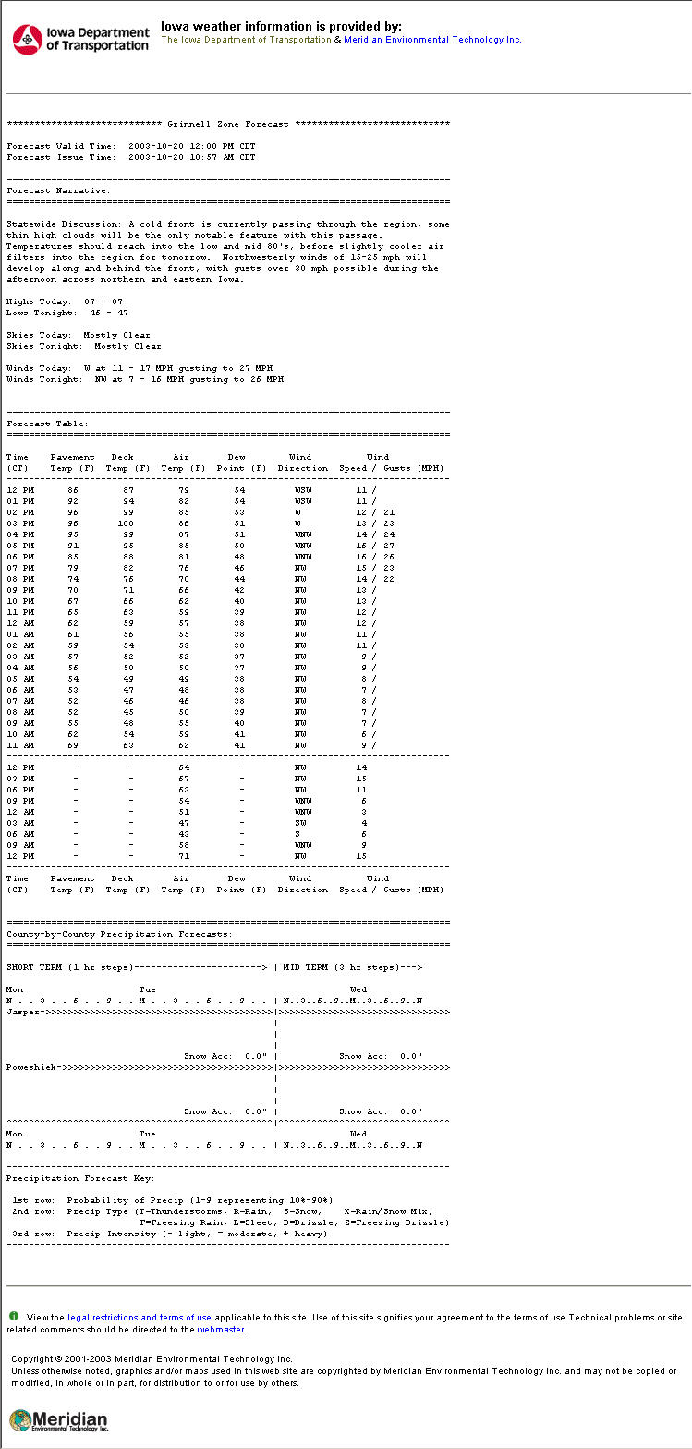
Meridian Zone Forecasts on DTN
Notes:
Final forecast format was not available when this presentation prepared. This is a prototype.

Slide 7
Sources of weather information in the shop
Meteorlogix/DTN Weather Centers
Pavement, frost and general weather forecasts
Current conditions & radar
Maintenance DOTNET page (requires a network connection) links to:
Current RWIS information
DTN and Meridian web sites
Notes:
Explain DOTNET – the department’s Intranet, which uses web based technology to deliver information within an organization. Only available when connected to the DOT’s network. Contains a lot of information on winter operations as well as from other offices throughout the department.

Slide 8
Internet sites to support winter operations (User ID/Password Required)
Meridian Forecasts – Pavement and Frost Forecasts
http://www.iadot.meridian-enviro.com
User Name: iadot Password: plow
DTN’s Iowa web site – Current Conditions, radar, and forecasts
http://weathersentry.meteorlogix.com
User Name: (enter garage name)
Password: iowa

Slide 9
Internet sites to support winter operations (No User ID/Password Required)
Weatherview – http://www.dotweatherview.com
Iowa’s RWIS and AWOS current conditions, forecasts; link to road conditions & NWS – designed for the general public
General Weather Sites
National Weather Service, Accuweather, Intellicast, etc. An extensive list of Internet links is available on DOTNET

Slide 10
Sources of weather information available by phone
Toll Free Forecast Summary Recording 1-888-988-2468
District Forecast
Frost Forecast
Toll Free Direct to Forecaster
1-888-595-8726

Slide 11
Automated Weather Observations Station (AWOS)
Located at 38 airports in Iowa and maintained by the Modal Division of the Iowa DOT
Provides air temp, relative humidity, wind speed and direction, cloud tops, precipitation, and visibility for aviation industry
Visibility at an AWOS site can provide clues as to rate of snowfall or blowing snow conditions
Data available on the Internet
http://www.dotweatherview.com

Slide 12
Other Weather Sources
Internet
Radio
Television
Neighboring garages in the path of the storm
Other jurisdictions – city, county crews, etc.
Law Enforcement

Slide 13
Roadway Weather Information System (RWIS)
Pavement and bridge temperature
Subsurface temperature
Wind speed and direction
Air temperature
Relative humidity
Precipitation
Color Camera (14 sites)
Notes:
Emphasize that RWIS is

Slide 14
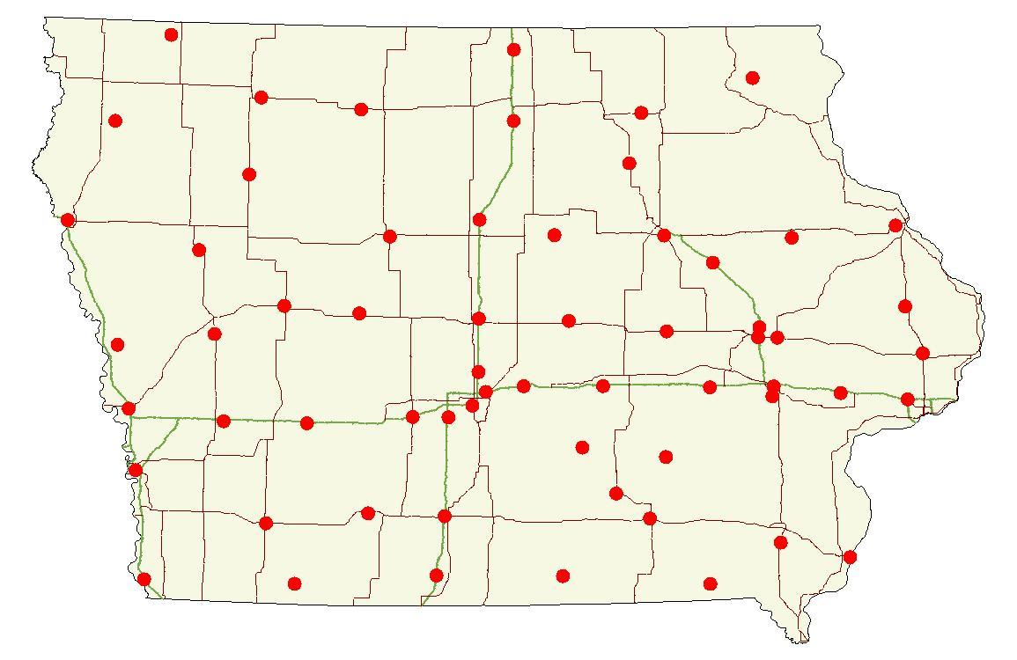
61 site locations in Iowa

Slide 15
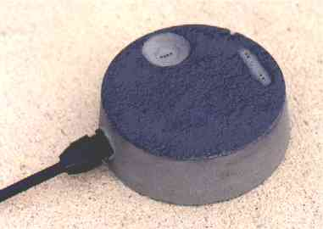
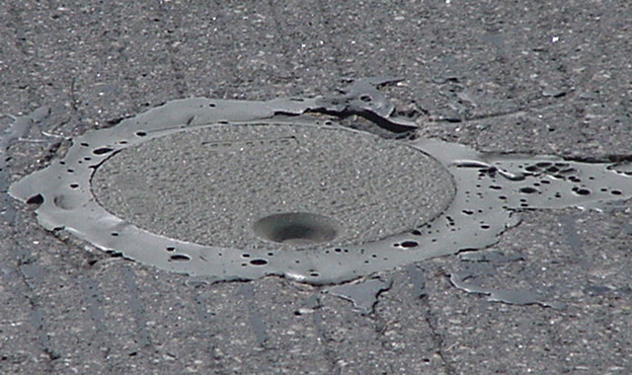
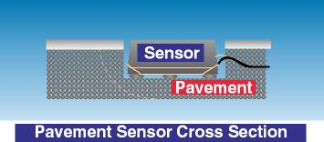
Pavement Sensors
2 – 4 sensors per site
Placed both on bridge decks and pavement surface wherever possible
Measures
Pavement Temperature
Chemical Concentration
Calculates
Pavement Status – dry, wet, chemically wet, etc.
Notes:
Emphasize importance of pavement temp. Pavement temp is “where the rubber meets the road” and determines what happens to the roadway when precipitation falls. Air temp means little in winter operations.

Slide 16
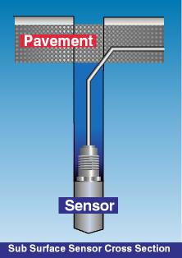
Subsurface Temperature Probe
Sensor is approximately 18” below the pavement surface

Slide 17
New sub-surface temperature data probe (TDP)
Temperature readings every few inches from 3” below surface to 6’ below

Slide 18
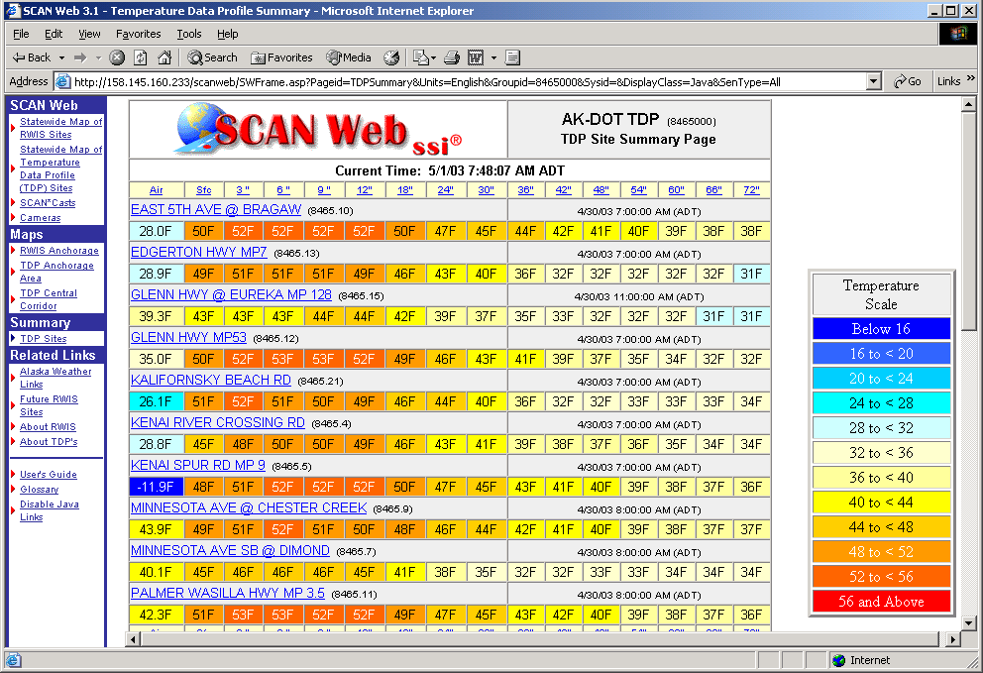
TDP in Scan Web

Slide 19
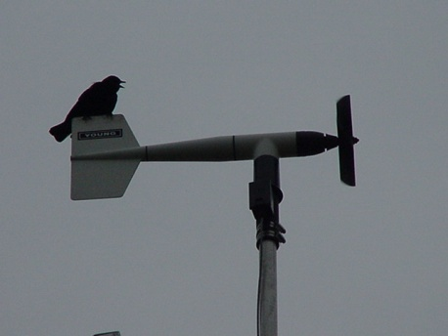
Wind Speed and Direction Sensor
Measures
Wind Speed
Wind Direction
Wind Gusts

Slide 20
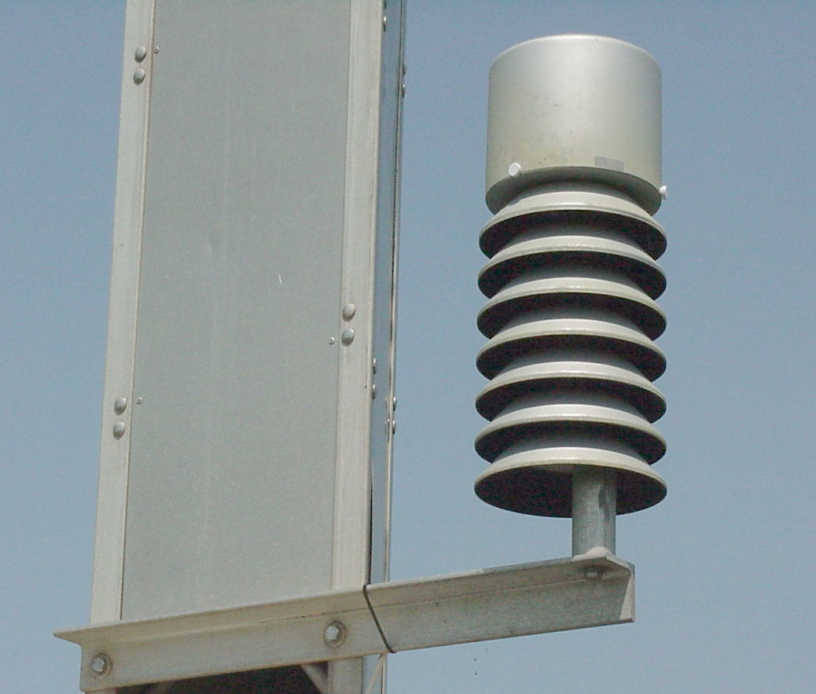
Air Temperature and Humidity
Dew point temperature is calculated from these two measurements

Slide 21
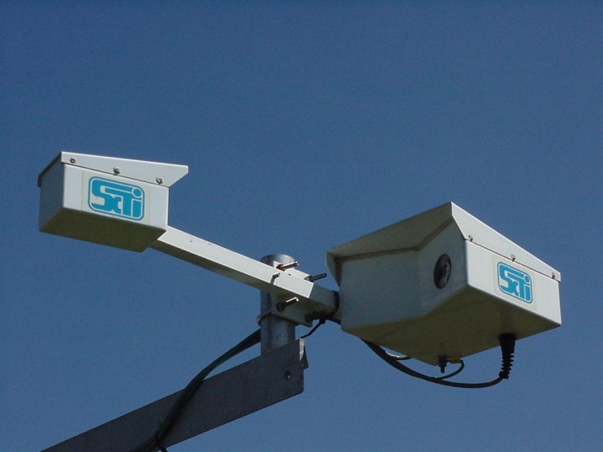
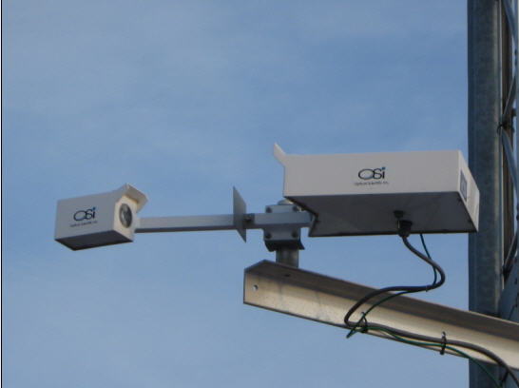
Precipitation Sensors
Yes/No sensor
Optical Weather Identifier
WIVIS sensor
Reports Presence
or absence of
precipitation
Reports
Type of precipitation
Rate of precipitation
Accumulation
Visibility (on a few sites)
Reports Visibility and precipitation identification
Notes:
21

Slide 22
RWIS benefits
Pavement and bridge surface temperatures
Actual roadside weather and surface conditions (wind speed/direction, dew point, chemical concentrations, etc.)
Better ability to predict how road conditions will change
Newer pavement sensors indicate salt concentration on the roadway, depth of precipitation and freezing point of the solution on the road surface

Slide 23
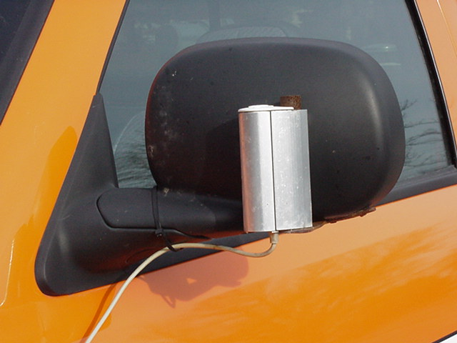
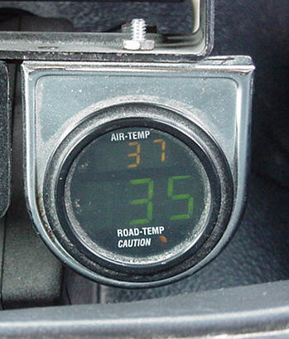
Infrared Thermometers
RoadWatch Infrared thermometers

Slide 24
Infrared Thermometers
In-vehicle device to measure surface temperature while driving at normal highway speeds
Approx. 641 in use on trucks and pickups
Measures only what it can see (Ice, Snow, Pavement
Check accuracy with a pan of ice- should read 32 degrees
Avoid placing too close to heat sources or blocking the view of the lens

Slide 25
How to Use Weather Data

Slide 26
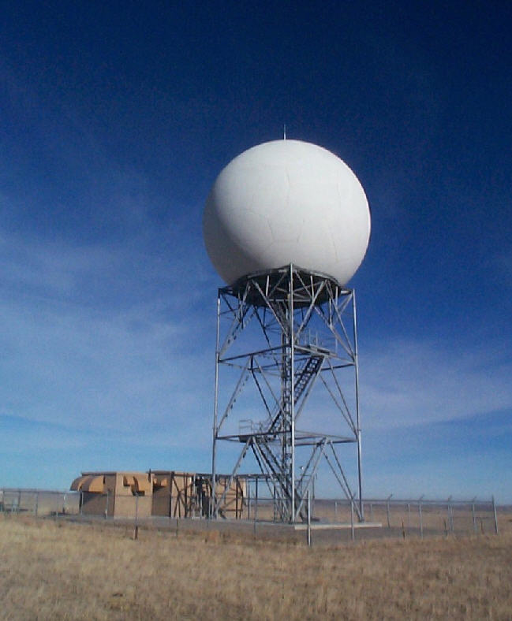
Radar
Radar is a valuable tool to locate where precipitation is falling, but be aware that it can at times be deceptive

Slide 27
The farther you are from a radar site, the more likely this is to occur.

