Slide 1
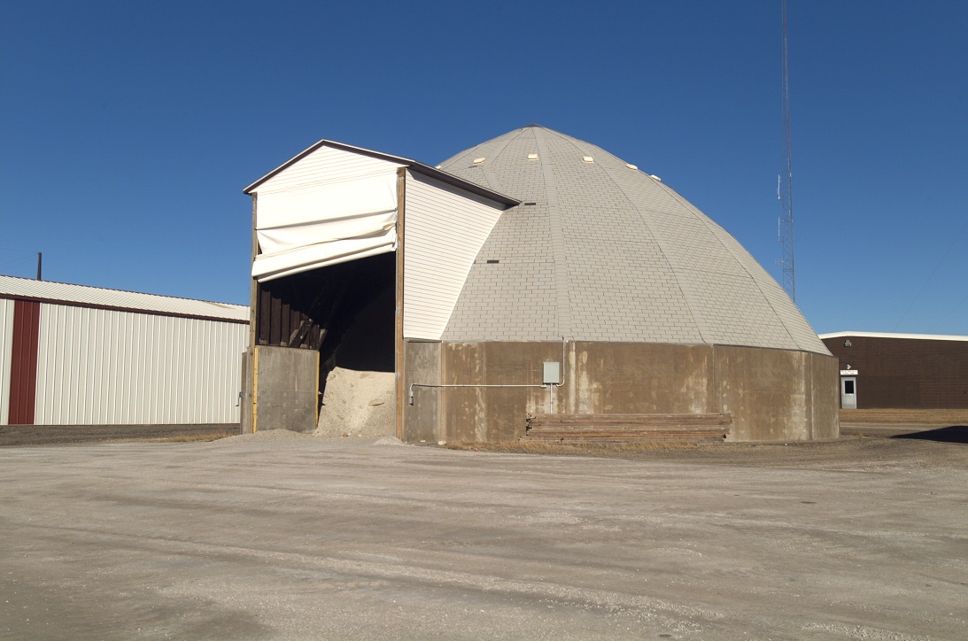
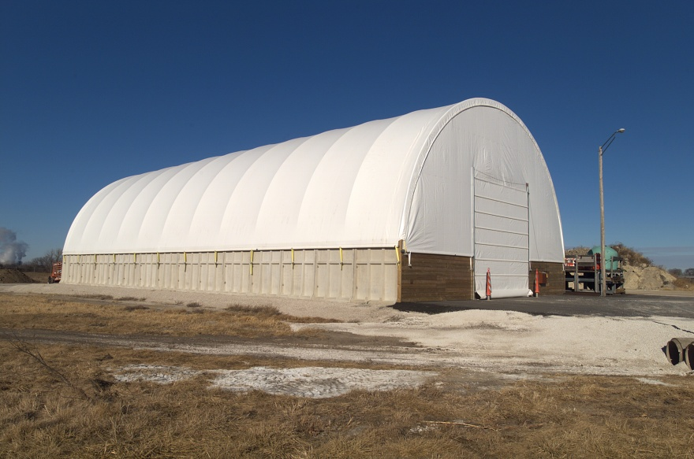
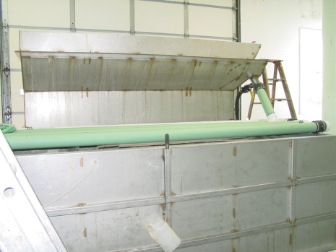
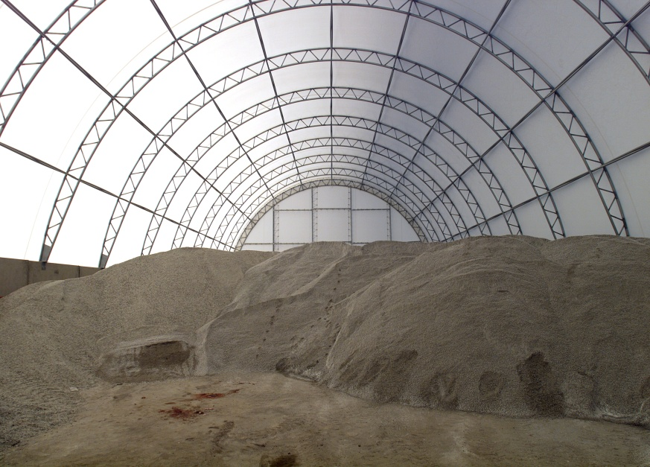
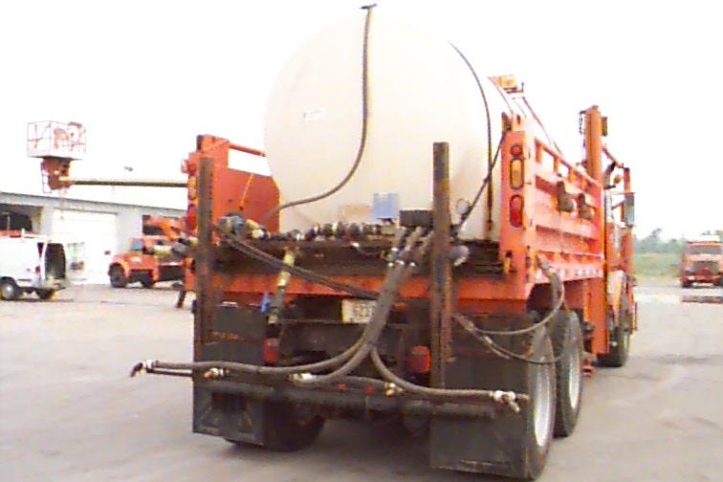
Deicing Chemicals

Slide 2
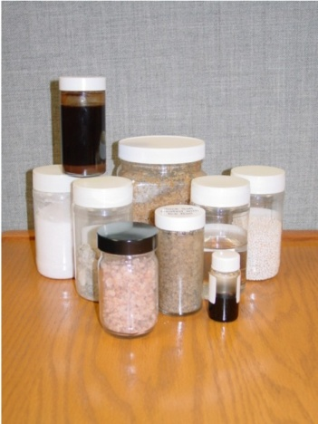
You will learn:
Deicing chemicals are a key tool in snow fighting
An introduction to deicing chemicals and how they work
This is no attempt to convert you
  to a chemist, but you will need to
  understand some of the key chemical
  characteristics of deicing chemicals
  used in Iowa

Slide 3
At the garage, on the job, you will learn:
How to apply deicing chemicals with the available equipment
Selection and preparation of the various deicing chemicals used in your garage
Appropriate application rates

Slide 4
Chemicals and how they work
View video segment - Chemicals and How they Work (approx. 17 minutes)

Slide 5
Salt brine
2.2 pounds of salt in each gallon of brine
Used over 18,004,412 gallons last season
Most garages have brine making capabilities
Cost of making brine is approximately $0.09 per gallon
A gallon of salt brine weighs 9.76 lbs.

Slide 6
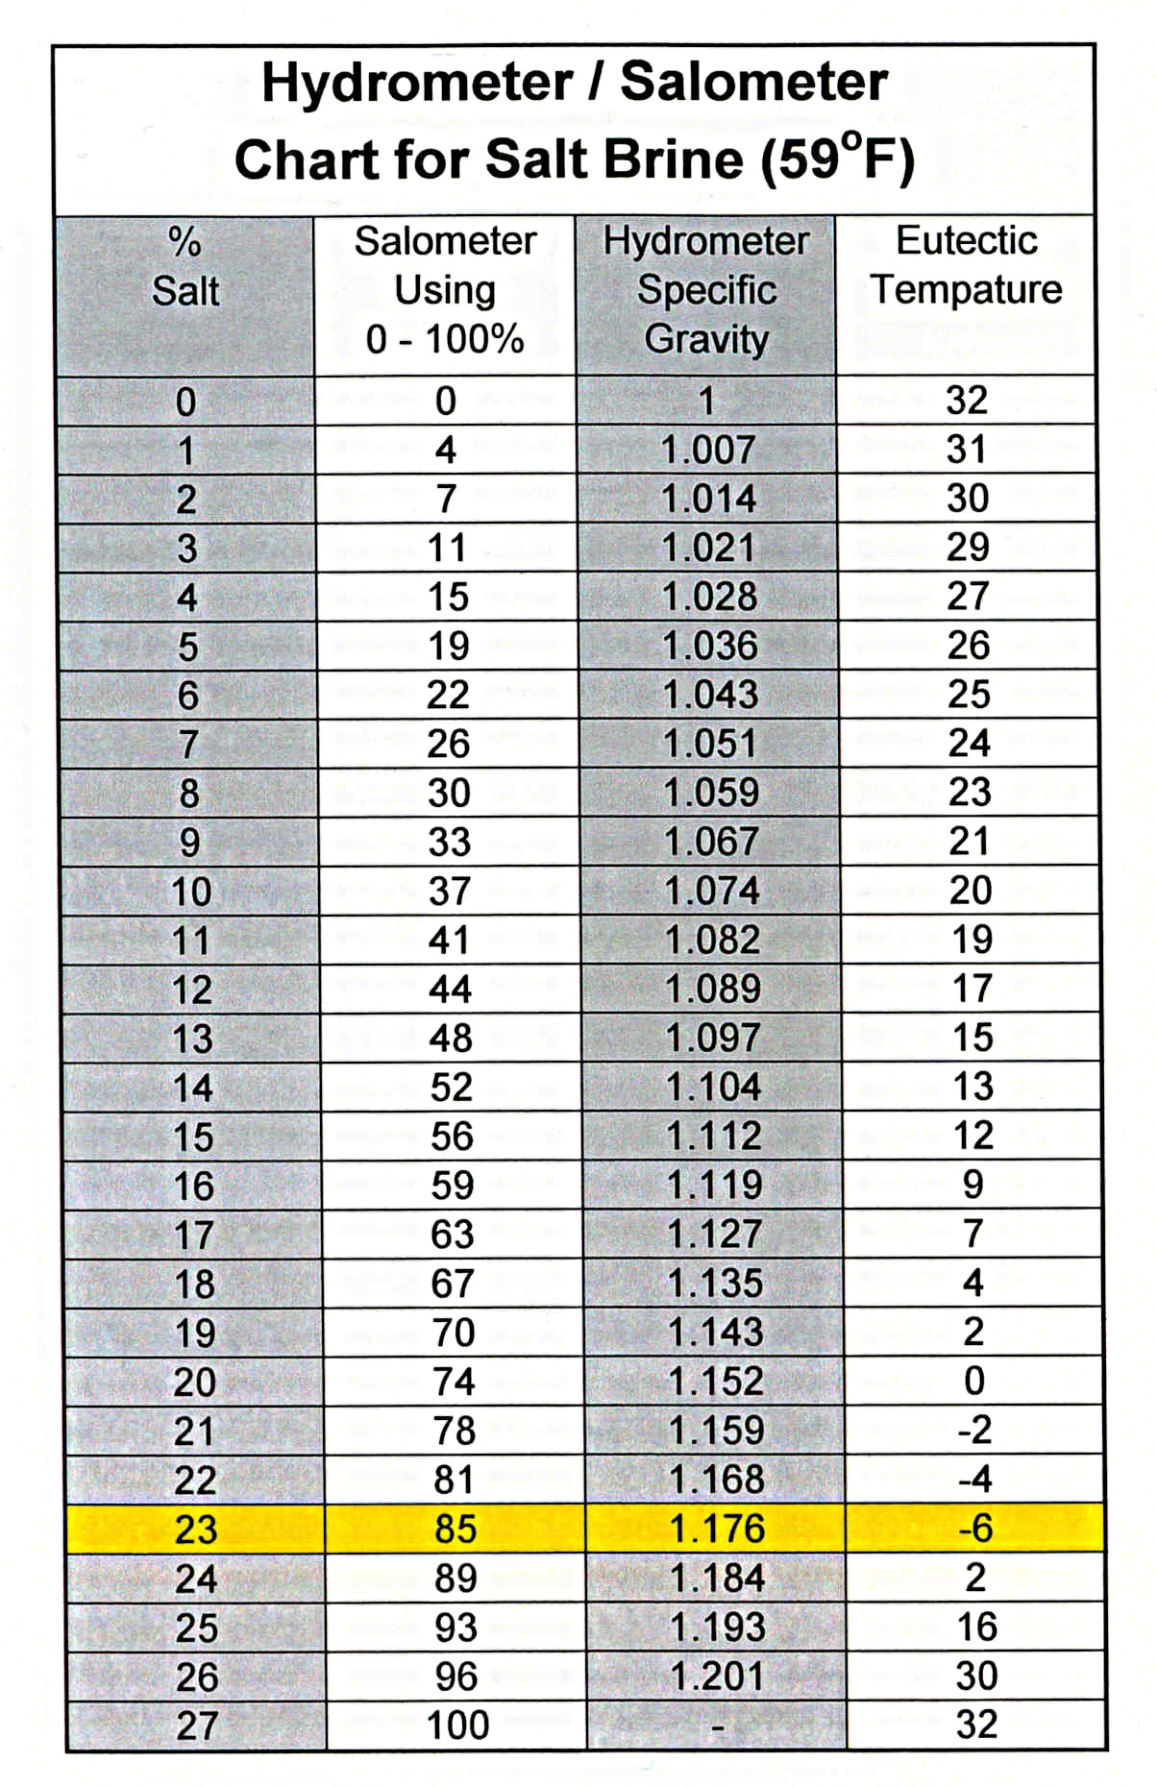
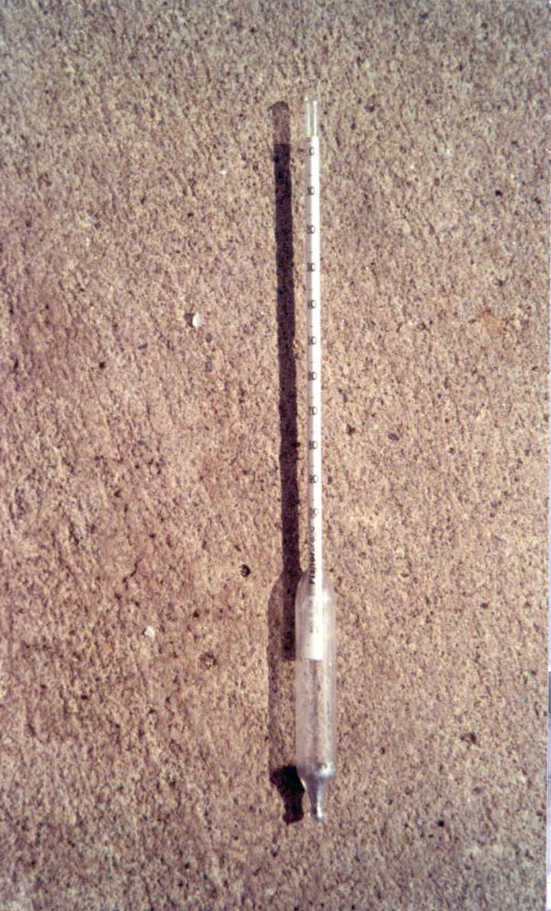
Brine Making
Notes:
Video talks about 23% solution, but our salimeters use a different scale. Point out the 23% and 85, which both indicate the correct concentration.

Slide 7
Temperature Definitions
Eutectic temperature - the point where a substance freezes
Effective temperature - point when a deicing chemical may no longer be economically efficient. The chemical may still work but require too much time and material to be efficient
Surface temperature - the temperature of the pavement or bridge deck which is the critical temperature to determine if precipitation is likely to freeze on the roadway
Notes:
The following slides simply reinforce the key points about chemicals which are maybe the hardest to grasp. Though repetitive, included to allow trainers to reemphasize these points, take questions on this topic, and tell if there is comprehension by the audience.

Slide 8
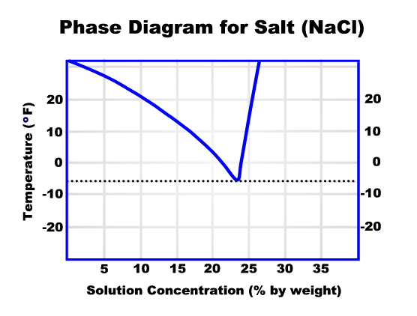
Phase Diagram
Shows the different phases a deicing chemical will undergo at different concentrations and temperatures

Slide 9
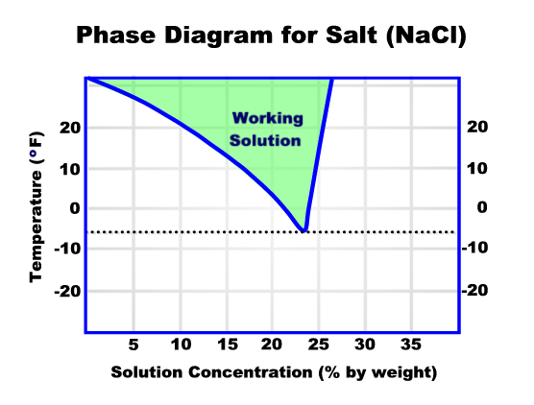
Salt melts snow & ice when the combination of solution and temperature are in the green area

Slide 10
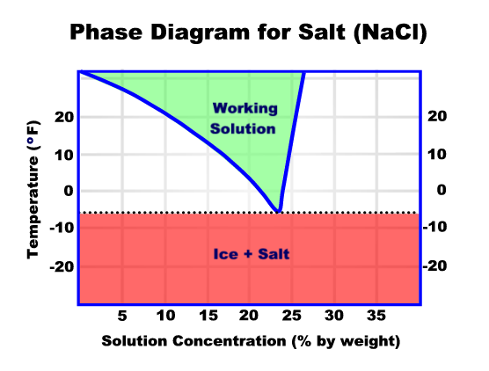
Salt does not work below -6 degrees

Slide 11
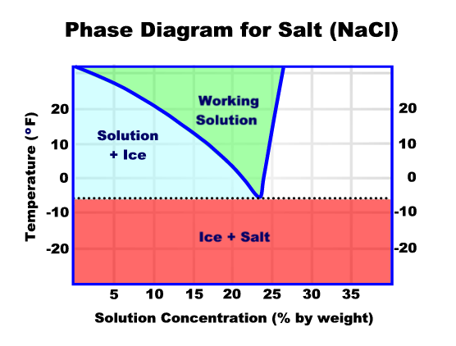
Salt does not melt snow/ice when the solution freezes

Slide 12
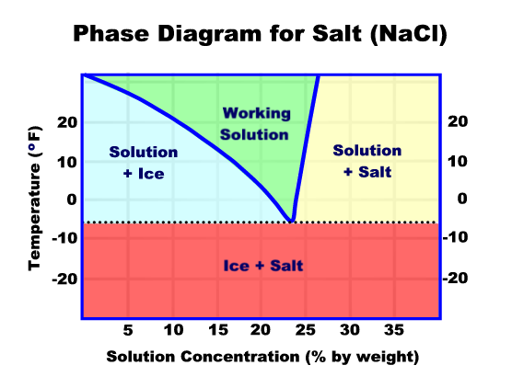
(Frozen – Not Enough Salt)
(Frozen – Too Much Salt)
Salt does not melt snow/ice when the solution is too concentrated. More is not better!

Slide 13
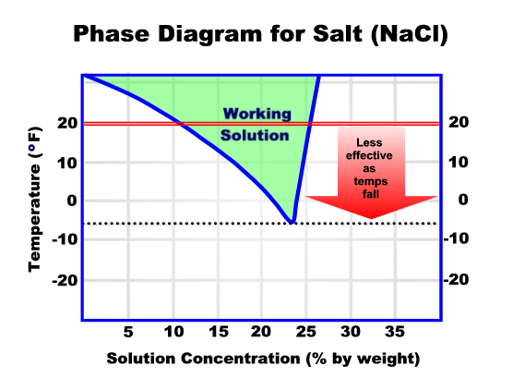

Slide 14
Pounds of Ice Melted per Pound of Salt
50
45
40
35
Pounds
30
25
20
15
10
5
0
30
25
20
15
10
5
0
-6
Temperature
It takes over 5 times more salt at 20 degrees than it does at 30 degrees to melt the same amount of ice!!!
Notes:
Animated slide – title and animation to emphasize difference will appear after a few seconds. Emphasize the huge difference in effectiveness for only a few degrees.

Slide 15
Iowa’s Primary Deicing Chemicals
Salt (NaCl) –
  average purchase price - $68.00/ton
  salt brine approx. $0.09/gal.
Calcium chloride (CaCl₂) –
  liquid with corrosion inhibitor- $0.91/gal
  dry flake - $9.35/50# bag

Slide 16
Other Deicing Chemicals
Magnesium chloride (MgCl) - popular in other states but not used in Iowa due to potential damage to concrete- $0.65/gal
Calcium magnesium acetate (CMA) – previously used only on Burlington bridge- $1,000+/ton (currently treat with brine)
Potassium acetate (KAc) - used as a pre-wetting agent with CMA- $3/gallon

Slide 17
Sand
Provides quick traction when needed and can be a valuable winter tool
Does not melt snow and ice
Environmental concerns for air quality and waterways
When used with salt it may rob the moisture needed by salt to melt snow and ice
Loose abrasives left on roadway can cause loss of traction

Slide 18

Sand has low purchase price but high overall costs
Causes chips on vehicles and may chip windshields
May be classified as hazardous waste when cleaned from the roadway resulting in high disposal costs
May need to be removed if buildup occurs

Slide 19

Environment
Deicing chemicals and abrasives can change the soil characteristics, affect water quality and damage plant life
Abrasives can affect air quality, build-up along guardrails and clog drains

Slide 20
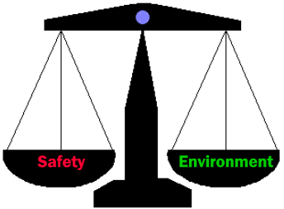
We must balance the use of deicing chemicals and abrasives required to ensure motorist safety against environmental effects and total costs

