Slide 1
Service Level Guidelines for snow and ice operations
Priority system for snow removal
IM performance levels differ by service level
Goal is to provide continuity of travel
Reviewed annually
Notes:
Winter Road Guide and Service Level Map brochure is a good handout at this point so that the Service Level Map can be better examined.

Slide 2
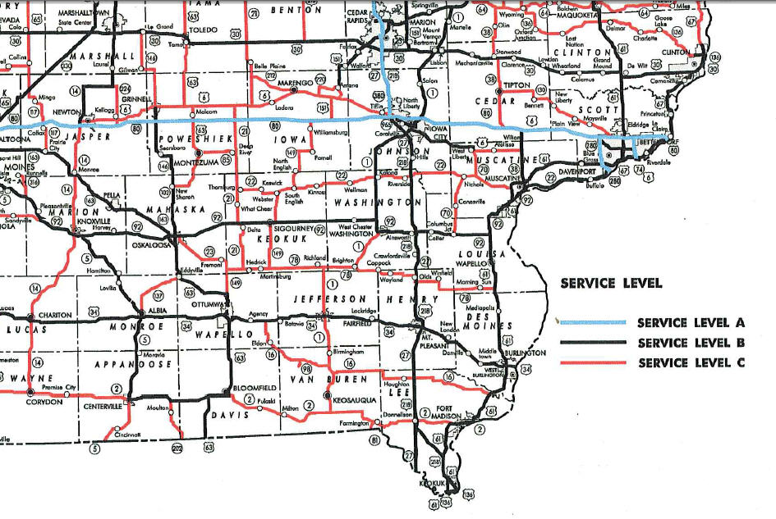
Example of Service Level Map

Slide 3
Service Level General Guidelines
Service level A- Interstates
Service level B- commercial and industrial roadway network and roads with more than 5,000 vehicles per day
Service level C- roads with less than 5,000 vehicles per day

