Slide 1
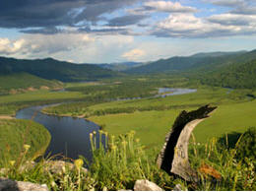
Environment
Deicing chemicals and abrasives can change the soil characteristics, affect water quality and damage plant life
Abrasives can affect air quality, build-up along guardrails and clog drains

