Slide 1
Weather Forecasts
Iowa DOT contracts with a forecast agency specializing in roadway weather forecasting
Pavement and bridge deck temperature forecasts are provided for 99 counties
Forecasts received at 6 AM, noon, 6 PM and Midnight
Forecast summaries are available via a toll free number
Available on DTN Weather Centers, and the Internet
Speak directly to a weather forecaster via a toll free number
Notes:
Toll free # on a later slide

Slide 2
Frost Forecasts
“Official” noon zone forecast for bridge frost
Available on DTN, and the Internet
Frost forecast information also available via toll-free number
“Yes” means the weather forecaster expects frost to occur
Road frost probabilities
Notes:
Toll free number on a later slide

Slide 3
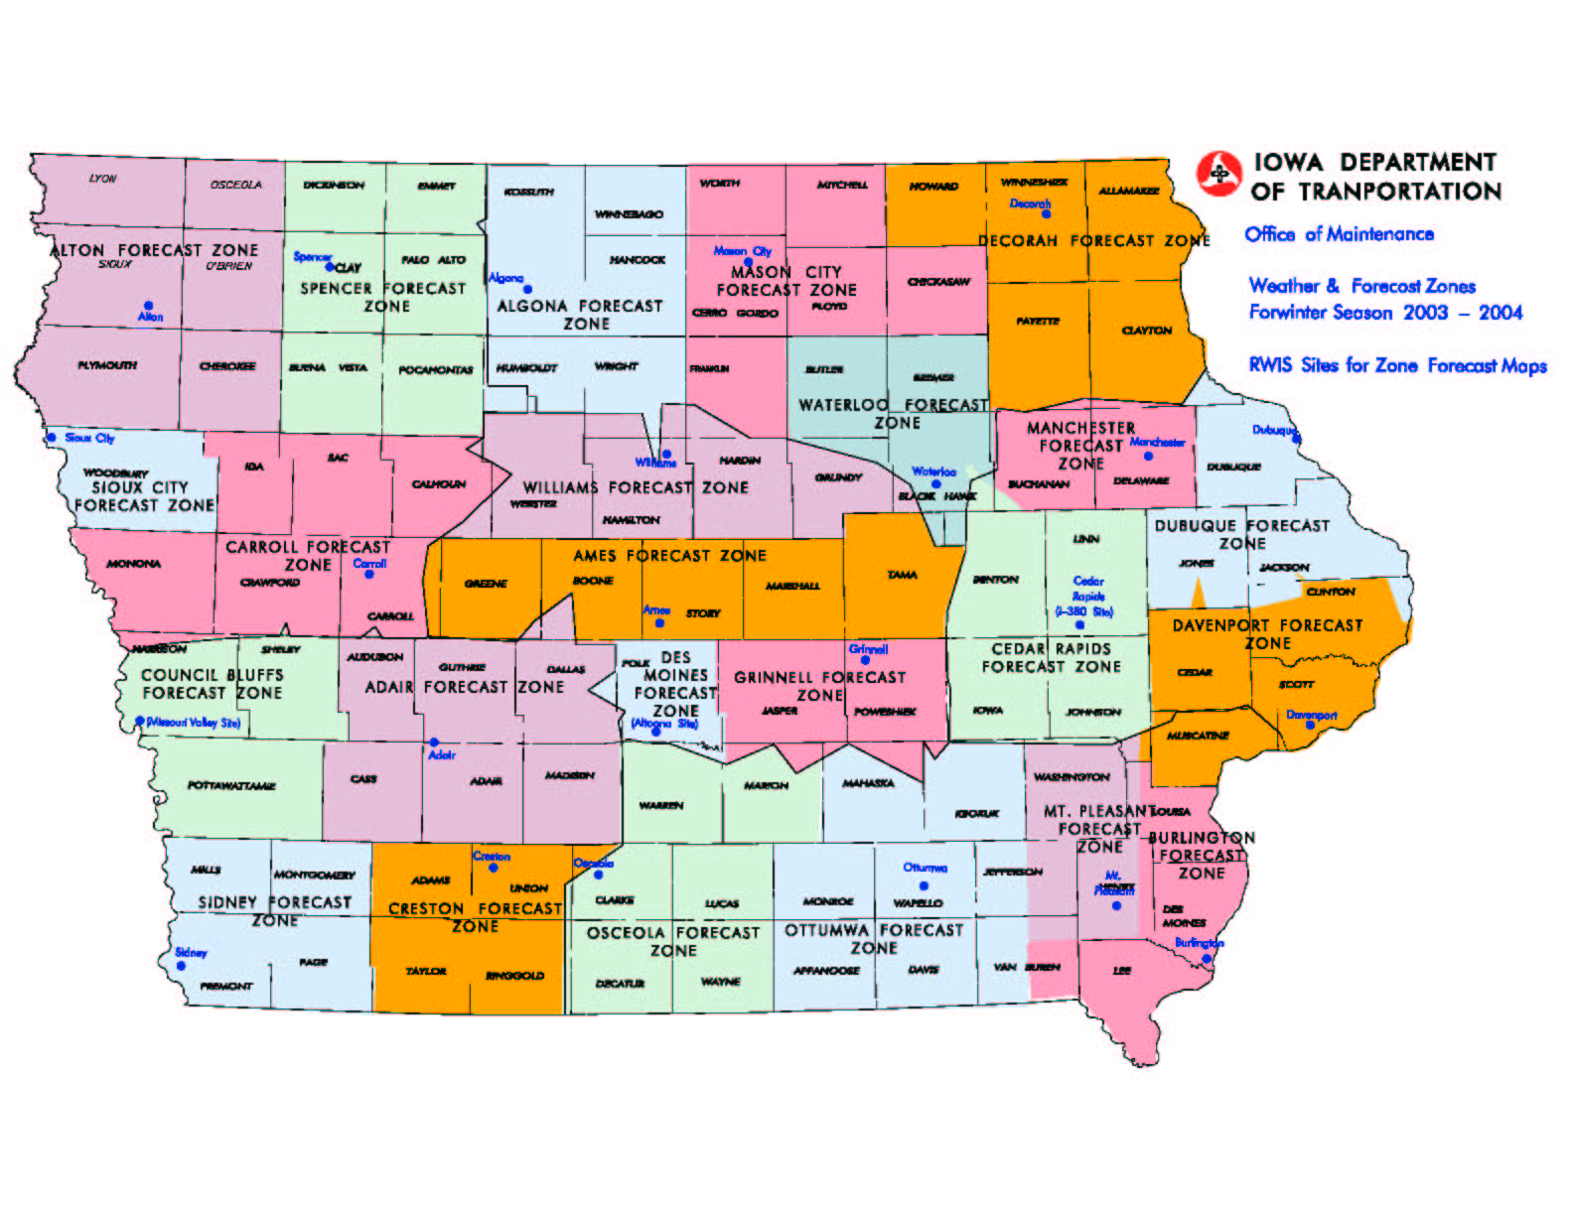
Frost Forecast Zones

Slide 4
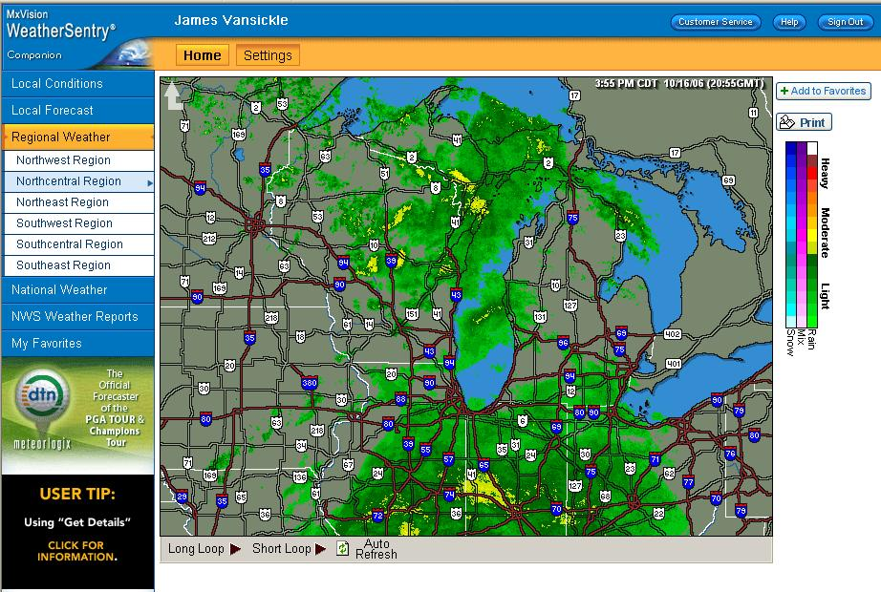
DTN/Meteorlogix
Available at 110 garages
Available on line for home use
Provides radar, current conditions and forecasts

Slide 5
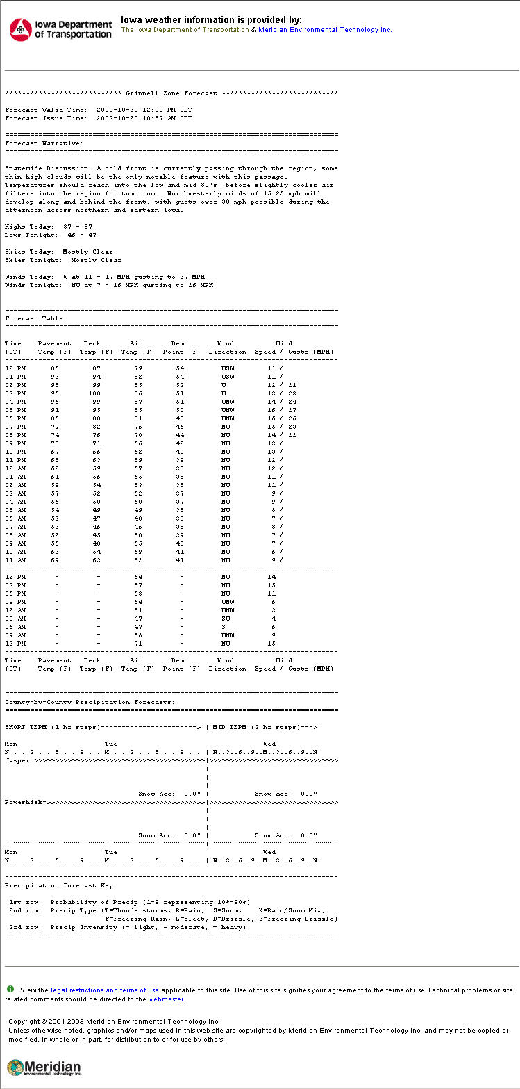
Meridian Zone Forecasts on DTN
Notes:
Final forecast format was not available when this presentation prepared. This is a prototype.

Slide 6
Sources of weather information in the shop
Meteorlogix/DTN Weather Centers
Pavement, frost and general weather forecasts
Current conditions & radar
Maintenance DOTNET page (requires a network connection) links to:
Current RWIS information
DTN and Meridian web sites
Notes:
Explain DOTNET – the department’s Intranet, which uses web based technology to deliver information within an organization. Only available when connected to the DOT’s network. Contains a lot of information on winter operations as well as from other offices throughout the department.

Slide 7
Internet sites to support winter operations (User ID/Password Required)
Meridian Forecasts – Pavement and Frost Forecasts
http://www.iadot.meridian-enviro.com
User Name: iadot Password: plow
DTN’s Iowa web site – Current Conditions, radar, and forecasts
http://weathersentry.meteorlogix.com
User Name: (enter garage name)
Password: iowa

Slide 8
Internet sites to support winter operations (No User ID/Password Required)
Weatherview – http://www.dotweatherview.com
Iowa’s RWIS and AWOS current conditions, forecasts; link to road conditions & NWS – designed for the general public
General Weather Sites
National Weather Service, Accuweather, Intellicast, etc. An extensive list of Internet links is available on DOTNET

Slide 9
Sources of weather information available by phone
Toll Free Forecast Summary Recording 1-888-988-2468
District Forecast
Frost Forecast
Toll Free Direct to Forecaster
1-888-595-8726

Slide 10
Automated Weather Observations Station (AWOS)
Located at 38 airports in Iowa and maintained by the Modal Division of the Iowa DOT
Provides air temp, relative humidity, wind speed and direction, cloud tops, precipitation, and visibility for aviation industry
Visibility at an AWOS site can provide clues as to rate of snowfall or blowing snow conditions
Data available on the Internet
http://www.dotweatherview.com

Slide 11
Other Weather Sources
Internet
Radio
Television
Neighboring garages in the path of the storm
Other jurisdictions – city, county crews, etc.
Law Enforcement

