Slide 1
Temperature Definitions
Eutectic temperature - the point where a substance freezes
Effective temperature - point when a deicing chemical may no longer be economically efficient. The chemical may still work but require too much time and material to be efficient
Surface temperature - the temperature of the pavement or bridge deck which is the critical temperature to determine if precipitation is likely to freeze on the roadway
Notes:
The following slides simply reinforce the key points about chemicals which are maybe the hardest to grasp. Though repetitive, included to allow trainers to reemphasize these points, take questions on this topic, and tell if there is comprehension by the audience.

Slide 2
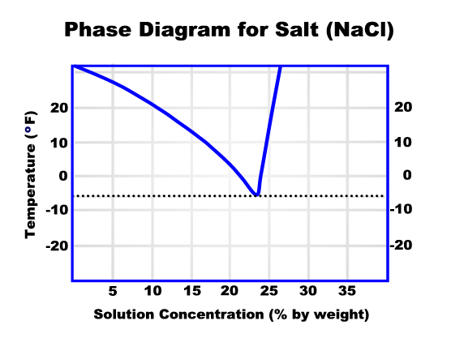
Phase Diagram
Shows the different phases a deicing chemical will undergo at different concentrations and temperatures

Slide 3
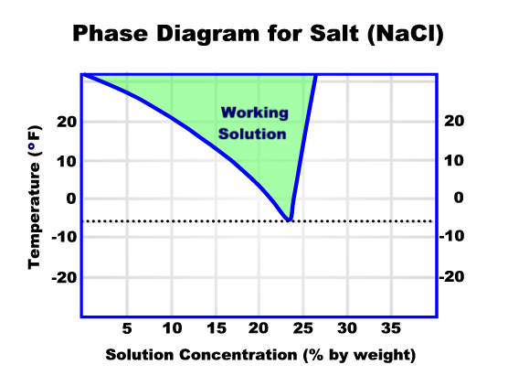
Salt melts snow & ice when the combination of solution and temperature are in the green area

Slide 4
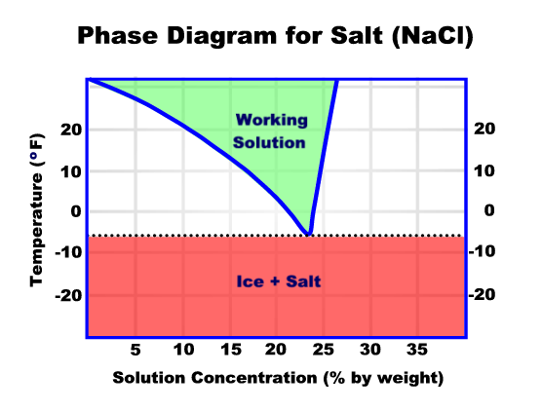
Salt does not work below -6 degrees

Slide 5
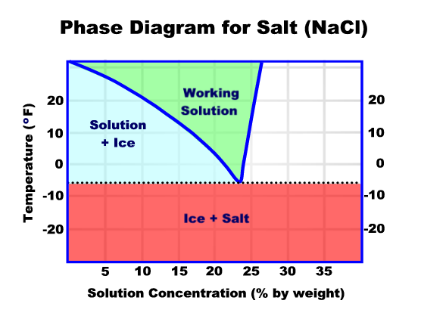
Salt does not melt snow/ice when the solution freezes

Slide 6
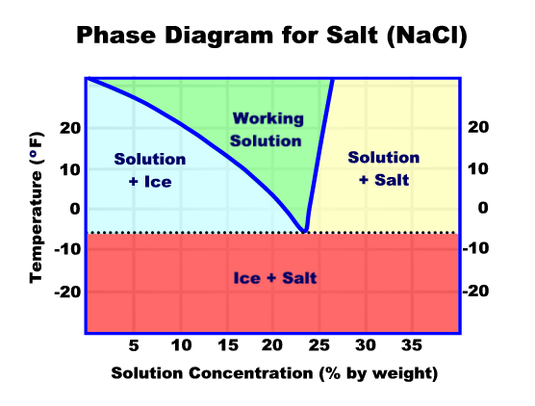
(Frozen – Not Enough Salt)
(Frozen – Too Much Salt)
Salt does not melt snow/ice when the solution is too concentrated. More is not better!

Slide 7
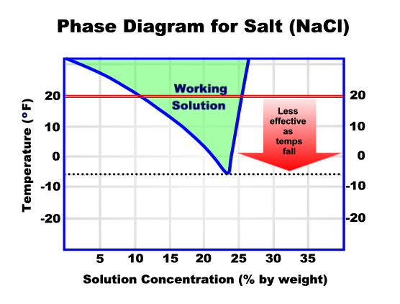

Slide 8
Pounds of Ice Melted per Pound of Salt
50
45
40
35
Pounds
30
25
20
15
10
5
0
30
25
20
15
10
5
0
-6
Temperature
It takes over 5 times more salt at 20 degrees than it does at 30 degrees to melt the same amount of ice!!!
Notes:
Animated slide – title and animation to emphasize difference will appear after a few seconds. Emphasize the huge difference in effectiveness for only a few degrees.

Slide 9
Iowa’s Primary Deicing Chemicals
Salt (NaCl) –
average purchase price - $68.00/ton
salt brine approx. $0.09/gal.
Calcium chloride (CaCl₂) –
liquid with corrosion inhibitor- $0.91/gal
dry flake - $9.35/50# bag

Slide 10
Other Deicing Chemicals
Magnesium chloride (MgCl) - popular in other states but not used in Iowa due to potential damage to concrete- $0.65/gal
Calcium magnesium acetate (CMA) – previously used only on Burlington bridge- $1,000+/ton (currently treat with brine)
Potassium acetate (KAc) - used as a pre-wetting agent with CMA- $3/gallon

