Slide 1
Salt brine
2.2 pounds of salt in each gallon of brine
Used over 18,004,412 gallons last season
Most garages have brine making capabilities
Cost of making brine is approximately $0.09 per gallon
A gallon of salt brine weighs 9.76 lbs.

Slide 2
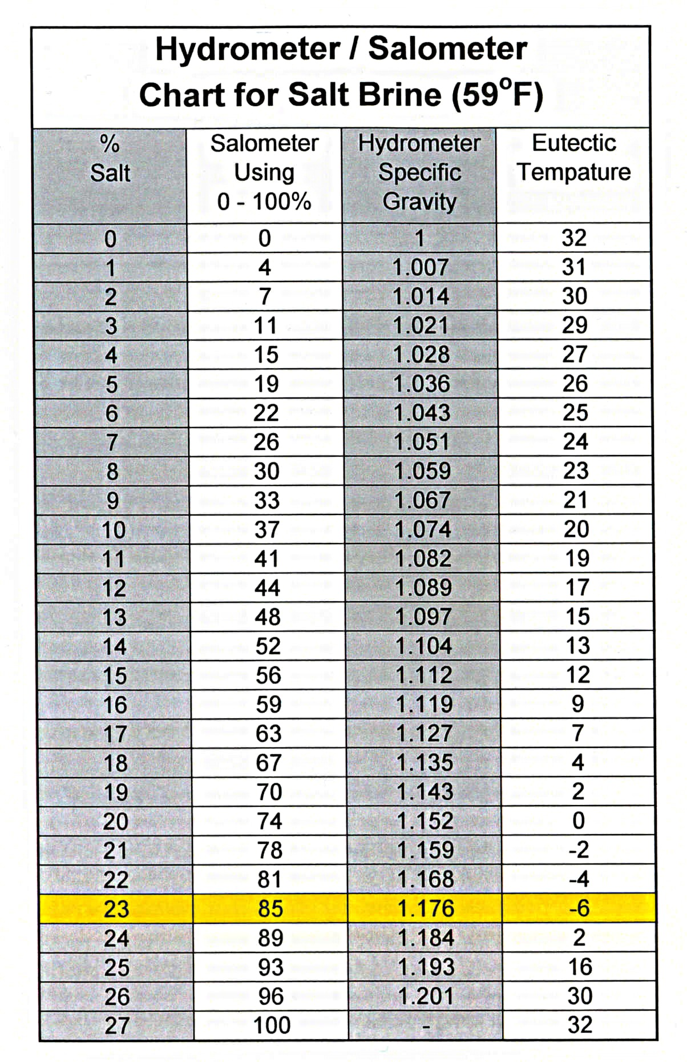
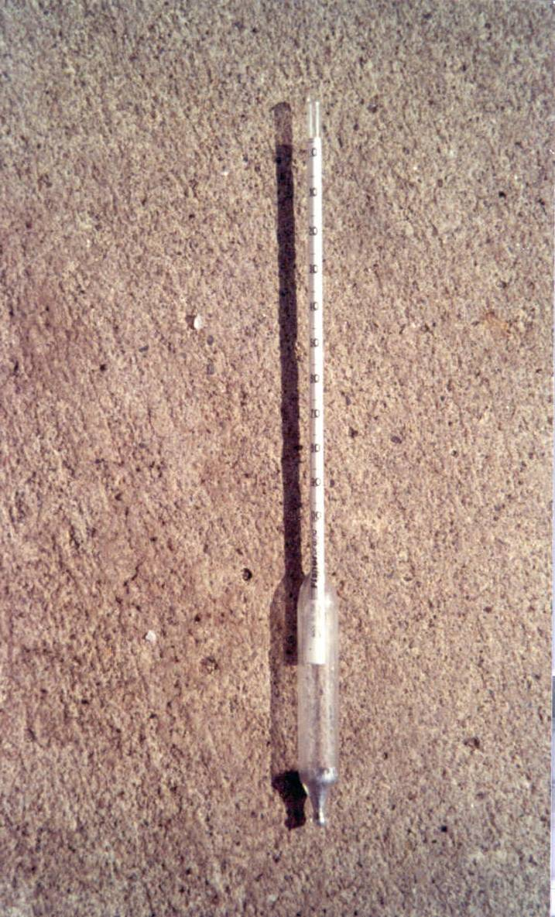
Brine Making
Notes:
Video talks about 23% solution, but our salimeters use a different scale. Point out the 23% and 85, which both indicate the correct concentration.

