Slide 1
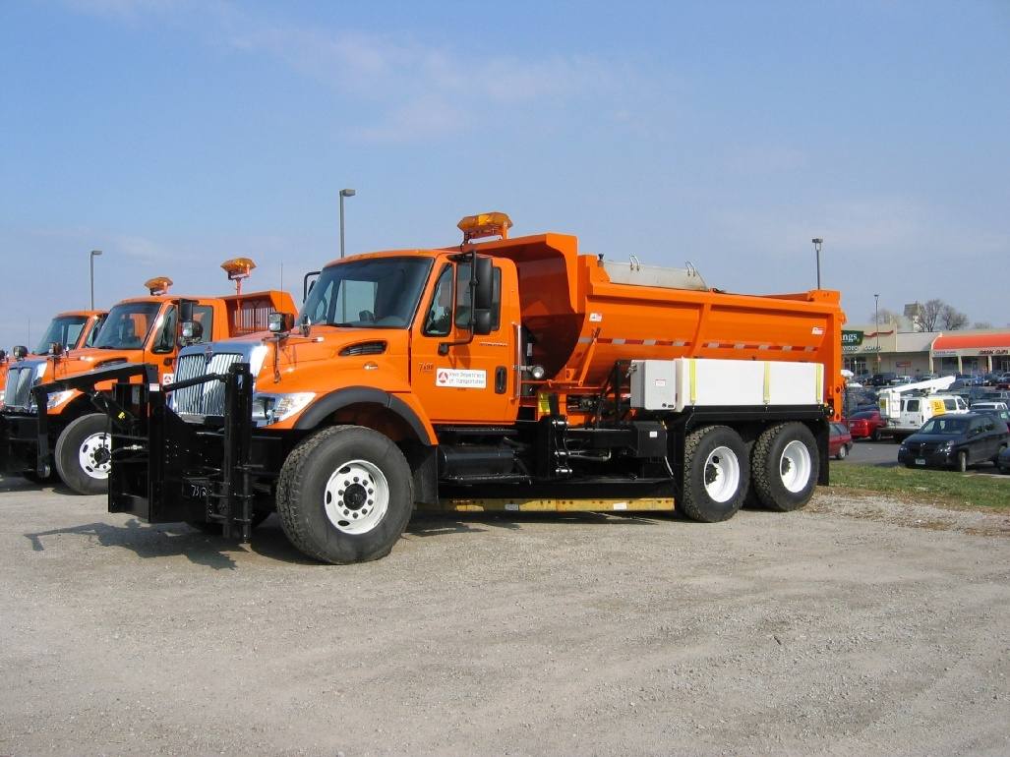
Take care of your equipment
A typical new truck must last 15+ years
Notes:
Animated slide – heading will appear after a few seconds.

Slide 2
Overview of Equipment
View Video segment – Introduction to Snow Removal (approx. 10 minutes)

Slide 3
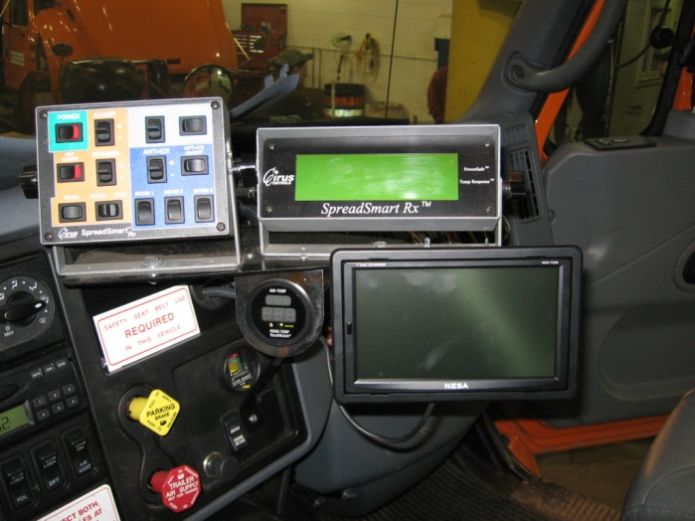
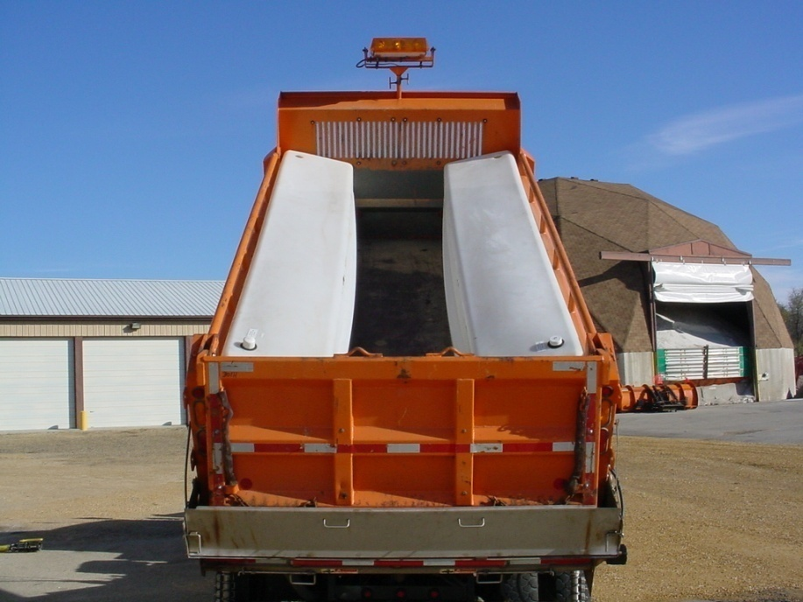
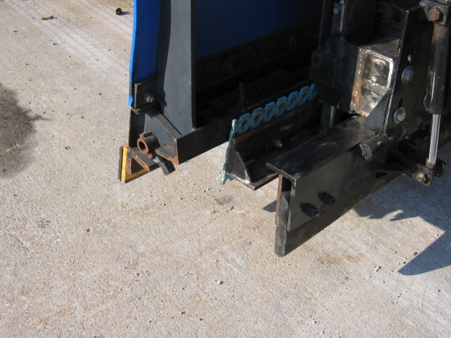
Equipment upgrades & modifications
Changing practices, technology, budget constraints and other issues require constant changes in equipment

Slide 4
Mechanics
Each maintenance circle has at least one mechanic
Each district has a district mechanic
The specific duties of mechanics is for equipment repairs and service – this may vary at each garage

Slide 5
Preventive Maintenance
Expect hands-on direction and guidance for preventive maintenance practices at your garage
Make sure you understand what your preventative maintenance responsibilities are and when something should be reported to your mechanic
Remember that a snowplow truck has to last approximately 15 years, making good preventative maintenance critical

Slide 6
Equipment Calibration
Important to make sure the proper amount of material is placed on the roadway to get the desired action
Prevents waste of materials
Helps protect the environment through controlled applications
Now many trucks are equipped with ground-speed oriented systems to provide controlled applications regardless of speed
You will be instructed on how to calibrate a tailgate spreader and how to operate the controls later this week
Notes:
Stress need for operators to be aware of when calibration should be done, when re-calibration may be necessary, and if any question, get it checked.

Slide 7
Calibration
An average statewide 5% calibration error equates to:
9,532 tons of salt
(95 rail cars!)
$648,176
Notes:
Animated slide – box will appear after a few seconds

Slide 8
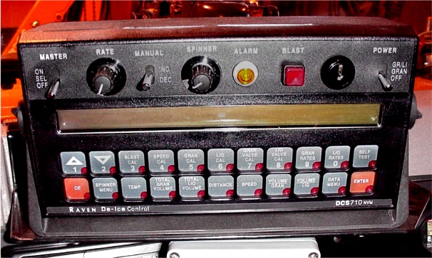
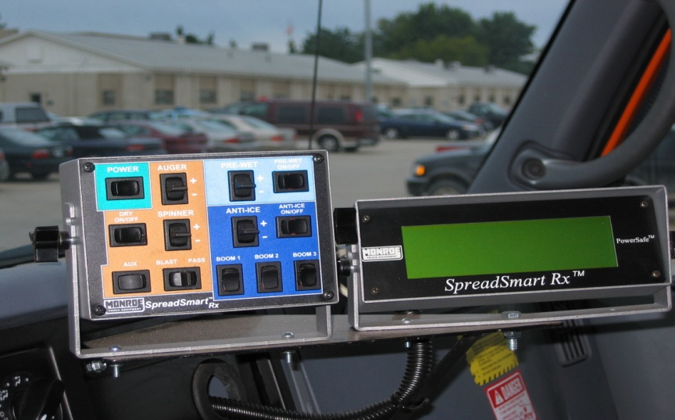
Raven
SpreadSmart
A ground speed oriented controller

Slide 9
Notes:
May need some additional explanation with this slide. Without ground speed controls, operators must adjust rate when slowing, turning, etc. Potential to more appropriately lay down material at a consistent, appropriate rate.

Slide 10
After the storm
Benching/winging may be required to provide storage for additional snow
Clean guardrails and bridges to remove built-up snow
Evaluate the actions and effectiveness of snow removal operations to see if there are ways to improve

Slide 11
Post Storm Cleanup & Maintenance
View video segment - Post Storm Equipment Cleanup & Maintenance (approx. 2 min.)

Slide 12
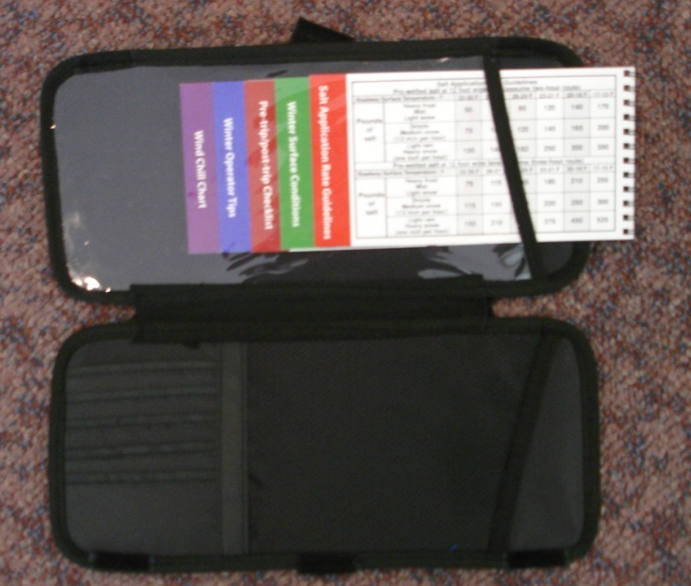
Post Storm Cleanup
Clean trucks, loaders, brine maker and other equipment thoroughly – deicers are highly corrosive and act quickly to deteriorate equipment
Check to see if any equipment repairs are needed
Do post storm walk around (follow guidelines found in visor holder)
Remember:
The average truck must last for 15+ years
Notes:
Animated slide – box will appear after a few seconds.

