Slide 1
Safety
Worker safety is top priority
Safety of traveling public is a goal
Winter operations present unique safety issues
Monthly safety meetings are required at each garage
Safety calendar has monthly programs

Slide 2
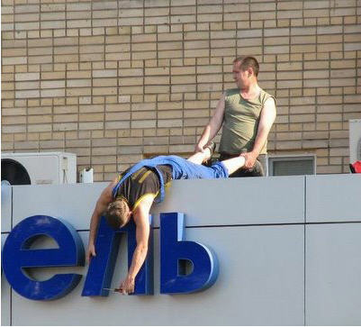
Safety
Is
#1
Safety is a component of everything you do and should be foremost in your thoughts and actions always!!

