Slide 1
Current Snow and Ice Operations
Prewet materials to help keep materials on the roadway and activate deicing chemical
Training at all levels, including educating law enforcement and the public
More scientific approach
More analysis of operations

Slide 2
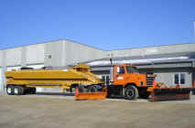
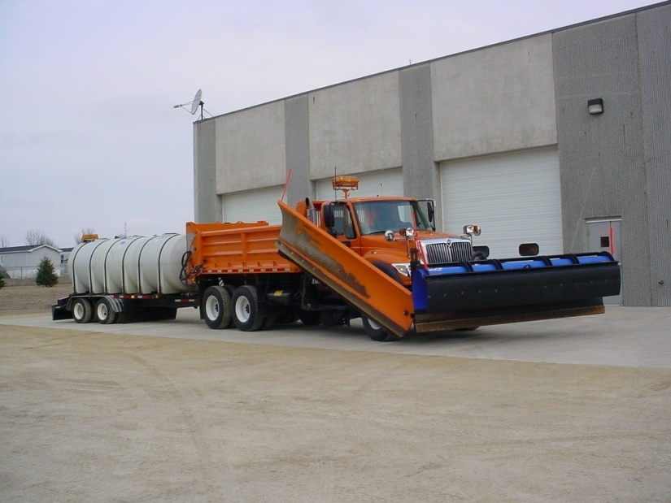
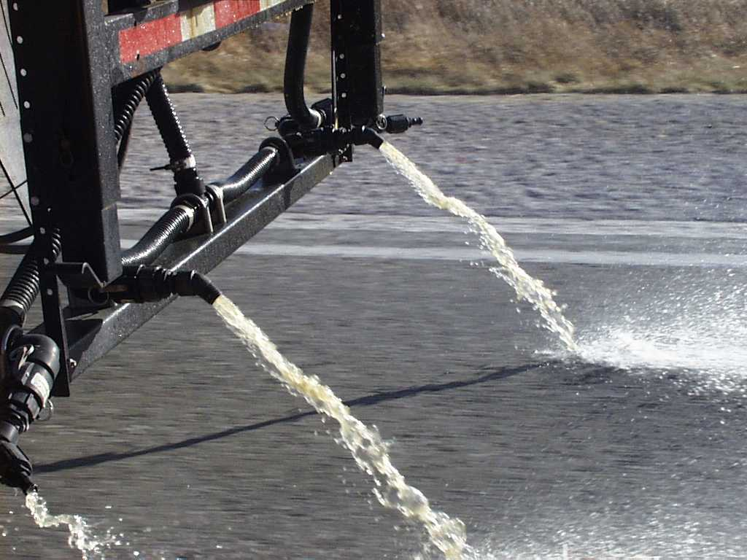
Prewetting/Anti-icing Equipment Overview
Notes:
Videos were produced before we had the variety of equipment we have now – following pictures provided to fill that gap.

Slide 3
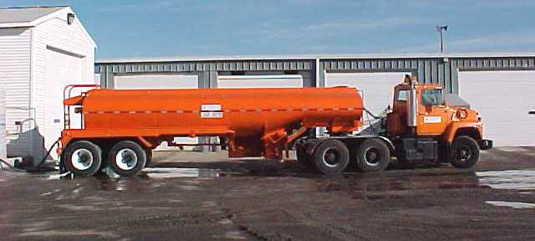
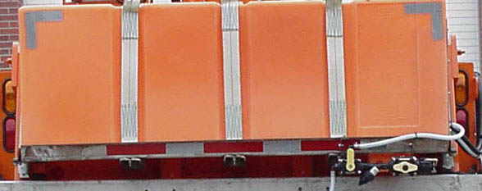
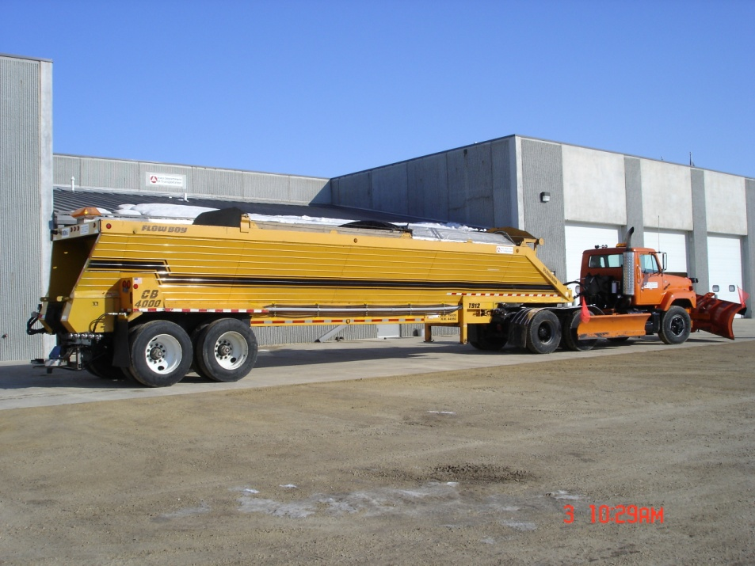
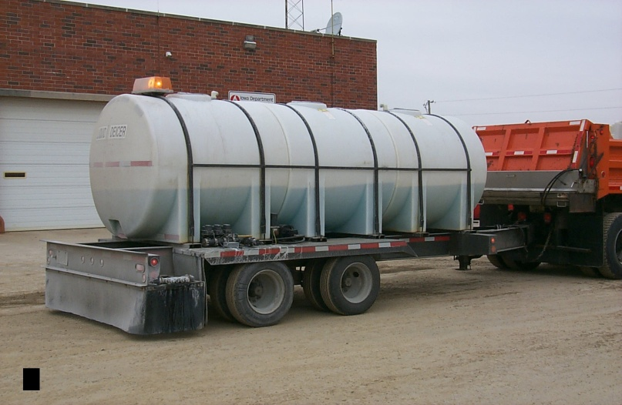
Monroe Pre-wet tank
3,500 gallon tanker
2,700 gallon anti-ice trailer
Flow boy semi trailer

Slide 4
Anti-icing and Deicing Techniques
View video segments (total 16 min.)
Definition of anti-icing and deicing (approx. 2 min.)
Anti-icing (approx. 3 min.)
Application Equipment (approx.4 min.)
Pre-wetting (approx. 2 min.)
View video segment on deicing (approx. 5 min.)

Slide 5
Prewetting
Prewet dry materials (including sand) with liquid deicers to help the material stay on the roadway
Prewet salt with liquid deicers to help accelerate the melting action of salt
If sufficient moisture is already present on the roadway prewetting of salt may not be required but can still be helpful

Slide 7
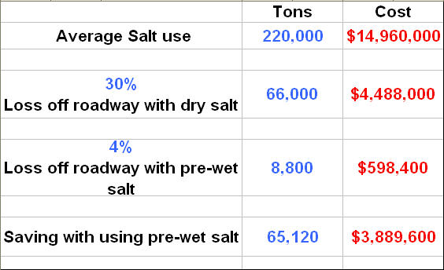
Prewetting Economics
Notes:
Since more stays on the roadway, prewetting should allow lower application rates for the same effect, so savings primarily would be in reduced salt use.

