Slide 1
Current Snow and Ice Operations
Proactive response – apply salt brine out ahead of the storm (Anti-icing)
Attempt to prevent the bond of snow and ice to the roadway
Application rates appropriate for conditions
More salt, less sand (effective and efficient use of deicing chemicals)
Notes:
Operations have changed dramatically in the last 5-6 years – in strategy, equipment, and approach. These changes require a more educated workforce to make the best use of the tools and information at our disposal.

Slide 2
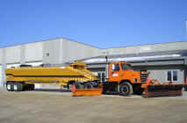
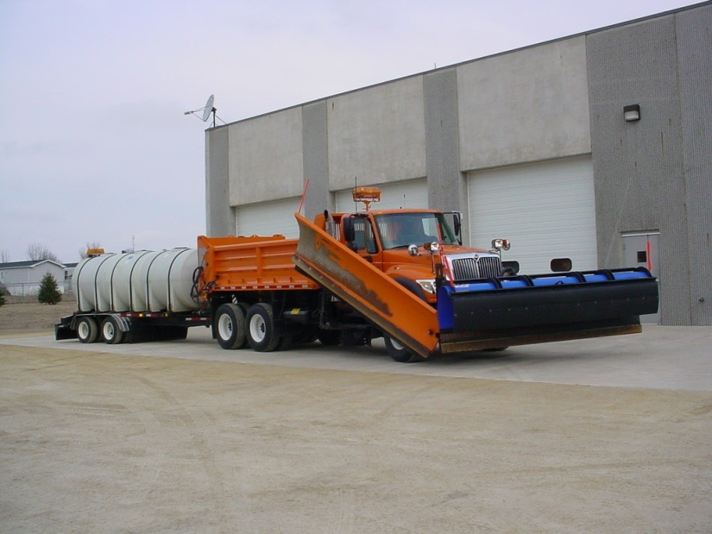
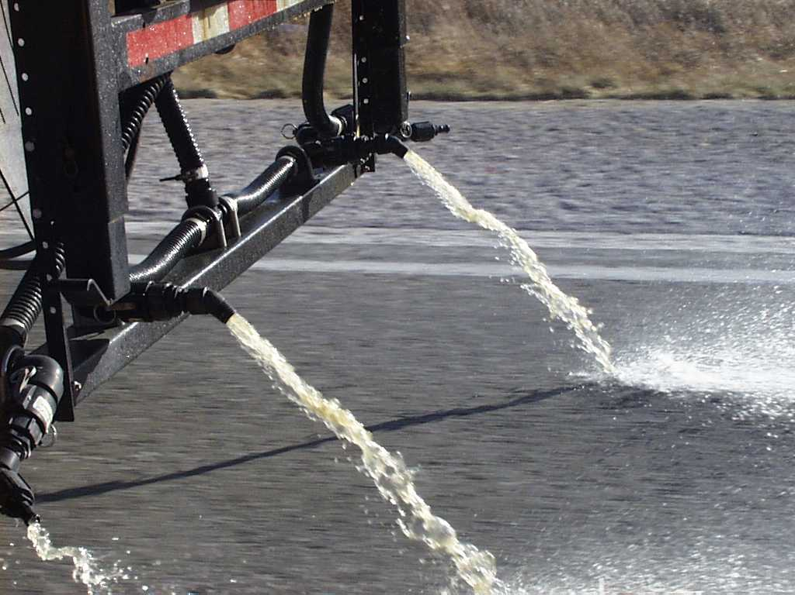
Prewetting/Anti-icing Equipment Overview
Notes:
Videos were produced before we had the variety of equipment we have now – following pictures provided to fill that gap.

Slide 3
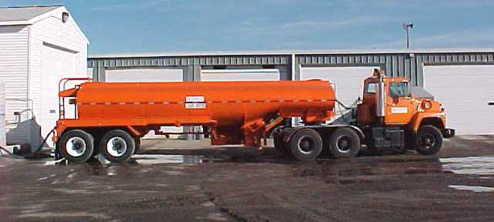
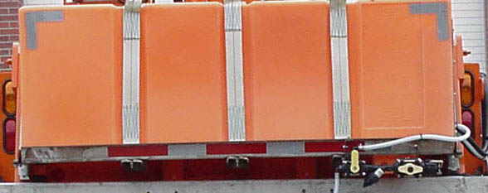
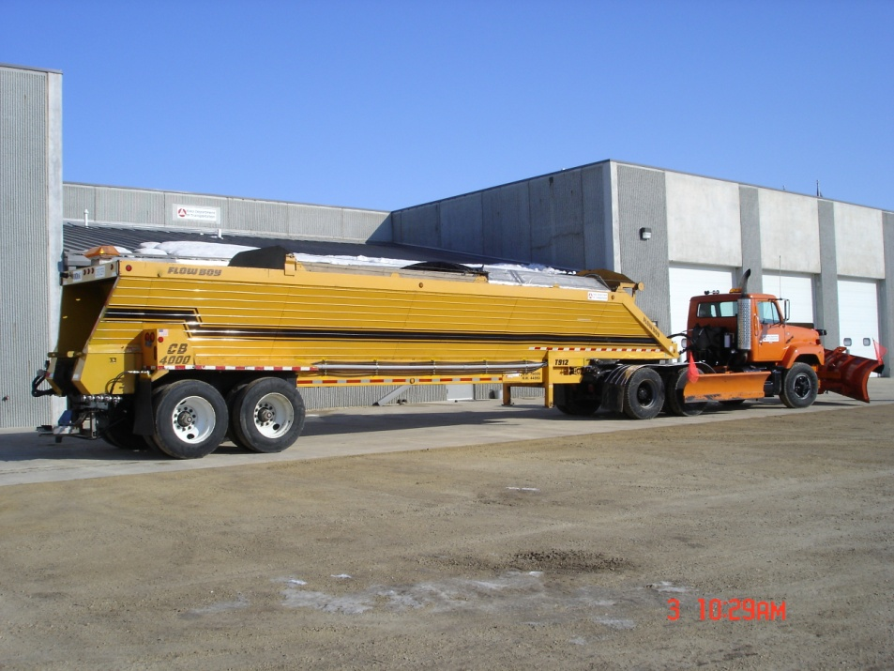
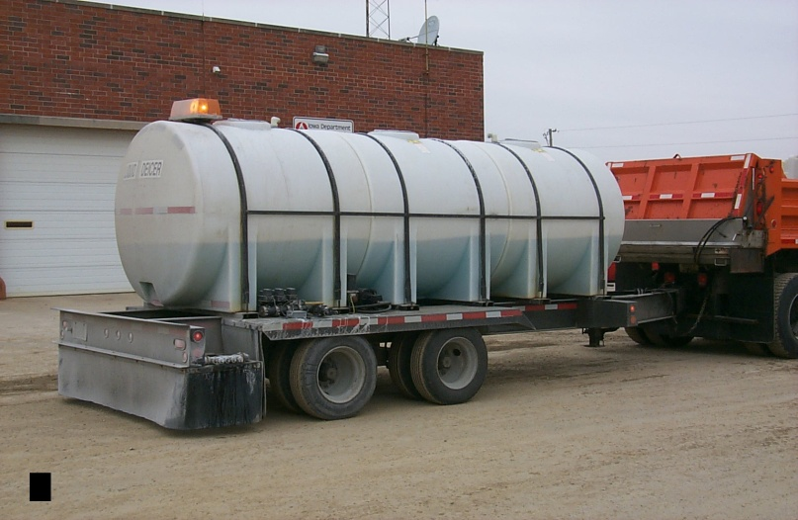
Monroe Pre-wet tank
3,500 gallon tanker
2,700 gallon anti-ice trailer
Flow boy semi trailer

Slide 4
Anti-icing and Deicing Techniques
View video segments (total 16 min.)
Definition of anti-icing and deicing (approx. 2 min.)
Anti-icing (approx. 3 min.)
Application Equipment (approx.4 min.)
Pre-wetting (approx. 2 min.)
View video segment on deicing (approx. 5 min.)

Slide 5
Anti-icing Guidelines
Anti-icing plans should be set up and activated when weather conditions are favorable
Forecasts from the weather consultant should be used in scheduling
Use liquid de-ing chemicals
Application rates of 50+ gallons per lane mile
Apply when pavement temperatures are 15 degrees F and rising
Avoid application if loose blowing snow is present
Minimize salt spray when traffic present
Notes:
Phase 2 plan still in place

