Slide 1
Roadway Weather Information System (RWIS)
Pavement and bridge temperature
Subsurface temperature
Wind speed and direction
Air temperature
Relative humidity
Precipitation
Color Camera (14 sites)
Notes:
Emphasize that RWIS is

Slide 2
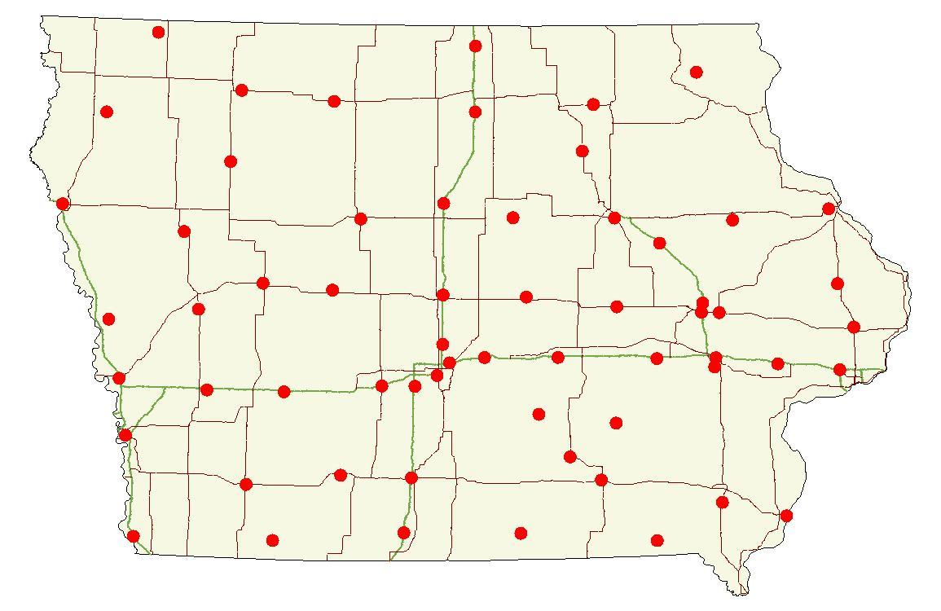
61 site locations in Iowa

Slide 3
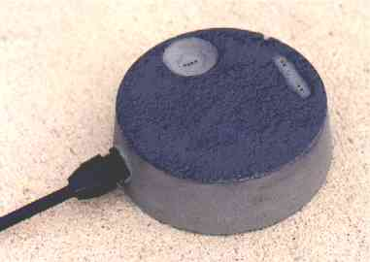
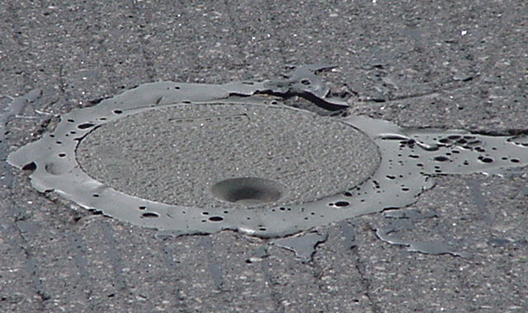
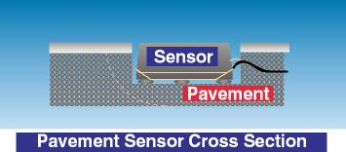
Pavement Sensors
2 – 4 sensors per site
Placed both on bridge decks and pavement surface wherever possible
Measures
Pavement Temperature
Chemical Concentration
Calculates
Pavement Status – dry, wet, chemically wet, etc.
Notes:
Emphasize importance of pavement temp. Pavement temp is “where the rubber meets the road” and determines what happens to the roadway when precipitation falls. Air temp means little in winter operations.

Slide 4
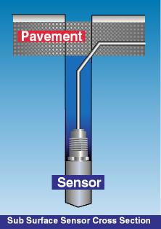
Subsurface Temperature Probe
Sensor is approximately 18” below the pavement surface

Slide 5
New sub-surface temperature data probe (TDP)
Temperature readings every few inches from 3” below surface to 6’ below

Slide 6
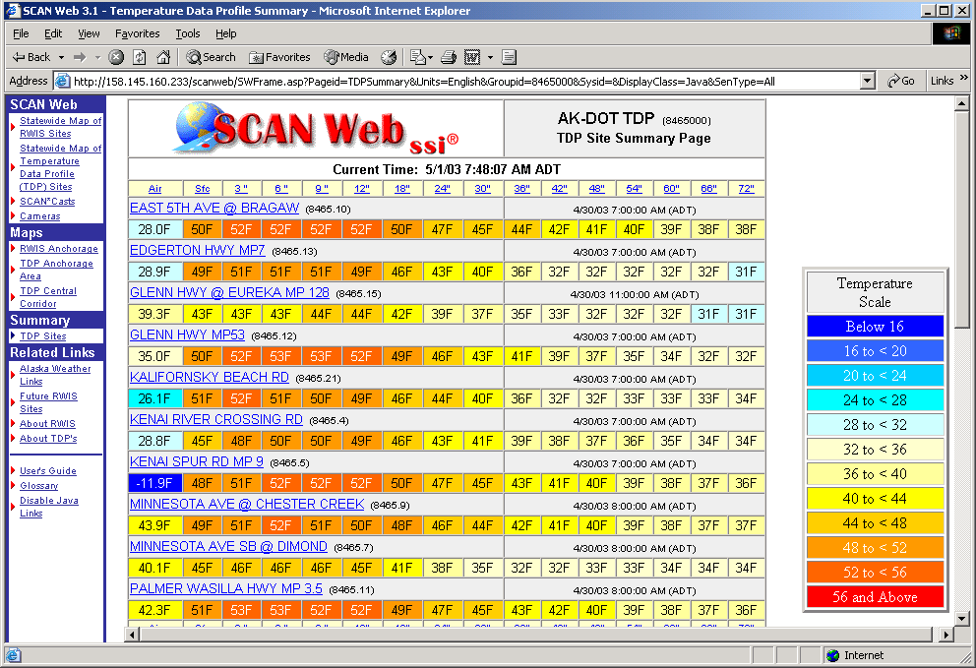
TDP in Scan Web

Slide 7
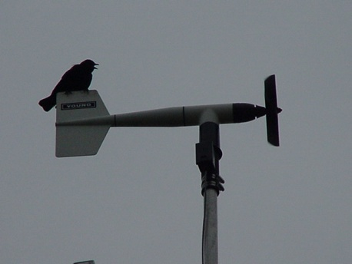
Wind Speed and Direction Sensor
Measures
Wind Speed
Wind Direction
Wind Gusts

Slide 8
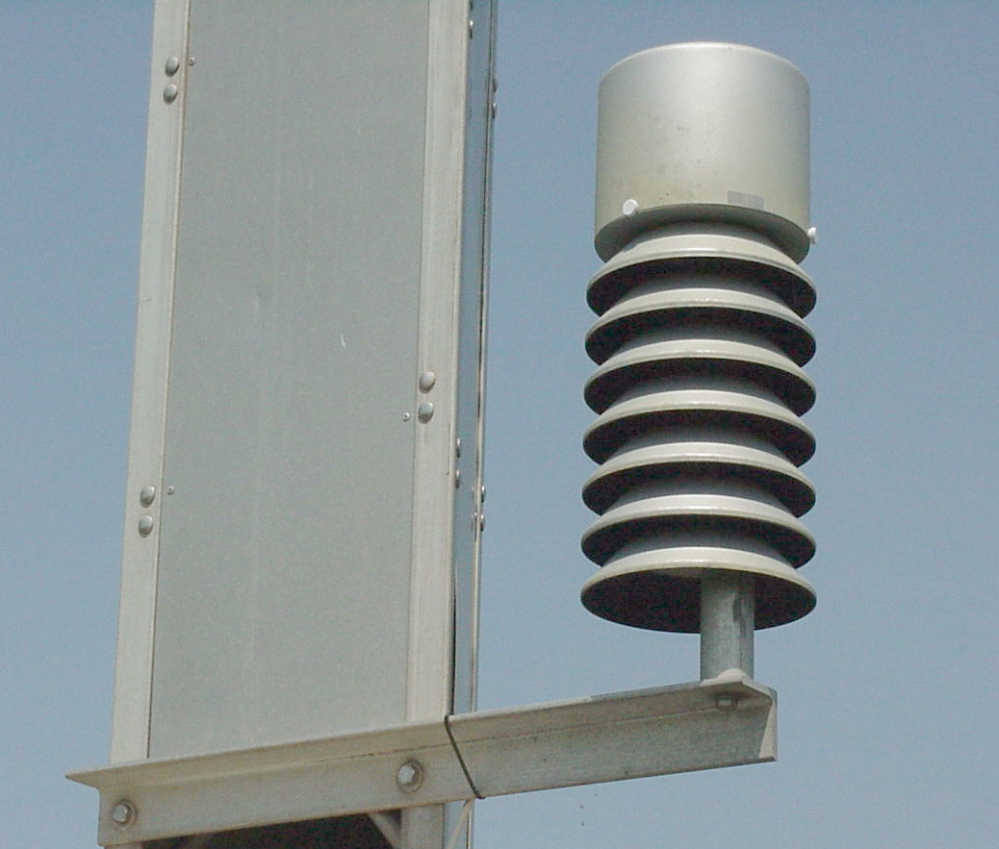
Air Temperature and Humidity
Dew point temperature is calculated from these two measurements

Slide 9
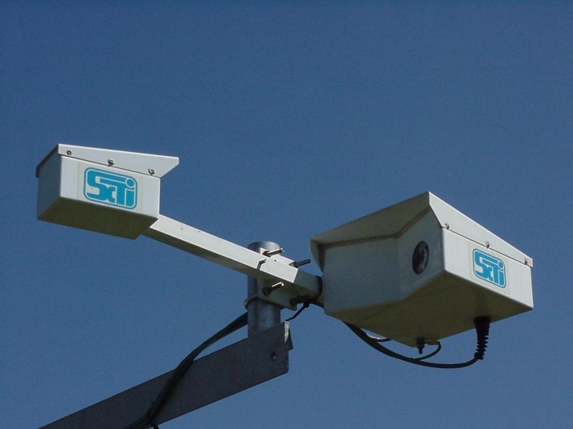
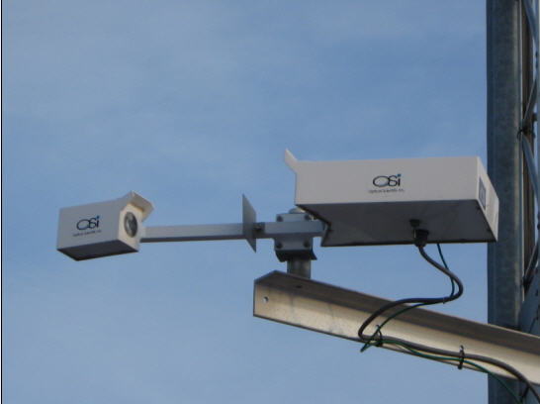
Precipitation Sensors
Yes/No sensor
Optical Weather Identifier
WIVIS sensor
Reports Presence
or absence of
precipitation
Reports
Type of precipitation
Rate of precipitation
Accumulation
Visibility (on a few sites)
Reports Visibility and precipitation identification
Notes:
9

Slide 10
RWIS benefits
Pavement and bridge surface temperatures
Actual roadside weather and surface conditions (wind speed/direction, dew point, chemical concentrations, etc.)
Better ability to predict how road conditions will change
Newer pavement sensors indicate salt concentration on the roadway, depth of precipitation and freezing point of the solution on the road surface

Slide 11
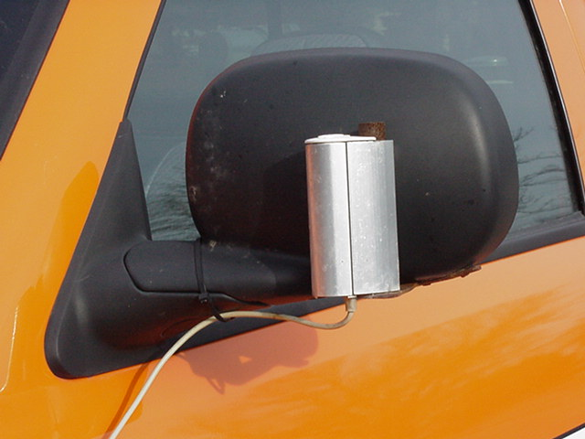
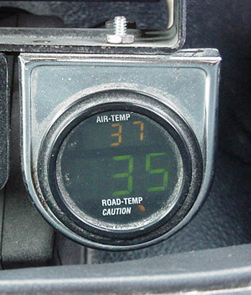
Infrared Thermometers
RoadWatch Infrared thermometers

Slide 12
Infrared Thermometers
In-vehicle device to measure surface temperature while driving at normal highway speeds
Approx. 641 in use on trucks and pickups
Measures only what it can see (Ice, Snow, Pavement
Check accuracy with a pan of ice- should read 32 degrees
Avoid placing too close to heat sources or blocking the view of the lens

