Slide 1
Pre-Wetted Sand
PRO’S
Adheres to roadway.
Chances of refreeze less than other products.
Works from top down.
Keeps snow pack from bonding.
Cost Savings, reduces sand and liquid usage.
Desired product in snow areas, where colder temperatures exist.
CON’S
Additional storage and Containment
Mixing of product is time consuming.
Can plug sanders.
Depending on what type of liquid deicer used to pre-treat sand, can leach out of sand.

Slide 2
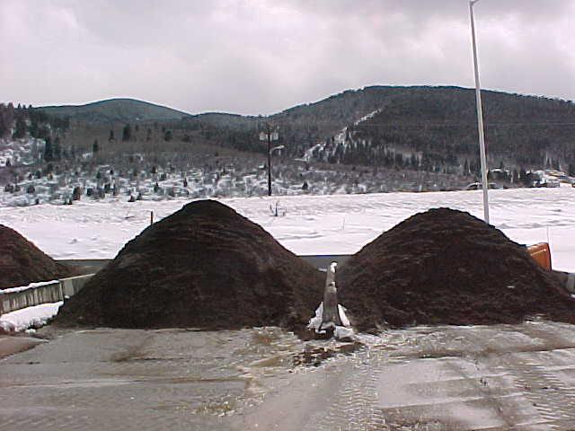
Pre-Wetted Sand
Two piles for tests
One pile, 8 gals caliber 2000 with one ton of sand
Second pile 10 gallons caliber 2000 with one ton of sand

Slide 3
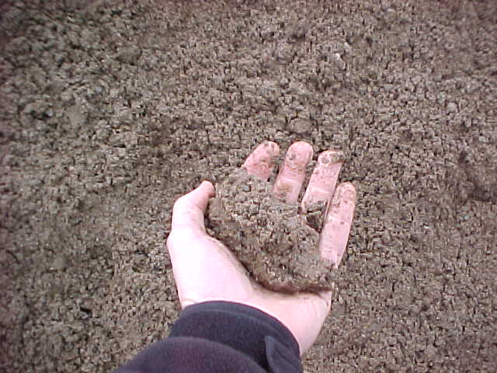
Caliber -2000 Pre-Wetted Sand
8 - Gallons Caliber 2000 per ton of Sand
Sand Balls up in Hand
Unable to Squeeze any Product from Sand
8 Gallons Maximum is Recommended (Due to plugging grates and sanders)

Slide 4
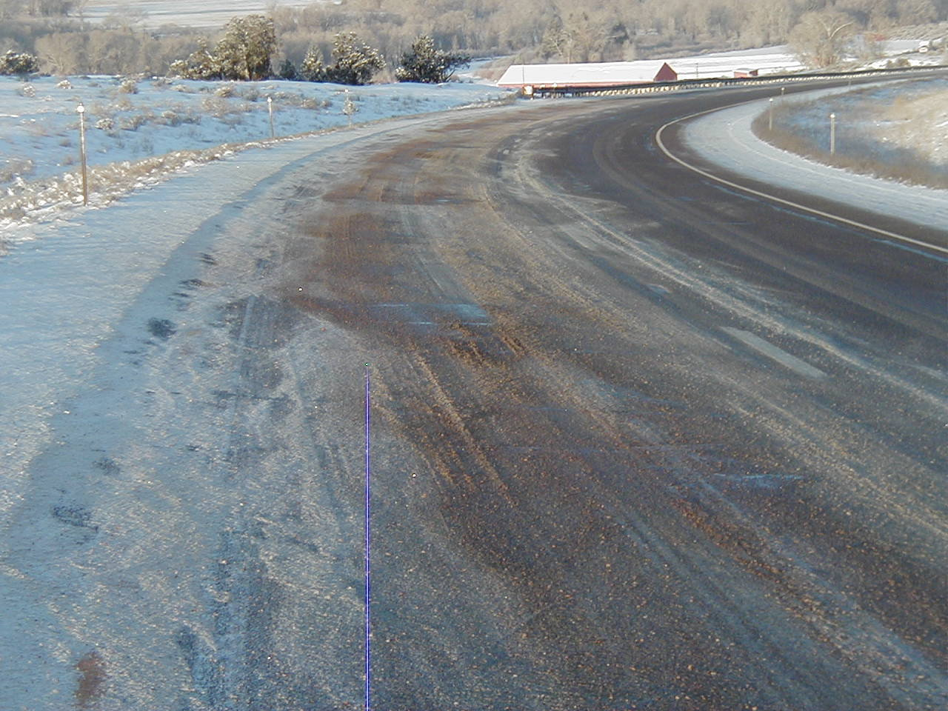
Caliber 2000 – Pre-Wetted Sand
Caliber 2000
8 gallons per ton of sand
500 lbs. per lane mile
Reduces sand usage
More effective than salt/sand mixes

Slide 5
Caliber 2000 – Pre-Wetted Sand
Caliber 2000
8 gallons per ton of sand
500 lbs. per lane mile
Reduces sand usage
More effective than salt/sand mixes

Slide 6
Reducing the Loss to Bounce and Scatter Slow Down and don’t sand bare roads!
Traditional Dry Application
Pre-wet Salt Application
Pre-wetting allows you to reduce the amount of material applied per lane mile and still get the same amount where you want it. The solid deicer also becomes more effective.
Don’t apply liquids on the shoulders.
5%
90%
5%
20%
60%
20%
5%
Critical Area
Critical Area

