Slide 1
Sand/Salt Mixes
Pros
Most common product used
Provides traction
Works well in all type of weather and storm events
Initial Cost
Cons
Bad for the environment
Causes additional work for maintenance crews
Water and Air Quality
Broken Windshields
Cost of Clean-up
Bicycle Safety

Slide 2
Pre-Wetted Sand
PRO’S
Adheres to roadway.
Chances of refreeze less than other products.
Works from top down.
Keeps snow pack from bonding.
Cost Savings, reduces sand and liquid usage.
Desired product in snow areas, where colder temperatures exist.
CON’S
Additional storage and Containment
Mixing of product is time consuming.
Can plug sanders.
Depending on what type of liquid deicer used to pre-treat sand, can leach out of sand.

Slide 3
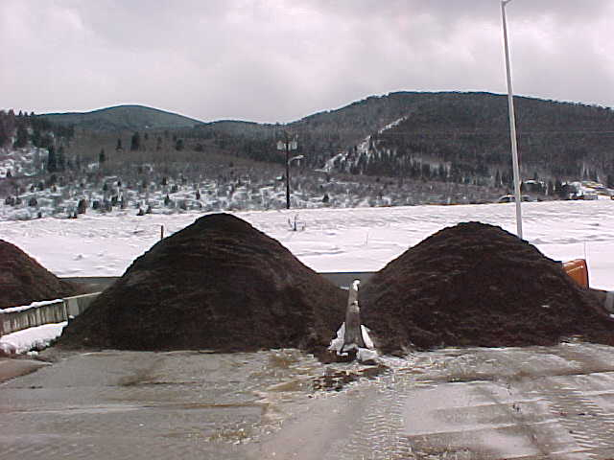
Pre-Wetted Sand
Two piles for tests
One pile, 8 gals caliber 2000 with one ton of sand
Second pile 10 gallons caliber 2000 with one ton of sand

Slide 4
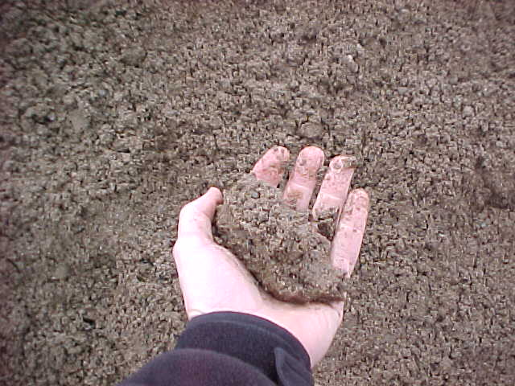
Caliber -2000 Pre-Wetted Sand
8 - Gallons Caliber 2000 per ton of Sand
Sand Balls up in Hand
Unable to Squeeze any Product from Sand
8 Gallons Maximum is Recommended (Due to plugging grates and sanders)

Slide 5
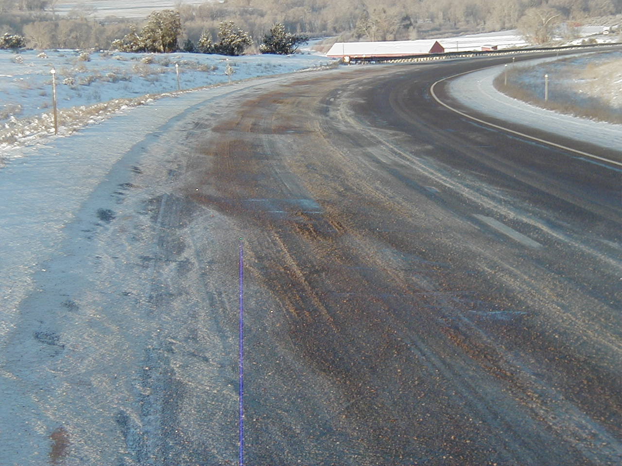
Caliber 2000 – Pre-Wetted Sand
Caliber 2000
8 gallons per ton of sand
500 lbs. per lane mile
Reduces sand usage
More effective than salt/sand mixes

Slide 6
Caliber 2000 – Pre-Wetted Sand
Caliber 2000
8 gallons per ton of sand
500 lbs. per lane mile
Reduces sand usage
More effective than salt/sand mixes

Slide 7
Reducing the Loss to Bounce and Scatter Slow Down and don’t sand bare roads!
Traditional Dry Application
Pre-wet Salt Application
Pre-wetting allows you to reduce the amount of material applied per lane mile and still get the same amount where you want it. The solid deicer also becomes more effective.
Don’t apply liquids on the shoulders.
5%
90%
5%
20%
60%
20%
5%
Critical Area
Critical Area

Slide 9
Ice-Slicer
PRO’S
Excellent melting capabilities
Excellent results when applied to snow pack
Melts from the bottom up
Reduces Amount of Product used in heavy snow fall areas
CON’S
Can refreeze.
Storage and Containment
Can cause icing during initial melting stages.
If Over applied, increased costs (Sanders need to be calibrated)

Slide 10
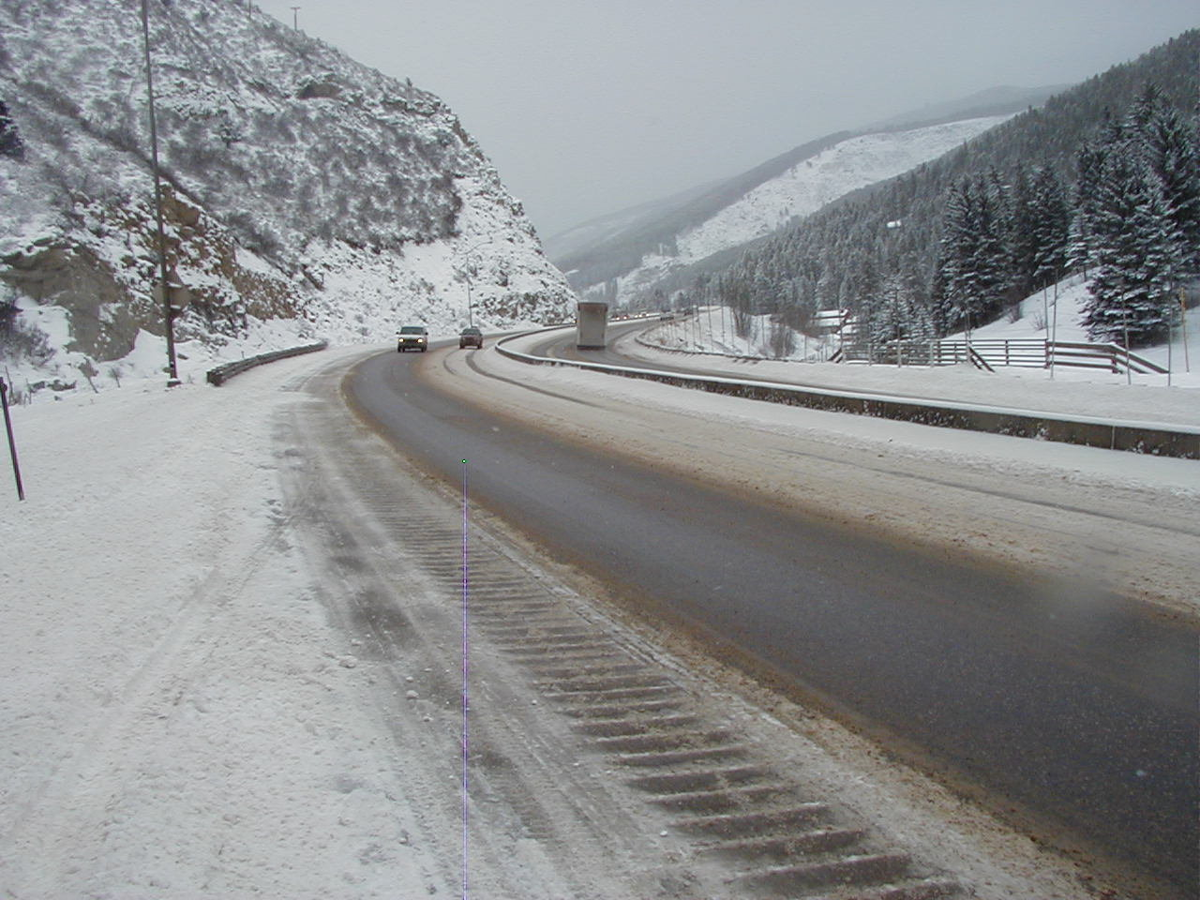
Ice Slicer 300 lbs. Per Lane Mile

Slide 11
Ice Slicer / Sand Mix
PRO’s
Fast melting with additional traction,
Chances of refreeze not as severe.
Can be used as anti-icing and de-icing applications.
Good application for heavy snow fall areas
CON’s
Storage and Containment
Mixing of Products
Expensive product if over applied. (Sanders Need to be Calibrated)

Slide 12
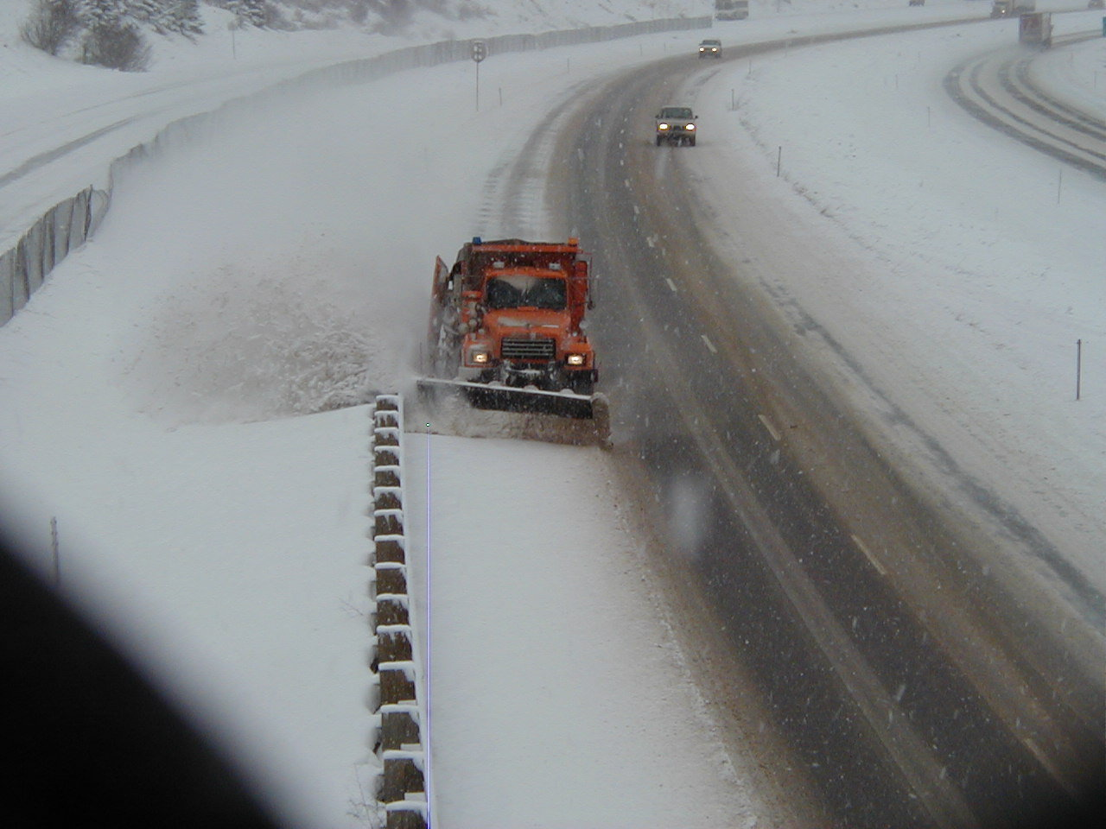
Ice Slicer/Sand Mix
350 lbs. per lane mile
4 inches of snow
22 degrees ambient temperature
25 degree surface temperature
Results - right lane remained wet

Slide 13
Liquid Program
Overview, goals and strategies
Materials
Tool box
Application rates
Safe loading and unloading of products
Response to spills
Calibration
Clean equipment
Notes:
All spills must be reported to your supervisor.

